Slide 1
MEMBERSHIP
ESSENTIALS
PDG Jayne Lowe
District Membership Chair
Rotary Club of Bentonville, AR
President-elect training 2021

Slide 2

I LOVE Rotary
I Love what we do for our communities and the world
I Love the friends I’ve made
I Love my friend that sponsored me into Rotary 29 years ago.
What about you??
EACH ONE, BRING ONE!

Slide 3
Membership Resources
Membership Satisfaction Survey
 | Agree | Somewhat Agree | Neither Agree Or Disagree | Somewhat Agree | Disagree
My club does a good job involving new members
My club’s members care about one another
My club reflects the demographic profile of our area’s business, professional, and community leaders
My club actively seeks to involve all members in projects and activities according to their interests, skills, and availability
The amount of fundraising activities is appropriate
.
:
 | Agree | Somewhat agree | Neither agree nor disagree | Somewhat disagree

Slide 4
Club Membership Chair
Do me a favor………
Identify
  A
  Membership
  Chair

Slide 5
Membership Resources
Membership Initiative
  3 – 5 club members
  Choose no more than 3 ideas on how to attract members
  Select no more than 3 ideas on how to engage and retain members
  Create an Action Plan
  Your AG will facilitate
  Prospective member leads from RI

Slide 6
Membership Resources
Additional ways to attract members
  Host a prospective members social
  Select a “Person of the Month”
  “Talk up Rotary” at your business networking events
  Wear your Rotary pin
  https://my.rotary.org/en/learning-reference/learn-topic/membership

Slide 7
Membership Resources
New Member Orientation
  What should it include?
  Where and when to hold it?
  Assign a mentor
  https://learn.rotary.org/members/learn/course/internal/view/elearning/76/kick-start-your-new-member-orientation
  Rotary Basics
  https://my.rotary.org/en/learning-reference/learn-topic/membership

Slide 8
Membership Resources
Flexibility and Adaptability
  # of meetings per month
  Location of meetings
  Meeting times
  Content of meetings
  In person, Virtual or Hybrid
  https://rotary6690.org/maintaining-engagement/.
  https://my.rotary.org/en/club-flexibility

Slide 9
Membership Resources
Satellite Clubs
  Different day/time
  Cause based
  Community close to yours
  THINK OUTSIDE THE BOX
  https://my.rotary.org/en/learning-reference/learn-topic/start-club

Slide 10
Membership Contest

Slide 11
Key Takeaways
EACH ONE, BRING ONE!
Identify your club membership chair
Conduct the membership satisfaction survey
Create a New Member Orientation
Check out all the great information in MyRotary and The Learning Center
Use Social Media to promote your club
Be Flexible! Think Outside the Box!
Have FUN and enjoy Loving Rotary!

Slide 12
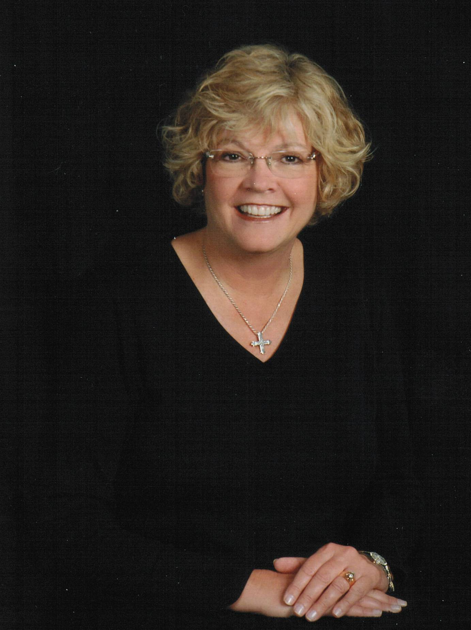
District Resource
Questions? Looking for ideas? Have successes to share? Contact me! I’m here to help!
PDG Jayne Lowe
District Membership Chair
jaynerotary@gmail.com
479.644.6576
Notes:
You’ve had a lot of information thrown at you for the past 90 minutes with more to come. It can be a little overwhelming, but just remember that your AG’s and the District Committee Chairs are here to help you! You don’t have to go it alone! I’m so excited for all of you as you plan to take the gavel and lead your club. Bring in those new members! Engage them along with your current members. Be the inspiration to them as well as to your community. Thank you so much for your attention and don’t hesitate to call on me with any questions, suggestions or ideas. Best of Luck to each and every one of you. SERVE TO CHANGE LIVES!

