Slide 1
AG Membership Training
TITLE
District 6110 Membership Chair: PDG Jayne Lowe
Notes:
Good Morning! What a great group of Rotarian leaders we have to serve our clubs during this next Rotary year! I’m looking forward to working with all of you as we do our best to GROW ROTARY. We’ve got a lot of ground to cover so Let’s get started!
2. I hate to start off with bad news, but the #’s don’t lie! As you can see, we were making some good progress through the first 9 months of the 2019-20 Rotary year, and then…..well, you all know what happened in March of last year. The current AG’s and those of you that are still club Presidents have been doing a great job in keeping your clubs meeting and engaging your members as well as working on getting new members, but for varied and obvious reasons, they’re leaving faster than we can replace them.!
Title page – Membership Initiative and Leads
I’m sure you all want another title to add to Assistant Governor, so you’ll officially have the designation of Membership Facilitator! You’ll be assisting your clubs to GROW ROTARY with the focus on Attraction & Engagement/Retention. Training to be a membership facilitator usually takes an hour or more as we take time to role play the facilitation so you feel comfortable when you’re presenting to a club. AG Coordinators John Rains and Brett Brough have experience in these facilitations, so call on them or me if you want to “practice.” AND…these facilitations can be done virtually or in person! It’s wise to only have a small group….no more than 5 people….for these facilitations.
You should have received all of the collateral material we’re going to go over now from Cole. If you made copies, please pull them out. Here are some suggestions to attract new members for you to choose from. (Give a few examples). OR, they can come up with any ideas that they feel will fit your club culture!

Slide 2
MEMBERS: Our greatest asset!!
July 1, 2019 3,900 members
January 1,2020 3,943 members
March 1,2020 3,951 members
June 30, 2020 3,796 members
December 31, 2020 3,597 members
February 1, 2021 3,581 members
Notes:
6. Engagement/Retention is so important!! Here you’ll see some ideas to choose from (give a few examples) OR…as with the attraction strategies, encourage them to come up with their own ideas
7. This is the form that the clubs membership team will use to get their plan together…and (next slide)
8. This is….the result…..and it’s SO important!… the finished Action Plan! As we all know, it is very helpful when you have a written plan in place to follow. (Go through the action plan that this club chose for one of their attraction strategies.)
9. Now….let’s look next at the Membership leads that we receive from Rotary International which will help us achieve our goals to GROW ROTARY.
GO TO MANAGE LEADS.
How to work the membership leads:
We need to keep thinking outside the box. I believe that Kevin is establishing a New Club Development committee that will work hand in glove with the Membership Committee. Please take the time to use The Learning Center to become acquainted with these different types of clubs so you are conversive on them. There’s also SO much great information in the Learning Center that will assist you in being the best AG you can be.
Thank you so much for agreeing to serve our District as Assistant Governors! Together….we can GROW ROTARY and I’m looking forward to working with each and every one of you! Enjoy your year and remember that I’m here to answer any questions or help you in any way I can.

Slide 3
The Membership Initiative & Membership Leads

Slide 4
The Membership Initiative
Once we finish this training today, you will be designated a Membership Facilitator !!
You’ll be able to assist your club’s membership team to #Grow Rotary by focusing on…..
Attraction & Engagement/Retention
Notes:
4. I’m sure you all want another title to add to Assistant Governor, so you’ll officially have the designation of Membership Facilitator! You’ll be assisting your clubs to GROW ROTARY with the focus on Attraction & Engagement/Retention. Training to be a membership facilitator usually takes an hour or more as we take time to role play the facilitation so you feel comfortable when you’re presenting to a club. AG Coordinators John Rains and Brett Brough have experience in these facilitations, so call on them or me if you want to “practice.” AND…these facilitations can be done virtually or in person! It’s wise to only have a small group….no more than 5 people….for these facilitations.

Slide 5
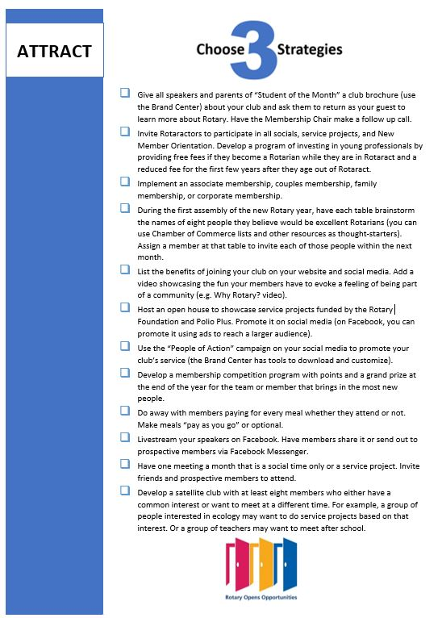
Attraction Strategies
This is for the club to choose what works for THEIR club’s culture………
Notes:
5. You should have received all of the collateral material we’re going to go over now from Cole. If you made copies, please pull them out. Here are some suggestions to attract new members for you to choose from. (Give a few examples). OR, they can come up with any ideas that they feel will fit your club culture!

Slide 6
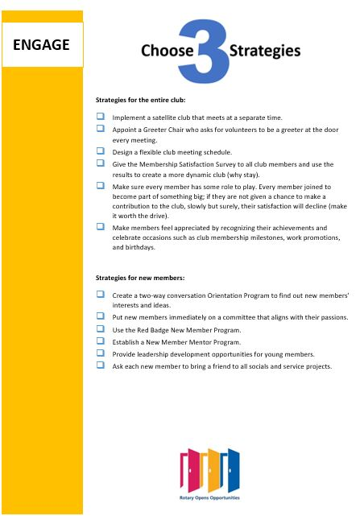
Engagement Strategies
Choose strategies for existing members as well as newer members………
Notes:
Engagement/Retention is so important!! Here you’ll see some ideas to choose from (give a few examples) OR…as with the attraction strategies, encourage them to come up with their own ideas.

Slide 7
Action Plan Strategies
Action Plan for Attraction & Engagement Strategies
Strategy:
What:
Who:
When:
Result Anticipated:
Membership team member assigned to Champion this strategy:
Notes:
This is the form that the clubs membership team will use to get their plan together…and (next slide)

Slide 8
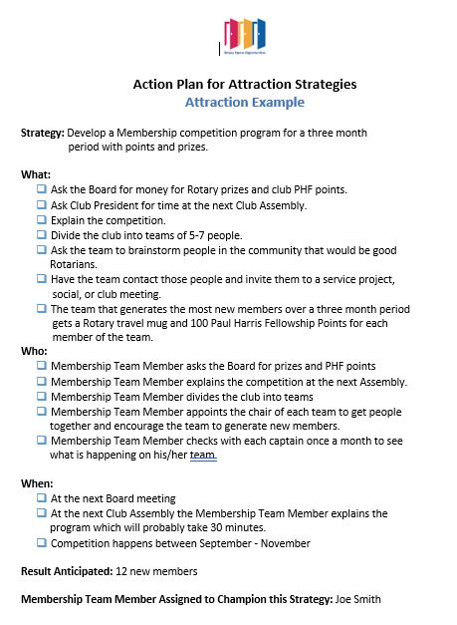
Action Plan
As the club’s “coach”, you’ll be there to help them Develop their action plans for Attraction and Engagement/Retention
Notes:
This is….the result…..and it’s SO important!… the finished Action Plan! As we all know, it is very helpful when you have a written plan in place to follow. (Go through the action plan that this club chose for one of their attraction strategies.)

Slide 9
Membership Leads
Notes:
Now….let’s look next at the Membership leads that we receive from Rotary International which will help us achieve our goals to GROW ROTARY.

Slide 10
Contacting leads
You’ll be getting the leads via email.
Contact the prospects as soon as you possibly can via email and/or phone.
If you serve clubs in Tulsa, Pittsburg or Bartlesville, I will make the first contact.
Once you’ve made contact, put information in to Managing Leads.

Slide 11
GO TO MANAGING LEADS IN ROTARY CLUB CENTRAL

Slide 12
So many options to keep in mind….
E-Clubs
Passport Clubs
Satellite Clubs
Cause based clubs
Notes:
We need to keep thinking outside the box. I believe that Kevin is establishing a New Club Development committee that will work hand in glove with the Membership Committee. Please take the time to use The Learning Center to become acquainted with these different types of clubs so you are conversive on them. There’s also SO much great information in the Learning Center that will assist you in being the best AG you can be.

Slide 13
Thank You! Thank You! Thank You!
Without your help, this District will not grow!!
You are the key to helping #GrowRotary and I’m so very Thankful to each and every one of you for your service!!
Notes:
Thank you so much for agreeing to serve our District as Assistant Governors! Together….we can GROW ROTARY and I’m looking forward to working with each and every one of you! Enjoy your year and remember that I’m here to answer any questions or help you in any way I can.

Slide 14
Questions?
Notes:
Quit screen share for face to face to answer questions.

