Slide 1

Assistant Governor Training – February 20, 2021

Slide 2
Top Ten Foundation Questions

Slide 3
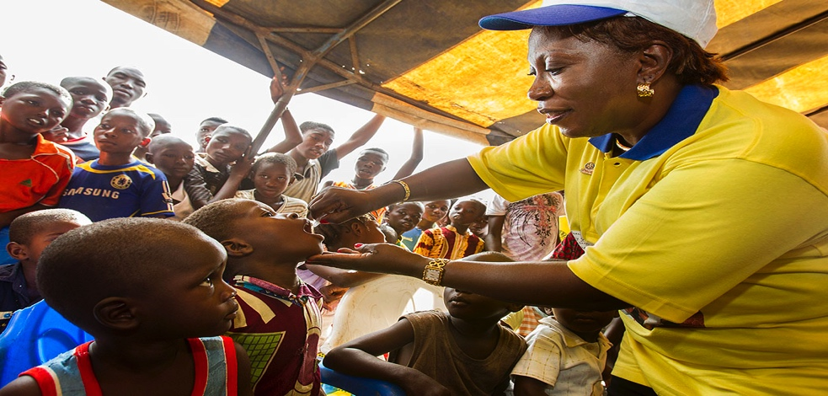
To Which Fund Do I send My Contribution?
100 YEARS OF DOING GOOD IN THE WORLD
Notes:
The Rotary Foundation is a primary source of funding for Rotary’s humanitarian activities, from clubs’ and districts’ local service projects to global initiatives. It also leads Rotary’s ongoing effort to eradicate polio worldwide.
Our Foundation is able to achieve its mission through the generous contributions and active participation of Rotarians and friends of Rotary.

Slide 4

Where Do I Send My Contribution?
100 YEARS OF DOING GOOD IN THE WORLD
Notes:
The Rotary Foundation is a primary source of funding for Rotary’s humanitarian activities, from clubs’ and districts’ local service projects to global initiatives. It also leads Rotary’s ongoing effort to eradicate polio worldwide.
Our Foundation is able to achieve its mission through the generous contributions and active participation of Rotarians and friends of Rotary.

Slide 5
100 YEARS OF DOING GOOD IN THE WORLD
Notes:
The Rotary Foundation is a primary source of funding for Rotary’s humanitarian activities, from clubs’ and districts’ local service projects to global initiatives. It also leads Rotary’s ongoing effort to eradicate polio worldwide.
Our Foundation is able to achieve its mission through the generous contributions and active participation of Rotarians and friends of Rotary.

Slide 6
100 YEARS OF DOING GOOD IN THE WORLD
Notes:
The Rotary Foundation is a primary source of funding for Rotary’s humanitarian activities, from clubs’ and districts’ local service projects to global initiatives. It also leads Rotary’s ongoing effort to eradicate polio worldwide.
Our Foundation is able to achieve its mission through the generous contributions and active participation of Rotarians and friends of Rotary.

Slide 7

Can You Donate Online?
100 YEARS OF DOING GOOD IN THE WORLD
Notes:
The Rotary Foundation is a primary source of funding for Rotary’s humanitarian activities, from clubs’ and districts’ local service projects to global initiatives. It also leads Rotary’s ongoing effort to eradicate polio worldwide.
Our Foundation is able to achieve its mission through the generous contributions and active participation of Rotarians and friends of Rotary.

Slide 8
100 YEARS OF DOING GOOD IN THE WORLD
Notes:
The Rotary Foundation is a primary source of funding for Rotary’s humanitarian activities, from clubs’ and districts’ local service projects to global initiatives. It also leads Rotary’s ongoing effort to eradicate polio worldwide.
Our Foundation is able to achieve its mission through the generous contributions and active participation of Rotarians and friends of Rotary.

Slide 9
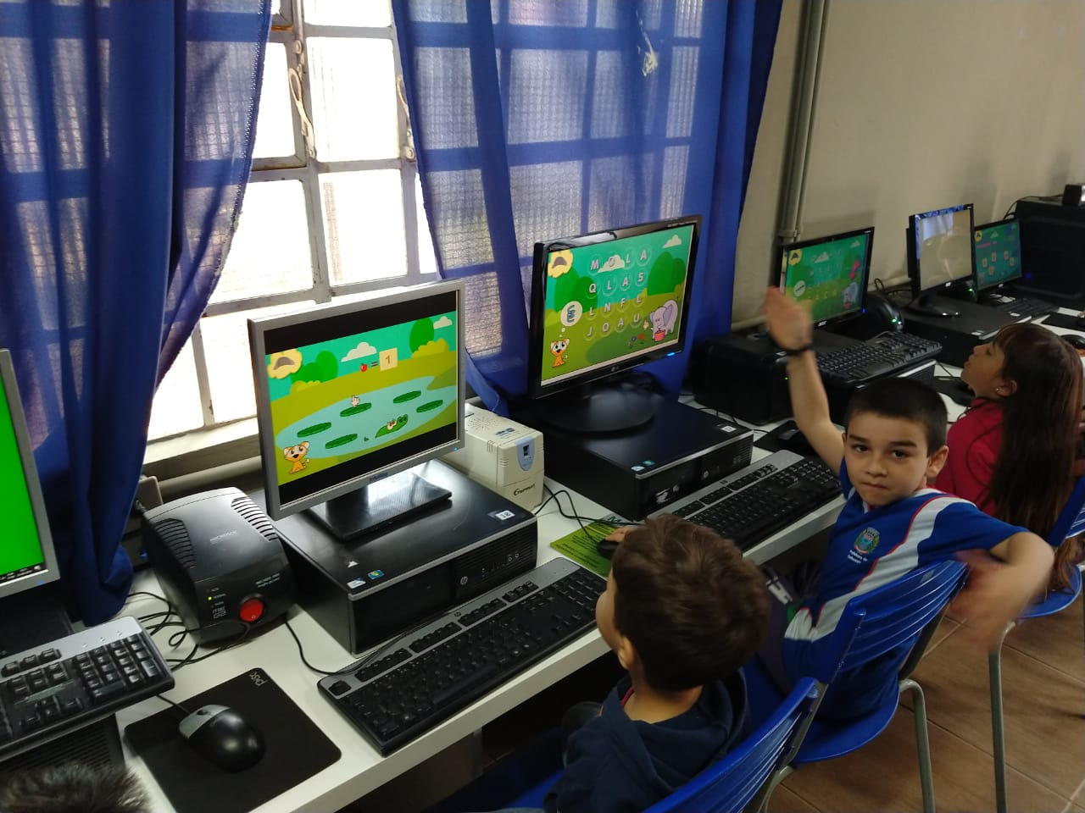
How Do I Find a Club’s Giving to the Rotary Foundation?
100 YEARS OF DOING GOOD IN THE WORLD
Notes:
The Rotary Foundation is a primary source of funding for Rotary’s humanitarian activities, from clubs’ and districts’ local service projects to global initiatives. It also leads Rotary’s ongoing effort to eradicate polio worldwide.
Our Foundation is able to achieve its mission through the generous contributions and active participation of Rotarians and friends of Rotary.

Slide 10
Notes:
Through the Foundation, Rotary members find satisfaction in serving others. The Foundation offers countless opportunities for all members, alumni, and their friends to do good in their communities and in the world — and to make a real, life-changing difference for people in need.
And because of the Foundation, people around the world recognize Rotary as an agent of positive change in the world.
There are many ways that you can improve lives today and build a better future though Rotary:
Work with an international partner club to develop a project in one of Rotary’s six areas of focus and apply for a global grant
Participate in or support your club or district’s grant projects
Contribute to the Foundation to ensure it can continue to do good in the world for many years to come

Slide 11
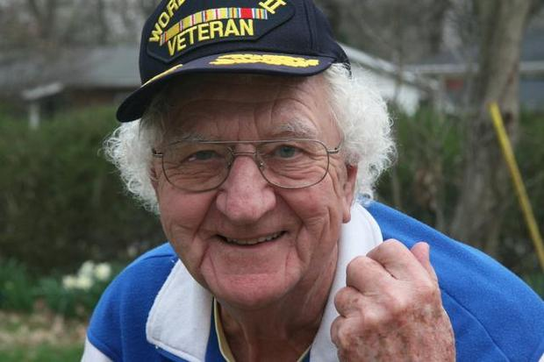
What are Foundation Recognition Points?
How can they be used?
100 YEARS OF DOING GOOD IN THE WORLD
Notes:
The Rotary Foundation is a primary source of funding for Rotary’s humanitarian activities, from clubs’ and districts’ local service projects to global initiatives. It also leads Rotary’s ongoing effort to eradicate polio worldwide.
Our Foundation is able to achieve its mission through the generous contributions and active participation of Rotarians and friends of Rotary.

Slide 12
Notes:
Through the Foundation, Rotary members find satisfaction in serving others. The Foundation offers countless opportunities for all members, alumni, and their friends to do good in their communities and in the world — and to make a real, life-changing difference for people in need.
And because of the Foundation, people around the world recognize Rotary as an agent of positive change in the world.
There are many ways that you can improve lives today and build a better future though Rotary:
Work with an international partner club to develop a project in one of Rotary’s six areas of focus and apply for a global grant
Participate in or support your club or district’s grant projects
Contribute to the Foundation to ensure it can continue to do good in the world for many years to come

Slide 13

What Are the Levels of Foundation
Giving Recognition?
100 YEARS OF DOING GOOD IN THE WORLD
Notes:
The Rotary Foundation is a primary source of funding for Rotary’s humanitarian activities, from clubs’ and districts’ local service projects to global initiatives. It also leads Rotary’s ongoing effort to eradicate polio worldwide.
Our Foundation is able to achieve its mission through the generous contributions and active participation of Rotarians and friends of Rotary.

Slide 14
Individual recognition
Rotary Foundation Sustaining Member
When you give $100 or more per year to the Annual Fund.
Benefactor
When you include the Endowment Fund as a beneficiary of
$1,000 or more in your estate plans or when you donate
$1,000 or more to the fund outright. Benefactors receive a certificate and insignia to wear with a Rotary or Paul Harris Fellow pin.
Paul Harris Fellow
When you give $1,000 or more to the Annual Fund, PolioPlus, or an approved Foundation grant. To recognize someone else as a Paul Harris Fellow, you can give that amount in their name.
Multiple Paul Harris Fellow
When you give additional gifts of $1,000 or more to the Annual Fund, PolioPlus, or an approved Foundation grant.
100 YEARS OF DOING GOOD IN THE WORLD
Notes:
The Rotary Foundation is a primary source of funding for Rotary’s humanitarian activities, from clubs’ and districts’ local service projects to global initiatives. It also leads Rotary’s ongoing effort to eradicate polio worldwide.
Our Foundation is able to achieve its mission through the generous contributions and active participation of Rotarians and friends of Rotary.

Slide 15
Paul Harris Society member
When you elect to contribute $1,000 or more annually to the Annual Fund, PolioPlus, or an approved Foundation grant
Bequest Society
When you make a commitment for future gifts of $10,000 or more to The Rotary Foundation, you’ll be invited to join the Bequest Society.
$10,000: Bequest Society pin and an exclusive art piece suitable for framing
$25,000: Rotary’s Promise crystal and named endowed fund, plus all of the above
$50,000: Separate named endowed funds directed to two areas of focus or districts, plus all of the above
$100,000: Customized Rotary’s Promise crystal, plus all of the above
$250,000: Posthumous induction into the Arch Klumph Society, plus all of the above
$500,000: Special seating and registration benefits at the Rotary International Convention, plus all of the above
100 YEARS OF DOING GOOD IN THE WORLD
Notes:
The Rotary Foundation is a primary source of funding for Rotary’s humanitarian activities, from clubs’ and districts’ local service projects to global initiatives. It also leads Rotary’s ongoing effort to eradicate polio worldwide.
Our Foundation is able to achieve its mission through the generous contributions and active participation of Rotarians and friends of Rotary.

Slide 16
Major Donor
When your cumulative donations reach $10,000. Major Donors can choose to receive a crystal recognition piece and a Major Donor lapel pin or pendant. Level 1: $10,000 to $24,999
Level 2: $25,000 to $49,999
Level 3: $50,000 to $99,999
Level 4: $100,000 to $249,999
Arch Klumph Society
When your cumulative donations reach $250,000. rustees Circle: $250,000 to $499,999
Chair’s Circle: $500,000 to $999,999
Foundation Circle: $1,000,000 to $2,499,999
Platinum Trustees Circle: $2,500,000 to $4,999,999
Platinum Chair’s Circle: $5,000,000 to $9,999,999
Platinum Foundation Circle: $10,000,000 and above
Legacy Society
When you promise a gift of $1 million or more to the Endowment, you’ll be listed in Rotary’s annual report and invited to exclusive Rotary International and Foundation events.
100 YEARS OF DOING GOOD IN THE WORLD
Notes:
The Rotary Foundation is a primary source of funding for Rotary’s humanitarian activities, from clubs’ and districts’ local service projects to global initiatives. It also leads Rotary’s ongoing effort to eradicate polio worldwide.
Our Foundation is able to achieve its mission through the generous contributions and active participation of Rotarians and friends of Rotary.

Slide 17
A Member Has Not Received Recognition.
What Do I do?
100 YEARS OF DOING GOOD IN THE WORLD
Notes:
The Rotary Foundation is a primary source of funding for Rotary’s humanitarian activities, from clubs’ and districts’ local service projects to global initiatives. It also leads Rotary’s ongoing effort to eradicate polio worldwide.
Our Foundation is able to achieve its mission through the generous contributions and active participation of Rotarians and friends of Rotary.

Slide 18
Notes:
Through the Foundation, Rotary members find satisfaction in serving others. The Foundation offers countless opportunities for all members, alumni, and their friends to do good in their communities and in the world — and to make a real, life-changing difference for people in need.
And because of the Foundation, people around the world recognize Rotary as an agent of positive change in the world.
There are many ways that you can improve lives today and build a better future though Rotary:
Work with an international partner club to develop a project in one of Rotary’s six areas of focus and apply for a global grant
Participate in or support your club or district’s grant projects
Contribute to the Foundation to ensure it can continue to do good in the world for many years to come

Slide 19

What Recognition Is Provided to Clubs?
100 YEARS OF DOING GOOD IN THE WORLD
Notes:
The Rotary Foundation is a primary source of funding for Rotary’s humanitarian activities, from clubs’ and districts’ local service projects to global initiatives. It also leads Rotary’s ongoing effort to eradicate polio worldwide.
Our Foundation is able to achieve its mission through the generous contributions and active participation of Rotarians and friends of Rotary.

Slide 20
Club Recognition
100% Paul Harris Fellow Club
For clubs in which all dues-paying members are Paul Harris Fellows. This is a one-time recognition.
100% Paul Harris Society Club
For clubs in which every dues-paying member contributes a minimum of $1,000 to the Annual Fund, PolioPlus, or global grants within a Rotary year
100% Foundation Giving Club
For clubs that achieve an average of $100 in per capita giving and 100 percent participation, with every dues-paying member contributing at least $25 to any or all of the following during the Rotary year: Annual Fund, PolioPlus Fund, approved global grants, or Endowment Fund
100 YEARS OF DOING GOOD IN THE WORLD
Notes:
The Rotary Foundation is a primary source of funding for Rotary’s humanitarian activities, from clubs’ and districts’ local service projects to global initiatives. It also leads Rotary’s ongoing effort to eradicate polio worldwide.
Our Foundation is able to achieve its mission through the generous contributions and active participation of Rotarians and friends of Rotary.

Slide 21
Club Recognition
100% Rotary’s Promise Club
A designation provided to clubs in which every dues-paying member supports The Rotary Foundation’s Endowment with a minimum commitment of $1,000 or more in an estate plan or via an outright gift of $1,000 or more. A certificate honoring the achievement will be provided upon request.
Every Rotarian, Every Year Club
For clubs that achieve a minimum Annual Fund contribution of $100 per capita during the Rotary year, and every dues-paying member must personally contribute at least $25 to the Annual Fund during the year.
Top Three Per Capita in Annual Fund Giving
For the three clubs in each district that give the most, per capita, to the Annual Fund. Clubs that give at least $50 per capita are eligible.
100 YEARS OF DOING GOOD IN THE WORLD
Notes:
The Rotary Foundation is a primary source of funding for Rotary’s humanitarian activities, from clubs’ and districts’ local service projects to global initiatives. It also leads Rotary’s ongoing effort to eradicate polio worldwide.
Our Foundation is able to achieve its mission through the generous contributions and active participation of Rotarians and friends of Rotary.

Slide 22
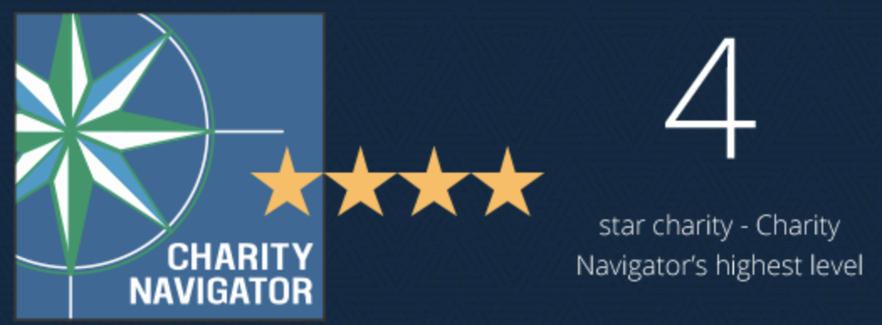
How does our Foundation rank among other charitable organizations?
100 YEARS OF DOING GOOD IN THE WORLD
Notes:
The Rotary Foundation is a primary source of funding for Rotary’s humanitarian activities, from clubs’ and districts’ local service projects to global initiatives. It also leads Rotary’s ongoing effort to eradicate polio worldwide.
Our Foundation is able to achieve its mission through the generous contributions and active participation of Rotarians and friends of Rotary.

Slide 23
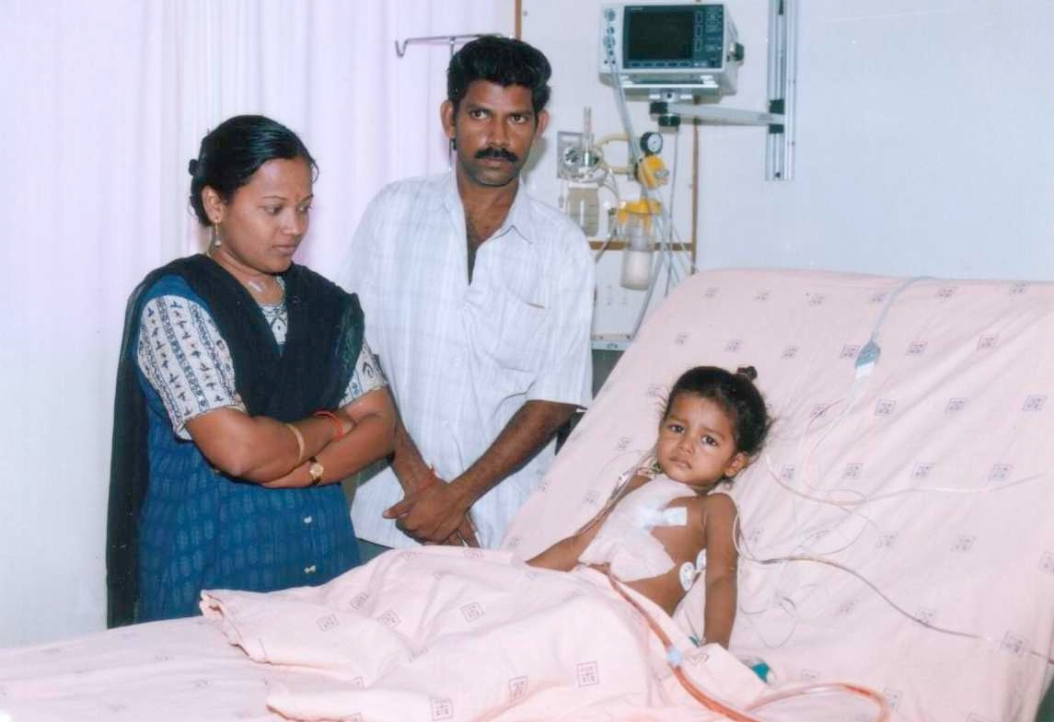
What types of grants are available to clubs?
100 YEARS OF DOING GOOD IN THE WORLD
Notes:
The Rotary Foundation is a primary source of funding for Rotary’s humanitarian activities, from clubs’ and districts’ local service projects to global initiatives. It also leads Rotary’s ongoing effort to eradicate polio worldwide.
Our Foundation is able to achieve its mission through the generous contributions and active participation of Rotarians and friends of Rotary.

Slide 24
District Grants

Slide 25
Disaster Recovery Grant

Slide 26
Global Grants

Slide 27
Your Questions

Slide 28
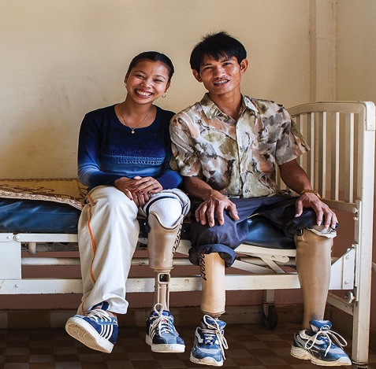
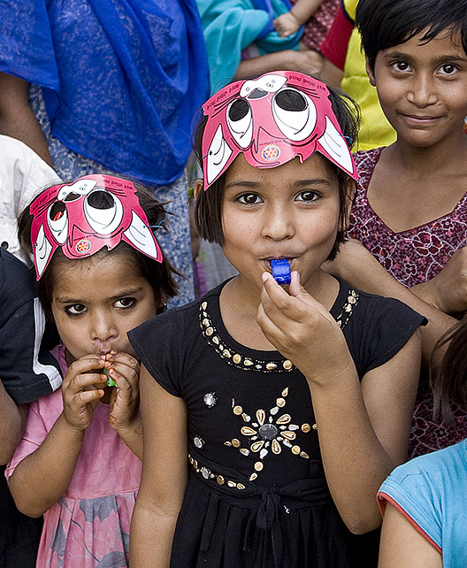
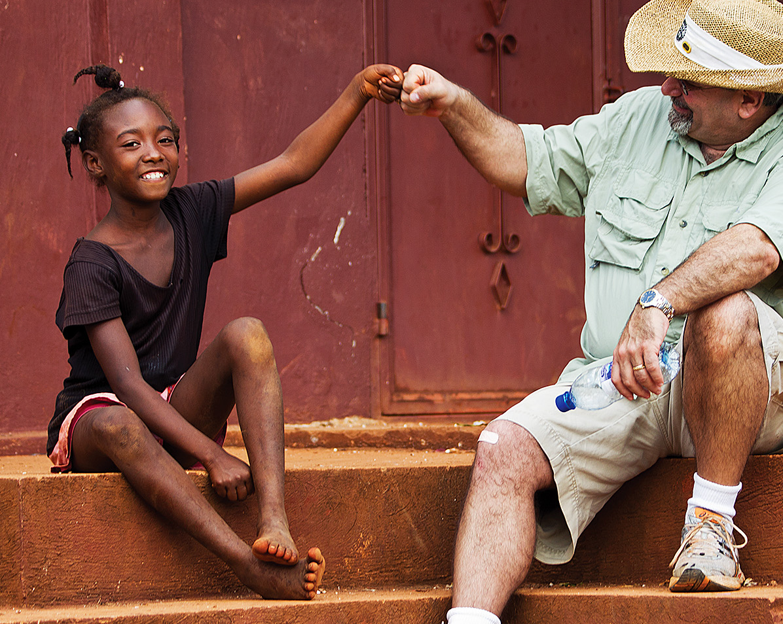
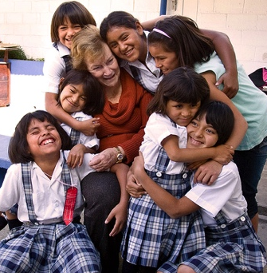
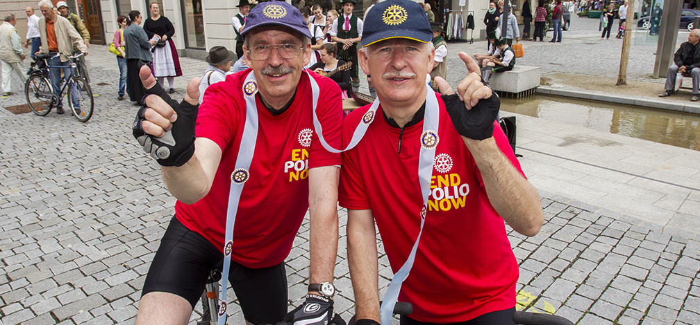
We should not live for ourselves alone, but for the joy in doing good for others
— Arch Klumph, 1929
Notes:
Through the Foundation, Rotary members find satisfaction in serving others. The Foundation offers countless opportunities for all members, alumni, and their friends to do good in their communities and in the world — and to make a real, life-changing difference for people in need.
And because of the Foundation, people around the world recognize Rotary as an agent of positive change in the world.
There are many ways that you can improve lives today and build a better future though Rotary:
Work with an international partner club to develop a project in one of Rotary’s six areas of focus and apply for a global grant
Participate in or support your club or district’s grant projects
Contribute to the Foundation to ensure it can continue to do good in the world for many years to come

