Slide 1

Mid-America PETS 2023

Slide 2
District Grants

Slide 3
District Grants – How Are They Funded?
Districts may use up to 50% of their District Designated Fund to receive one district grant annually
This percentage is calculated based on the amount of DDF generated from a district’s Annual Fund giving three years prior, including Endowment Fund earnings

Slide 4
District Grant Funds Available
$108,815 available 2022 – 2023
(2019 – 2020 giving)
$76,480 available 2023 – 2024 (2020 – 2021 giving)

Slide 5
District Grant Club Qualification
$76,480 available 2022 – 2023
(2020 – 2021 giving)
$1,000 per club/1 – 1
Preference to clubs with $100 per capita giving to the Annual Fund the prior year
Must attend Grant Management Seminar on April 4 via Zoom and sign MOU

Slide 6
District Grant Procedures
Apply on DACdb by November 30, 2023
Foundation Chair submits District’s spending plan to the Rotary Foundation after all club projects are approved

Slide 7
District Grant Procedures
TRF approves spending plan and transfers funds to District
Clubs complete projects and submit the final reports to receive funds
Projects must be completed and final reports submitted by November 30, 2024
Foundation Chair submits final report to TRF

Slide 8
District Grant Project Examples

Slide 9
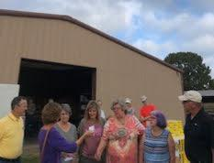
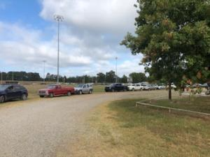
Altus Area Food Bank

Slide 10
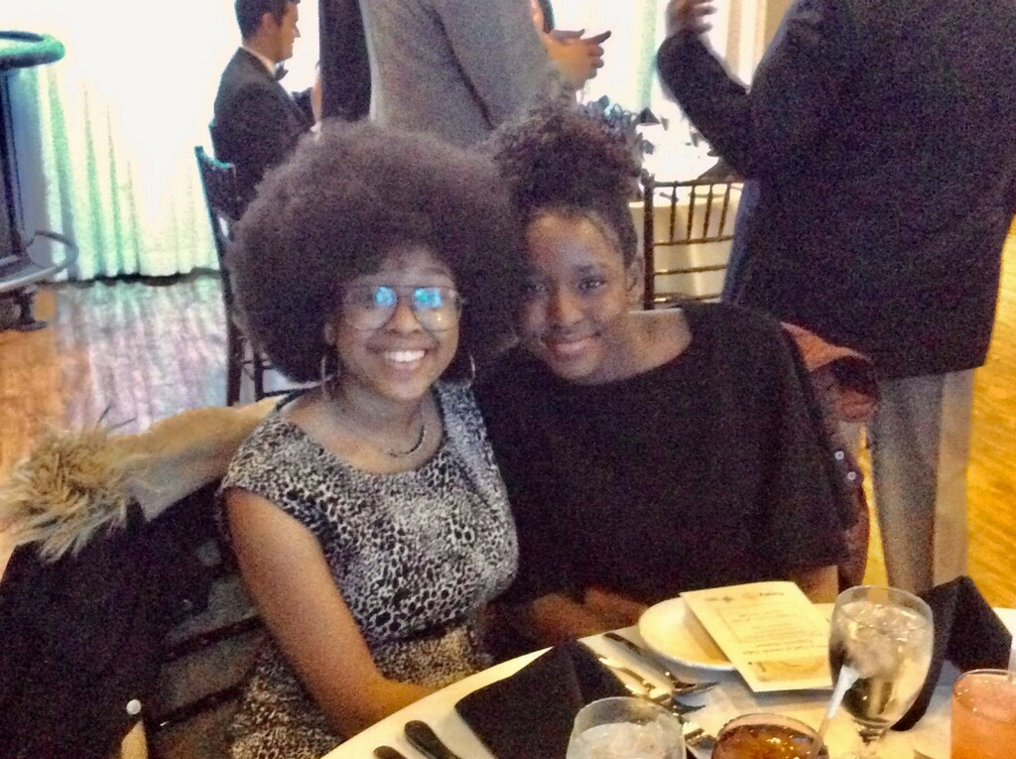
Etiquette Dinner – North Tulsa

Slide 11
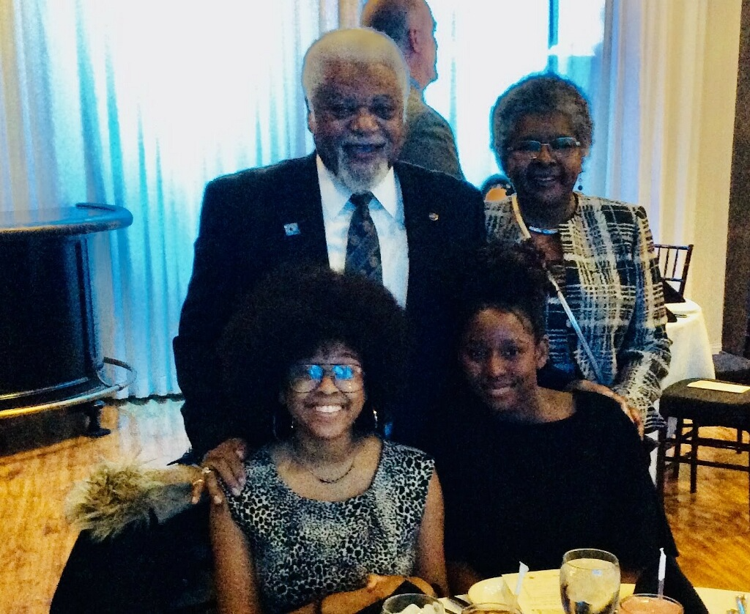
Etiquette Dinner – North Tulsa

Slide 12
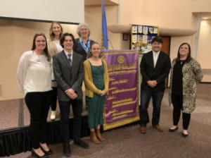
Four Way Test Speech Contest – Bartlesville

Slide 13
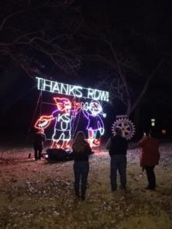
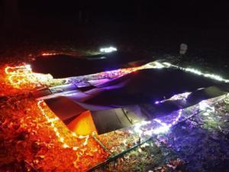
Fantasy Land – Bartlesville Daybreak

Slide 14
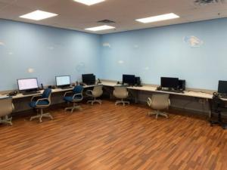
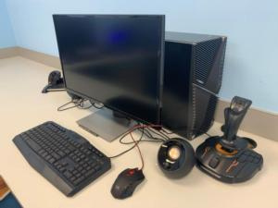
Tulsa Air and Space Museum Flight Lab – Tulsa Sunrise

Slide 15
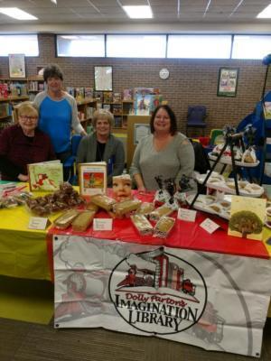
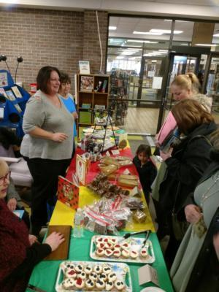
Imagination Library - Coffeyville

Slide 16
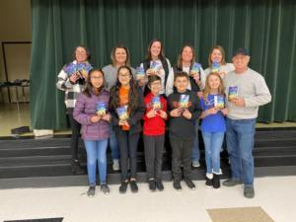
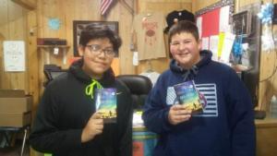
Where the Red Fern Grows Book Project - Tahlequah

Slide 17
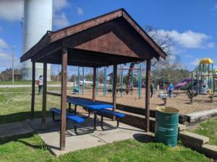
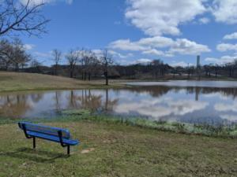
Park Benches - Bristow

Slide 18
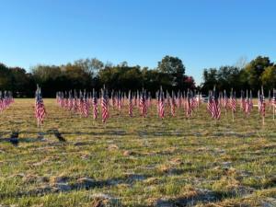
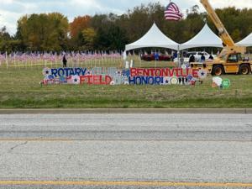
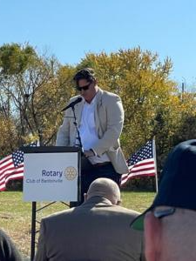
Field of Honor - Bentonville

Slide 19
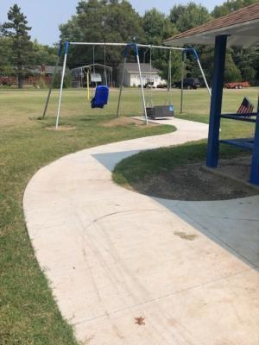
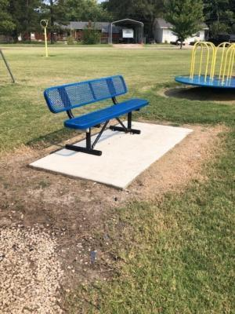
Rotary Park - Fredonia

Slide 20
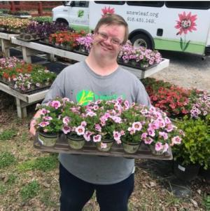
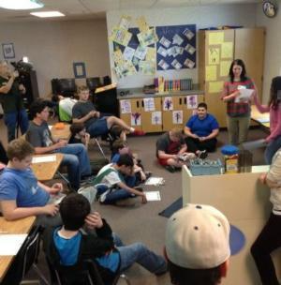
New Leaf Vocational Training for Disabled – Tulsa Sunrise

Slide 21
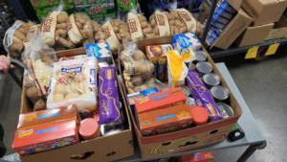
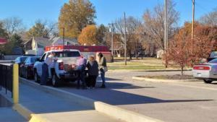
Thanksgiving Baskets - Iola

Slide 22

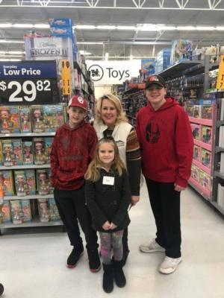
Shop With a Rotarian – Broken Arrow

Slide 23
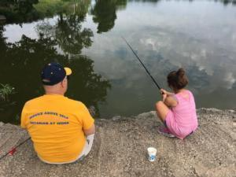
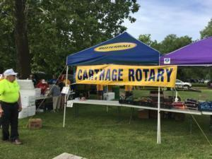
Kids Fishing Day - Carthage

Slide 24
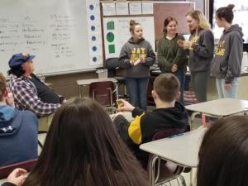
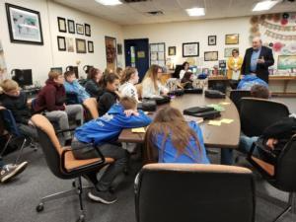
Choices Program - Grove

Slide 25
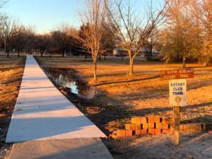
Arboretum Walking Trail - Parsons

Slide 26
Questions

