Slide 1
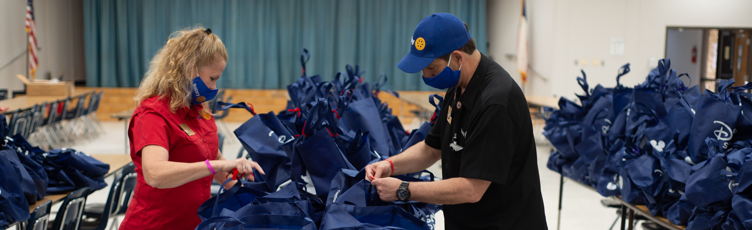
6110 MEMBERSHIP ACTIVITIES REIMBURSEMENT
Haris Sofradzija
Regional Membership Officer
Rotary International

Slide 2
REIMBURSEMENT GUIDELINES
District 6110 can receive up to $500 in reimbursements from RI for specific activities that are aimed at increasing membership in their districts.
Clubs can do these activities on their own or as a group. Reimbursements will be processed on a first come, first serve basis by the district until the $500 limit is reached.
Questions? Ask DMC Jayne Lowe at jaynerotary@gmail.com.
Ineligible expenses include training events, cash or cash-equivalent incentives, direct payments, travel expenses without preapproval, or recognition items such as awards, theme pins, banners, frames, gifts, and plaques.

Slide 3
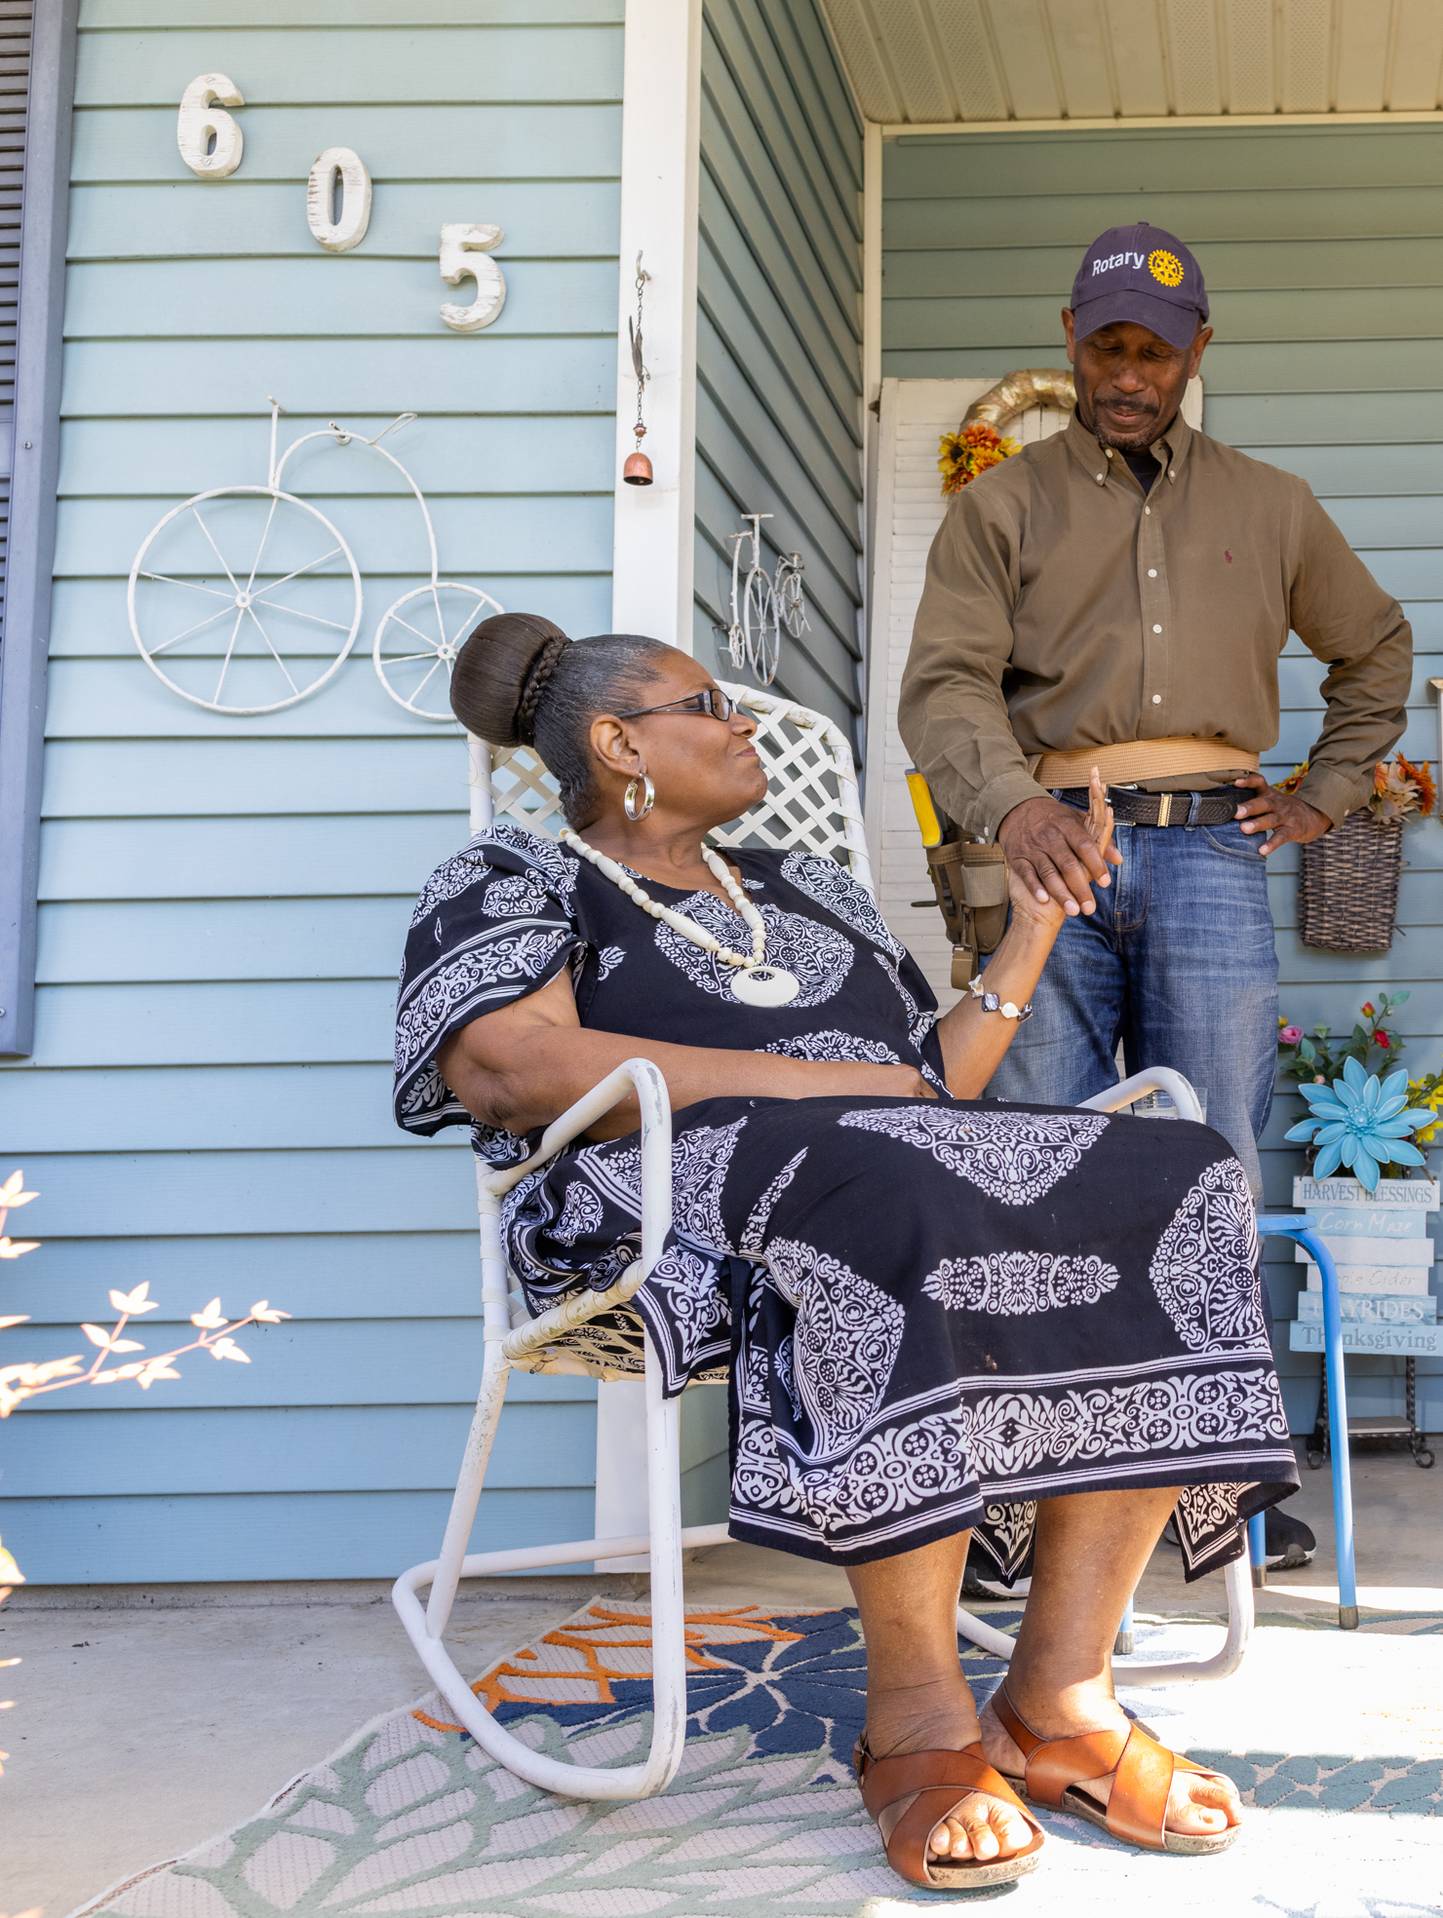
Efforts to develop and support new Rotary and Rotaract clubs:
Informational meetings that help communities learn about their Rotary and Rotaract clubs; work with your district Rotaract representative to plan these
Informational meetings in communities where no clubs exist
Club charter celebrations that engage the larger community
Organizational meetings, especially ones where a new club’s leaders work on establishing their new club.

Slide 4
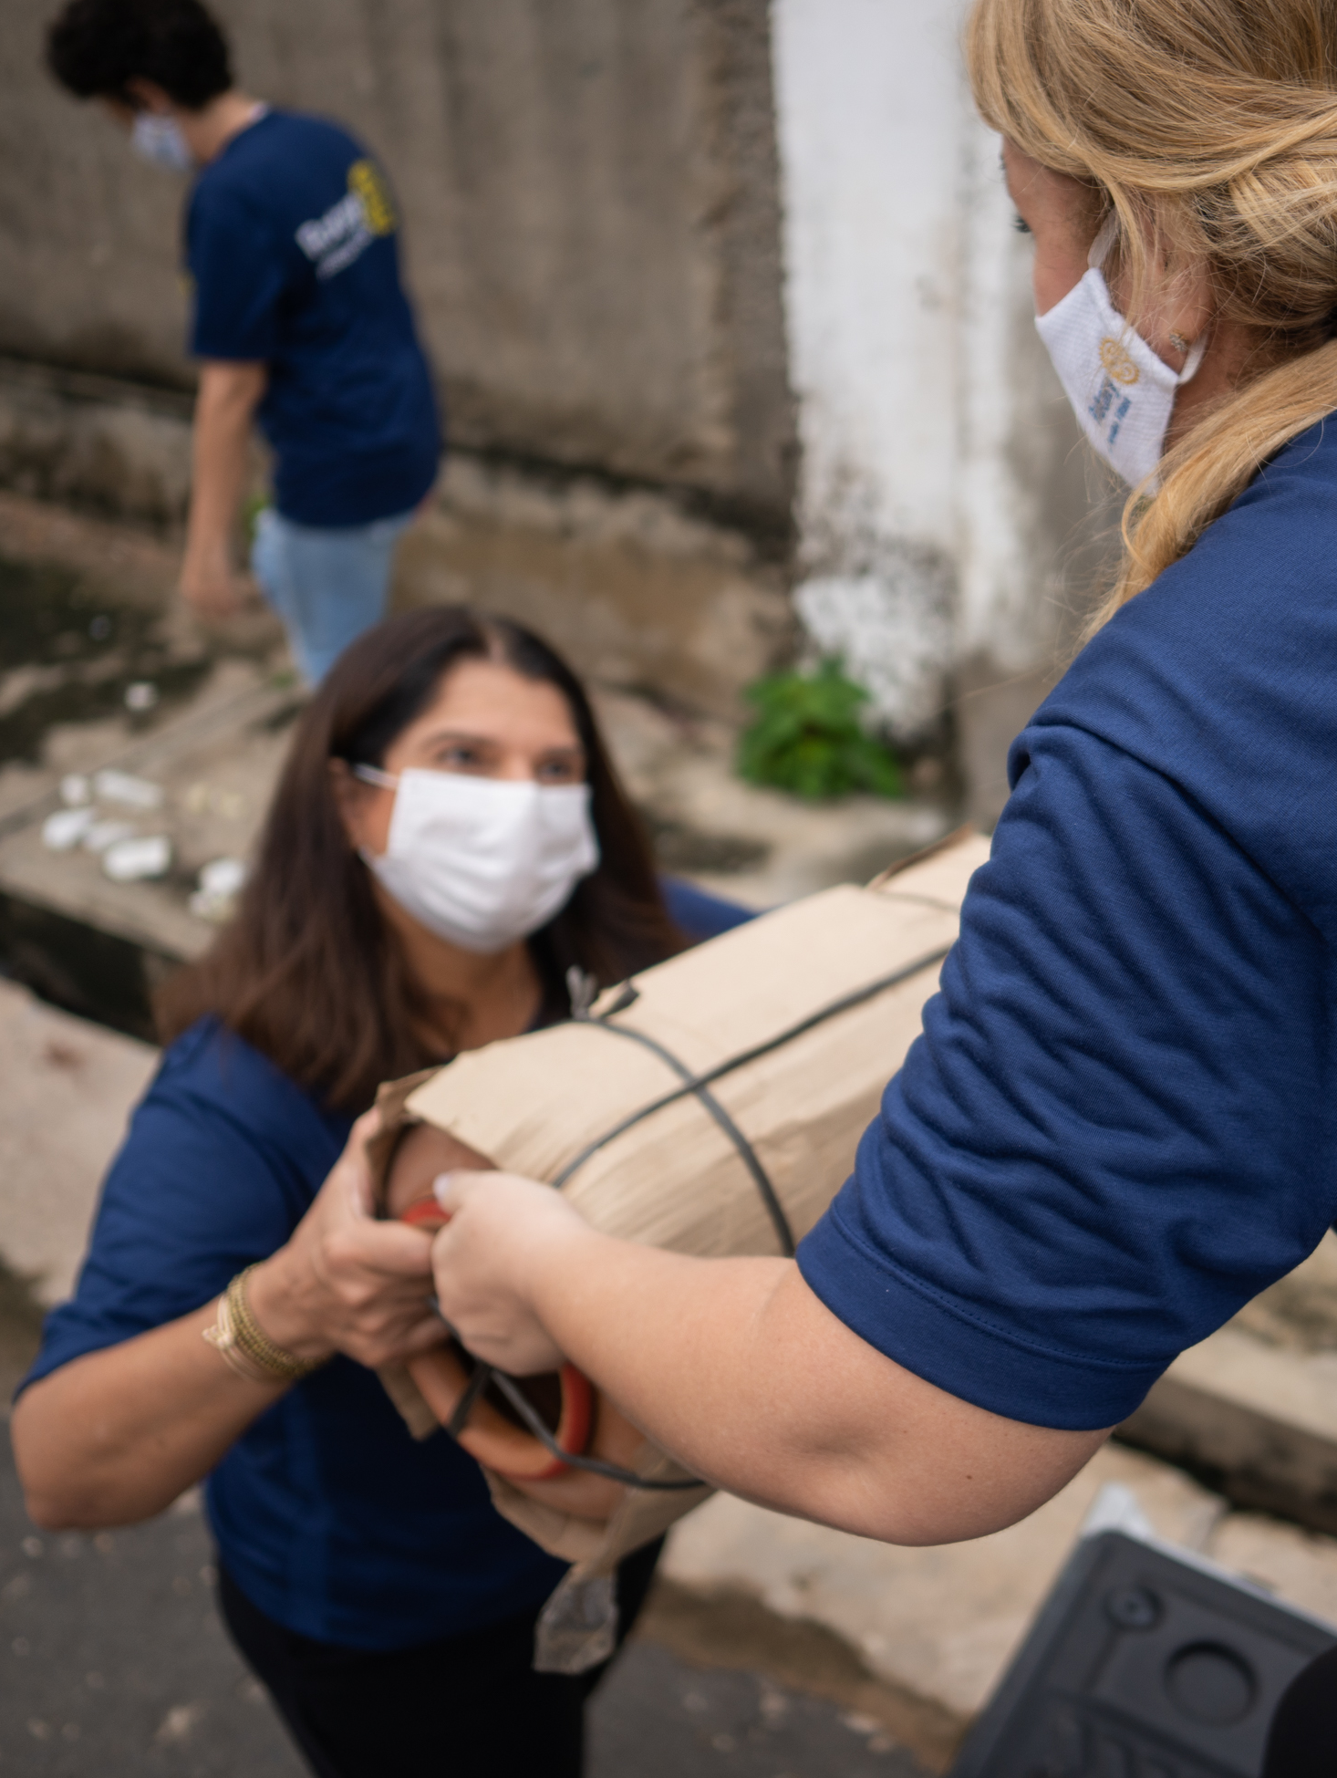
Efforts to build relationships with prospective and new members:
Events such as informational meetings, service projects, or social functions that engage diverse groups of prospective members, including young professionals, women, and people in underrepresented professions
Gatherings to get acquainted with and engage prospective members who have expressed interest in membership through rotary.org/join
Orientation and engagement opportunities for new members

Slide 5

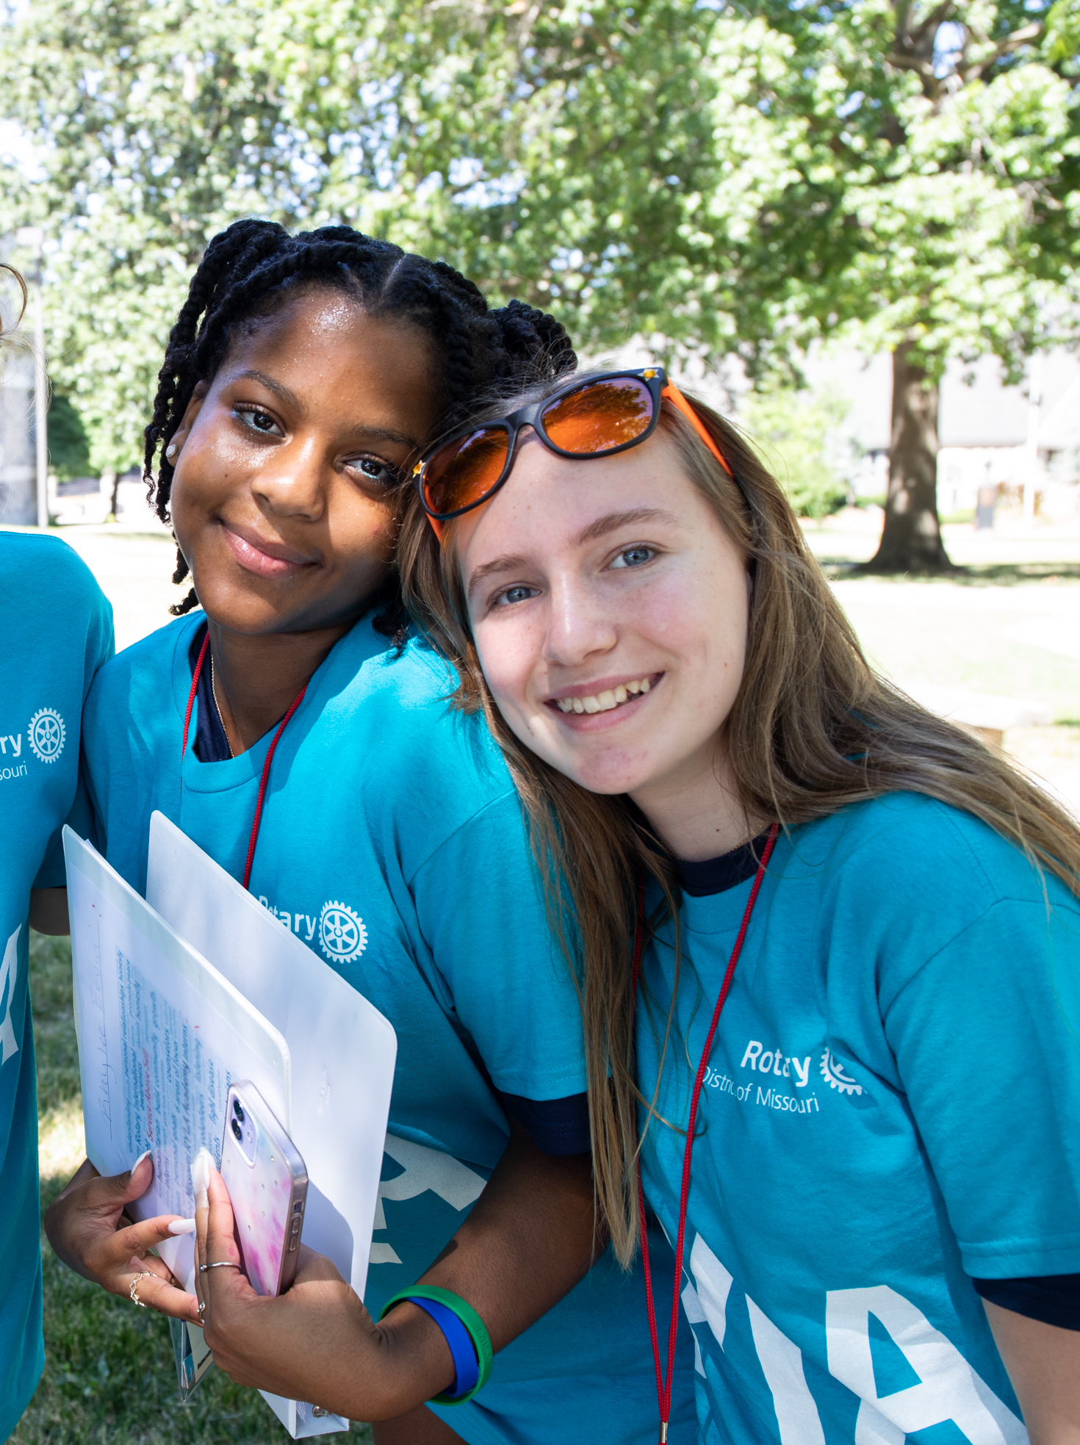
Efforts to improve our public image and raise awareness of Rotary:
Paying for social media or other ads that use materials or templates from the Brand Center on My Rotary; work with your district public image chair to create these
The purchase of Rotary-branded materials (a tablecloth, retractable banner, flyer display rack, etc.) to use at public events

Slide 6
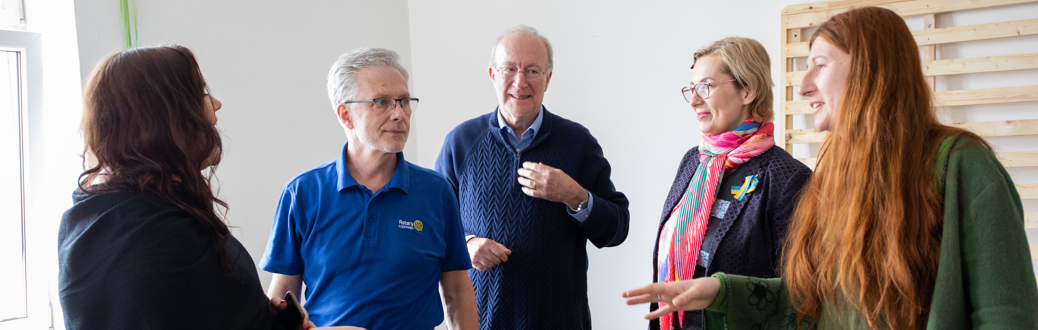
PAYMENT
Submit your expenses including receipts within 60 days and by 15 May 2024 to DMC Jayne Lowe.
Questions? Ask DMC Jayne Lowe at jaynerotary@gmail.com.

