Slide 1


Mid-America PETS
March 23-25, 2023

Slide 2
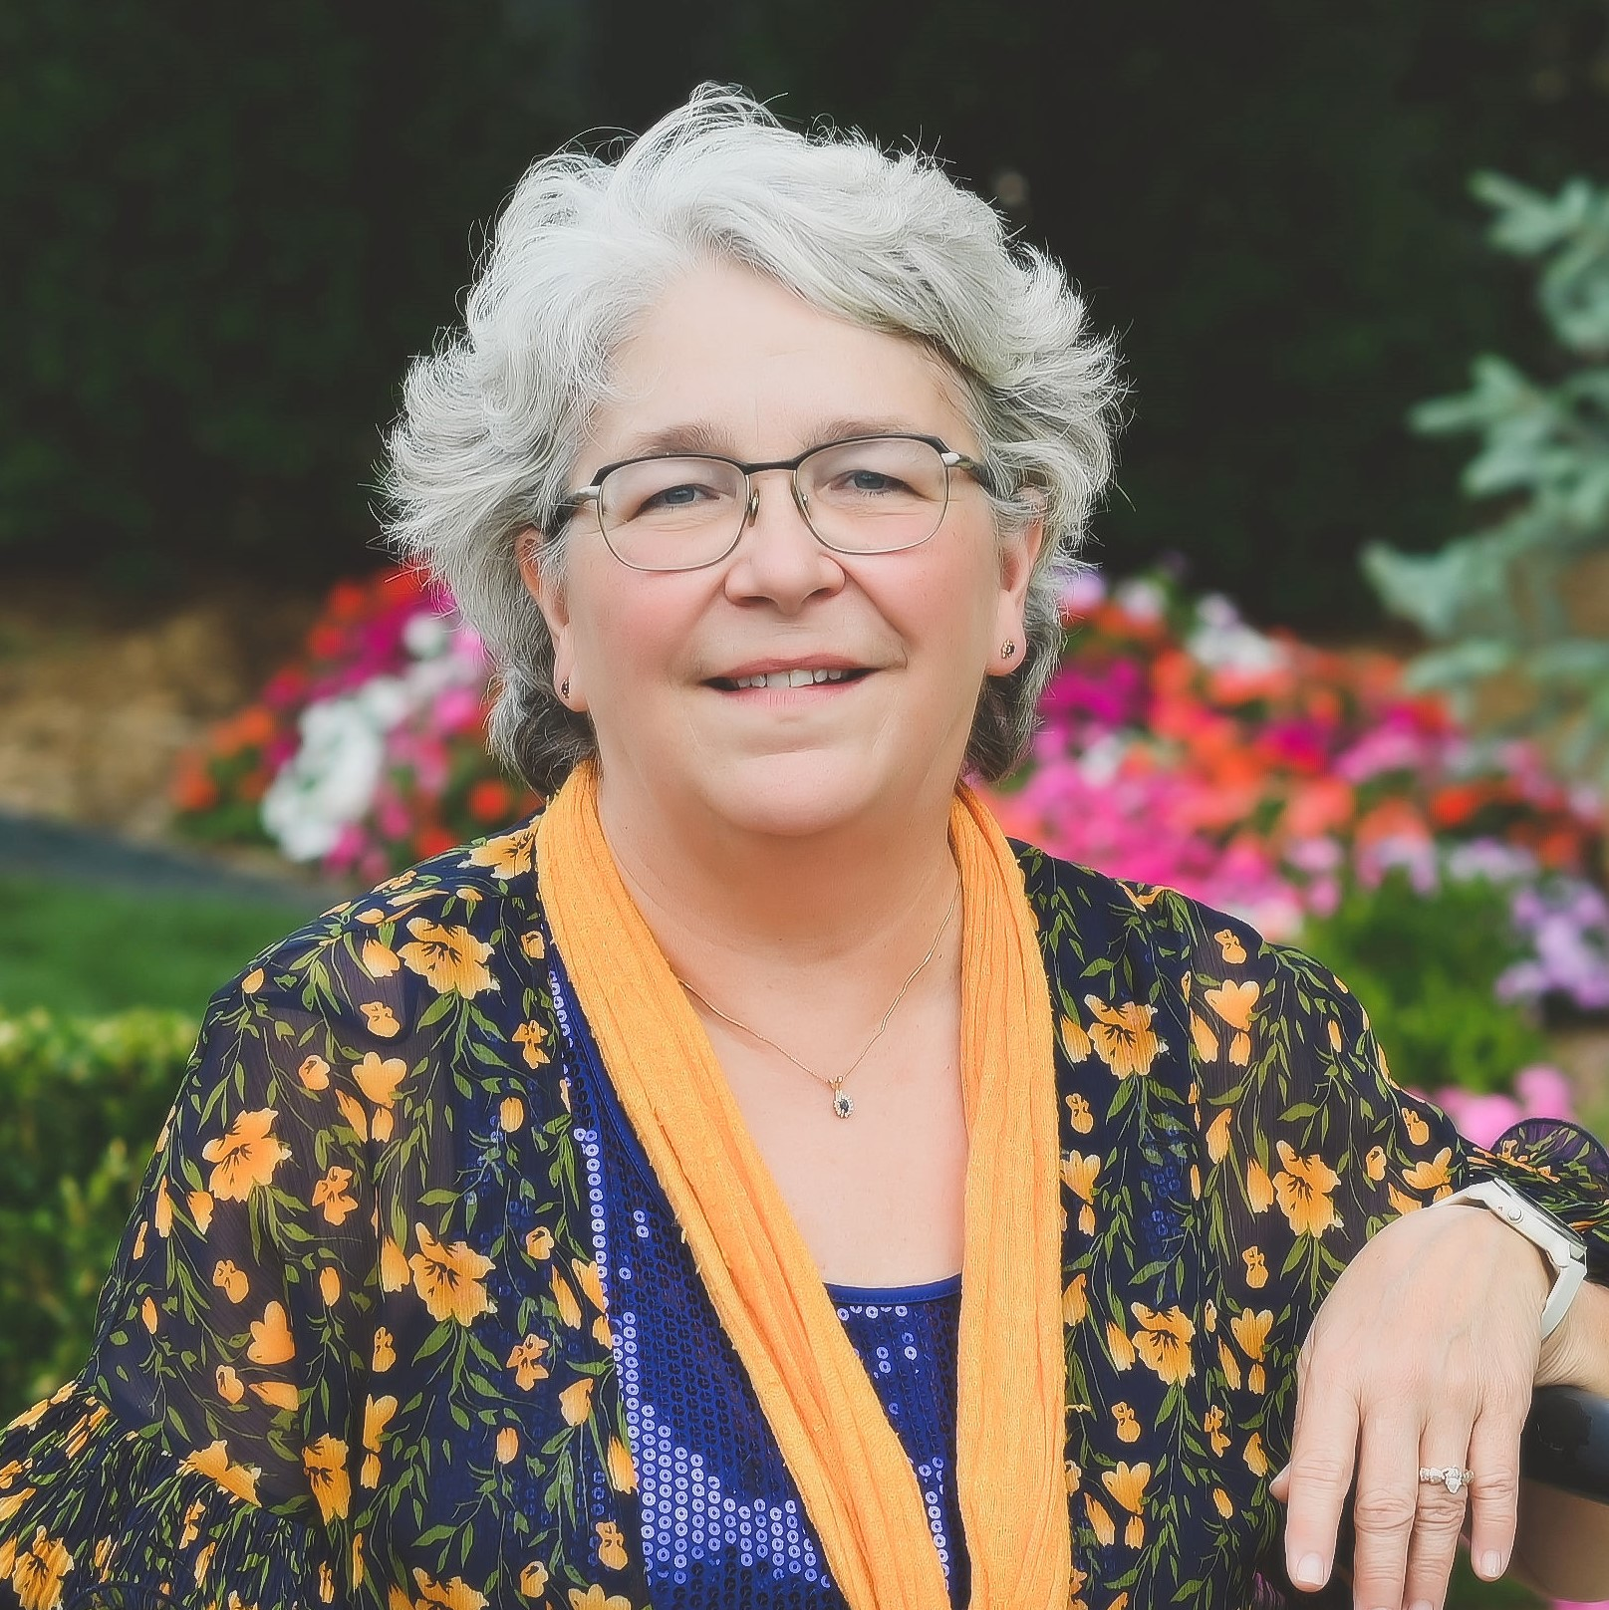
Pam Crawford
District Governor Elect

Slide 3
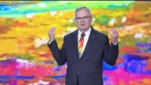

Slide 4
Mid-America PETS
March 23-25, 2023

Slide 6
Mid-America PETS
March 23-25, 2023

Slide 7
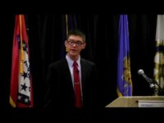

Slide 8
THE FOUR-WAY TEST
Of the things we think, say or do
1. Is it the TRUTH?
2. Is it FAIR to all concerned?
3. Will it build GOOD WILL and BETTER FRIENDSHIPS?
4. Will it be BENEFICIAL to all concerned?

Slide 9
District 6 1 1 0
4-Way Test Speech Contest
Your Rotary Club
can help youth
understand
ethic and moral lessons

Slide 10
Appoint a Chair Now
Get started in August
I would like to see EVERY Rotary Club in the District participating in the 4-Way Test Speech Contest it will be the highlight of your year as President!

Slide 11
COMPLETE MANUAL WILL BE ON THE WEB IN JULY 2023
Go to the district web site Http://rotarydistrict6110.org
FOR NOW, CHAIR CAN WATCH FINALISTS
Navigate to “Youth Services” THEN to Four Way Test Speech Contest

Slide 12
Go to the Speech Teacher
In August
Share the District Web address
Have them watch the YouTube speeches
CHECK OUT THE EASY TO FOLLOW MANUAL
EVERYTHING YOU NEED IS THERE
FIND IT On the district web site http://rotarydistrict6110.org
NAVIGATE “YOUTH SERVICES” THEN FOUR WAY TEST SPEECH CONTEST

Slide 13
LOOK BEYOND YOURSELF
These Students WILL inspire you
Your Club
Your Community

Slide 14
Call or email
CO-Chair Ron Petersen 417-359-3417
ronsr@cbciraio.com
Co-Chair Jayne Lowe 479-644-6576
jaynerotary@gmail.com

Slide 15

OCTOBER 19-22, 2023
OCTOBER 17-20, 2024

Slide 16


Slide 17


Slide 18
Mid-America PETS
March 23-25, 2023

Slide 19
Pam Crawford
District Governor Elect

Slide 20
Mid-America PETS
March 23-25, 2023

Slide 21

Mid-America PETS 2023

Slide 22
District Grants

Slide 23
District Grants – How Are They Funded?
Districts may use up to 50% of their District Designated Fund to receive one district grant annually
This percentage is calculated based on the amount of DDF generated from a district’s Annual Fund giving three years prior, including Endowment Fund earnings

Slide 24
District Grant Funds Available
$108,815 available 2022 – 2023
(2019 – 2020 giving)
$76,480 available 2023 – 2024 (2020 – 2021 giving)

Slide 25
District Grant Club Qualification
$76,480 available 2022 – 2023
(2020 – 2021 giving)
$1,000 per club/1 – 1
Preference to clubs with $100 per capita giving to the Annual Fund the prior year
Must attend Grant Management Seminar on April 4 via Zoom and sign MOU

Slide 26
District Grant Procedures
Apply on DACdb by November 30, 2023
Foundation Chair submits District’s spending plan to the Rotary Foundation after all club projects are approved

Slide 27
District Grant Procedures
TRF approves spending plan and transfers funds to District
Clubs complete projects and submit the final reports to receive funds
Projects must be completed and final reports submitted by November 30, 2024
Foundation Chair submits final report to TRF

Slide 28
District Grant Project Examples

Slide 29
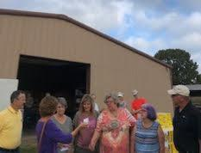
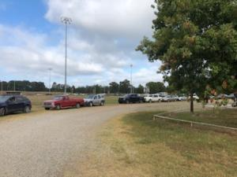
Altus Area Food Bank

Slide 30
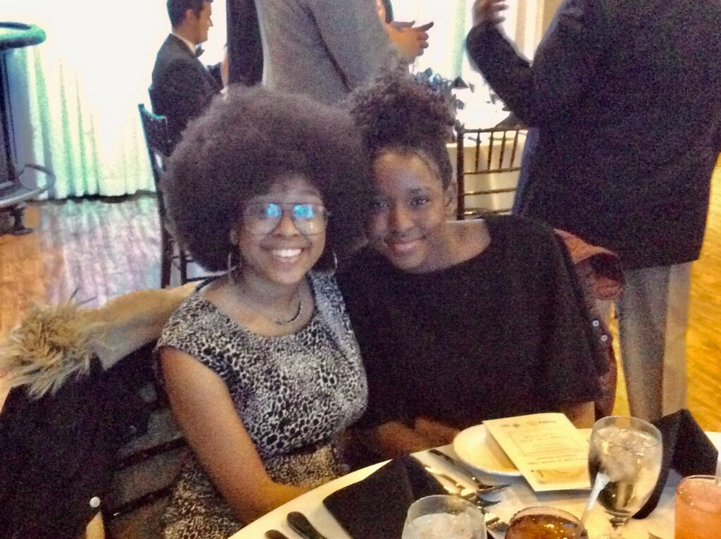
Etiquette Dinner – North Tulsa

Slide 31
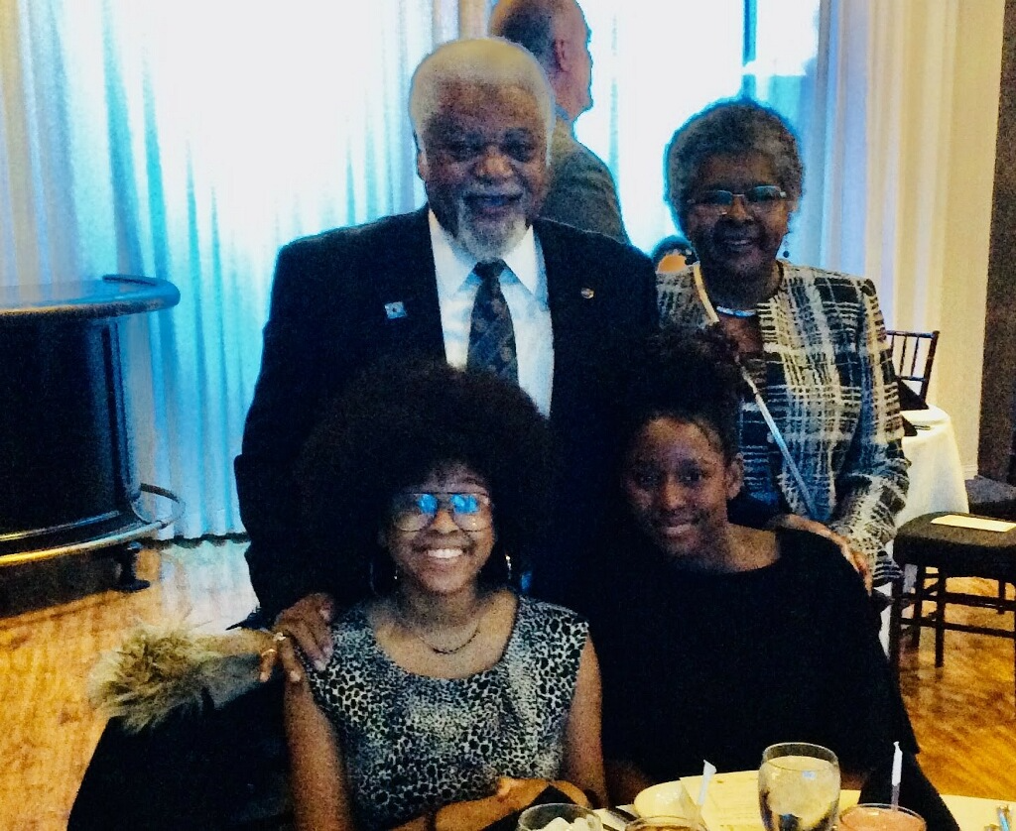
Etiquette Dinner – North Tulsa

Slide 32
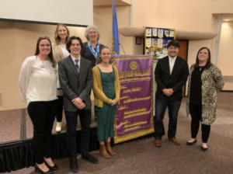
Four Way Test Speech Contest – Bartlesville

Slide 33
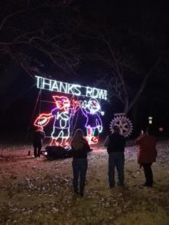
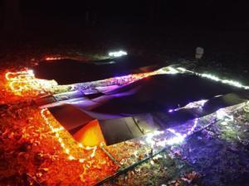
Fantasy Land – Bartlesville Daybreak

Slide 34
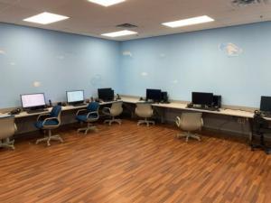
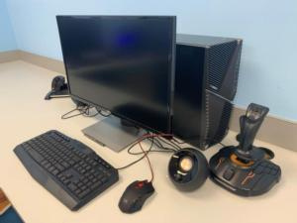
Tulsa Air and Space Museum Flight Lab – Tulsa Sunrise

Slide 35
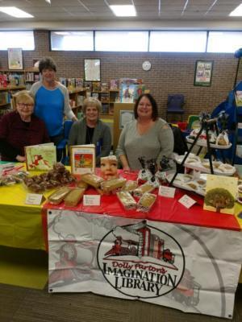
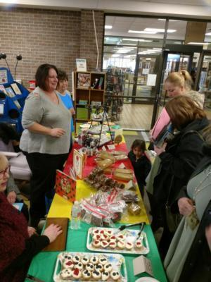
Imagination Library - Coffeyville

Slide 36
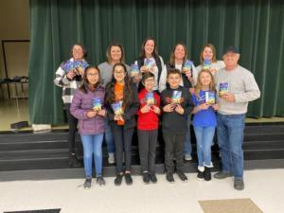
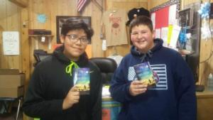
Where the Red Fern Grows Book Project - Tahlequah

Slide 37
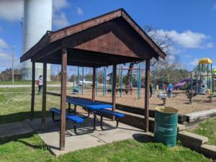
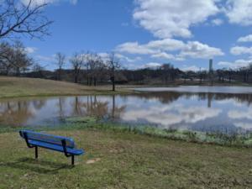
Park Benches - Bristow

Slide 38
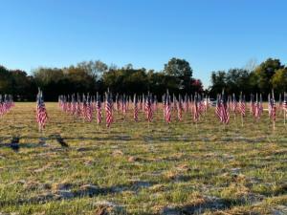
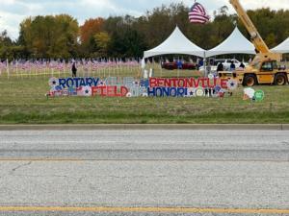
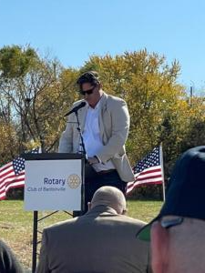
Field of Honor - Bentonville

Slide 39
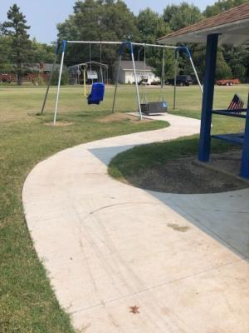
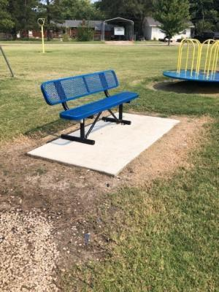
Rotary Park - Fredonia

Slide 40
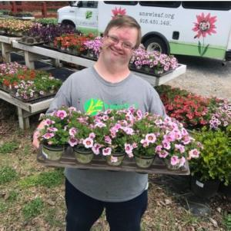
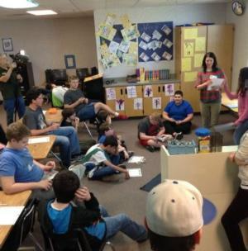
New Leaf Vocational Training for Disabled – Tulsa Sunrise

Slide 41
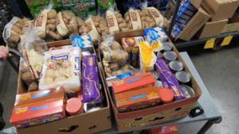
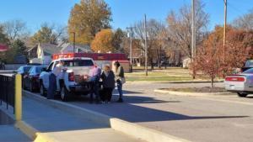
Thanksgiving Baskets - Iola

Slide 42
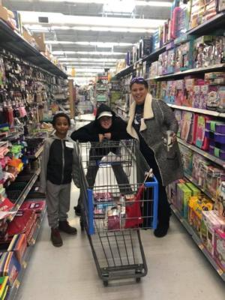
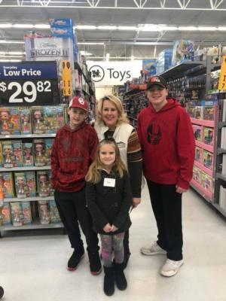
Shop With a Rotarian – Broken Arrow

Slide 43
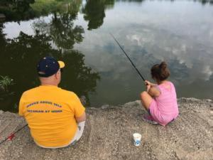
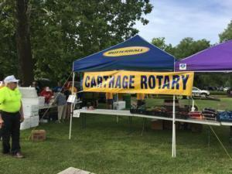
Kids Fishing Day - Carthage

Slide 44
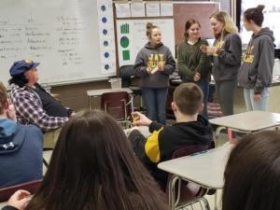
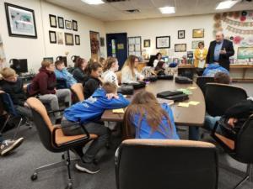
Choices Program - Grove

Slide 45
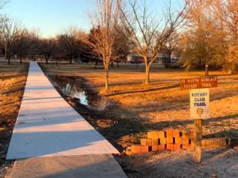
Arboretum Walking Trail - Parsons

Slide 46
Questions

Slide 47
Mid-America PETS
March 23-25, 2023

Slide 48
Pam Crawford
District Governor Elect

Slide 49
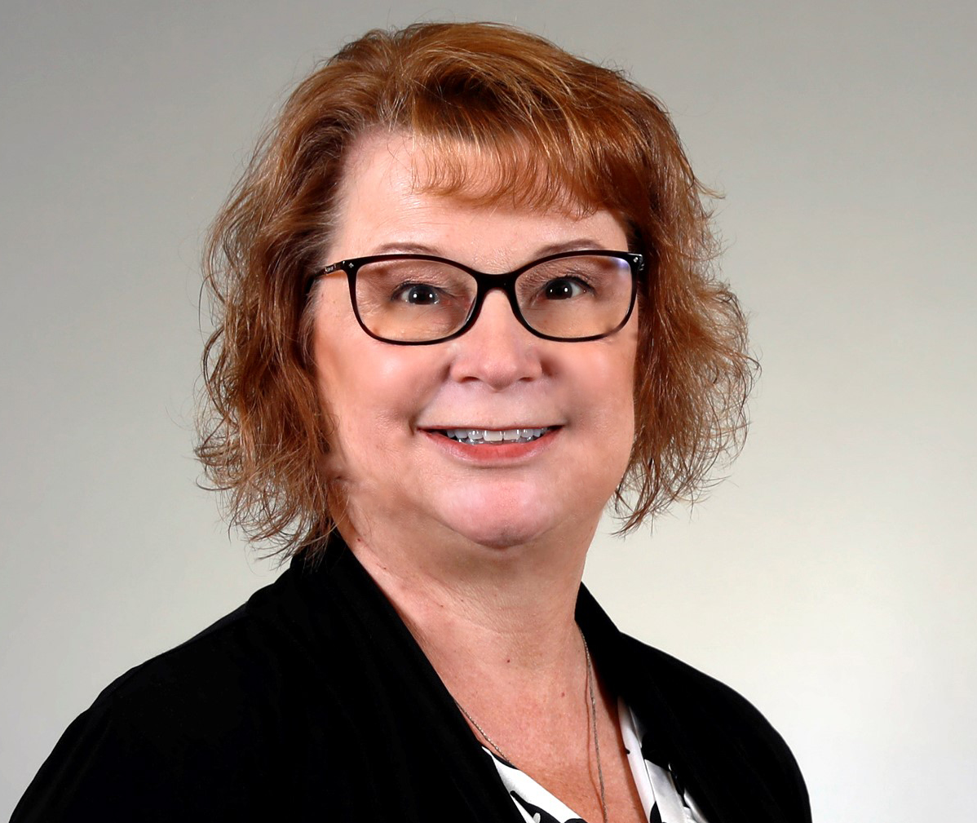
Jill Pietrusinski,
Zone 31 Rotary Coordinator

Slide 50
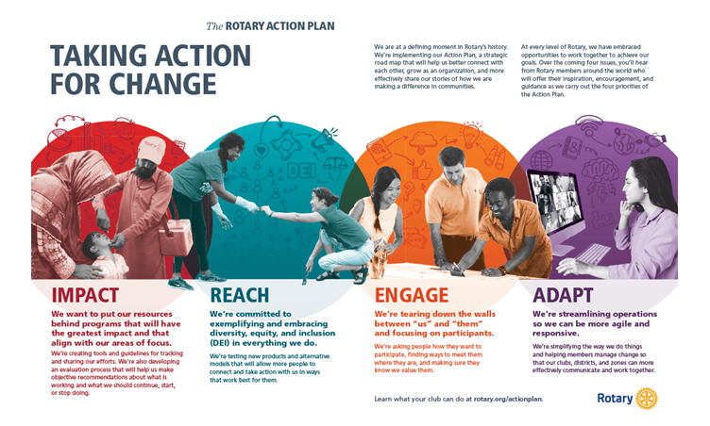

Slide 51
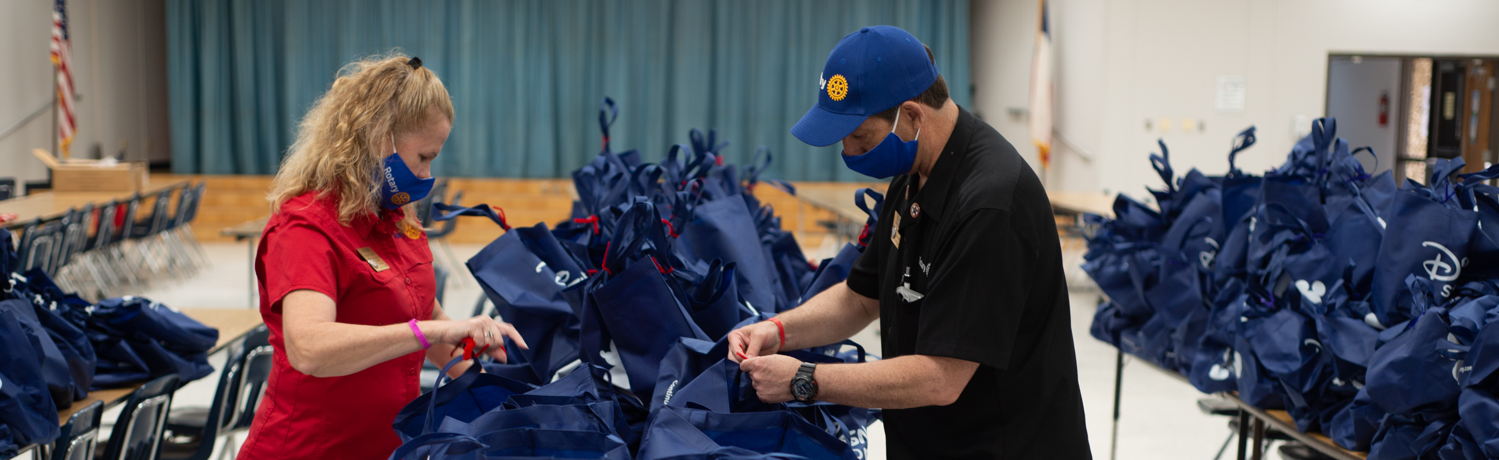
6110 MEMBERSHIP ACTIVITIES REIMBURSEMENT
Haris Sofradzija
Regional Membership Officer
Rotary International

Slide 52
REIMBURSEMENT GUIDELINES
District 6110 can receive up to $500 in reimbursements from RI for specific activities that are aimed at increasing membership in their districts.
Clubs can do these activities on their own or as a group. Reimbursements will be processed on a first come, first serve basis by the district until the $500 limit is reached.
Questions? Ask DMC Jayne Lowe at jaynerotary@gmail.com.
Ineligible expenses include training events, cash or cash-equivalent incentives, direct payments, travel expenses without preapproval, or recognition items such as awards, theme pins, banners, frames, gifts, and plaques.

Slide 53
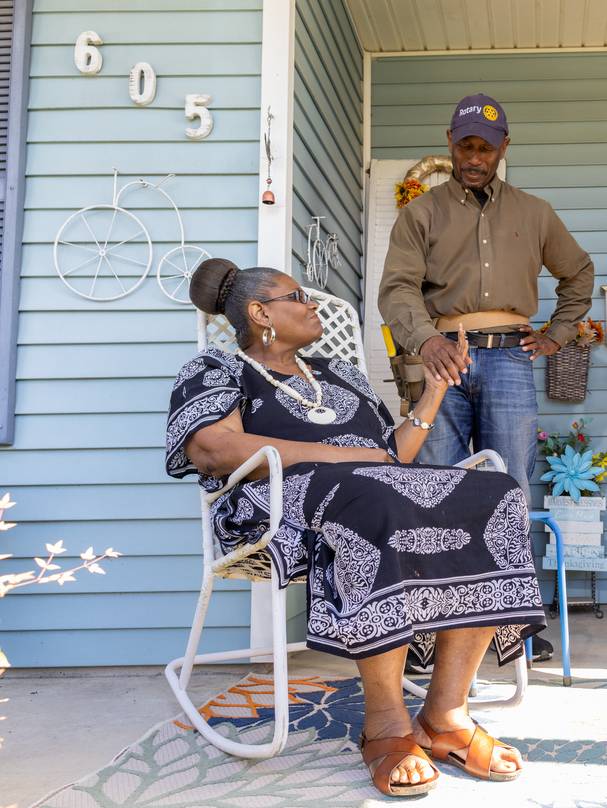
Efforts to develop and support new Rotary and Rotaract clubs:
Informational meetings that help communities learn about their Rotary and Rotaract clubs; work with your district Rotaract representative to plan these
Informational meetings in communities where no clubs exist
Club charter celebrations that engage the larger community
Organizational meetings, especially ones where a new club’s leaders work on establishing their new club.

Slide 54
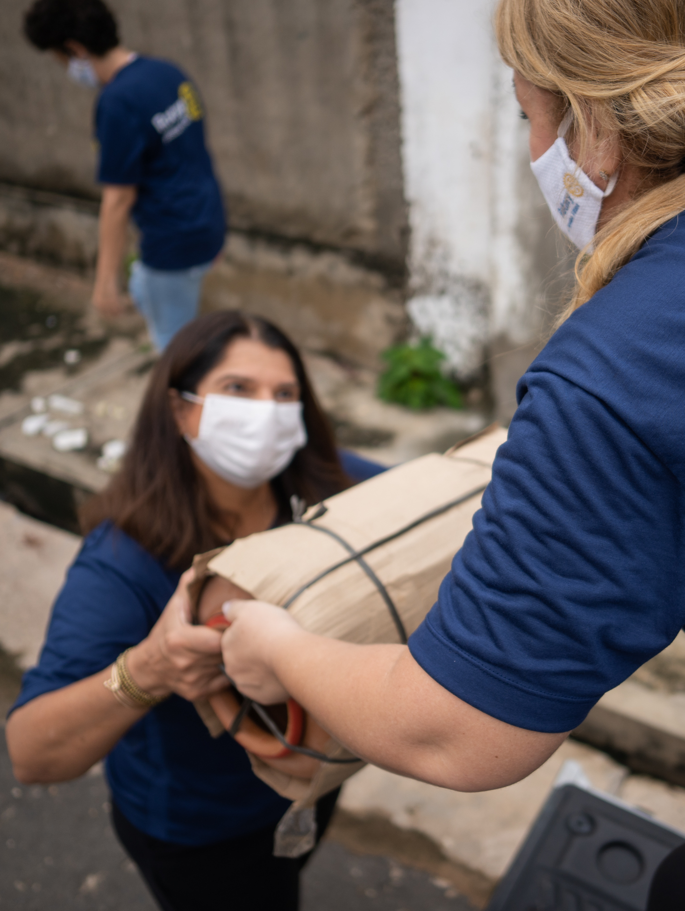
Efforts to build relationships with prospective and new members:
Events such as informational meetings, service projects, or social functions that engage diverse groups of prospective members, including young professionals, women, and people in underrepresented professions
Gatherings to get acquainted with and engage prospective members who have expressed interest in membership through rotary.org/join
Orientation and engagement opportunities for new members

Slide 55

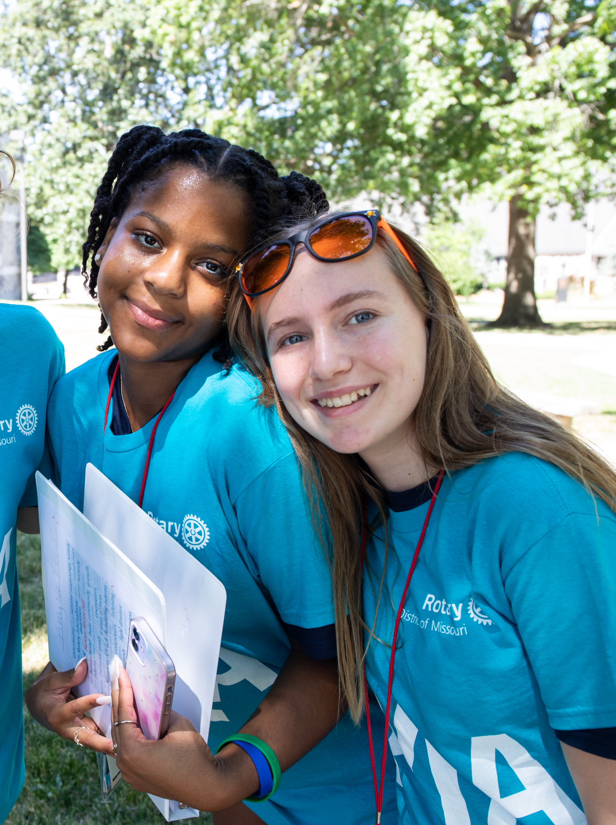
Efforts to improve our public image and raise awareness of Rotary:
Paying for social media or other ads that use materials or templates from the Brand Center on My Rotary; work with your district public image chair to create these
The purchase of Rotary-branded materials (a tablecloth, retractable banner, flyer display rack, etc.) to use at public events

Slide 56
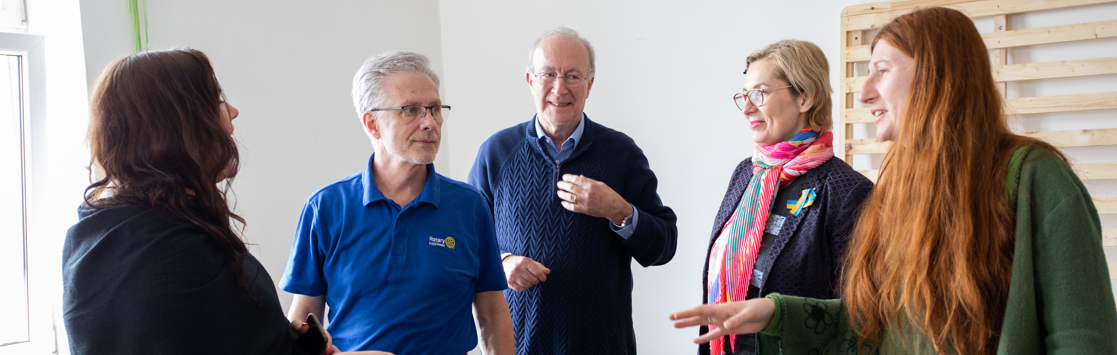
PAYMENT
Submit your expenses including receipts within 60 days and by 15 May 2024 to DMC Jayne Lowe.
Questions? Ask DMC Jayne Lowe at jaynerotary@gmail.com.

Slide 57
Haris PowerPoint

Slide 58

Resources for Building Rotary’s Public Image and Strengthening the Rotary Brand
Mid-America PETS 2023

Slide 59
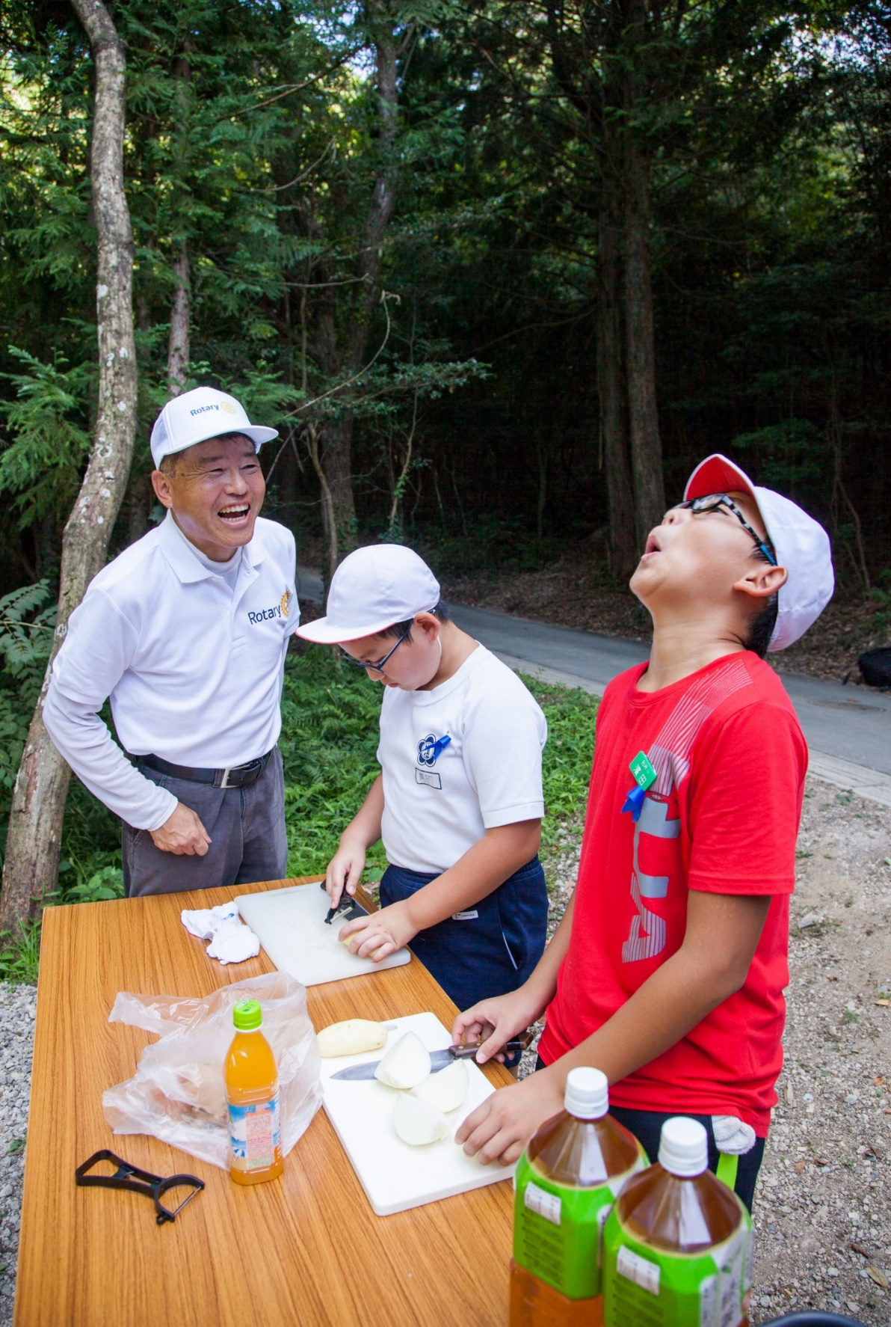
59
THE BENEFITS OF STRONG PUBLIC IMAGE
Motivates to support the efforts
Inspires to get involved
Engages new members, volunteers, partners
Attracts new donors
Distinguishes from other opportunities
Notes:
Strong Rotary’s public image motivates public to support our efforts and projects; inspires to get involved; engages new members, volunteers, and partners; attracts new donors; and positively distinguishes Rotary from other servicing opportunities.
In my position, I always receive a lot of inquiries and questions “Why does my Rotary club or district logo need to look this particular way? Why do I need to follow those guidelines? Why can’t I just go with my own club logo (or my old logo) – let’s say, with a wheel and a rising sun; in my own colors with my own symbols?”.
Well, before answering those popular questions, let’s do this little exercise: please use the list of strong public image benefits on the screen and make up questions out of them in regards of your own clubs.
Do I want to motivate people around me to support my club’s efforts?
Do I want to inspire others in my community to get involved in what we do?
Do I want to engage new members, volunteers, and partners?
Do I want to attract new donors?
Do I want to distinguish my Rotary club in the community from many other humanitarian or service organizations on the market? (In other words, do I want people get involved in my Rotary club, or work with my competitors?)
Think about those questions! And most important – think about your answers!
If you answered “yes” to at least one of those questions, that is exactly the reason WHY your club logo should be consistent with all the Rotary’s logos in the world. To create consistent recognition, and strong trusting reputation. After all, it’s the face of “Rotary”. Using creative variations of Rotary logo is like wearing various wigs, fake mustaches, theatrical make-up and expect others to recognize you.

Slide 60

Public image (noun): the perception or opinion others have of you
Rotary’s public image isn’t just what we think of ourselves –
It’s what people outside of Rotary think of us

Slide 61

Public Image – what is ours?
  While many people have heard of Rotary, the many also don’t understand who we are or what we do.
Notes:
And how do others see us? We regularly conduct research around the world with the general public, to assess what they know and think about Rotary. And while the responses vary from market to market, on thing remains the same – whiles some of the descriptions are accurate, there are a lot of misperceptions about our brand. In fact, many people respond “don’t know” when asked What comes to mind when you hear the name Rotary or Rotary Club?

Slide 62







Brand awareness varies
Have you heard of an organization called Rotary?
Taiwan India Brazil Kenya USA Germany Japan
Notes:
When we ask the public if they have heard of an organization called Rotary, you can see that it varies greatly around the world – from 91% brand awareness in Taiwan to 31% brand awareness in Japan. And everything in between.

Slide 63
Public Awareness of Local Rotary Clubs
Notes:
However, high brand awareness doesn’t always correlate to high brand understanding. For example, while 91% of people in Taiwan have heard of Rotary, only 34% are aware of a Rotary club in their community. In fact, a third of the global respondents were unfamiliar with ANY Rotary program, including our signature End Polio Now program.
On average 60% of the respondents were unfamiliar with a local Rotary club or project, and we call this out because our clubs are where people experience Rotary first hand and they provide the greatest opportunity for public engagement. While this measure is disappointing, it provides valuable insight into where RI can focus support in helping clubs promote themselves and their good work.

Slide 64


People of Action
Notes:
Is this more helpful to describe Rotary’s Brand?
How does the external public recognize what organization is this? What are the marks, symbols? What are the stories there? Is there an emotion that can touch someone’s heart, someone who is not connected with Rotary … yet?
(Read chat pane)

Slide 65
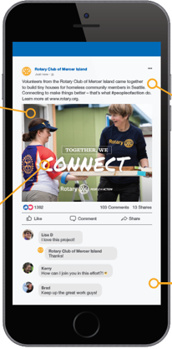

Raising Rotary’s public image
relies on clubs and members
sharing their stories of impact
Objective
Increase public awareness of Rotary – our impact and brand
Notes:
So, of course one of our main objectives at RI is to increase awareness and understanding of Rotary around the world. But how do we do that?
How do we help the public see Rotary as we do?
By highlighting the impact clubs and members are making in their local communities and presenting Rotary in a consistent and compelling way to those who don’t know us. And while we have a small but mighty marketing team at RI, the real power is in our membership. Who understands the benefits of Rotary better than our members – who can speak from experience? That is why our strategy relies on leveraging our >40,000 clubs and 1.4 million members to share their stories with the public.

Slide 66

A key pillar of our Action Plan
Eradicate polio and leverage
the legacy
Focus our programs and offerings
Improve our ability to achieve
and measure impact
Eradicate polio and leverage the legacy
Focus our programs and offerings
Improve our ability to achieve and measure impact
Build awareness of our impact
and brand
Grow and diversify membership and participation
Create new channels into Rotary
Increase our openness
and appeal
Grow and diversify our membership and participation
Create new channels into Rotary
Increase Rotary’s openness
and appeal
Build awareness of our impact
and brand
Increase
Impact
Expand
Reach
Increase
Impact
Expand
Reach
A
Stronger Brand
Build a culture of research, innovation and willingness
to take risks
Streamline governance,
structure and processes
Foster more diverse perspectives
in decision-making
Support clubs to better engage
members
Deliver value through participant-centered approach
Offer new opportunities for personal and professional connection
Provide leadership development
and skills training
Support clubs to better engage
their members
Develop a participant-centered approach to deliver value
Offer new opportunities for personal and professional connection
Provide leadership development
and skills training
Increase
Our Ability
to Adapt
Increase
Our Ability
to Adapt
Enhance Participant Engagement
Enhance Participant Engagement
Notes:
Expanding our Reach is one of the key pillars or our Action Plan which aims to strengthen and grow Rotary. To that end
we need to continue to narrow that gap between awareness and understanding among the general public and those who we want to engage with us AND
drive internal awareness and understanding of the priorities, because they all work together to make us a stronger and more attractive organization for current and future members and participants

Slide 67

subhead
Four key guiding principles
Notes:
Now that you see why it’s important to use Rotary’s logos properly, let’s talk about how Rotary’s logo should be used.

Slide 68


1.
Always use a club or district identifier when using the Rotary logo. They must be aligned with the Rotary logo.
Notes:
Rule #1: Always use a club or district identifier when using the Rotary logo.
A club can use the name they are known by locally, adding their club name above or above and below the Masterbrand Signature, like you see here. The layout you choose depends on how you say your club’s name. Create your club logo in our logo creator in the Brand Center.

Slide 69



2.
Never obscure the Rotary wheel,
use a partial wheel, manipulate the wheel,
or use the wheel as
an object.
Notes:
Rule #2: Never obscure the Rotary wheel, use a partial wheel, or manipulate the wheel in any way. The Mark of Excellence should only be used with the Masterbrand Signature. Don’t manipulate Rotary’s logo by making it into a pancake, place it on top of an apple, as a bike wheel, or the number zero.

Slide 70



3.
Do not use images
or graphics within
the Rotary logo.
Notes:
Rule #3: Do not use images or graphics within the Rotary logo. Nike wouldn’t add a tree behind their swoosh, nor should we add anything extra to the Rotary club logo.

Slide 71




4.
Retire the previous version of the Rotary logo and all uniquely made club logos.
Notes:
And finally, rule #4: Replace your heritage logos with our new refreshed logos. We must tell a consistent story of who we are as members of Rotary, and what we do. That’s our brand. Using the updated brand standards ensure we do that.

Slide 72











INCORRECT USAGE
Notes:
The use of various colors, fonts, and sizes, along with the alteration of the Mark of Excellence is a problem. There is no cohesion or unity. Perhaps all of these programs are part of a larger network, but it’s really hard to tell. And that can cause a potential member, donor or partner to doubt if we are an organization they can trust –- to join, to donate money to, or partner with.
We need our rules when it comes to our logos so we can share a consistent story and message.

Slide 73






CORRECT USAGE

Slide 74






CORRECT USAGE (lockups)

Slide 75
Protect Rotary’s name and intellectual property​
Credit and recognize members, clubs, districts, and programs for the good work they do ​
Tell Rotary’s story in a consistent way
WHY It’s important
to use the Rotary marks correctly
Notes:
Here’s why it matters for Rotary. But it’s not just Rotary, correct branding is important to every global brand. Think about your own business. Does it matter that your customers can easily identify you or distinguish you from others? Rotary is no different.
Like Coca-Cola, McDonald’s, and UNICEF, we must protect our name and intellectual property. It’s how we can grow our organization, increase our impact, and maintain our reputation as an organization that can be trusted. Misuse of our logo only weakens our brand.
Second, when a local club uses the Masterbrand Signature with their club name, they get credit for their good work in the community while leveraging the power of the Rotary’s global brand.
And finally, our logo helps us tell Rotary’s story in a consistent and compelling way. It’s our visual identity, No matter where you are in the world, if you see a Rotary club logo, you know that club is part of an international network of people of action.

Slide 76

subhead
RESOURCES
BRAND CENTER
rotary.org/brandcenter
LEARNING CENTER
Rotary.org/learn
PUBLIC IMAGE EXPERTS
  RPIC
  ARPICs
  DPICs
  CPICs
  www.rizones30-31.org
Notes:
You #1 PI resource is Rotary’s Brand Center. It has everything you need for your PI needs.
Visit the new Our Brand section in the Brand Center to find the most up-to-date guidelines, now in a convenient web-based format. This brand guidance section replaces PDFs like our Voice and Visual Identity Guidelines, so you can get comprehensive information in one place and navigate through the topics more easily. You can also find answers to frequently asked questions through Brand Center’s Help tab in the top toolbar.
Learning Center: Plenty of great public image courses available (Our Logo, “People of Action” campaign). I invite you to explore the Learning Center for other courses as well.
And of course I am happy to recommend great Public Image experts in your district: RPICs Nijad Al Atassi, their assistants, and District Public Chairs.

Slide 77
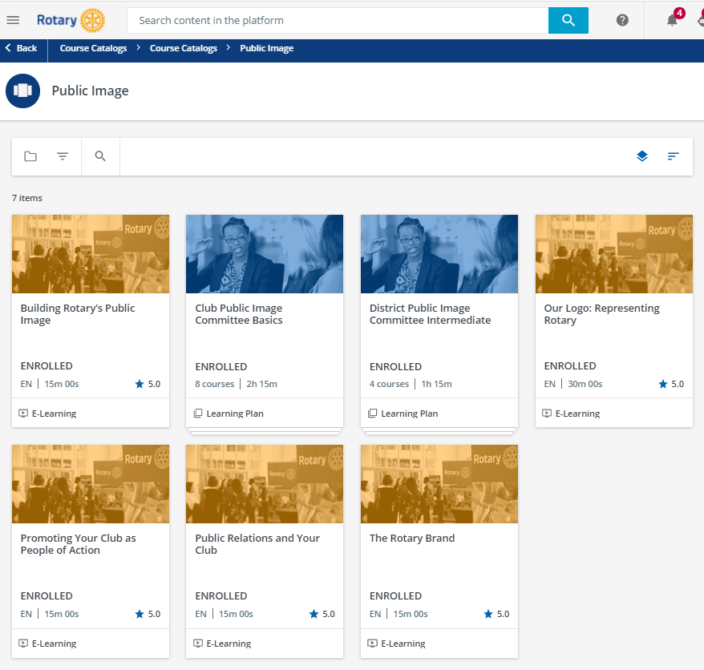
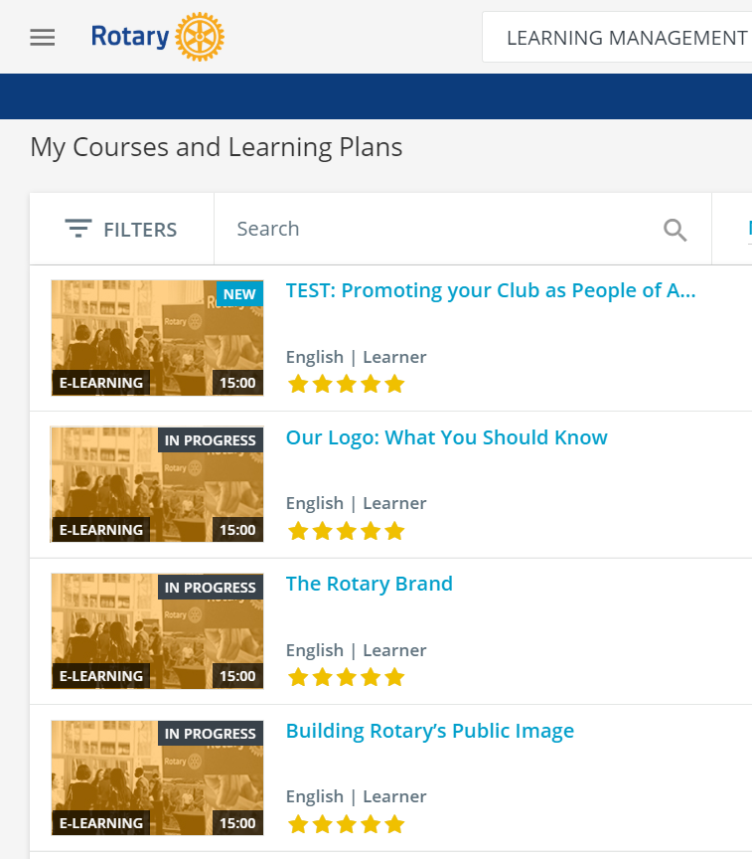
Courses & Learning Plans
Training modules and learning plans provide knowledge framework
Notes:
Five self-paced courses in the Learning Center
The Rotary Brand
Building Rotary’s Public image
Our Logo: Representing Rotary
Promoting Your club as People of Action
Public Relations and Your Club.
Two learning plans:
Club Public Image Committee Basics
District Public Image Committee Intermediate
New courses
Using social media
Photo and video tips and best practices

Slide 78
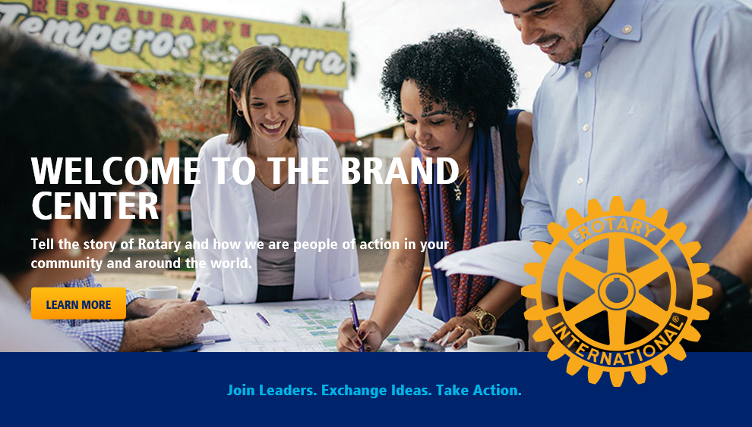
Updates to the Brand Center
Our Brand
Templates
New photos
New videos
rotary.org/brandcenter
Notes:
Ads: print, outdoor, digital, radio
Videos: 90, 30, 15, 10sec
Templates: print, digital, social
Roll-up banners
Photo library
Guides
Examples

Slide 79
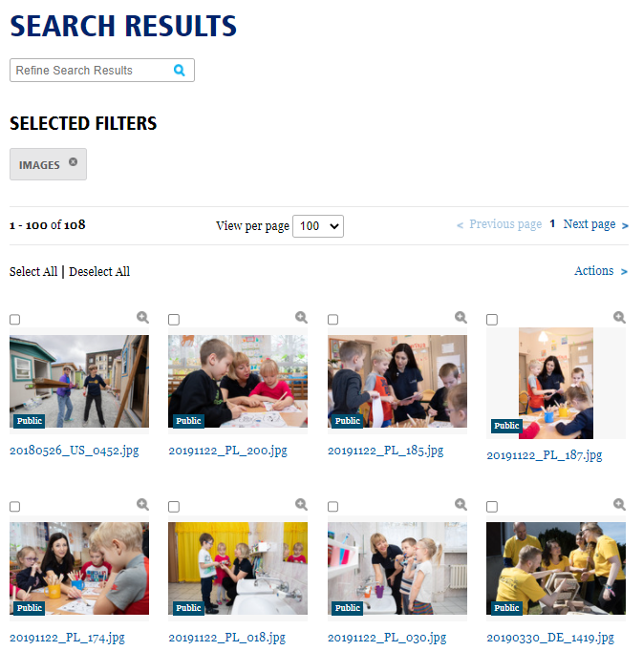
Brand Center resources
>100s fully released images and videos
10sec and 15 sec formatted for use in social media
Notes:
Videos: 90, 30, 15, 10sec – formatted for use in social media channels
Photo library – more than 100 fully released images
Use these photos or take inspiration from them to take your own.
Tips for taking photos. What’s your photo plan? Your shot list for your event?

Slide 80
People of Action resources on the Brand Center
Ads: print, outdoor, digital, radio
Videos: 90, 30, 15, 10sec
Templates: print, digital, social
Roll-up banners
Photo library
Guidance
rotary.org/brandcenter
Notes:
Ads: print, outdoor, digital, radio
Videos: 90, 30, 15, 10sec
Templates: print, digital, social
Roll-up banners
Photo library
Guides
Examples

Slide 81
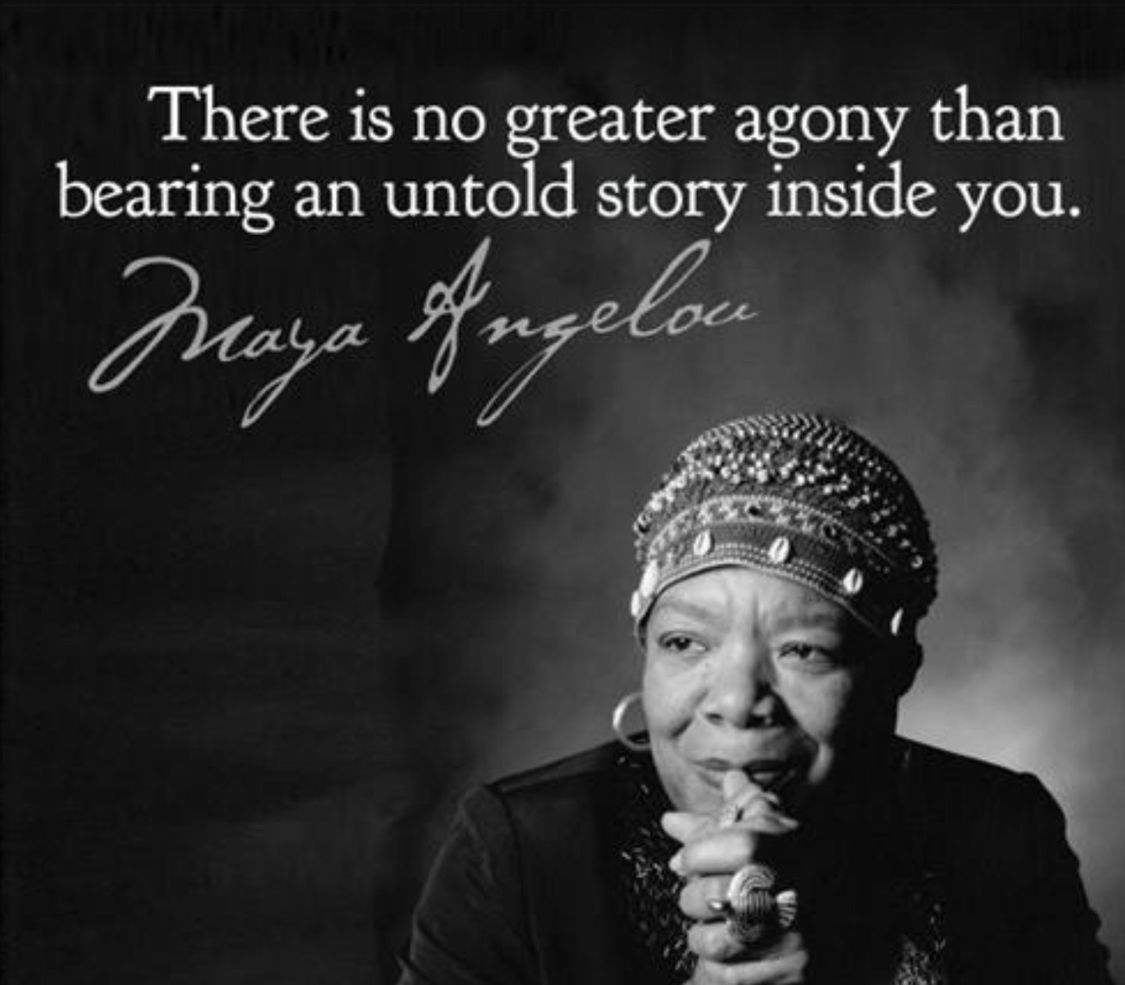

Slide 82


Slide 83
Mid-America PETS
March 23-25, 2023

