Slide 1

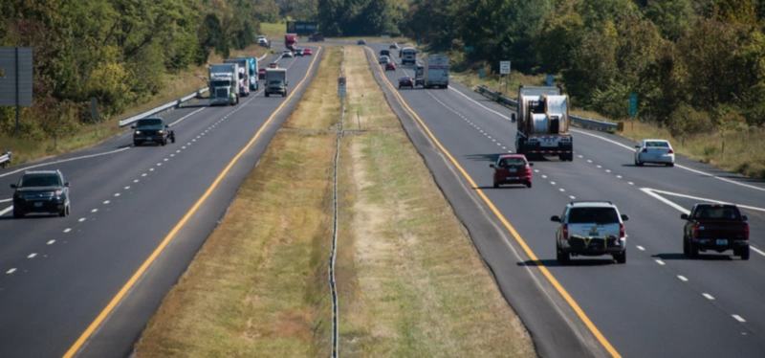
MoDOT ST. LOUIS TRANSPORTATION UPDATE
Tom Evers, P.E., Assistant District Engineer

Slide 2
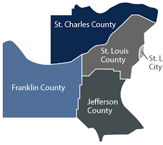






ST. LOUIS DISTRICT
Roadways
1,677 centerline | 5,736 lane miles and 26% of all vehicle miles traveled
Bridges
1,111 non-major bridges
55 major bridges ( > 1,000 feet )
Traffic Intersections
1070 locations
Highway Tunnel
1420 feet, first in Missouri
2.5Million
Lambert Int. Airport
15 Million passengers annual
Notes:
Only 4 counties & STL City = over 1/3 Missouri’s population
Only about 1,600 centerline miles of roadways … but the biggest & most traveled evidenced by nearly 6,000 lane miles (3x).
Bridges – only 1,100 of MoDOT’s 10K bridges (10%), including 58 Major (28% statewide), …. 21,536,047 sqft of MoDOT’ 87,661,177 sqft (25%).
Mobility Assets - SL has nearly ½ of traffic signal and more than have of the permanent roadside Dynamic Message Signs & many other mobility assets.
Finally … STL is home to Arch, Cardinals, Blues and too many great things to mention ☺

Slide 3
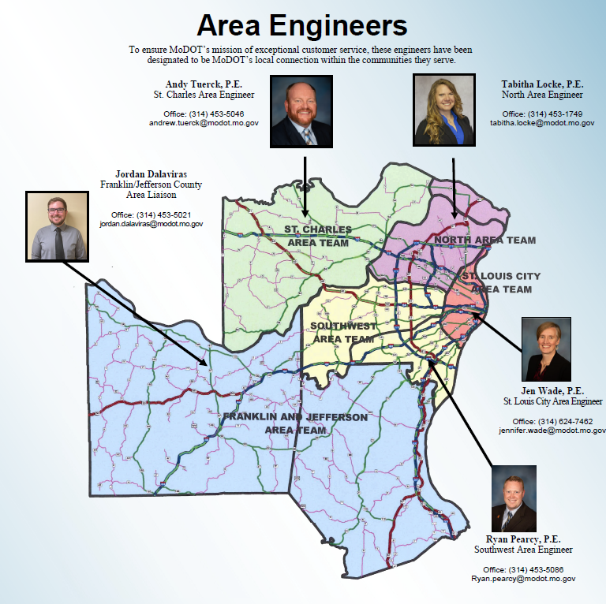

ST. LOUIS AREA ENGINEERS

Slide 4
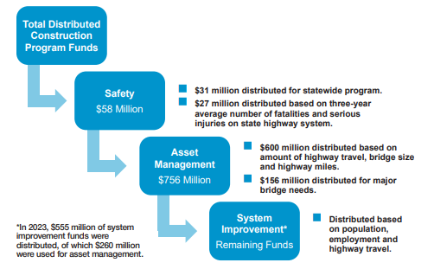
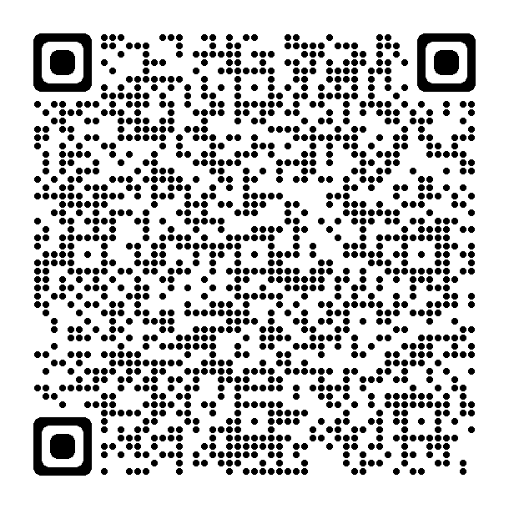
MODOT DISTRIBUTION OF FUNDS
Citizen’s Guide to Transportation Funding

Slide 5
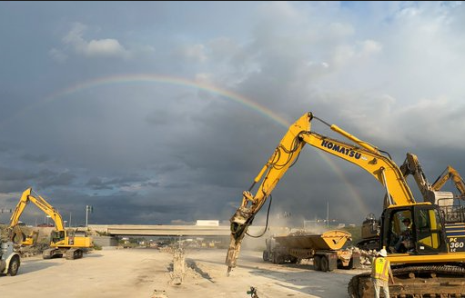
ST. LOUIS AREA PROJECTS
  Construction:
  90 Active Construction Projects ($774 million)
  Ongoing Major Projects:
  I-55 St. Louis City - Bridges
  I-270 at I-64 – Major Bridge Work
  I-55 Jefferson County – Expansion and Interchange Improvements
  I-70 St. Charles County – Bridges and Outer Roads
  Districtwide Safety Projects

Slide 6
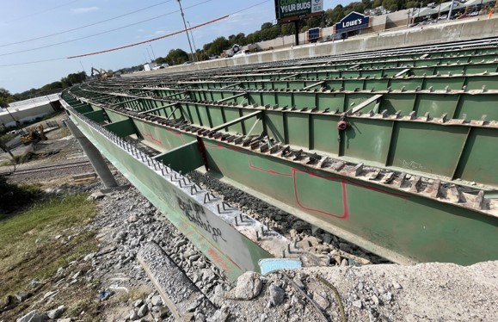
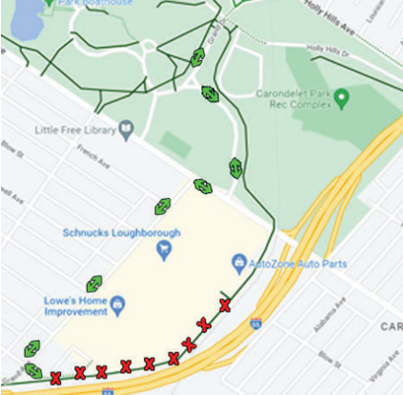
I-55 Bridge Rehab St. Louis City & County
I-55 Bridges – 14 structures between Lindbergh and Arsenal
Project began in Spring 2022
$50 million Several stages of traffic

Slide 7
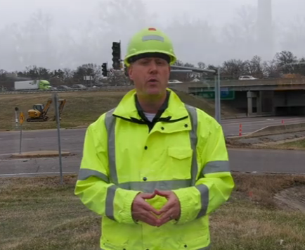
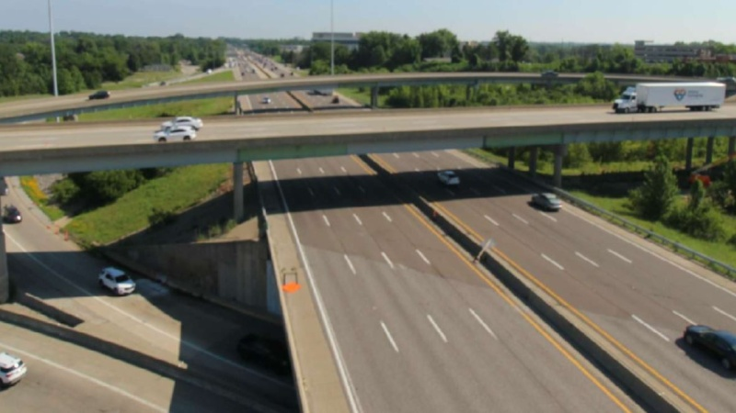
St. LOUIS COUNTY
I-270 Bridge Replacement at Conway Rd.
Awarded to Kozeny-Wagner for $38.5 million
Two year construction project (24-25)

Slide 8

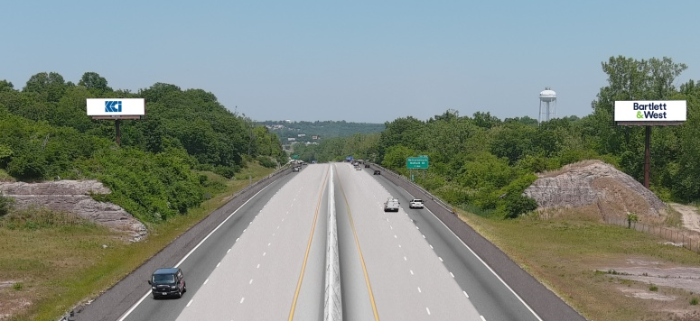
Jefferson County
I-55 Jefferson County from Rte Z to US 67 interchange
$246 million
Awarded to KCI in July
Begins work in early 2024
Public Meeting on Nov. 16

Slide 9
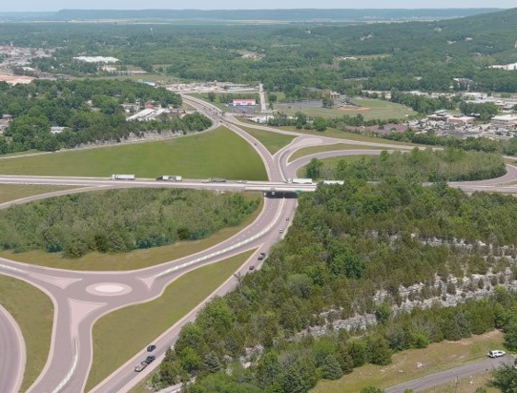
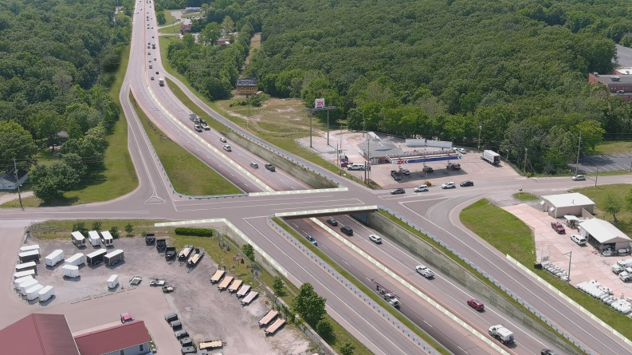
Jefferson County
I-55 at US 67 New Interchange Configuration
Rte. 67 at CC Interchange

Slide 10
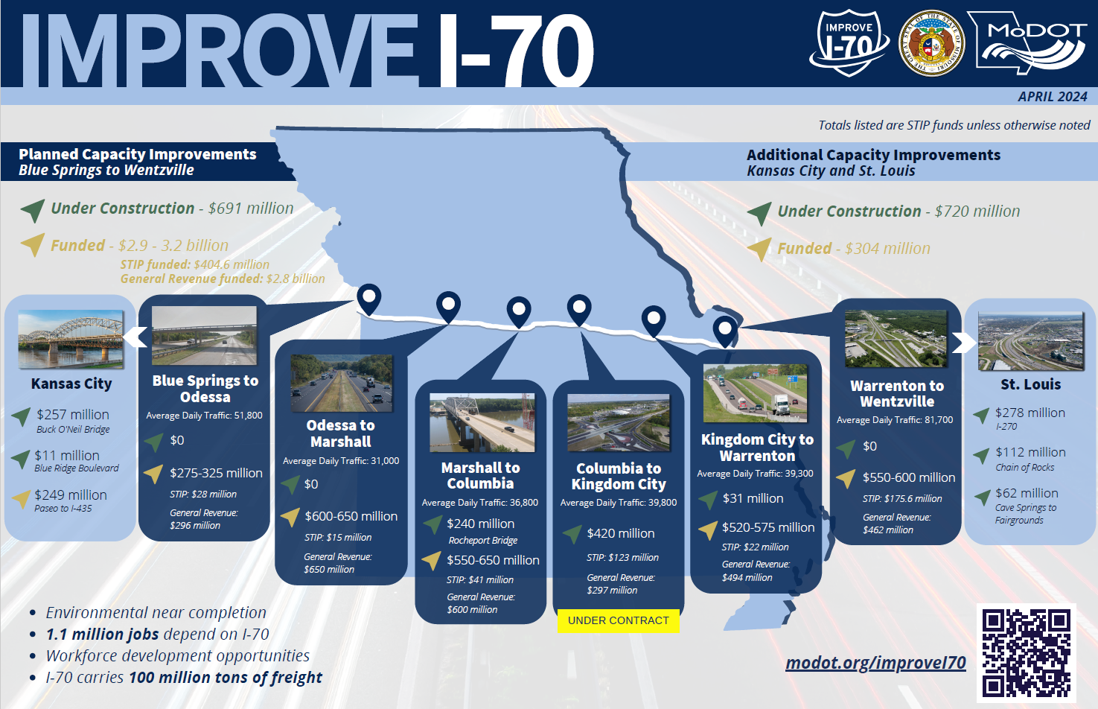

Slide 11
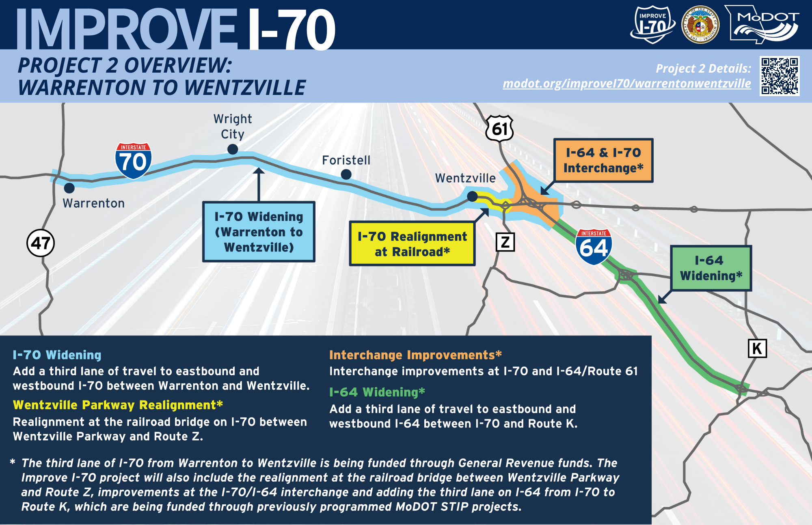

Slide 12
Program Schedule
Improve I-70 - Updated Schedule (DRAFT)
Project | Limits | Miles | GR Funds | STIP | Total | Procurement Method | Issue RFP/ATC Process | Project Award | Completion | Duration
1 | Columbia to Kingdom City | 20 | $297m | $123m | $420M | DB | Oct 2023 | Feb 2024 | Dec 2027 | 46 Months
2 | Warrenton to Wentzville | 19 | $462m | $176m | $550m to $600m | DB | July 2024 | Nov 2024 | Dec 2028 | 49 Months
3 | Blue Springs to Odessa | 18 | $296m | $28m | $275m to $325m | DB | Dec 2024 | Apr 2025 | May 2027 | 25 Months
4A | Rocheport to Columbia | 13 | $450m | $41m | $450m to $500m | DB/DBB | May 2025 | Oct 2025 | Oct 2029 | 48 Months
4B | Boonville to Rocheport | 10 | $150m | $0 | $100m to $150m | DBB | Nov 2025 Letting | Dec 2025 | Aug 2027 | 20 Months
4C | Kingdom City to Warrenton | 47 | $494m | $22m | $520m to $575m | DB/DBB | Jan 2027 | Apr 2027 | July 2030 | 39 Months
4D | Odessa to Boonville | 63 | $650m | $15m | $600m to $650m | DB/DBB | June 2027 | Nov 2027 | Dec 2030 | 42 Months
4E | High Hill Realignment | 3 | $70m | $5m | $70m to $75m | DBB | Nov 2026 Letting | Dec 2026 | Spring 2028 | 14 Months
 | Total | 193 | $2.8 Billion | $357m | $3.2 Billion | - | - | - | December 2030 | 7 Years

Slide 13
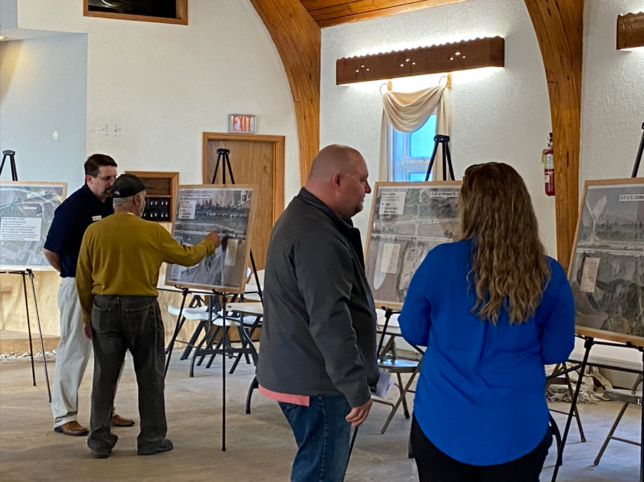
Projects in Design:
  New 5 Year Budget (STIP) Approved in July (2025-2029)
  Asset Management - 193 Projects, $520 million
  System Improvements- 60 Projects, $600 million
  Overall Program: Over 200 Projects, $1.6 billion!
  Upcoming Notable Projects –
    I-64 Daniel Boone Bridge rehabilitation (WB Bridge) to begin in 2025
    I-270 between 367 and Mississippi River
    I-64 in City of St. Louis
St. Louis Project Delivery

Slide 14

HIGH PRIORITY UNFUNDED NEEDS
I-64 Interchange Improvements, St. Louis City
I-70 Interchange and Operational Improvements, St. Louis County
Rte 30 (Gravois Rd) Safety and Interchange Improvements, St. Louis City
Rte N Capacity Improvements, St. Charles County
US 61 Safety Improvements, St. Charles County
US 67 Safety Improvements, Jefferson County

Slide 15



Slide 16

Buckle Up Phone Down
It is the Law in Missouri

Slide 17
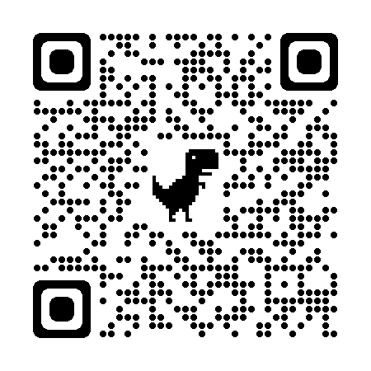

MoDOT St. Louis
1-888-ASK-MoDOT or 314-275-1500
SLCommunications@modot.mo.gov
https://www.x.com/MoDOT_StLouis

