Slide 1
Rotary Club of SaddleBrooke Club Assembly September 12, 2024

Slide 2
Silence is Golden
Please take a moment
to silence your cell phones

Slide 3
Pledge of Allegiance

Slide 4
Welcome Guests and Visiting Rotarians

Slide 5
District 5500 Governor Visit
Next Week’s Meeting
September 19th

Slide 6
Club Assembly Committee Reports

Slide 7
International
Harvey Smith

Slide 8
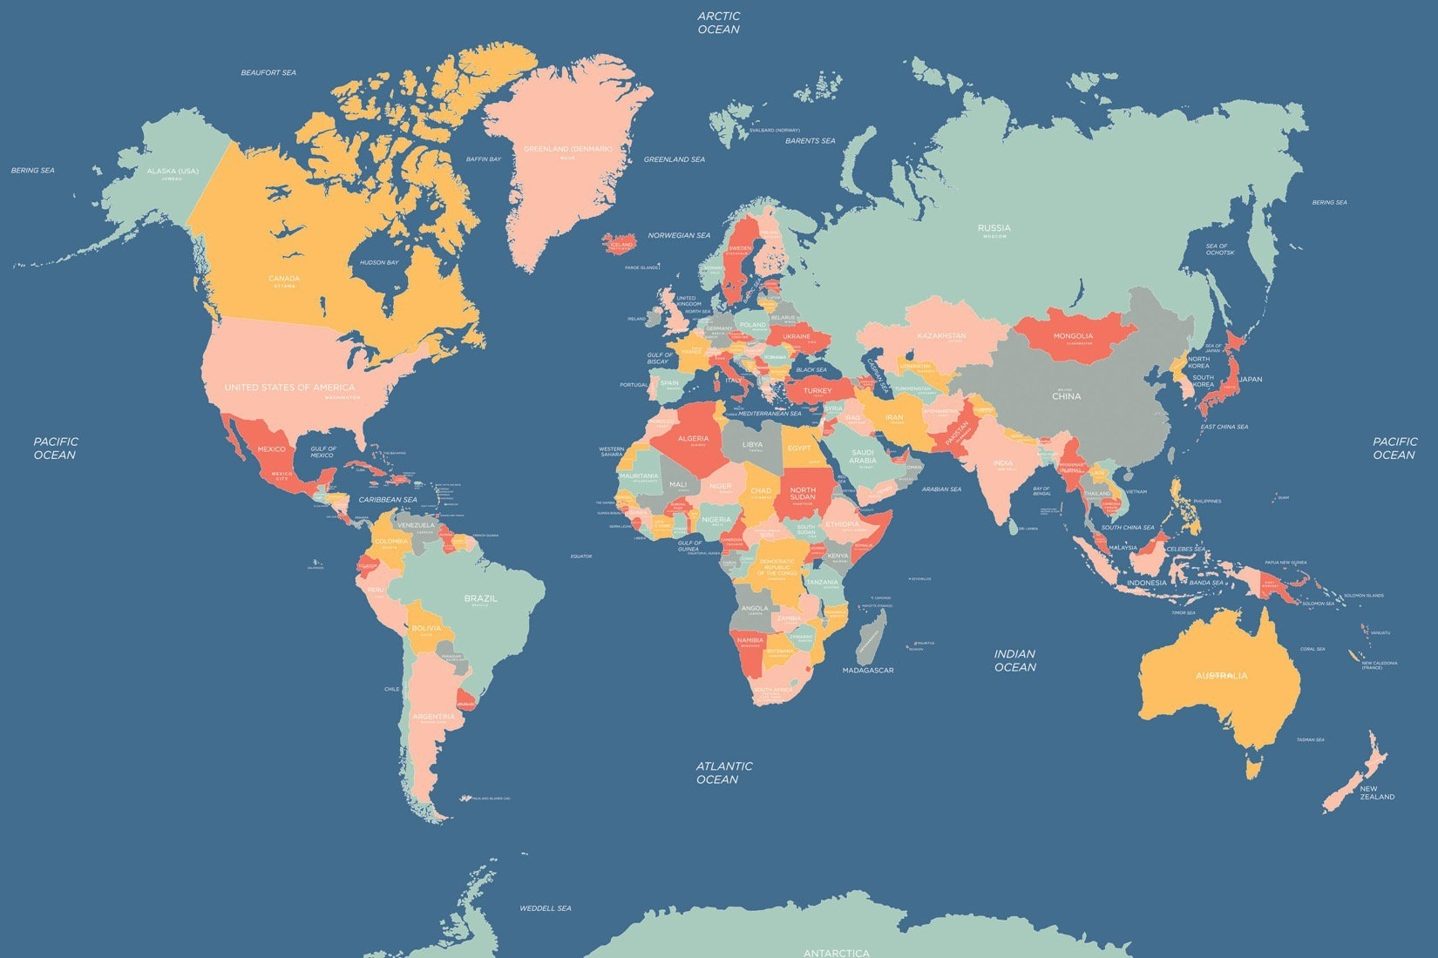
International – Service Projects
Hands-on International project Corazon “Build a house in a Day” in Tecate, MX
Participation in Global Grants
Ninas Sabias, Lake Chapala, Mexico
Wash for Kundiawa College of Nursing, Papua New Guinea (PNG)
Die Eiland Care Facility upgrade, Cape Town, South Africa
Vaatjie Mor primary School upgrade, Cape Town, South Africa; non participating partner.
Opportunity to improve Economic Opportunities for youth and community members living in poverty, especially women in Senegal, West Africa
ShelterBox; renewed as a Silver Hero club to assist in emergency habitation worldwide.
MicroCredit Partner; Joined as a new partner to assist small business owners in Nogales and Hermosillo, MX
CREATE HOPE In the World

Slide 9
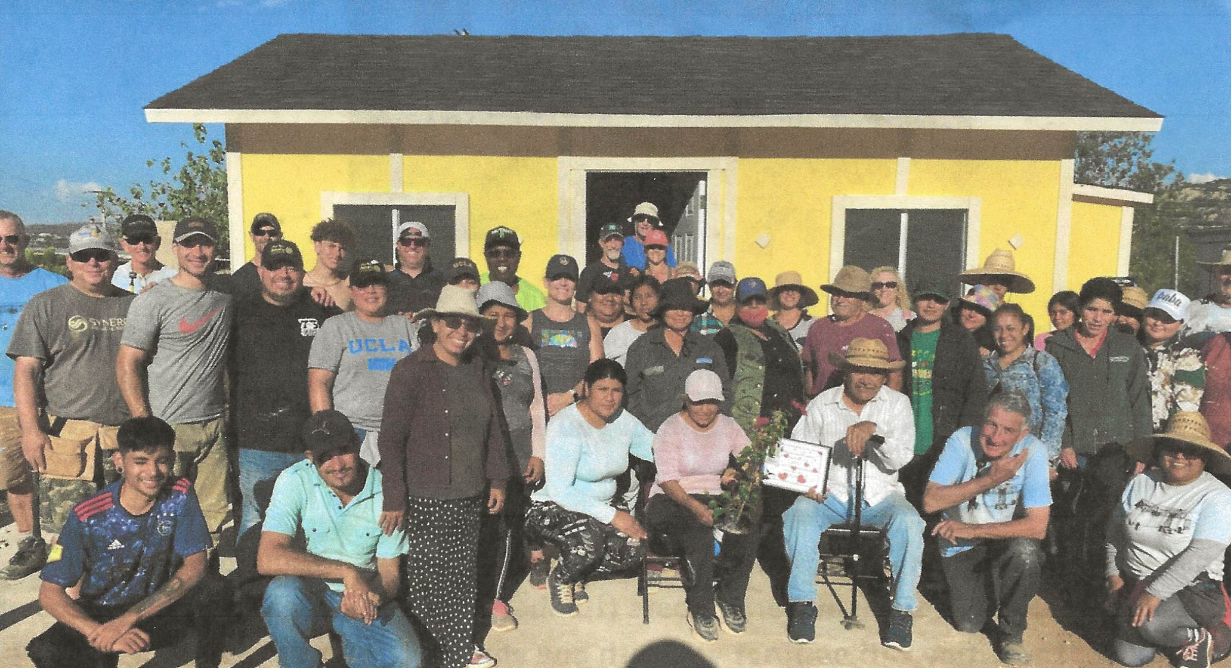
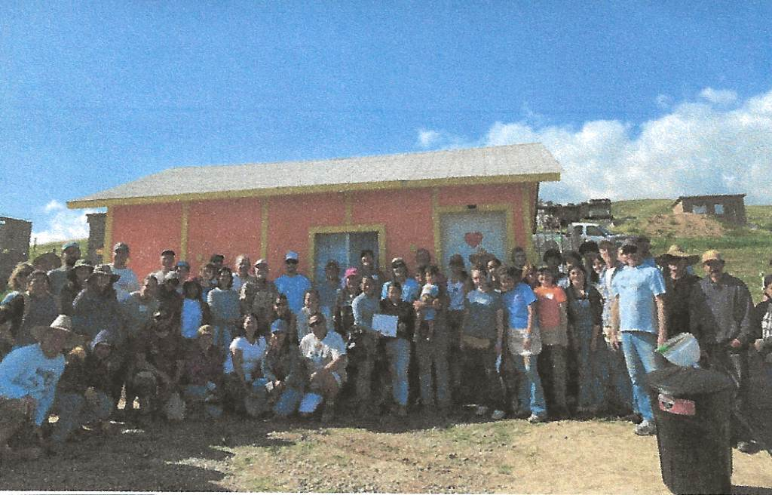
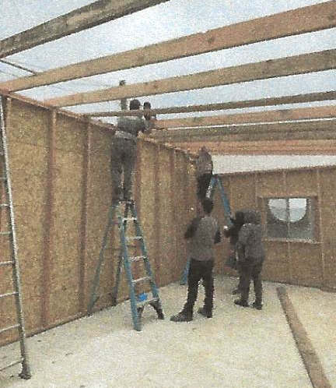
International – Hands-On project
Corazon “Build a House in a Day”
Tecate, MX October 26th, 2024
Funding complete!
6 D5500 clubs participating:
RC of SaddleBrooke
RC of Tucson
RC of Dove Mountain
RC of Sierra Vista
RC of Oro Valley
RC of Marana
Volunteers needed to build, paint and live our motto “Service above Self” !

Slide 10
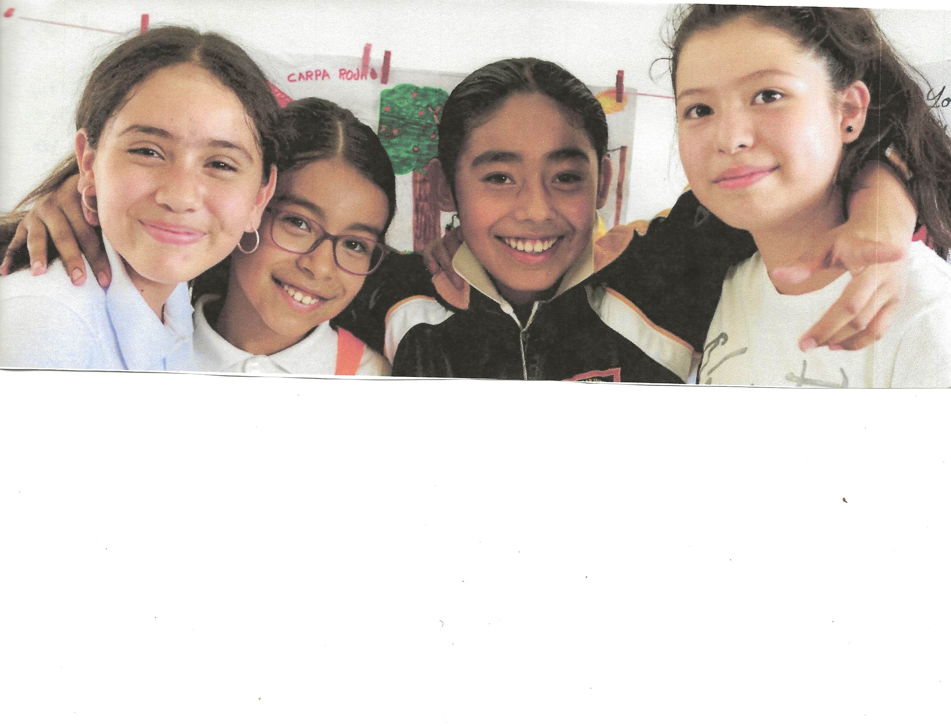
Global project GG# 2458379
Empowering Girls; Menstruation, Health and Education; Workshops to be conducted in small villages around Lake Chapala, Mexico
Area of focus; WASH ( Water, Sanitation and Hygiene)
Local Host; RC of Ajijic, Chapala, MX
International Host; RC of Glenwood Springs, CO
Budget; $30,753.00 fully funded
Our participation; $2500 with request for D5500 DDF
Project; The objective is to provide training workshops and washable, ecological menstrual kits to 600 girls. The workshops to be taught in primary schools in groups of 12 to 20 girls. The program will keep the girls in school and provide an equitable education and opportunities.
Goal; Improve community hygiene knowledge, behaviors and practices that help prevent the spread of disease.
Supporting Organization; Ninas Sabias
Status; Funding complete, final grant approval. Funds sent to RI annual share.
CREATE HOPE
In the
World

Slide 11
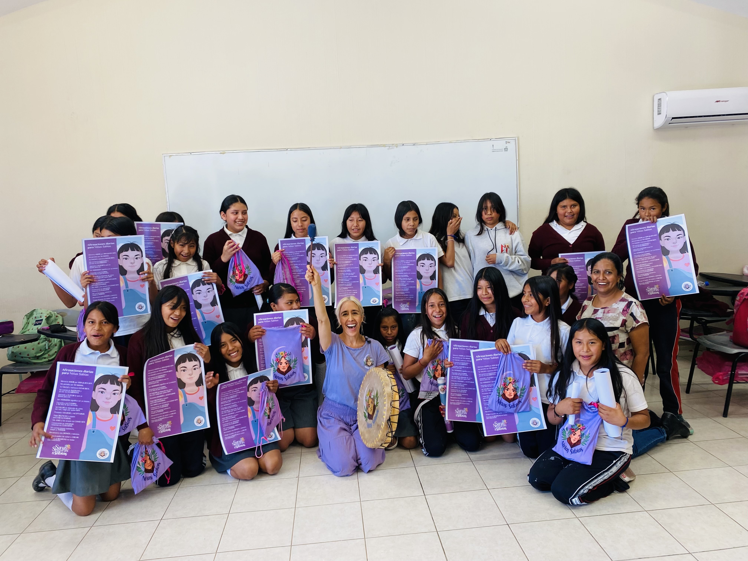
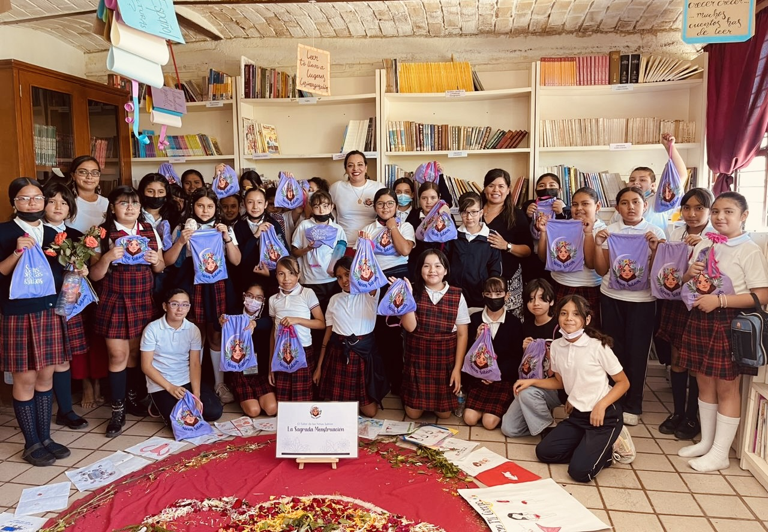
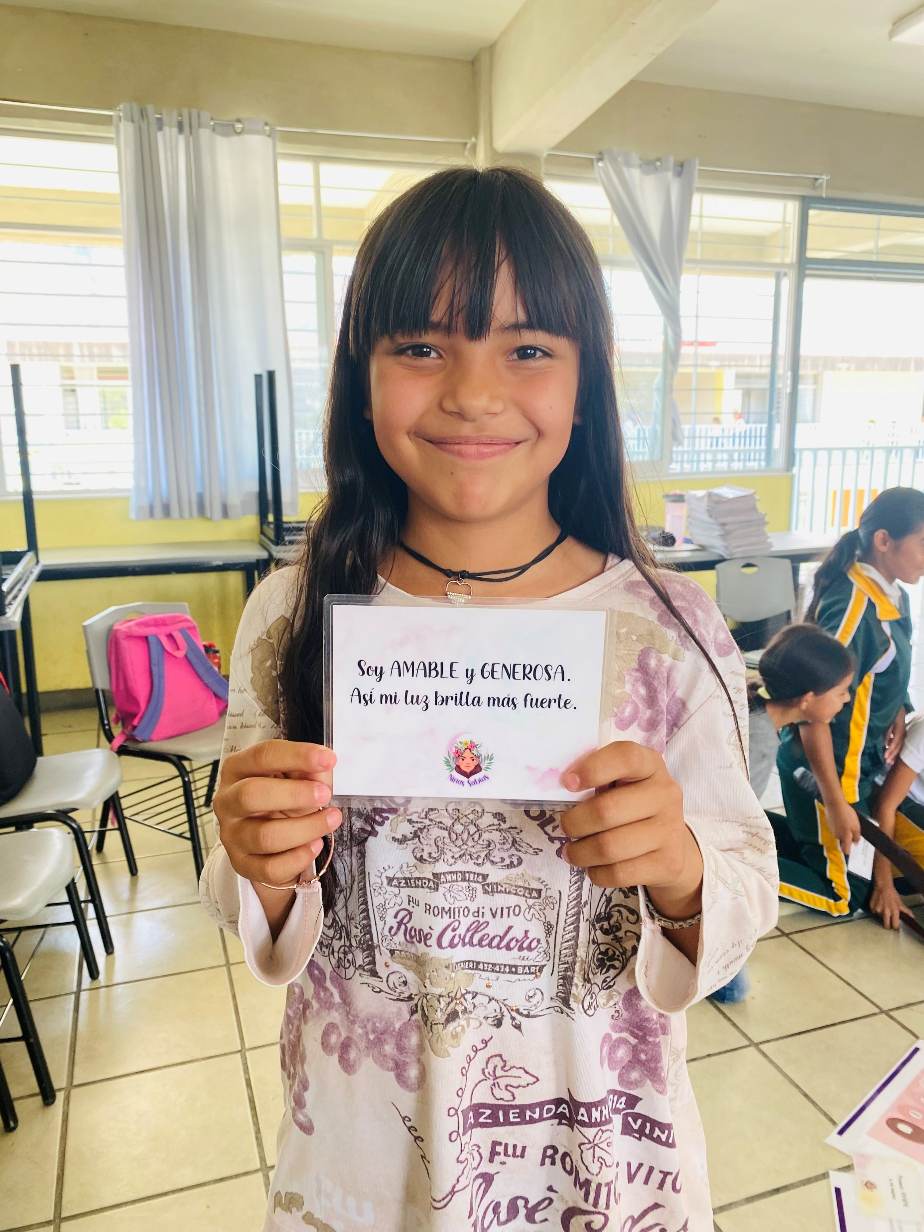
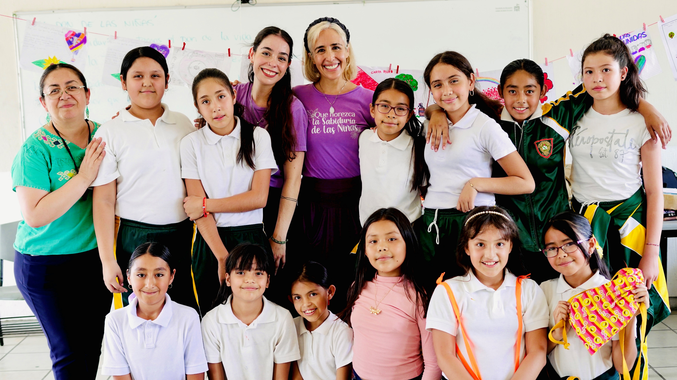
Global project – Ninas Sabias Workshops

Slide 12
Global project – WASH for Kundiawa College of Nursing, Papua New Guinea GG# 2456569
Area of focus; WASH and basic education/child health
Local host; RC of Port Moresby (RID 9620)
International host; RC of Honolulu Sunset (D5000)
Budget; $72,111.00 funded
Our participation; $2000 with match requested from D5500 DDF
Project; Project will provide safe water via an installed water catchment system. WASH training will be given to over 3730 people including 700 nursing students, 30 faculty members of Kundiawa College of Nursing and some 3000 members of the surrounding community.
Goal; Improve nursing school graduation rates and improve access to health care.
Status; funding complete have applied to RI for GG final approval.
CREATE HOPE
In the
World

Slide 13
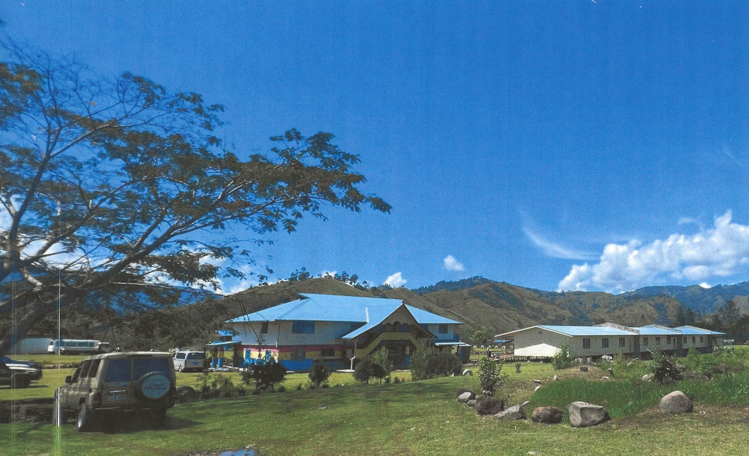
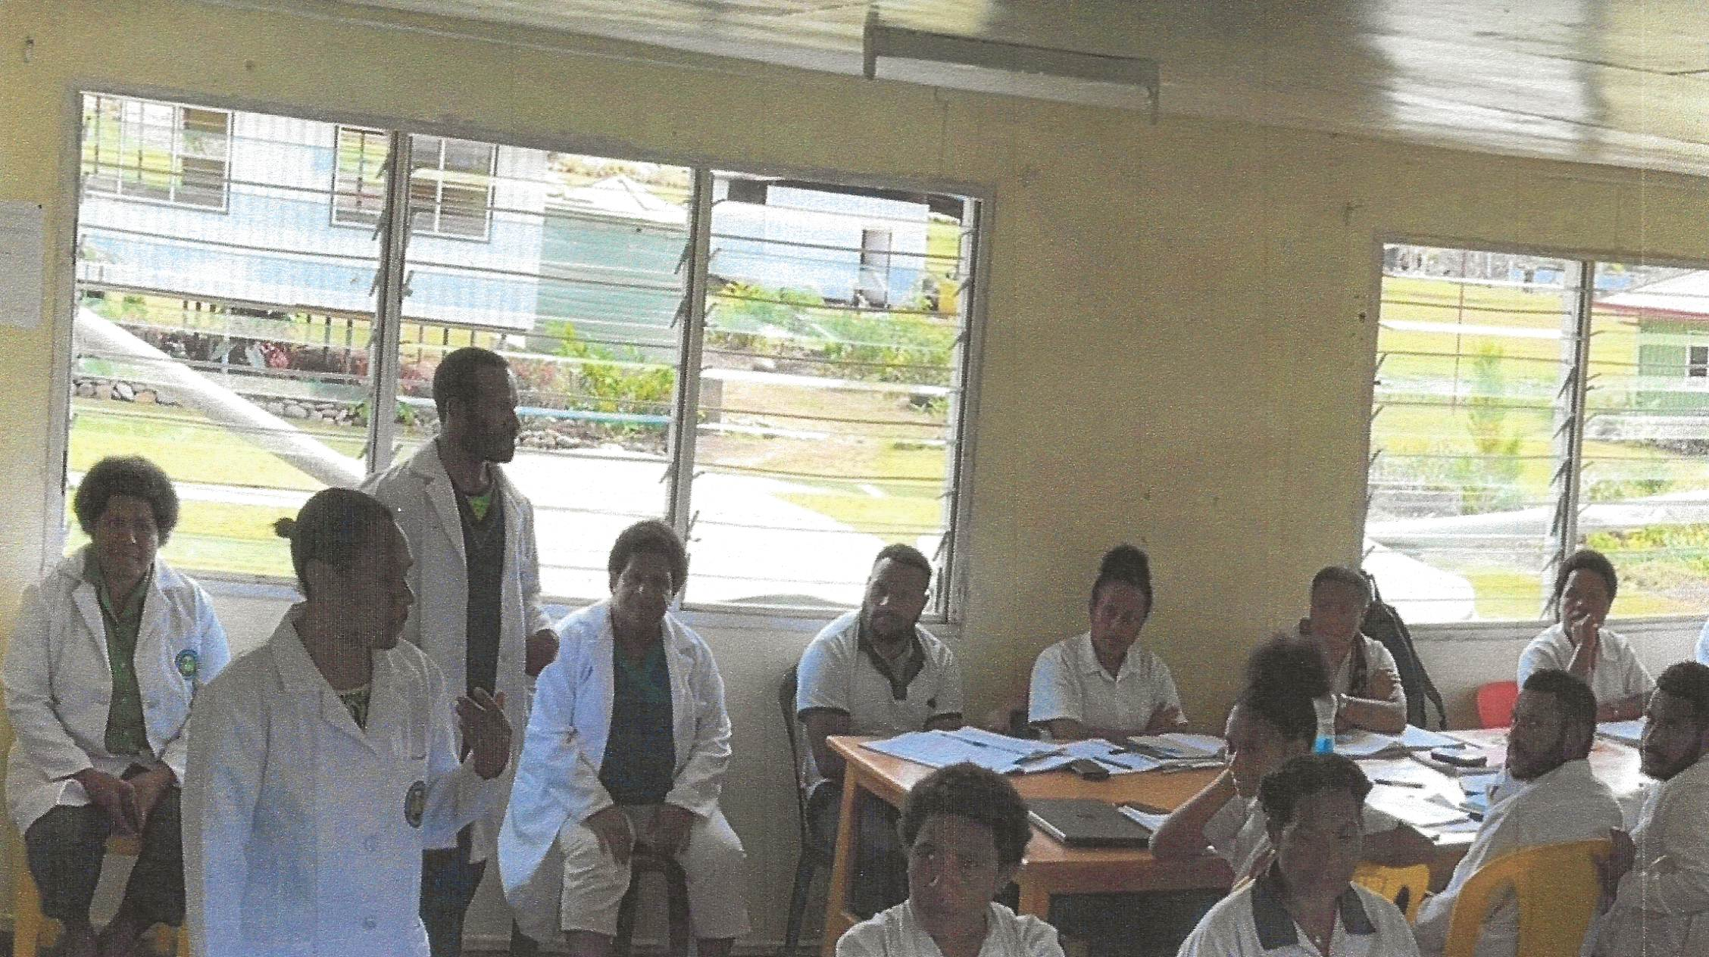
Global project
Kundiawa College of Nursing

Slide 14
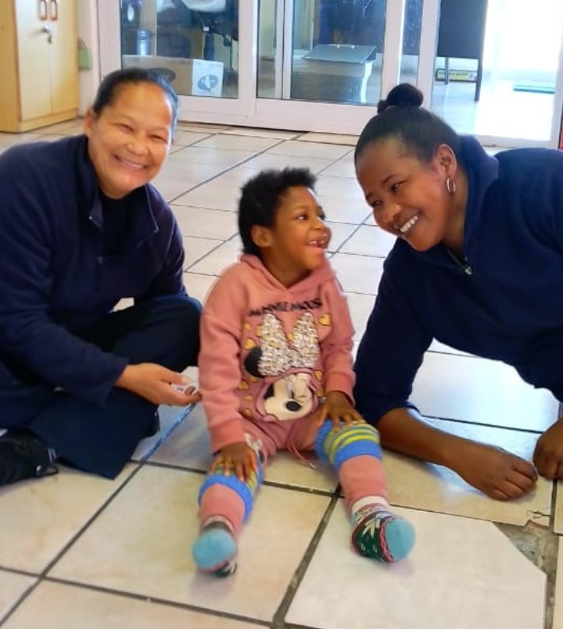
Global project – Die Eiland Care Facility for Persons with Severe Disabilities; St Helena Bay , South Africa GG# 2454020
Area of focus; Disease Prevention and Treatment
Local host; RC of Melkbos (RID 9350)
International host; RC of Port Moody, BC(D5050)
Budget; $47,175.00 funded
Our participation; $1000.00 with a request to D5500 for a match in DDF funds.
Project; This care facility for persons with severe disabilities is in need of upgrades to provide adequate care for 16 residents. The global grant will provide additional basic medical equipment, a backup electrical system (solar) during load sharing power interruptions, improve security at the facility (barrier fencing) and add air conditioning.
Goal; Provide clinical treatment and rehabilitation for physical disabilities.
Status; Draft grant has been submitted to RI for approval.
Create Hope
in the World

Slide 15
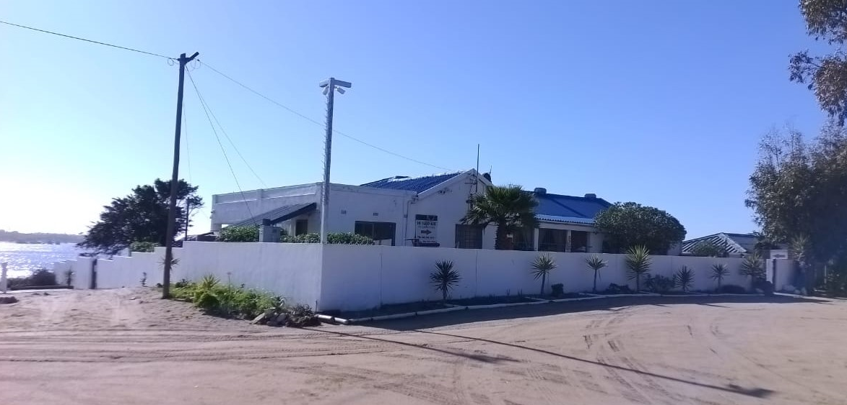
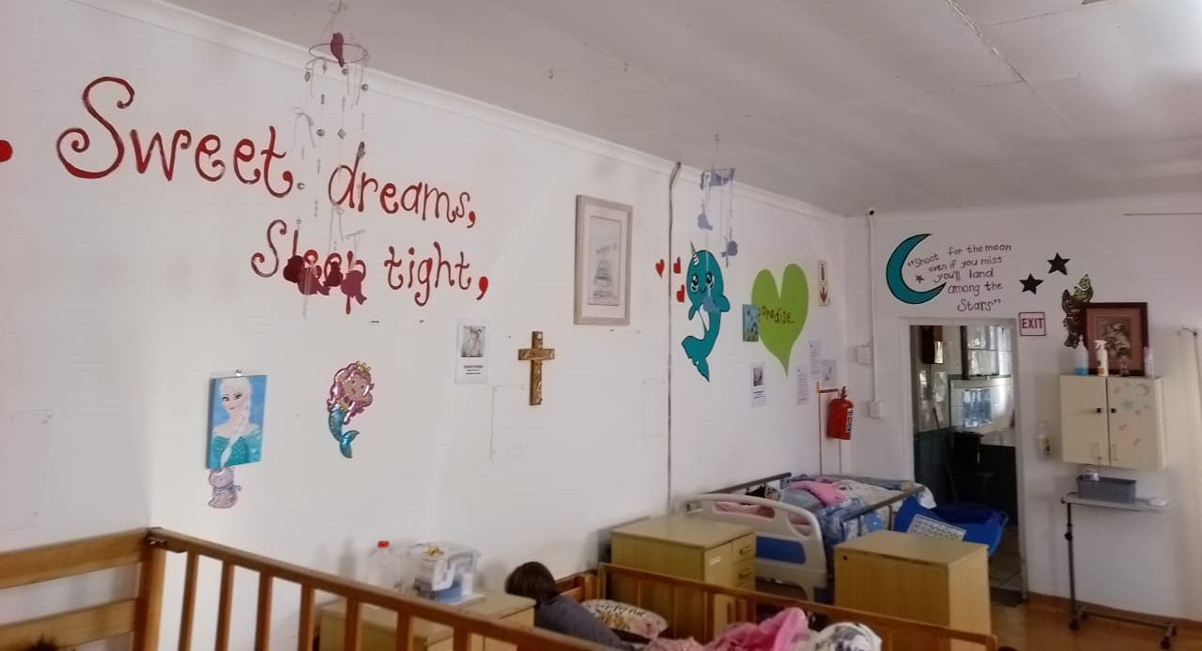
Global project – Die Eiland Care facility

Slide 16
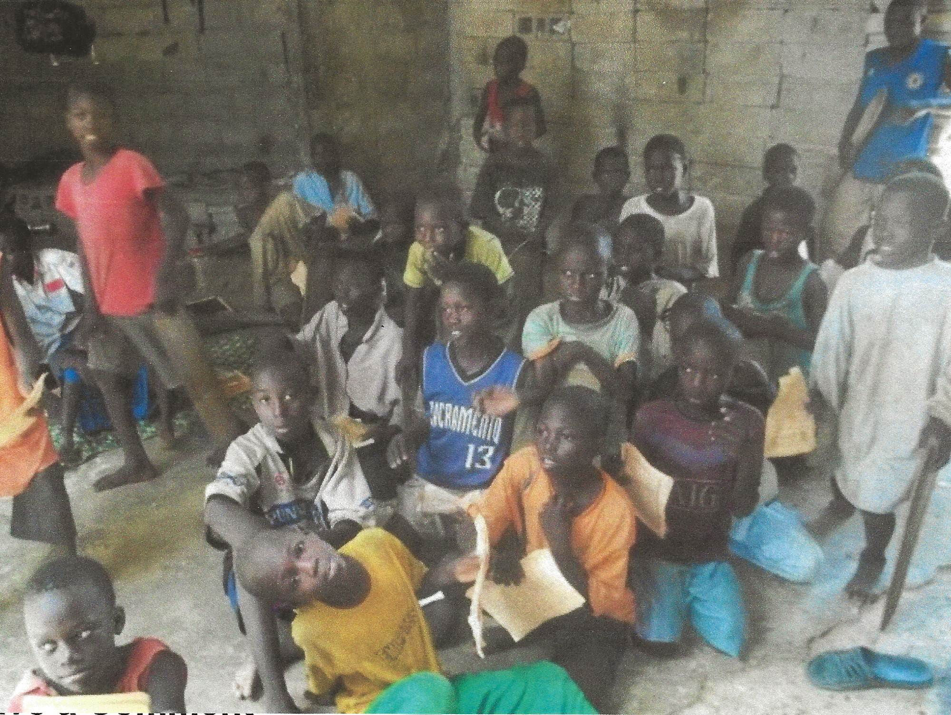
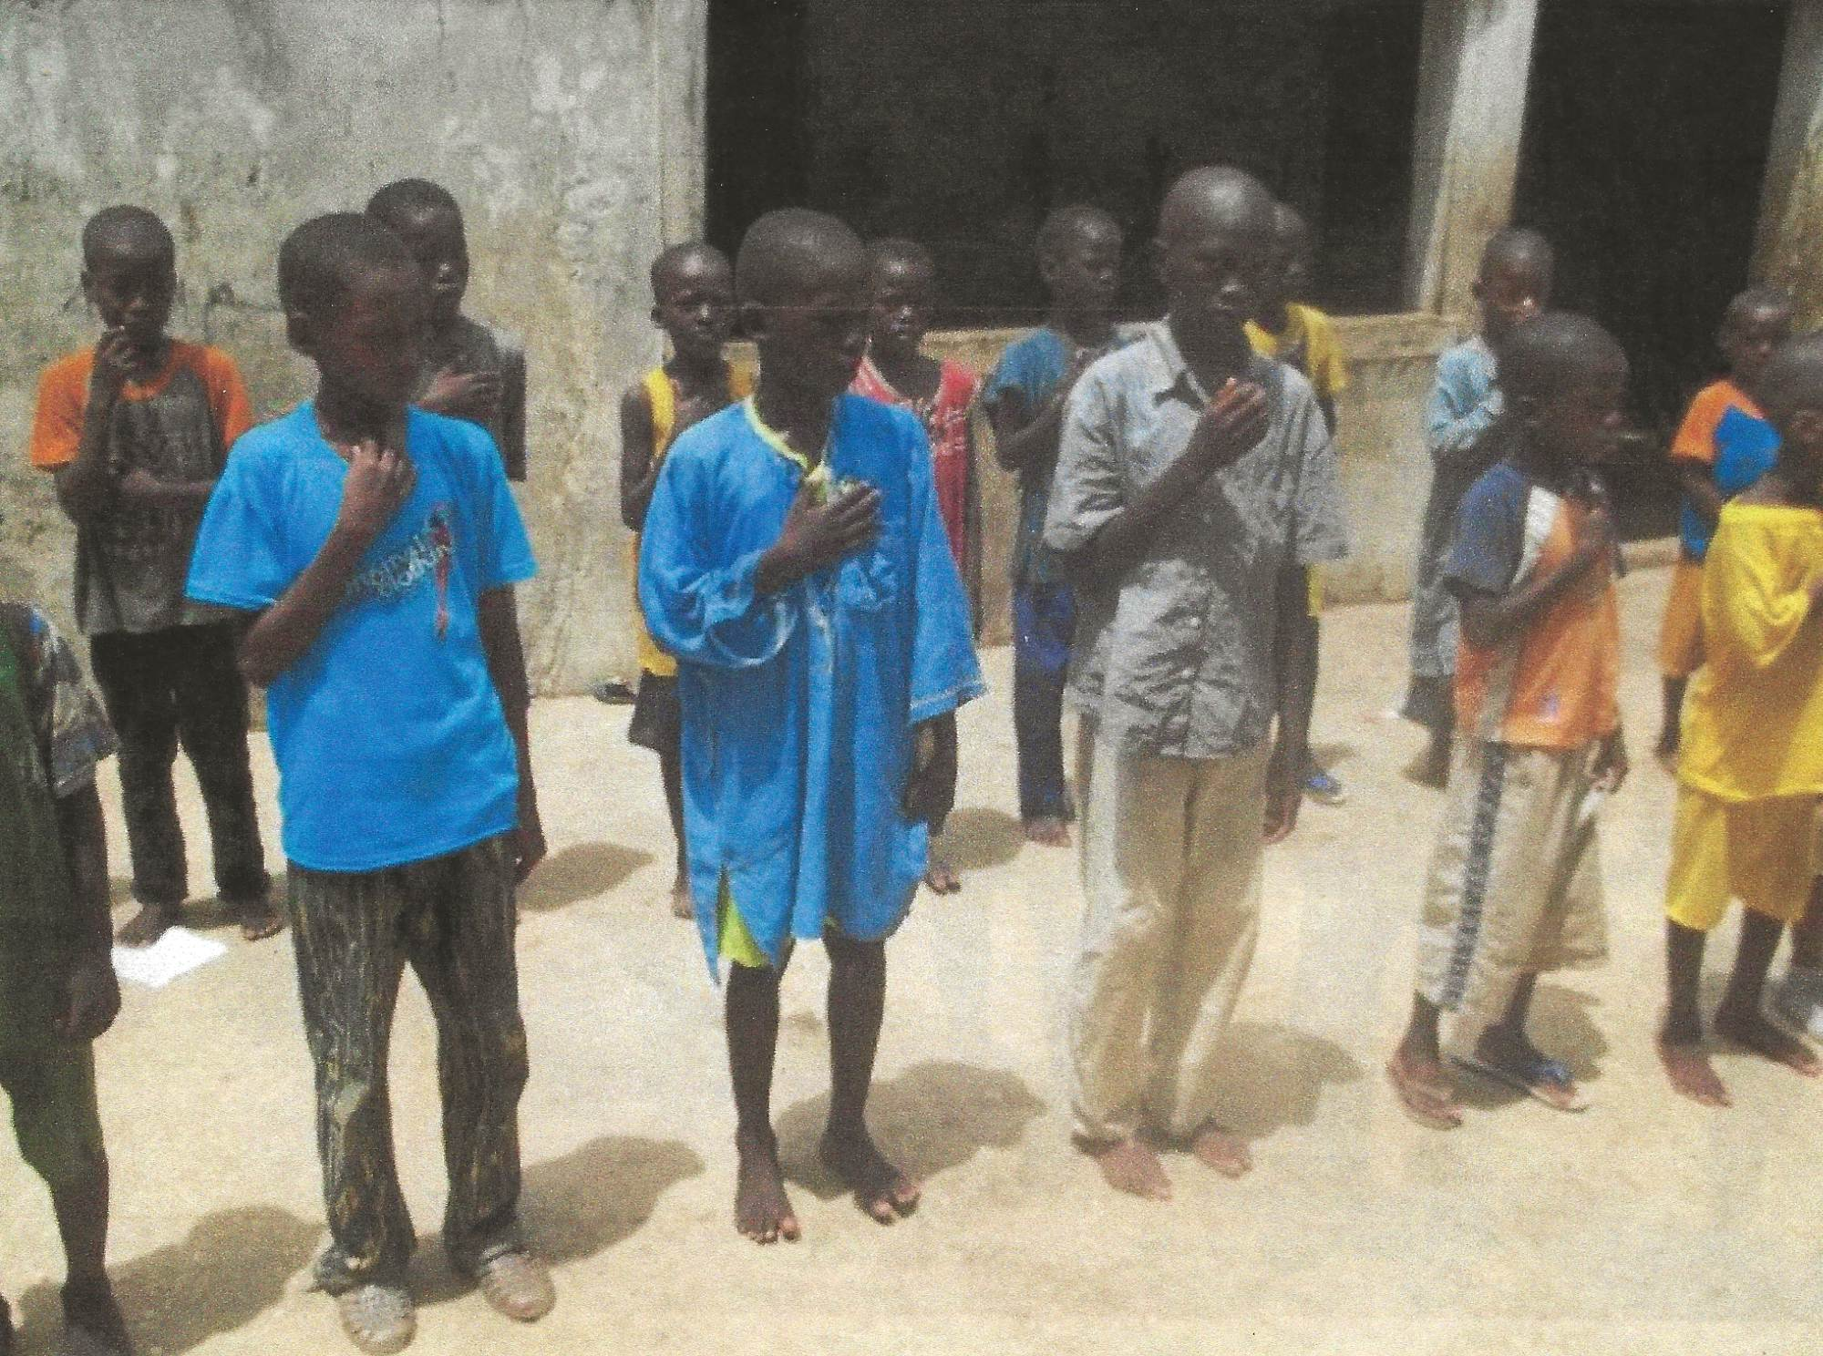
Global project – Opportunity to improve economic opportunities for youth and community members living in poverty, especially women, in Senegal, West Africa GG# 2465059
Area of focus; Economic Development
Local host; RC of Dakar Millennium (RID 9101)
International host; RC of Tucson, AZ(D5500)
Budget; $200,000.00 funding in progress
Our participation; $2500.00 with a request to D5500 for a match in DDF funds.
Project; This global Grant will develop a model educational program that increases the capacity of local schools to provide hands-on vocational training programs that lead to meaningful and productive employment.
Goal; Create a sustainable and replicable model of culturally appropriate vocational training that can build capacity in educational facilities like the School for Forgotten Children.
Status; Host club is applying to RI for GG approval.

Slide 17
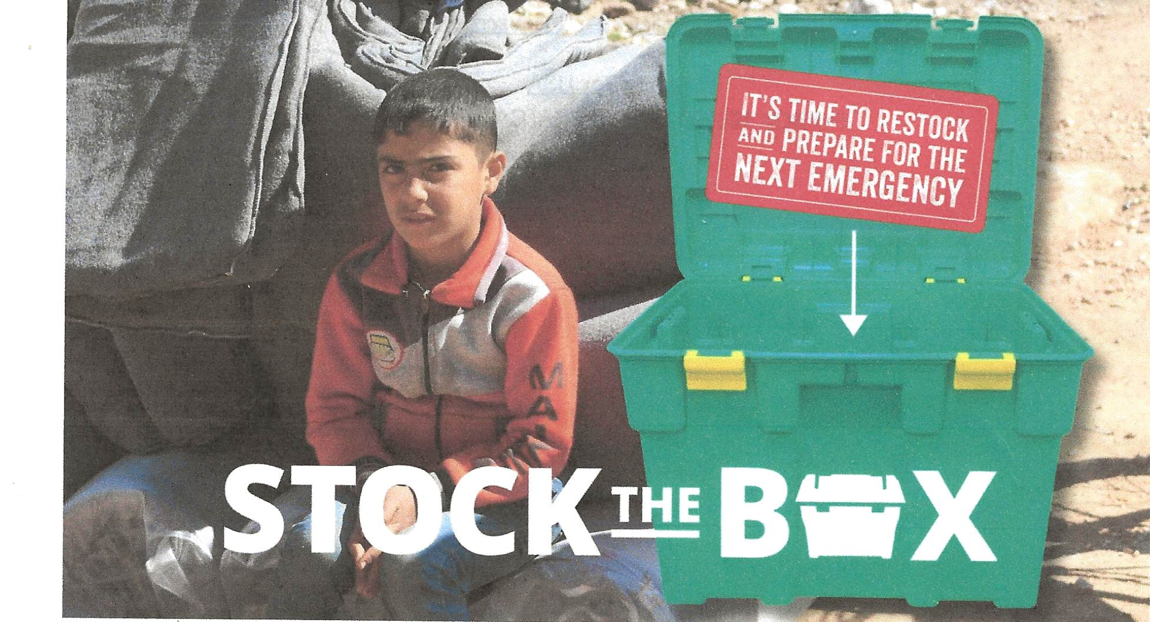
International Service Global project – Shelter Box
Annual donation to ShelterBox to provide emergency habitation equipment to people in areas experiencing disasters.
Our donation of $3000. is at the Silver level Rotary Hero club level. Members may donate as well and our club receives acknowledgement.
Regular updates are available re where ShelterBox is actively supplying emergency aid. In addition, ShelterBox regularly requests donations “Stock the Box” to have emergency aid prepositioned to rapidly deploy.
In the past Rotary year with the support of Rotarians and Rotary Clubs, ShelterBox was able to support over 325,000 people in 14 countries (including crises in Morocco, Melawi, Ukraine, Gaza and beyond).
Create hope
in the world

Slide 18
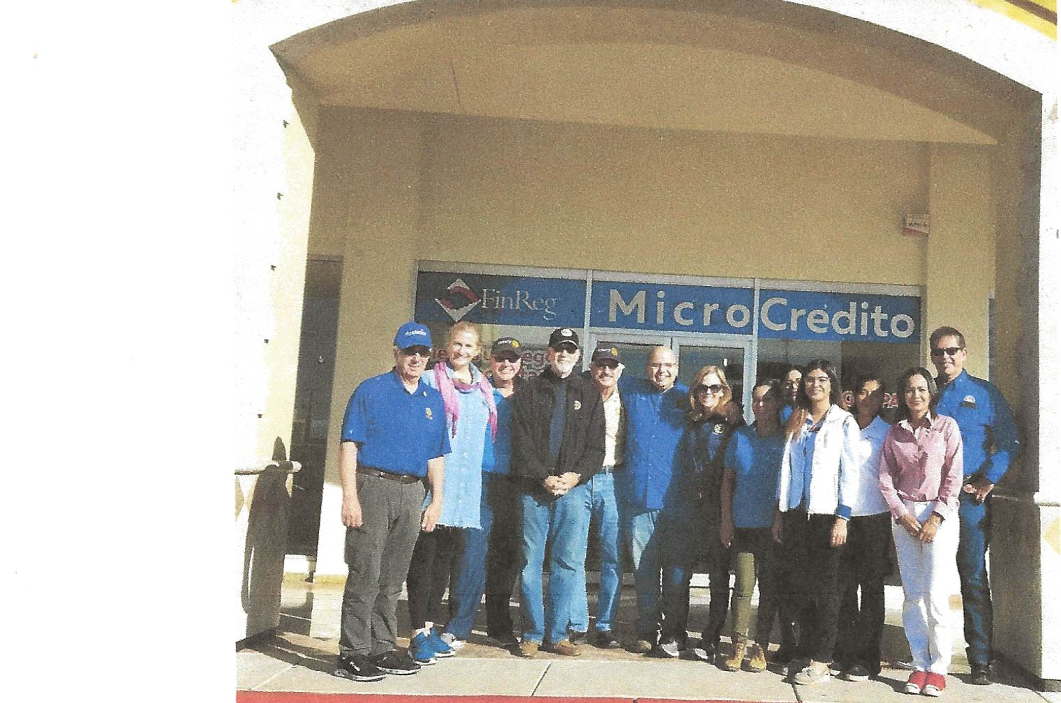
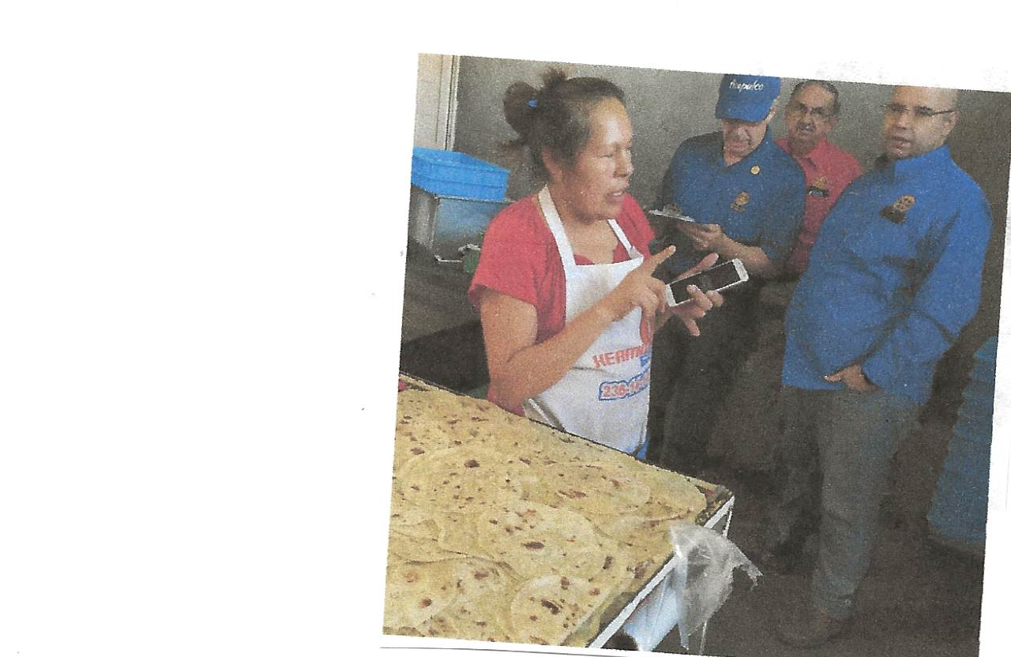
International Service Global project – Micro Credit Loans; Partner participation
This Arizona-Sonora program makes small business loans available to the poorest people in the poorest sections of cities and towns in Sonora, Mexico (Hermosillo and Nogales) through an existing microcredit financial institution (FinReg). The small business loans provide capital to small scale entrepreneurs to grow their business. Their success rate is outstanding with a loan payback of 97%.
The project is about “ helping those who are trying to help themselves”
To be a partner in the program (with other clubs in D5500 and D5495) requires a donation of $5000 payable over 3 years. We have summitted our first payment of $1500. to join the Partner Program.
The objective of the program is to provide opportunity for individuals to sustain or expand an income generating business venture by offering seed money in the form of a loan. The program is not meant to be a grant but a loan with full expectations for pay back of the principal with modest interest.
Microcredit is the most effective antipoverty intervention developed to date

Slide 19
International Service 2024-2025 Plan
Investigate and participate in 2 global grant projects to be initiated by the 1st quarter 2025. Projects will be in one of our 7 areas of focus.
Habitation assistance; Complete Corazon Project “Build a House in a Day”in the fall of 2024 with other D5500 clubs. Involves funding and hands-on volunteers.
Emergency habitation response; Donate to ShelterBox; continue to contribute at a club Silver Hero level and encourage members to donate.
Investigate MicroCredit Arizona-Sonora loan partnership. Should we join other D5500 and D5495 clubs in this program situated in Hermosillo and Nogales, Mexico?
Discuss and decide whether to initiate international interclub activities; a Friendship Exchange, a Sister club, Etc.
Enhance our club’s image locally by participating with other D5500 clubs in global grants and projects.
CREATE HOPE
In the World

Slide 20
International Service
Future projects
International Fair at Division Conference Oct 18 am 930-1130am
Corazon Build date October 26th, 2024…get ready!
Additional Global Grant; with a D5500 club, another US club or an international club
Sister club; develop a club profile
ShelterBox presentation
Microcredit report and a possible visit to Nogales or Hermosillo.
CREATE HOPE
In the World

Slide 21
Community Services
John Howard, Chair
Report given by Leslie Castner
Service Above Self

Slide 22
Community Services
What our Club brings to the table ….
Time & Talent
Financial Support

Slide 23
Community Services - Project Types….
Service
Dollars
Service & Dollars

Slide 24
Community Services – Goals and Objectives
That What We Do Is ...
Meaningful
Impactful

Slide 25
Community Services – Project types…
One Off Such as ---
Senior Holiday Luncheon
Thanksgiving Dinner Distribution
Wreathes Across America
SMRC National Night Out
Ongoing – Recurring Such as …
Packing IMPACT bags
OCC Monthly Monday Luncheon
American Avenue Roadside Cleanup

Slide 26
Community Services - partnerships
Who We Work and/or Partner With ...
OCC - Oracle
SMRC – San Manuel
IMPACT – Copper Corridor (Catalina to Mammoth)
SBCO – Annual Food Drive
Tri-Community Food Bank – Mammoth
YMCA - Oracle

Slide 27
Community Services - measurements
What Was Accomplished This Past Year….
Projects (7/1/23 – 6/30/24) …… 54
Volunteers ……………………… 361
Club Participation …54 of 62 members
Volunteer Hours ………………… 874.25
Most Important – People Impacted in the Copper Corridor ..
Directly …… 5,550
Indirect ……. 10,76554
Total………… 16,365

Slide 28
Community Services - Impact
There are “lots” of opportunities to join in and participate in with
29
Upcoming Activities
planned between
today and December 31st
We look to make the same impact this year – Thus far, thru Sept 11….
Projects ………………… 8
Volunteers ………………. 35
Volunteer Hours ………… 73.00
People Directly Impact …… 790
People Indirect Impacted …1,600
Total People Impacted0 ..… 2,390

Slide 29
Community Services
Help the Club to Continue
To Make
A
Difference
in the
Copper Corridor!

Slide 30
Packing food for Impact

Slide 31
New Generations
Roger Bailey

Slide 32
NEW GENERATIONS - MAJOR ACTIVITIES
Focus on youth and support other committee activities that relate to youth, i.e.,
Vocational: Career Pathways
Community Service: Service projects that serve youth and families
Environmental: Youth Environmental Education @ Oracle State Park
Peace & Conflict Resolution: SMART and Peace Pole with Interact
International: Youth related global grant - Care Facility/CapeTown
Strengthen existing programs, leverage to build partner relationships, and engage more members
Interact
RYLA
Perform needs assessment and determine greatest needs in the area of promoting literacy and other youth needs
Reviewing proposed Book Mobile project with SBCO
Funding recommendations
Academic Scholarships
FFK (Golf Tournament) Grants
Emerging Community Youth Needs

Slide 33
Oracle State Park Environmental Program
As seen in the photo, Friends of Oracle State Park brought teaching aids for the Park’s Environmental Education program: binocular kits, an imitation deer skin, skull and paw print replicas, and more. Young visitors to the park will benefit. In addition, the learning aids will be utilized at area school presentations. Friends of Oracle State Park is very appreciative of our club's support and partnership
These supplies were provided by a Rotary Club of SaddleBrooke $3,000 grant. Rotary at work once again!

Slide 34
Peace & Conflict
Doug May

Slide 35
We Supported Diversion Training Last Year
Summary from AZ Youth Partnership
17 Students and 20 adults, pizza for family meetings
See-through backpacks when the students returned to school
No students had repeat offenses (the most prevalent offense was vaping)
91% of students showed academic growth, one or more of:
^ Semester GPA ^ Percentile of class ranking ^ % of coursework passed
The donation we made was about $1000
Three-month trial and then the remainder of the school year
This is a very good program that we may repeat this year

Slide 36
Our Committee is Investigating an Addiction Prevention Program- Project SMART
Project SMART is initiated and guided by the Rotary Action Group for Addiction Prevention, RAG-AP
We have progressed through these steps with RAG-AP
Form a committee that will work with RAG-AP on Project SMART
John O., Gordon, Roger B., Anne, Wanda, Darien Mathews
Meet online with Larry Kenemore of RAG-AP North America, August 16
Decide which part of S M A R T we would like to start with
Form a subcommittee for that part and work with RAG-AP
If or when we decide to begin another part, form another subcommittee
Note: Larry Kenemore will present our meeting program here on October 24.
X
X

Slide 37
THE PARTS of PROJECT SMART
for Addiction Prevention
S-school education=12-14-month implementation/school contacts/school board/teachers union
M-Medicine and drug disposal=14-month implementation/requires contact with City officials/mayor/city manager/city attorney/meeting with city officials
A-awareness is 2 parts Naloxone training/Steri-Clean drug clean up=2 months implementation. Naloxone Training can start within 60 days and hold classes on a regular basis throughout your community/TV/Radio/News coverage immediately, Steri-Clean Drug Clean=2 months making community aware of clean up of contaminated Police,Fire,EMS,Hotels,Motels, Police Departments, Patrol Cars, EMS vehicles
R-recovery=3 months implementation of database on your website or RAG AP website providing your community with ability to see actual success rate of Re-Hab Recovery centers before they pay.
T-Treatment=4 months implementation of cards/website and advertising of the availability or 24/7 telehealth for treatment.

Slide 38
Choose which program of Project SMART to start
CHOOSE A COMMITTEE CHAIR
SEND US THE NAME/NAMES OF THE COMMITTEE ALONG WITH THEIR EMAIL ADDRESSES
WE WILL THEN CONTACT THAT PERSON OR PERSONS AND SET UP A MEETING EITHER ZOOM OR IN PERSON FOR ORIENTATION ON THE LAUNCH OF THAT PROGRAM
THIS IS THE SAME FOR ALL PROGRAMS OF PROJECT SMART!

Slide 39
FITS WITHIN ROTARY’S AREA OF FOCUS
PROJECT SMART ADDRESSES
6 OUT OF THE 7 AREAS

Slide 40
Environmental
Bill Demeroutis - Committee Chair

Slide 41
Environmental Major Activities
Soft Plastic Recycling
Road Cleanup
Support other recycling Programs
Investigate Solar
Look at Tucson hard plastic recycling program

Slide 42
How Many Plastic Bags are used each year?
We use 5 trillion plastic bags per year, over 700 per person per year
That’s 160,000 plastic bags per second
Most bags are thrown out
Less than 1% are recycled & they take centuries to degrade
12 minutes of use = 1000 years of pollution
By 2025 the worlds oceans could contain more plastic by weight than FISH!

Slide 43
Soft Plastic Recycling Program
SBRC has already reached 1000 lbs.
We will have a bench at District Conference in the Hall of Friendship
We are now collecting for our partner SBCO for a second bench

Slide 44
Membership
Diane demeroutis

Slide 45
Membership – Club demographics
64 Active Members
our newest members;
Dan Devou Bill Vegter Jan Baker
SBRC 5500
Gender 38 male 59% 57%
26 female 41% 42%
Years of Service SBRC 5500
22 under 2 years 34% 22%
19 2-5 years 30% 20%
23 over 5 years 36% 58%

Slide 46
Do you have your Rotary elevator speech?
We are All Membership
Things to think about
How can we connect better in the community
Capitalize on our many skills
Would you like to be on the Membership Committee?
Mentor coordinator
New members are your most vulnerable
How can we make the New Member experience better?
Retention & Engagement of members are keys to success
Connect to the listener
Explain Rotary's value proposition
Have a hook
Call to action

Slide 47
Finance
Joe Guyton

Slide 50
Take A Chance

Slide 51
Adjournment
Unmute your cell phones!

Slide 53
Get your tickets now and make this the best year yet?

Slide 54
The Four-Way Test

Slide 55
Award
Presented by
Assistant Governor
Barbara Bengen

