Slide 1
Notes:
SBCO celebrated its 25th anniversary in 2022. Kids’ Closet is the oldest SBCO program

Slide 2
Betty Ryan, Kids’ Closet Co-Director
Thursdays
Eileen Hansen, Kids’ Closet Co-Director
Mondays
Notes:
Introductions

Slide 3
Notes:
Kids Closet began as SaddleBrooke Women’s Outreach

Slide 4
Notes:
They began fundraising to help clothe the students

Slide 5
Notes:
Kids’ Closet in its early days at Mammoth Elementary School

Slide 6
Notes:
This is our service area. The closet is located in Mammoth to reduce travel times for children

Slide 7
VOLUNTEERS AT WORK
FEED
CLOTHE
ENRICH
EDUCATE
Notes:
SBCO has now four areas of service as listed above.

Slide 8
Notes:
Services expanded to include food drives, thanksgiving baskets, christmas gifts, enrichment grants for schools, libraries, communities, post high school scholarships

Slide 9
SOURCES OF FUNDS THAT SUPPORT THE WORK
Golden Goose Distributions
Make a Difference
Resident Donations
Business Supporters
Remodeled Home Tour
Walk for Kids
Memorials
Source Book Delivery
Shredding Events
Can and Golf Ball
Recycling
Notes:
This is how we fund all SBCO programs. Note the Golden Goose distributes equally to IMPACT and SBCO

Slide 10
KIDS CLOSET 2023-2024
1472 Fall Wardrobes
1520 Spring Wardrobes
Notes:
Note these are complete wardrobes not pieces of clothing

Slide 11
EACH WARDROBE INCLUDES:
3 SHIRTS AND 3 PANTS/SHORTS
1 JACKET (HAT AND GLOVES EACH FALL)
SHOES, SOCKS, PKG UNDERWEAR
HYGIENE KIT (Toothbrush/paste, Soap, Shampoo)
2 BOOKS
Notes:
In the fall session we provide winter clothing. In the spring we provide spring clothing

Slide 12
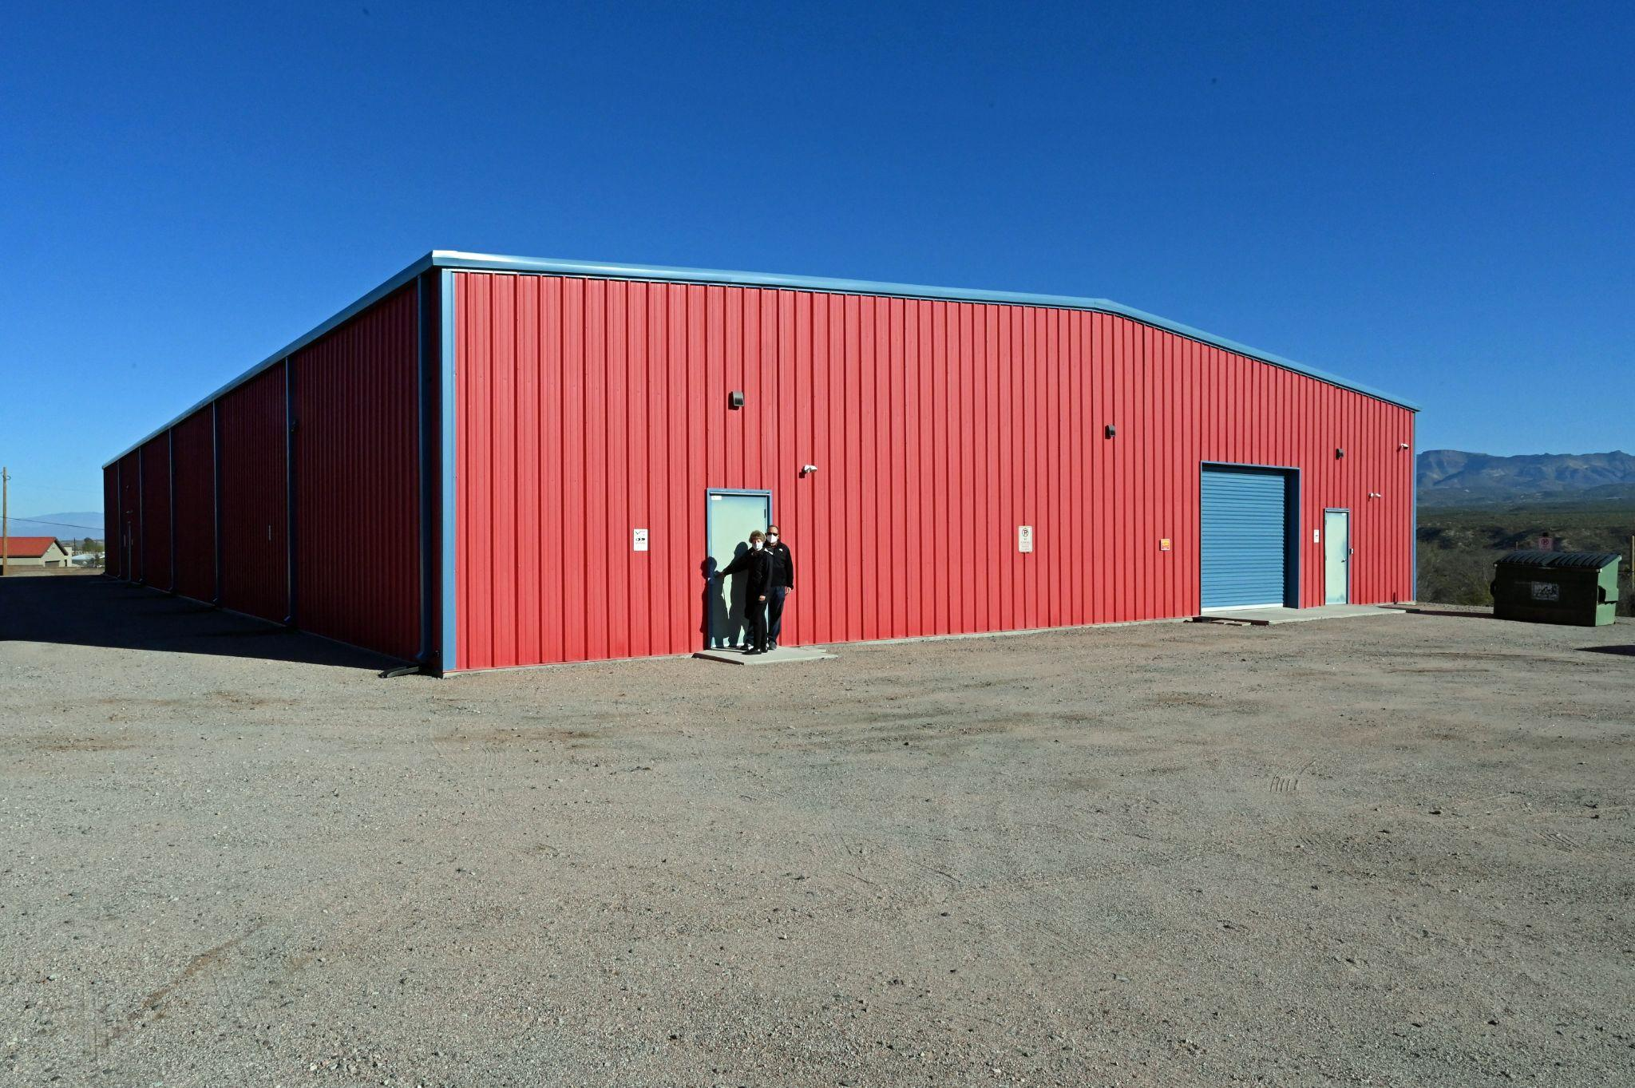
KIDS CLOSET WAREHOUSE IN MAMMOTH
Notes:
Our Warehouse is located on AZ 77 in Mammoth. 12,000 sq feet warehouse that has a class room, shopping area and warehouse storage. We have a team of buyers that shop twice yearly for clothes, shoes and accessories.

Slide 13
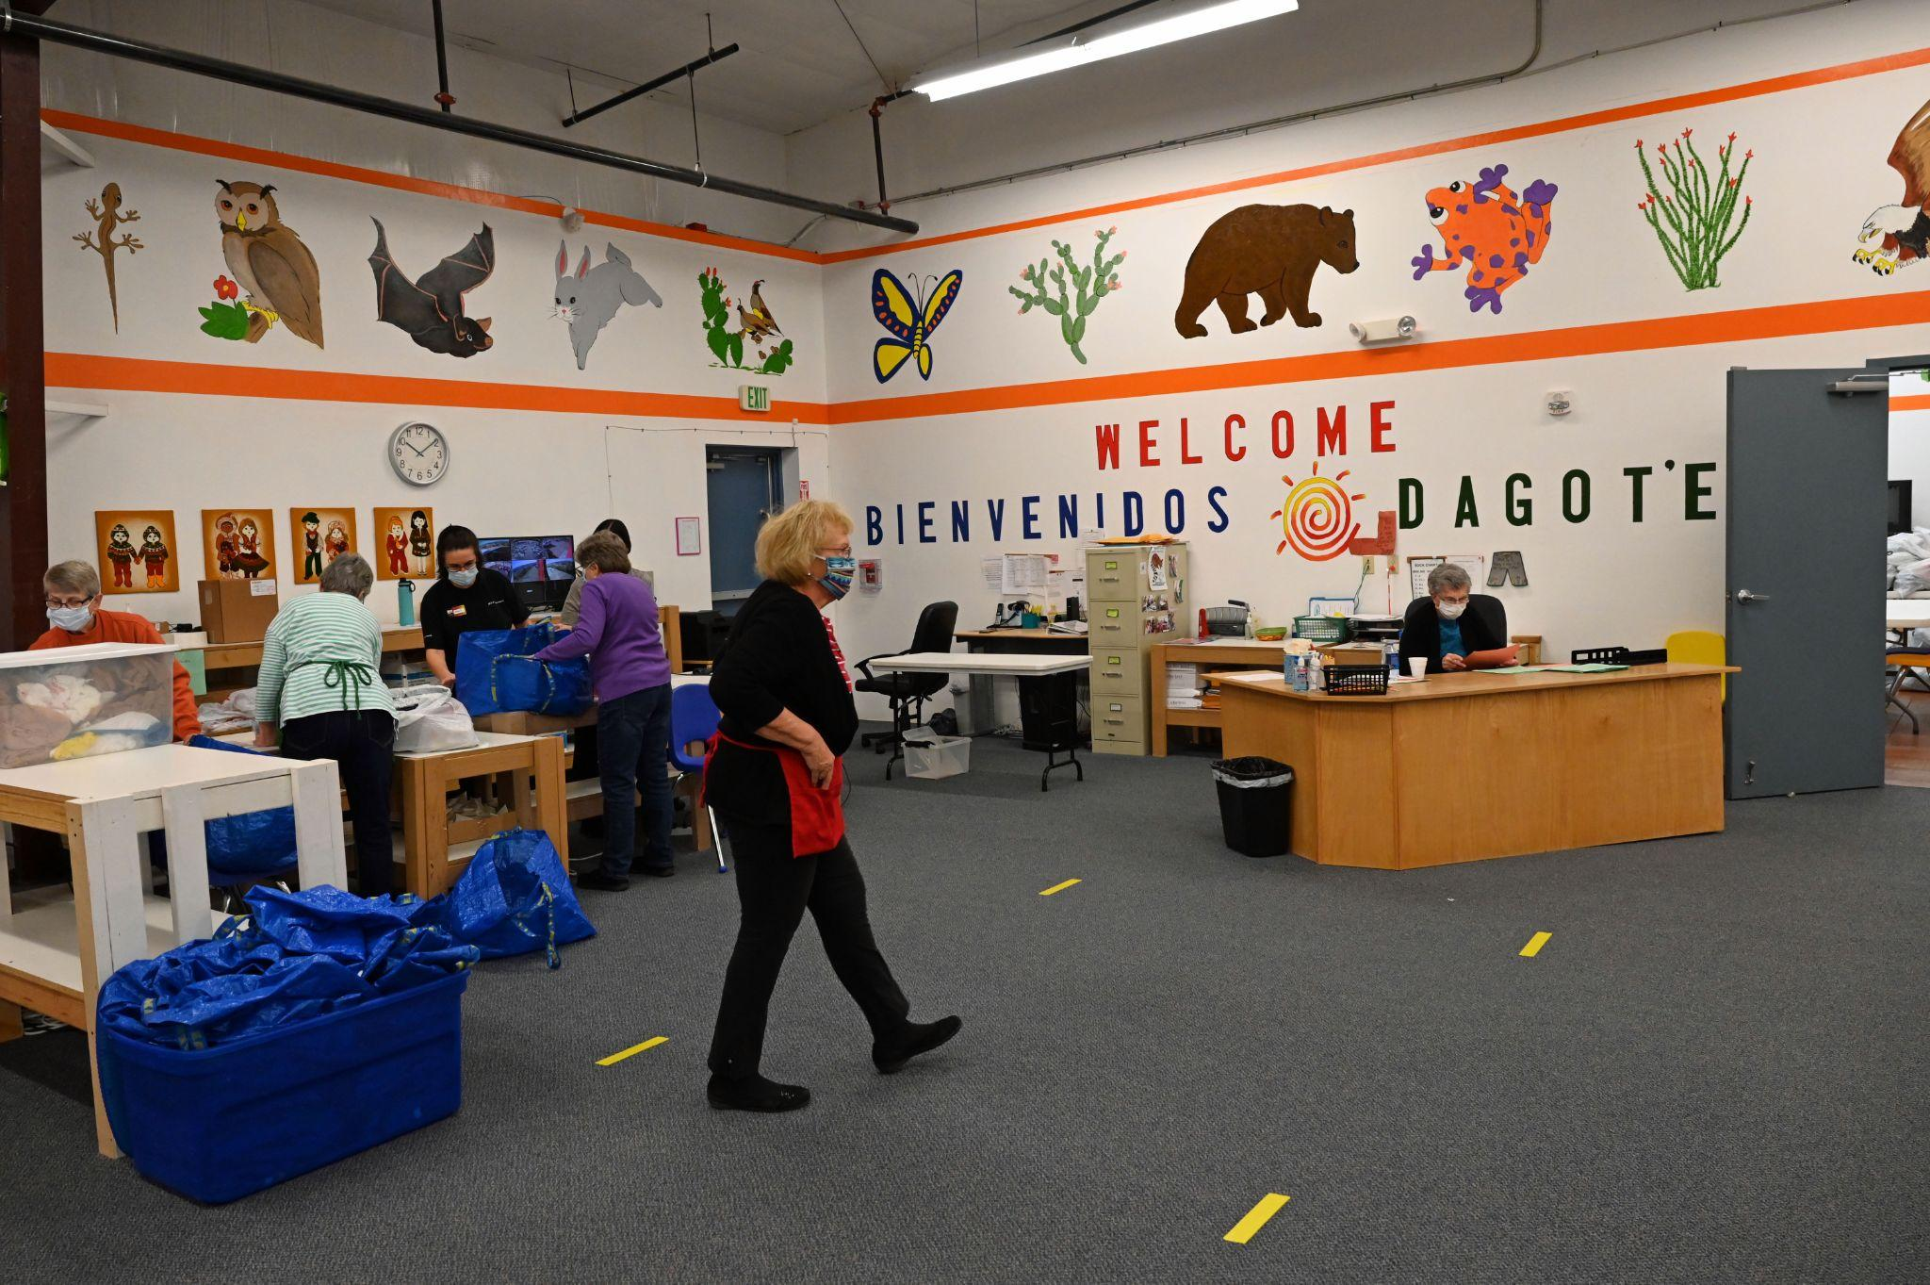
Notes:
Our “Zoo Room” or main room. We call it the Zoo room for all the colorful animals painted on the walls. Welcome is printed in English, Spanish and Apache. This is where our kids pick out and try on clothing

Slide 14
Kids’ Closet Sessions
50-100 Children visit with their schools on Mondays, Thursdays and two Saturdays. Hours are typically 8-12
Fall session runs from mid September to December. Spring session is mid January through early April
Our volunteer coordinator sends out a list of dates to volunteers. They sign up for one or as many as they choose

Slide 15
Help us make a Difference:
Volunteer Opportunities at Kids’ Closet
Notes:
Kids’ Closet is able to help so many by having a team of dedicated and caring volunteers. Consider joining us!

Slide 16
Kids Closet Shopper volunteer
Receives a shopping list with a child’s sizes
Helps a child select and try on clothes. Shoes are fitted by trained volunteers
Helps the child select grade level books
Goes with the child to the scanning station where their items are scanned
Notes:
Our volunteers are trained by working with another shopper until they feel comfortable shopping on their own. The shopper shows the child clothing in their size from they may select preferred items. The child goes to a dressing room to try on clothing without adult assistance.
Carpooling is available

Slide 17
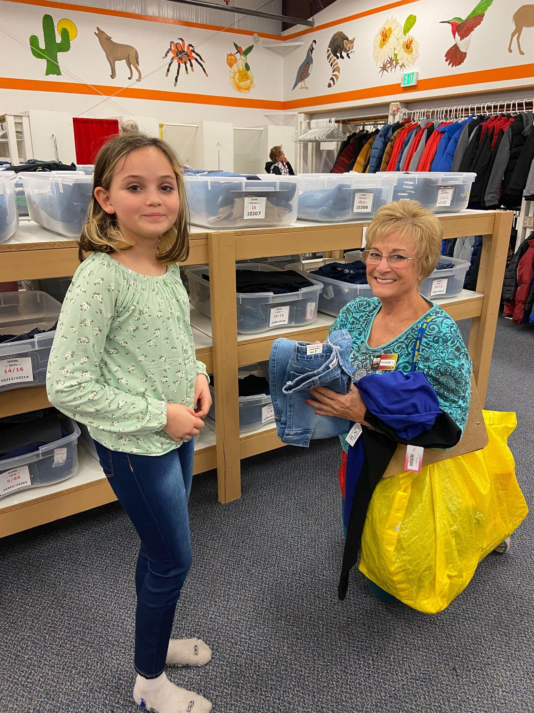
Notes:
A volunteer shopper helping a student to select clothing. Clothing is stored in bins by gender and size. We have shoe fitters in the shoe department. They measure and fit shoes for each child

Slide 18
Kids’ Closet Warehouse Re-stocker
While the children are shopping refill clothing bins with clothing from the stockroom
Refold and replenish bins for the next day
Notes:
Our warehouse volunteers are checking available stock in the zoo room. They replenish stock throughout the morning as needed

Slide 19
Kids’ Closet Van Driver
When the van is loaded with merchandise, the van is driven from the SBCO office to Kids’ Closet Warehouse
The merchandise is unloaded and stacked into the designated area of the warehouse
Notes:
Our clothing, shoes, books and everything else arrive at the SBCO office. These items are tagged and put into bins. The van is loaded at the SBCO office and unloaded at the warehouse

Slide 20
Kids’ Closet Transportation Manager
The manager coordinates drivers for deliveries to Kids’ Closet and other SBCO sponsored uses of the van
The manager maintains the van
The manager maintains records of expenses and driver hours

Slide 21
Kids Closet Contract/Maintenance Manager
Oversee building maintenance
Schedule yearly building inspections for HVAC, Fire prevention, pest control, alarm, etc
Oversee contracts for cleaning, pest control, trash collection, etc.
Notes:
We need someone who can help us maintain our warehouse.

Slide 22
Find us online
www.community-outreach.org
Questions ?

