Slide 1
The Modern Girl Scouts of Southern Arizona
Not Your Mom’s Girl Scouts

Slide 3
When you think of the Girl Scouts, what words or images come to mind?
Badges
Cookies
Young Girls
Camping
Troops
Outdoors
Uniforms
Crafts

Slide 4
While many of the same activities are included, the modern Girl Scouts are so much more!
Girls can join from ages 5 through 17
Girl Scouts teaches valuable life skills along with technical skills
A Girl Scout no longer has to belong to a Troop but can participate individually
Girl Scouts strive to make their girls more confident, more courageous, and build better character
Girl Scouts of Southern Arizona has over 40 programs for their Girl Scout members

Slide 5
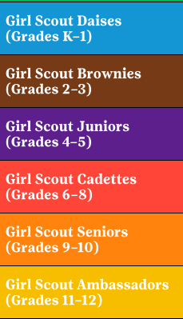
Girl Scout Classifications
Independent Girl Scouts, who for whatever reason can’t join an official Troop, are called Juliettes.

Slide 7
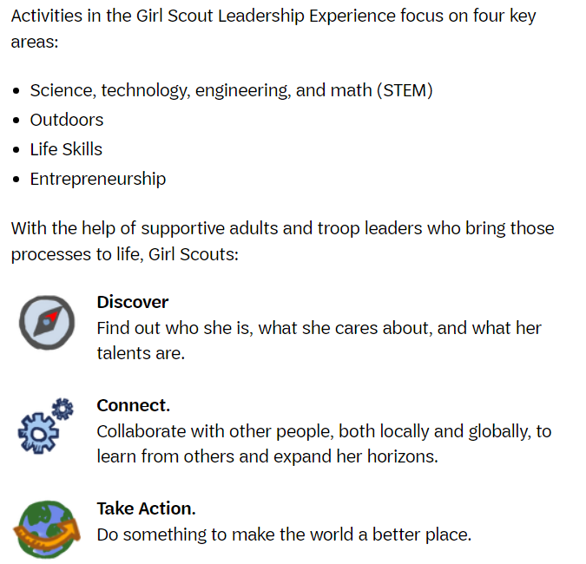

Slide 8
Girl Scouts of Southern Arizona has some of the most innovative programs in the country. There are two types; Staff Led and Partner Led
Staff Led Programs:
After School Programs - Girls meet right at their schools
Adelante Jovencitas – For girls who have entered or are at risk of re-entering the juvenile justice system
Foster Care – For girls living in a foster home
Girl Scouts Beyond Bars – For girls whose mothers are incarcerated. Girls and their mothers attend classes together at the prison to foster their relationships and learn life skills together.
GS adVENTURERs – Teaching middle school and high school girls entrepreneurship skills
Media Scouts – Teaching Girl Scouts media skills to represent GSSOAZ in print, television, and on social media

Slide 9
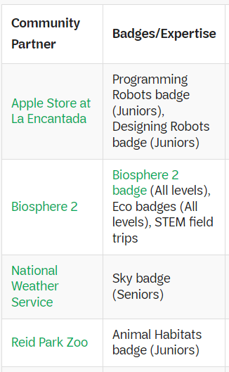
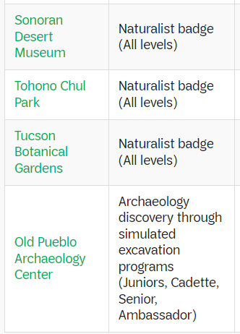
Partner Led Programs:
STEM

Slide 10
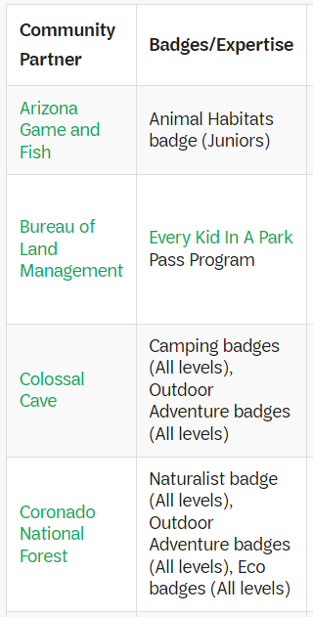
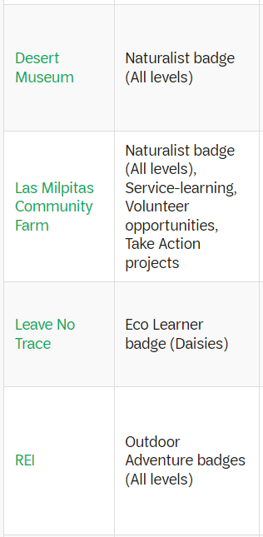
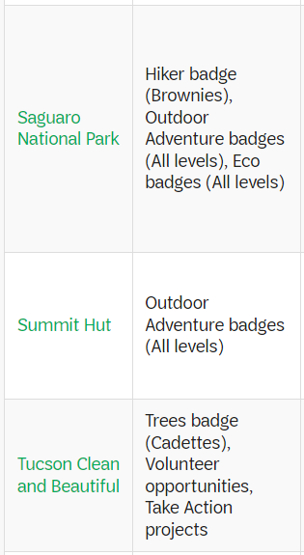
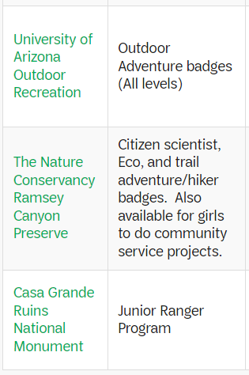
Partner Led Programs:
OUTDOORS

Slide 11
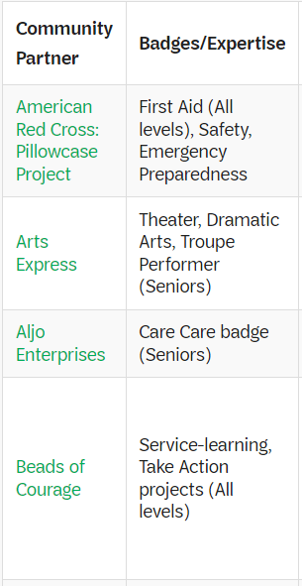
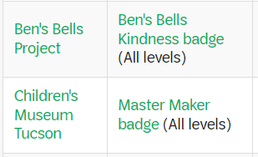
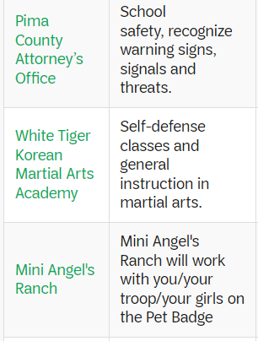
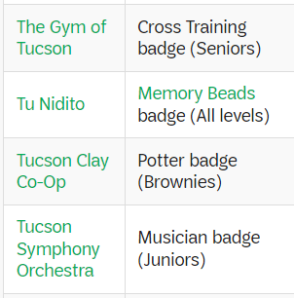
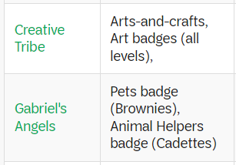
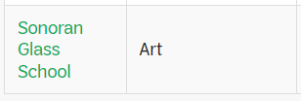
Partner Led Programs:
LIFE SKILLS

Slide 12
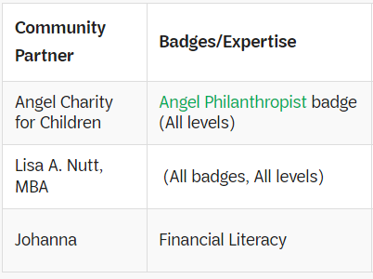
Partner Led Programs:
ENTREPRENEURSHIP

Slide 13
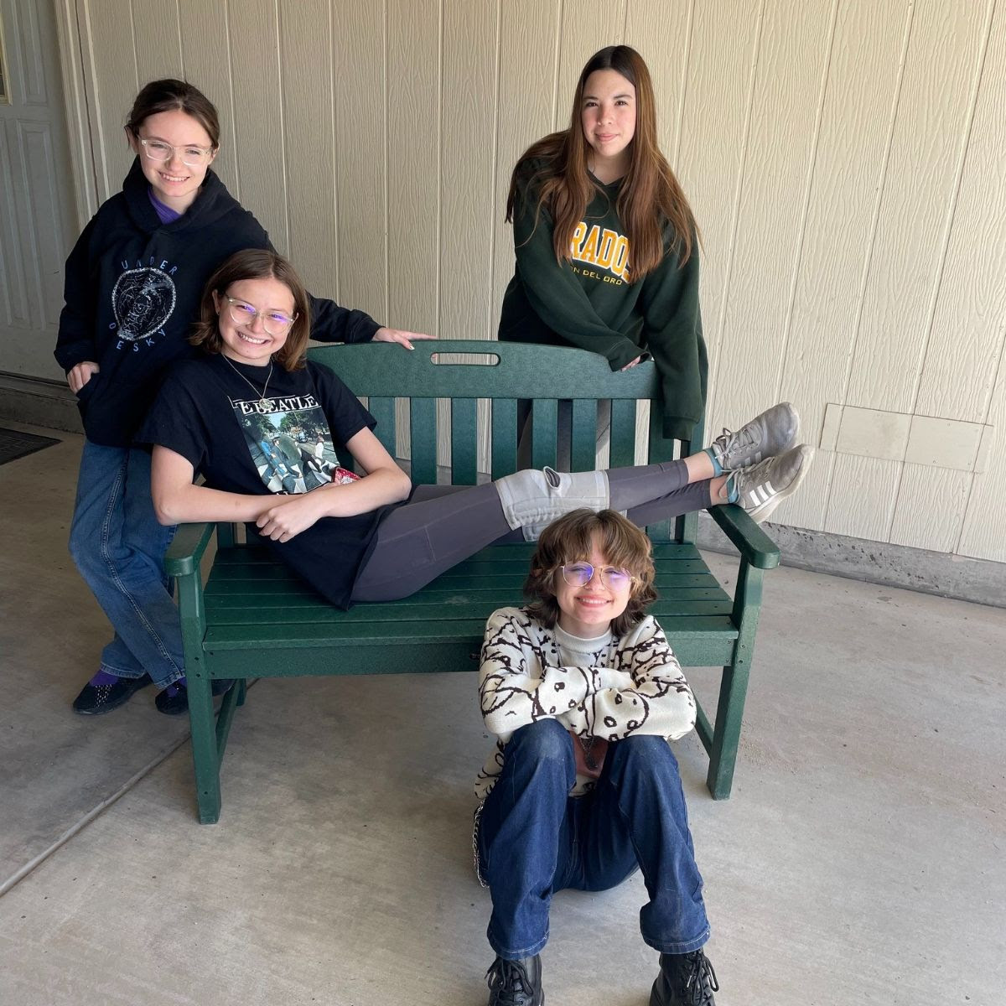
This Girl Scout troop collected 500 pounds of recyclable plastic and had it made into a bench.

Slide 14
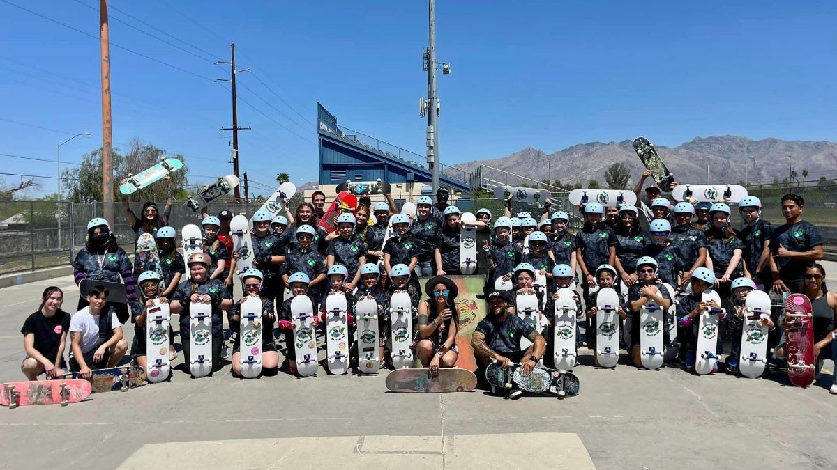
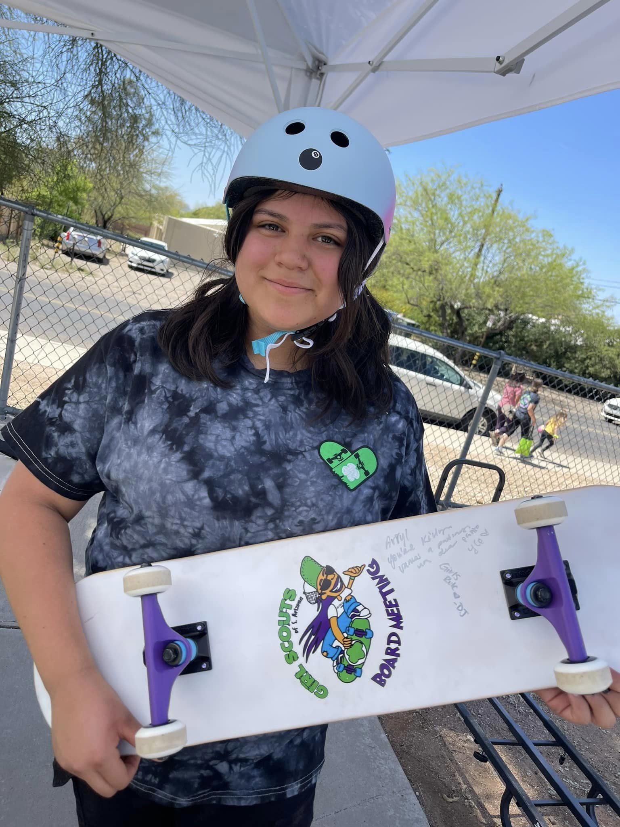
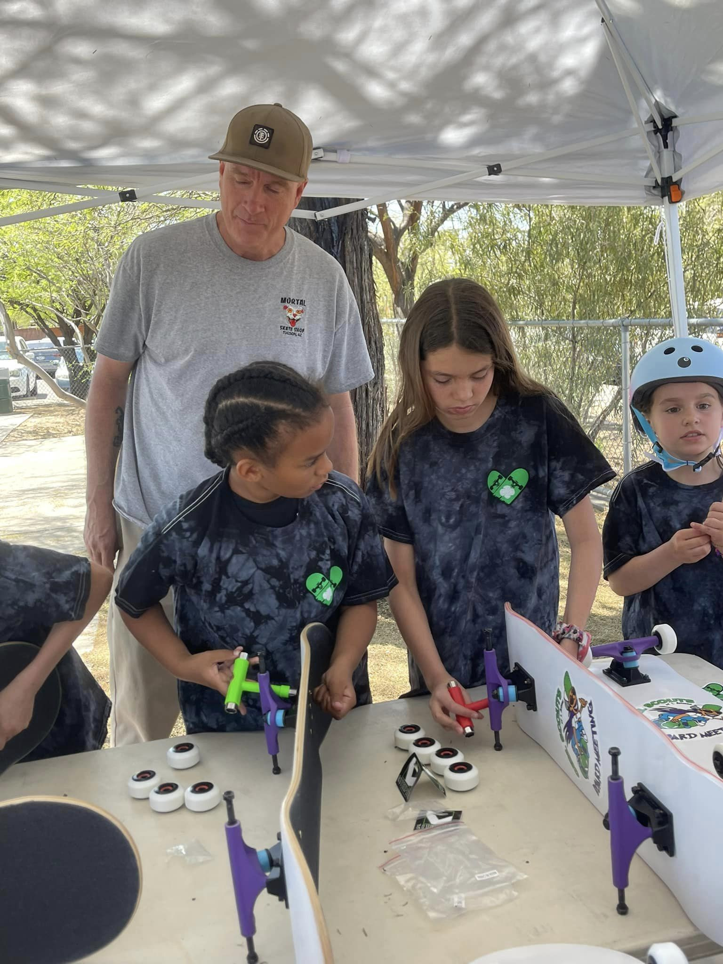
Girl Scouts attending the very first “Board Meeting”. Every girl who sold more than 1,700 boxes of cookies were given their own skateboards, taught the basics of skateboarding, and learned how to build skateboards.
Definitely NOT your Mom’s Girl Scouts!

Slide 15
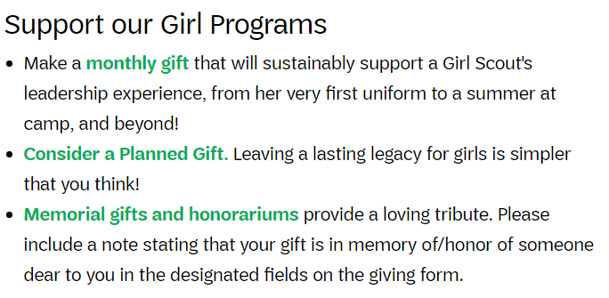
How YOU can HELP
Donate
Ways to Donate:
Go to www.girlscoutssoaz.org

Slide 16
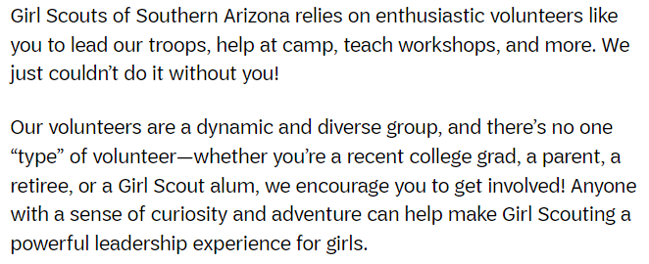
How YOU can HELP
Volunteer

Slide 17
Questions?

