Slide 1
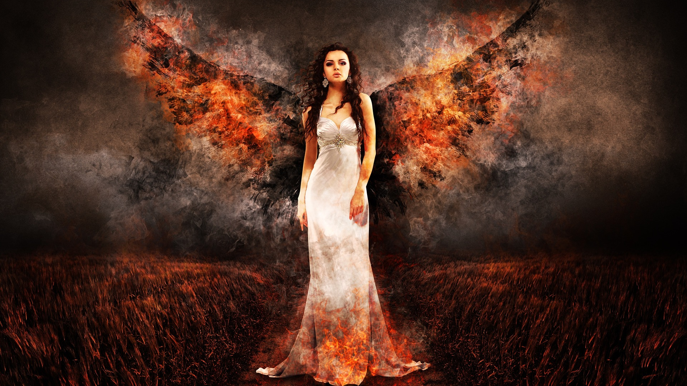

My Story
Notes:
Hi and thank you Linda for the invitation!
Please raise your hand if you’ve ever been burned.
I know we’ve all been burned – by something hot to the touch or tongue (coffee, a microwave item); by fire or fireworks; and/or by someone’s off-handed comment.

Slide 2
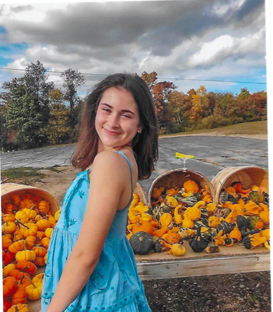
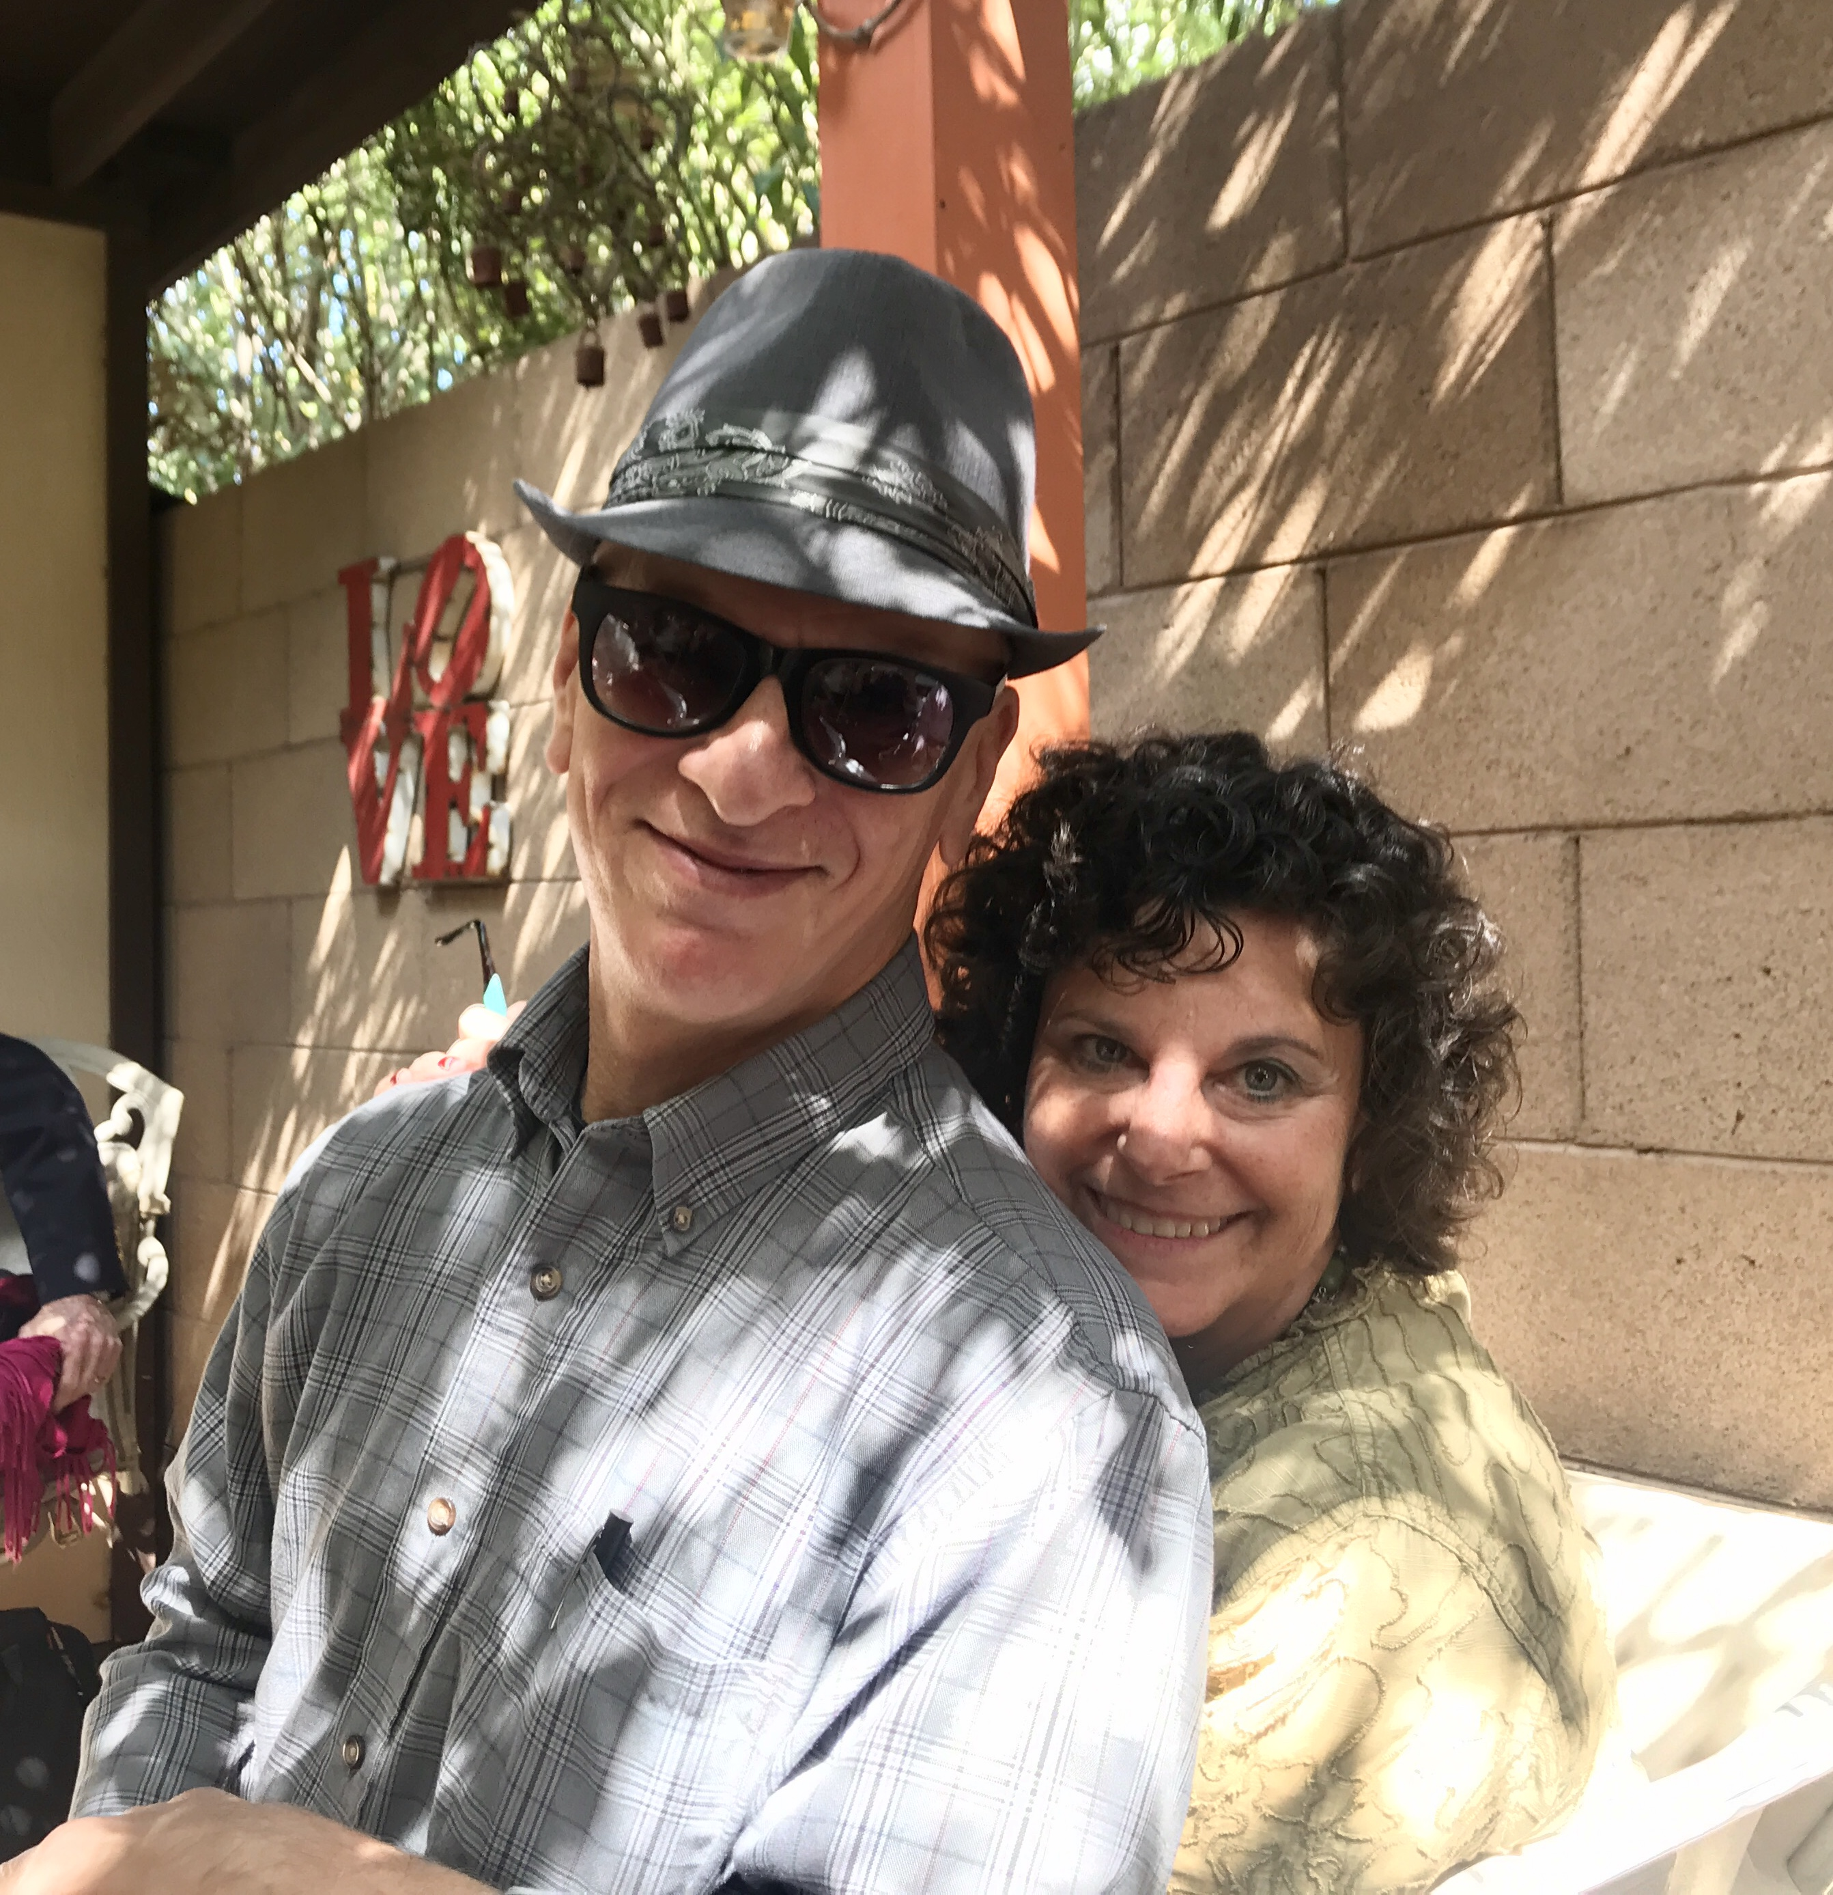
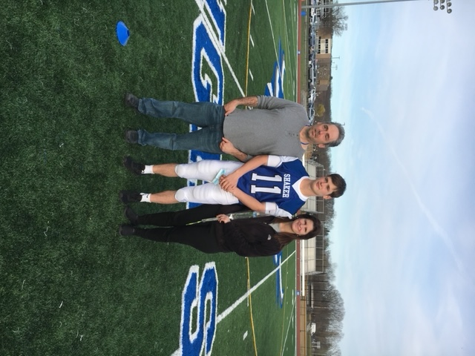
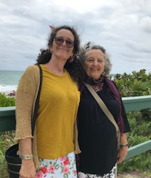

My Family
Notes:
I’m grateful for my Family - the most important people in my life. Here you see hubby for 42 years, Al, my best friend and most avid supporter in his favorite fedora. My mom, now in Tucson, and my sister as well as my daughter, Lisa, son in law Joe and grandchildren Juliana and Joey.

Slide 3

Gayle Petrillo – Image Consultant,
Career and Confidence Coach, Author, Speaker
Notes:
I’m Gayle Petrillo, an image consultant, career and confidence coach and author.
Tucson has been my home for over 24 years, having moved here from Upstate NY. I’m married to my best friend and most avid supporter, Al, for 42 years.
My background includes 35 years in healthcare leadership, much in the HR arena. 6 years ago I made the decision to open my own business and share with others how to improve their self-confidence and make their best first impression. First Impressions, my business, was created because we never get a second opportunity to make that all important first impression.
I decided to become a coach because I had an accident as a toddler that would shape the rest of my life. I could never have realized the impact one brief moment in time would have.

Slide 4
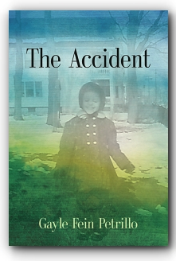

My Why
Notes:
My “why” is because I’ve walked the path, the same as others, and with the tools collected, it’s time to share my toolbox to help others change their path.
Please indulge me as I read from my book, my story, The Accident. I was a giggly, outgoing and friendly, girly girl who loved frilly everything – bows in my hair, on my shoes and everywhere in between.
Accidents just happen. There isn’t anyone to blame. It’s not anyone’s fault.
Have you fallen off a bike or out of a tree? Maybe you tripped down steps, or touched something hot or had something burn your tongue.
Some accidents are more serious than others.
My accident, at 2 ½, was a traumatic one.
We ran inside from where were playing in the beautiful Fall leaves in Upstate New York, as the smell of homemade cookies drifted out the screen door.
As I climbed up on a bench to sit at the table during a grown-up tea party, I knocked over a full pot of freshly brewed coffee, off the table and all over me causing third degree burns over 40% of my tiny body.
That element of surprise, at that moment and in the months and years ahead, I would learn would have a huge scope of impact on my life.
I was hospitalized for several months. My parents didn’t know if I would live or die. There were no support organizations like there are today, not for my parents, not for me. None of us knew what to expect as my burns healed.
I became afraid of everyone and everything. And I have residual physical and emotional scars.

Slide 5
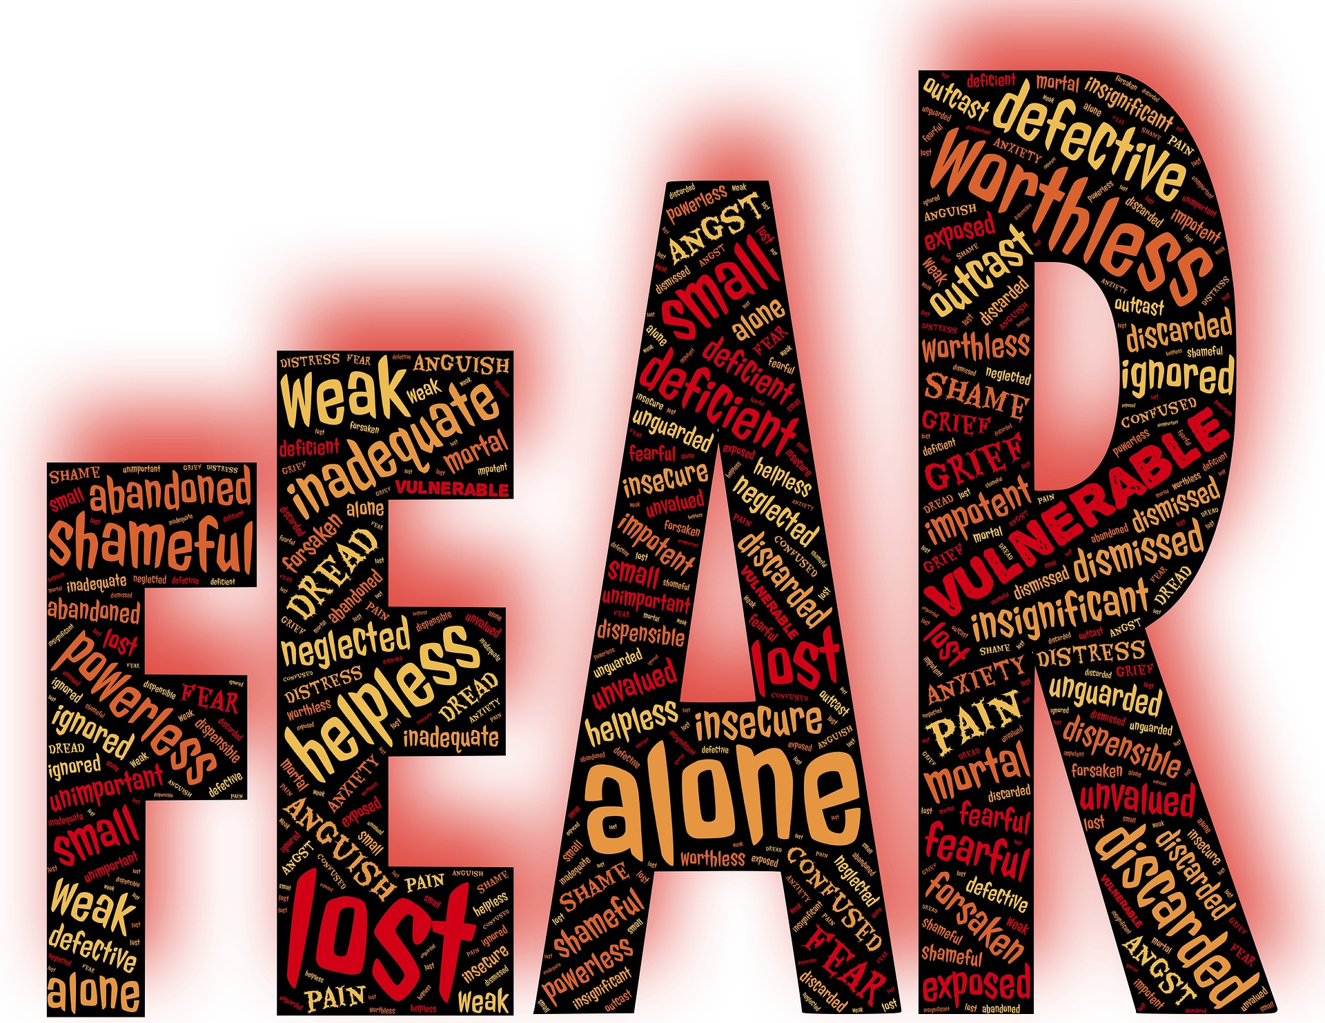
Notes:
I have been in hiding, never telling my story, not to relatives or friends, or anyone, until recently.
Physical scars impede movement; so do emotional scars. Without movement, we don’t fully heal. Movement can be physical or emotional.
My scars caused me to isolate. I felt different. I believed I was alone and was I lonely. I saw myself as I thought others saw me – from the outside in – disfigured, ashamed and even guilty, leading to a lack of self-confidence.
I know what it is like to lose control; to have one’s self-confidence shaken to the core.
My accident left me with deep seated fears – phobias. Some were rational; others not so much. Needles, fire, heights, reptiles, and public speaking, just to name a few.
I know you know that public speaking is the number one fear people have. In school, I never raised my hand in class even when I knew the answer. I did everything I could to avoid getting noticed.

Slide 6
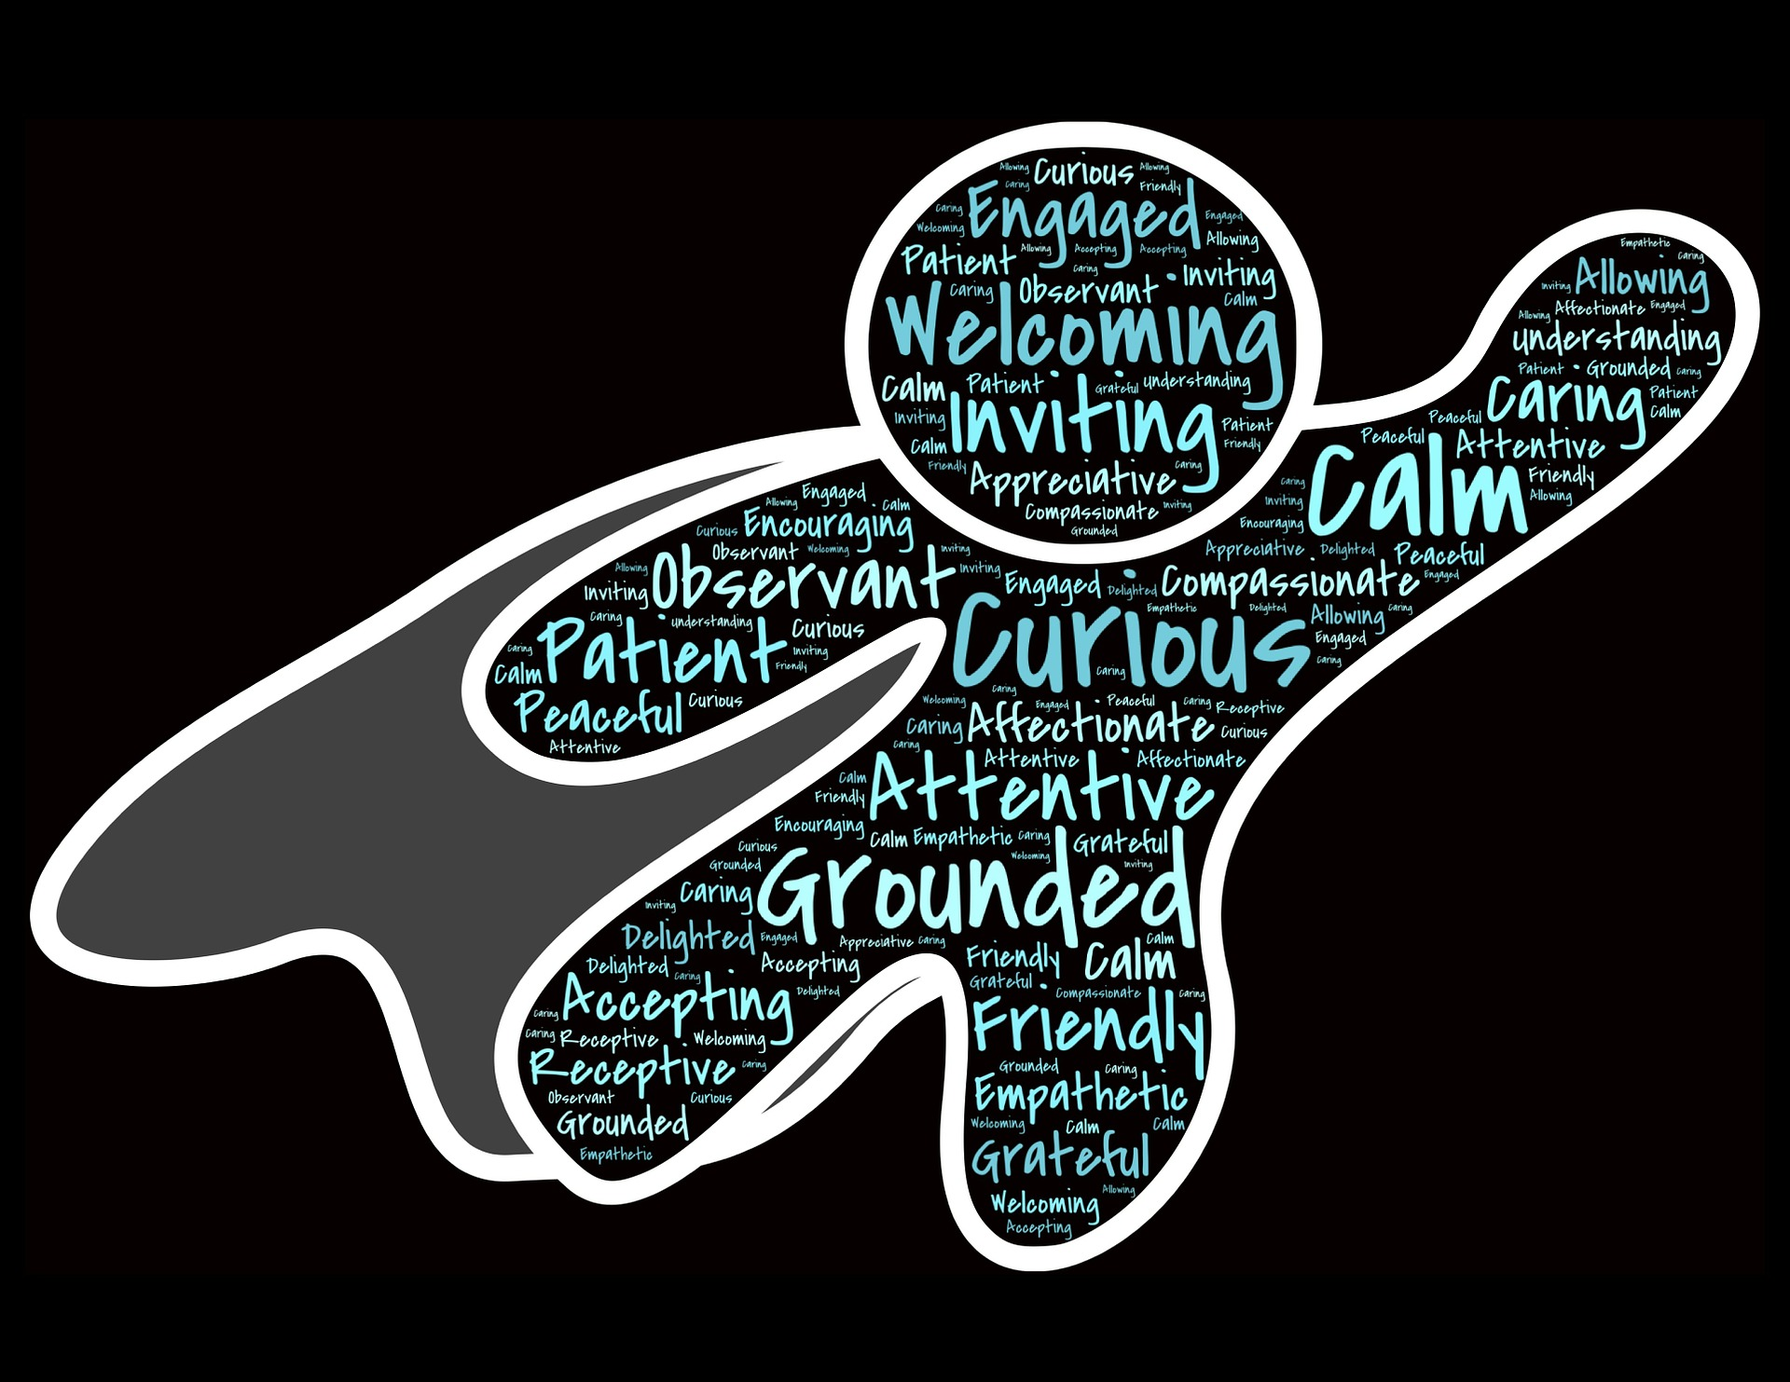

Notes:
Early in my career, I was shocked to learn that a hospital administrator identified ME as an up and coming leader. There were over 9,000 employees in this medical center and I was chosen with 11 others with high potential to attend Dale Carnegie course sessions. WOW, what did they see in me that I didn’t?
The Dale Carnegie courses helped me gain confidence to speak up and show my smart self. After graduating, I found myself comfortably chatting with managers whom I previously had been intimated by.
Another surprising turn of events happened at the same medical center years later. I was asked to apply for a job entailing travel around the country auditing clinical research trials. I found myself flying from city to city, state to state, renting cars, eating alone, and staying in hotel rooms by myself. Back then, there were no cell phones or GPS devices. The laptops we lugged around were heavy and cumbersome. I would not have been successful in this role without the self-confidence I was finding and built on.
Years later, I joined Toastmasters, which added depth and breadth to my public speaking capabilities. I spoke about work, in the HR field and overall operations.

Slide 7
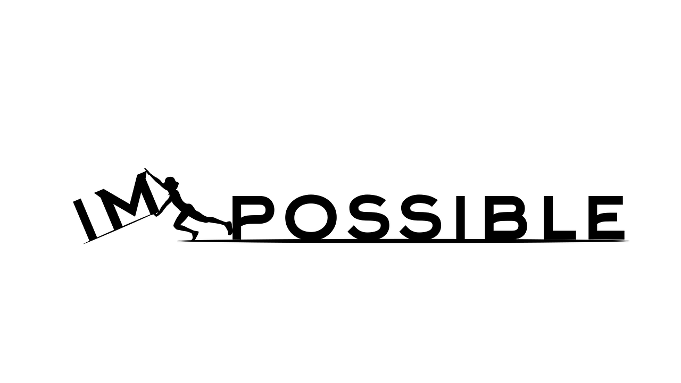
Notes:
In The Accident I share very personal stories about overcoming my phobias and how I did it. I learned a could hold a snake; cross a bridge and cook on a gas stove.
I’m not completely healed. I’m still on my journey, but I’ve come a very long way.
I’m now mostly outgoing, and have a lot of friends – in business and socially – I’m a connector in our community.
I’m still fearful -- of fire for one thing – I don’t light matches and avoid sparklers on July 4. My parents never worried about me smoking!
I encourage you to embrace your burn, whatever, however it happened. I’m finding healing through sharing. I bet You can too.

Slide 8
My Offerings
Career Coach
Stand-out Resumes
Wardrobe Analysis
Interview Preparation
Networking Skills
Negotiation Strategies
Etiquette
Customer Service
Team Building
Author/Speaker
Fears/Phobias (Rational and Irrational)
Body Image Issues
Bullying
Self-Confidence
Notes:
I am a successful career coach, author and new to this type of public speaking. The book was an unintended consequence.
I came out of hiding at the persistence and insistence of an acquaintance I barely knew. A slip of my tongue at a fundraising event spurred her to ask about my story. After very reluctantly revealing bits and pieces over 3 months, and after lots of wine, she cradled me and told me how inspiring it would be for others to hear.
So during Covid isolation, I typed. It was cathartic. I sent what would be my manuscript to a few people I deeply trusted. The feedback was astonishing to me. Teachers, a child psychologist, teenagers all told me it provides hope, inspiration and encouragement. I believe if it helps just one person I will have accomplished what I set out to do when it got published.

Slide 9
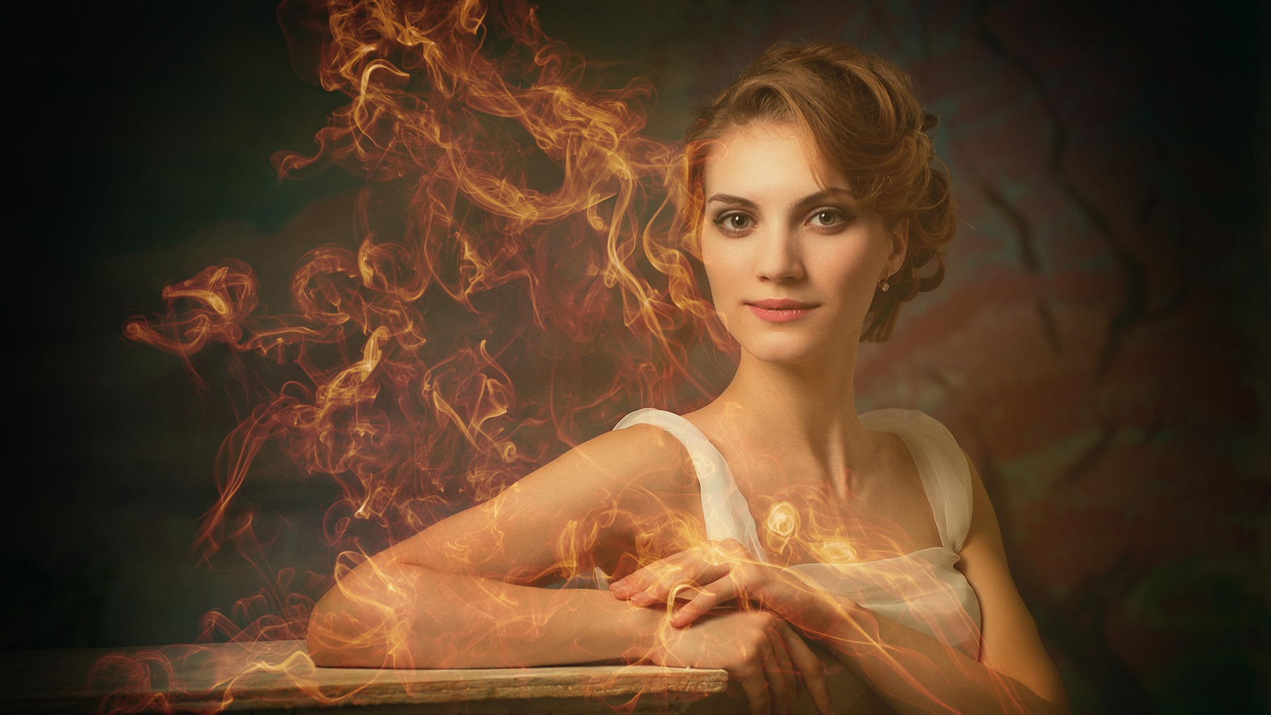
SUPER POWERS
Notes:
My book, The Accident, and its Spanish translation, El accidente, shares some of my very personal stories, told for the first time. In it, I ask, “What’s your superpower?”
Unsure? Start at the surface. Then dig deeper. You will be amazed at what you uncover. Your super powers have been there all along. They have likely been buried – hidden – and now it’s time to share them - they are part of your story.
People tell me that I have an infectious, positive attitude and energy. My super powers.
Another one of my more recently gained super powers is my smile. I’m often told it lights up a room. I’m grateful to my father for his smile which he shared with everyone he met. I take that to heart every time I enter a place that causes me to pause.
I owe that, my smile, to my orthodontist who at 50 gave me my smile.
I had a ‘braces off party’ and celebrated with family and friends. My orthodontist cried, he said, for the very first time in his career. I was overjoyed with the result. I could never have imagined the positive effect my newly acquired smile would have on my overall self-image.
There are times when we want to hide. We get embarrassed or uncomfortable.
By retreating, we give up our power. When we embrace our fears, our burns, our scars, only then can we move forward.
How do we do that? In my experience, here are a few things that worked.

Slide 10
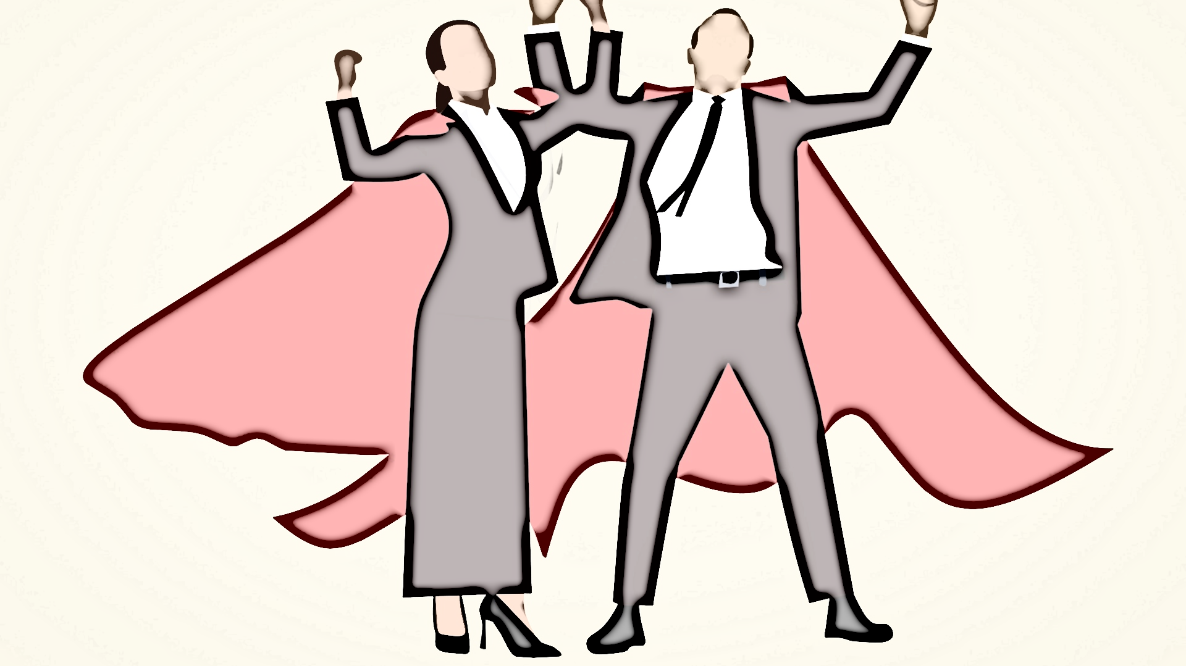
What Are Your Superpowers?
Jot down some compliments you receive from others
Document what makes you happy
Write down your strengths
Notes:
What was the last compliment you received?
Those compliments are the foundation of your superpowers.
Make a list of your super powers.
• Jot down some compliments you receive from others
• Document what makes you happy
• Write down your strengths
I discovered we have the power within us to deal with our challenges and use our strengths and decide how they will mold us. And, as important, I believe, we have the power to help make others more comfortable by embracing who they are, inside and out.
Having supportive people in our lives is very important. It’s also very important to know that we can do IT - whatever that IT is.
Write out one thing you want to share with a trusted person and specify what the outcome is that you want. When we have people who hold us accountable, we are better able to move forward, beyond our fears and phobias, which usually are nowhere near the worst case scenarios than we can possibly imagine. Others help us see our fears in a rational way.
Our supporters help us to ignore the negative self-talk and as they share what they see as our strengths, our super powers, we are more likely to believe them ourselves.

Slide 11
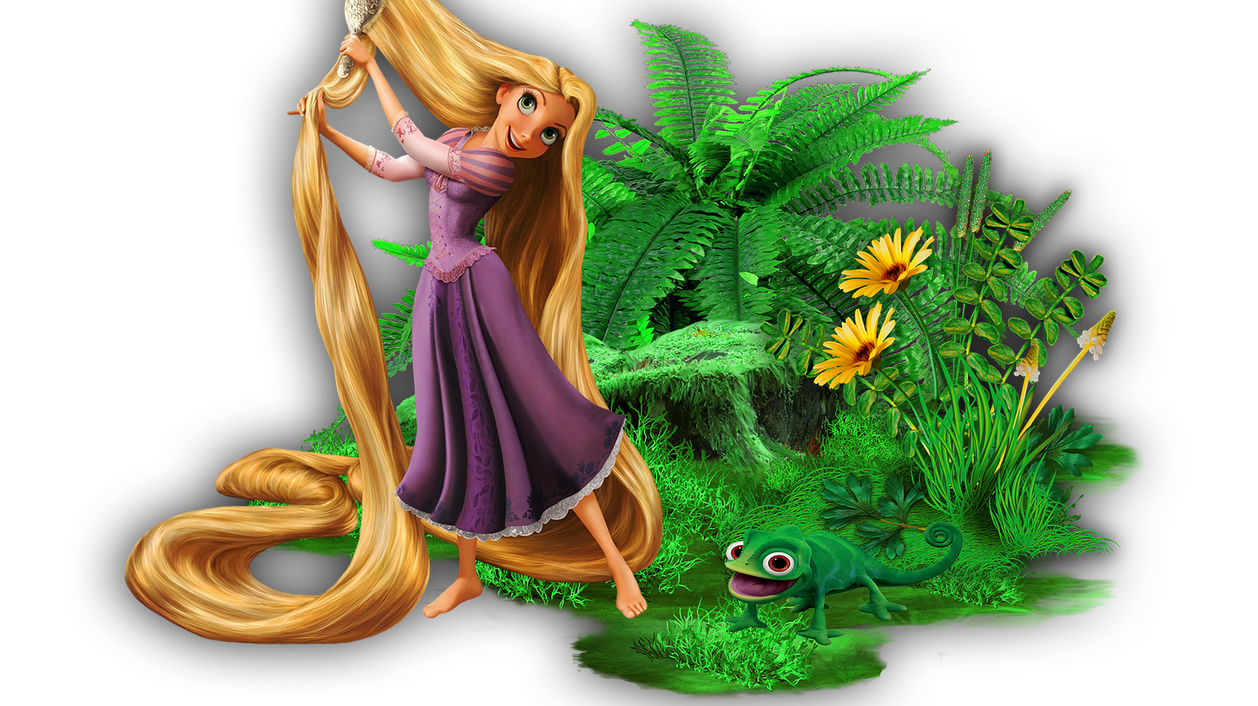
“The rewards are worth it.”
Notes:
Venturing out of our comfort zones is challenging; however as Rapunzel in the Disney movie Tangled said, “The rewards are worth it.”
When we share our stories, not only do we heal, but we help others heal too. We give permission to be vulnerable. We build strong foundations for more meaningful relationships.
We become self-confident.
When we feel confident, we hold ourselves more erect with better posture. We make a positive first impression. We are better able to formulate and reach our goals.
We smile more. Smiles are contagious – when you smile, you likely will receive a smile in return. I love sharing my smile and you will too.

Slide 12
Time To Give Back
Board Chair of Junior Achievement of Southern Arizona
Vice Chair Red Cross of Southern Arizona Board
Arizona Burn Foundation Volunteer
  Providing physical and emotional support and activities to burn survivors and their families
  SOAR (Survivors Offering Assistance in Recovery)
    Connecting survivors and loved ones with others who have experienced similar trauma.

Slide 13
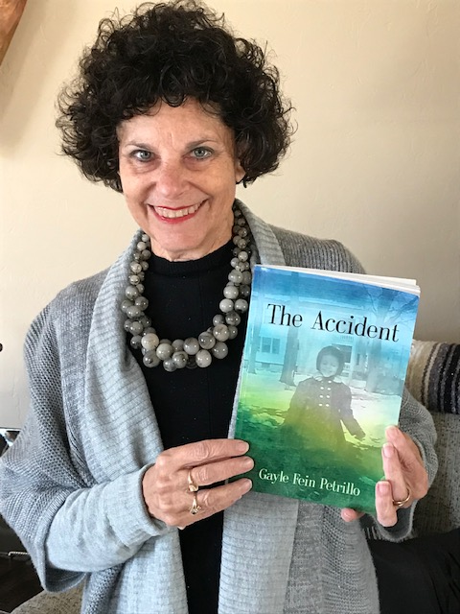
To purchase my books:
The Accident
https://booklocker.com/11593
El Accidente
https://booklocker.com/11681
Thank you!
You may find other information, including videos, by going to:
www.theaccidentmystory.com
Notes:
My book is available at the links above. Thank you for your time!

