Slide 1
2024-2025
UNIVERSITY
OF ARIZONA
ROTARACT CLUB

Slide 2
NEW GENERATION YOUTH EXCHANGE
THANK YOU ORO VALLEY ROTARY CLUB!!
Month long experience in Dénia Spain
Internship at a hospital working with doctors and nurses and several departments
Cultural events and fun adventures
Partnership with Rotary Club of Dénia
Important to learn about cultural differences but recognize the similarities from shared Rotary values.

Slide 3
OUR EXECUTIVE BOARD
Victor Sandrin
Megan Dwyer
Sophomore from Glendale, AZ
Neuroscience & Cognitive Science, Philosophy
Sophomore from Elko, Nevada
Neuroscience & Cognitive Science, Bioethics, Biochemistry, French
Vice President
Director of Membership
Brooke McKalip
Kanita Olson
Senior from Washington, DC
Environmental Public Health, Spanish, Pre-Health
Senior from Sedona, AZ
Physiology, Health and Human Values, Biochemistry
President
Treasurer

Slide 4
COMMUNICATIONS COMMITTEE
NYLA
FLEMING
LAUREN
GALLEGOS
ARJAN
KUNDAN
TAYLOR
GRAVES
CHRISTIANA KETEMA

Slide 5
2 SESSIONS
@ DISTRICT
CONFERENCE
4 PROFESSIONAL
DEVELOPMENT
EVENTS
2024 FALL SEMESTER @ A GLANCE
5 ROTARY CLUB COLLABORATIONS
RCOT, KINO, SUNRISE, RAINBOW, INTERACT,
15 DIFFERENT SERVICE EVENTS
20 AVG. MEMBERS @ MEETINGS
21.5 AVG. MEMBERS @ EVENTS

Slide 6
2024 FALL SEMESTER @ A GLANCE
SEDONA RETREAT
WORKSHOPS ON ETHICAL AND RESPONSIBLE VOLUNTEERING
SERVICE, TEAM BUILDING, FUN ACTIVITIES

Slide 7
2024 FALL SEMESTER HIGHLIGHTS
DISTRICT 5500
CONFERENCE
2 BREAKOUT SESSIONS ON MENTAL HEALTH
ASSISTED WITH COMMUNICATIONS - THANKS JANE!

Slide 8
2024 FALL SEMESTER @ A GLANCE
INTERACT X ROTARACT FRIENDSGIVING
CONNECTED 3 D500 INTERACT CLUBS W/ ROTARACT
CANNED FOOD DRIVE

Slide 9
2024 FALL SEMESTER @ A GLANCE
PROFESSIONAL DEVELOPMENT SESSIONS
ROTARIAN - ROTARACTOR CONNECTIONS
EX. FINANCIAL LITERACY WORKSHOP

Slide 10
2024 FALL SEMESTER @ A GLANCE
CAMPUS COLLABORATIONS
RECRUIT NEW MEMBERS AND IMPROVE NAME ID ON CAMPUS
33 PERSON EVENT - FELICA’S FARM

Slide 11
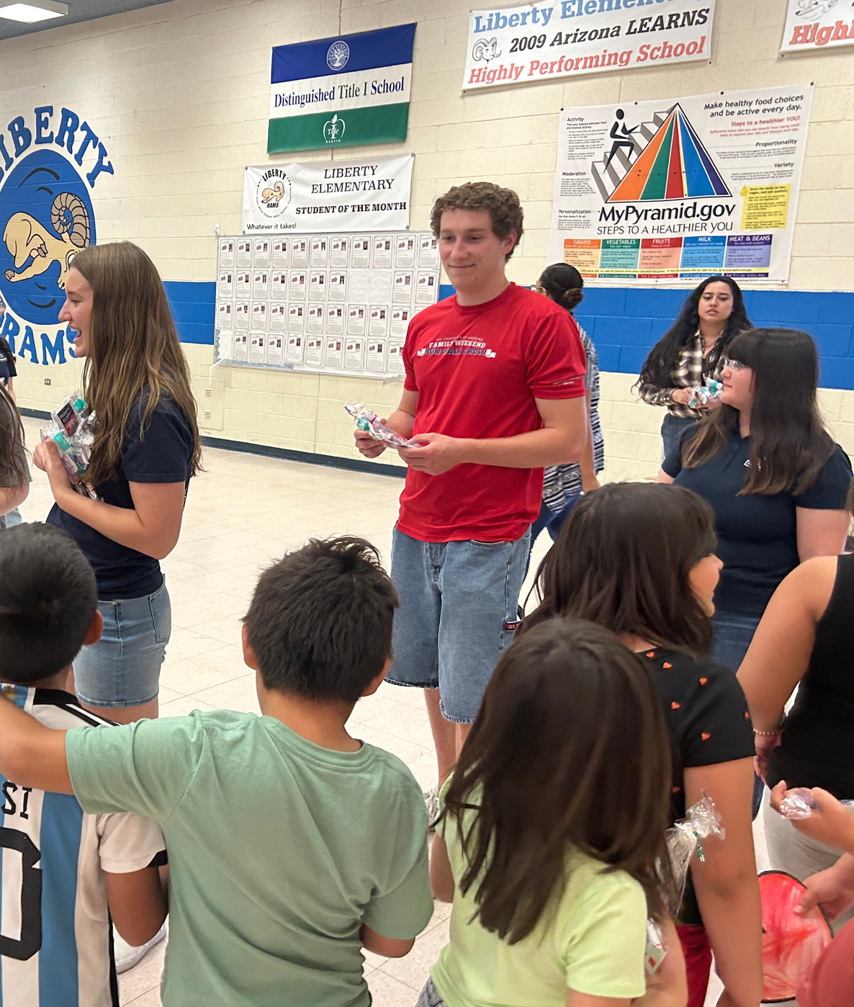
ANNUAL DENTAL PROJECT
2024 SPRING -1500 Dental Hygiene Bags Distibuted
1300 to K-8 students at local Title 1 local elementary schools
200 to unhoused individuals @ a local feeding project

Slide 12
Period Poverty
DIAPER BANK
OF
SOUTHERN ARIZONA
PROJECT
ISSUE: MENSTRUAL HYGINE PRODUCTS CAN BE EXPENSIVE AND DIFFICULT TO ACCESS
IN SOUTHERN ARIZONA, 2 IN 5 PEOPLE WHO MENSTRUATE STRUGGLE TO AFFORD OR ACCESS PERIOD PRODUCTS
1 IN 3 LOW-INCOME INDIVIDUALS HAVE HAD TO MISS WORK, SCHOOL, OR IMPORTANT EVENTS DUE TO LACK OF ACCESS TO MENSTRUAL SUPPLIES.
U OF A
FEMINIST
PHARMACY
Z MANSION
FEEDING PORJECT

Slide 13
Desire to cultivate a culture that embodies human connection and mutual support through service and community-building.
OPERATIONAL FRAMEWORK
UNITY IN COMMUNITY
person
problem
In an era characterized by division and pain, we seek to provide a safe and welcoming environment to enact positive change fostered from our shared Rotary values.

Slide 14
YOUR ROTARACT TOOLBOX
Website
Newsletter
Auction Log
Professional
Development
Sign-Up
Spring Calendar

Slide 15
SUPPORT ROTARACT’S MISSION
Zelle @ treasurer@uazrotaractclub.org

Slide 16
THANK YOU!
president@uazrotaractclub.org
uazrotaractclub.org
treasurer@uazrotarctclub.org for donations!
scan for website

