Slide 1
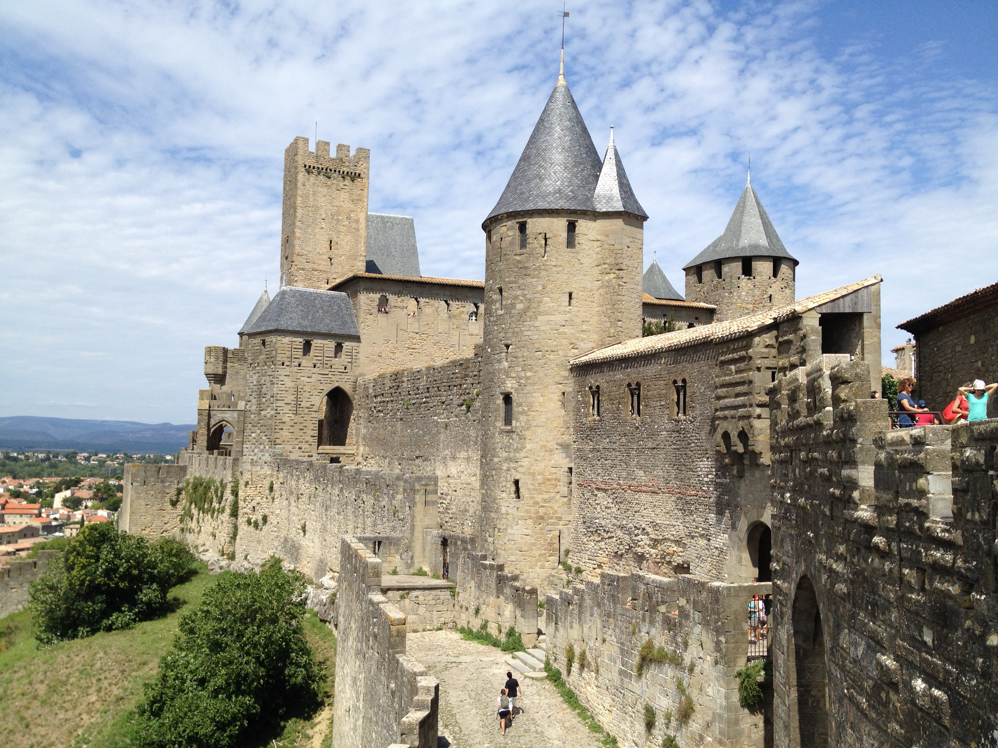
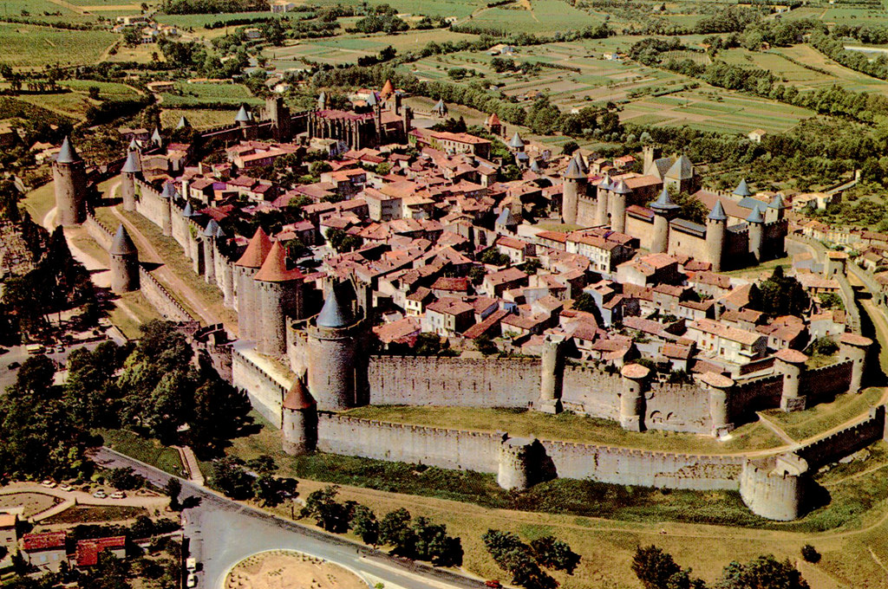
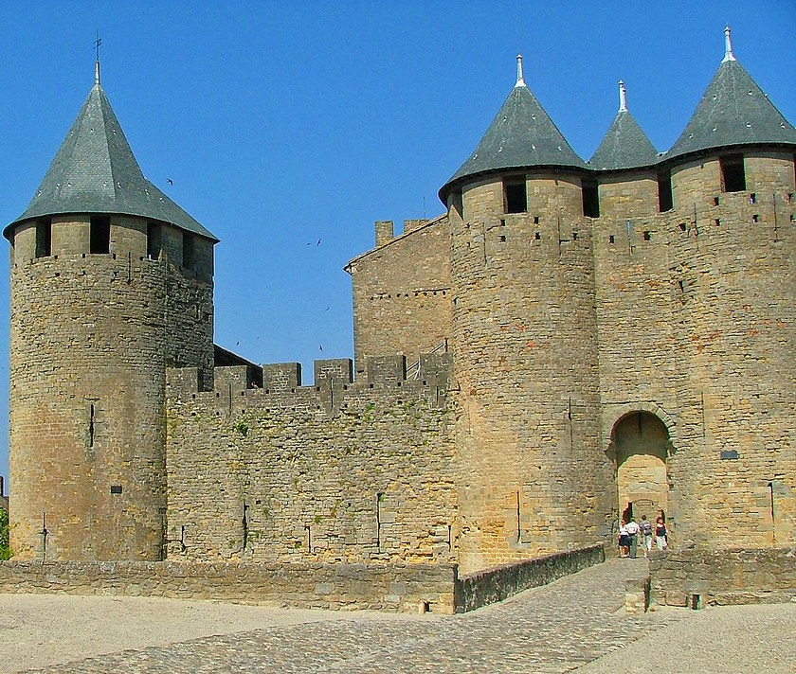
Born in Carcassonne-France

Slide 2
Marque Jaune – Studio Graphic Design
Small business
for 10 years in France
in Toulouse

Slide 3
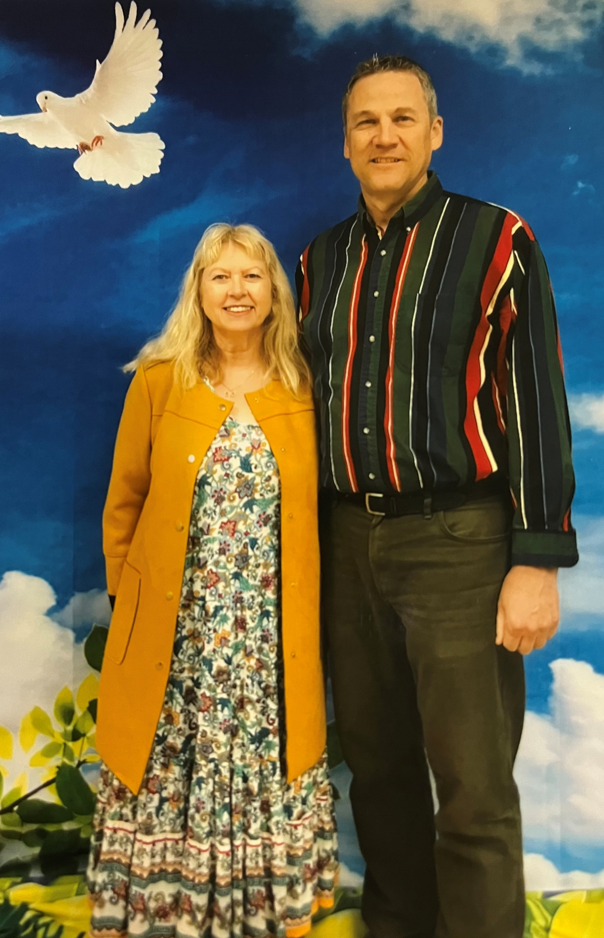
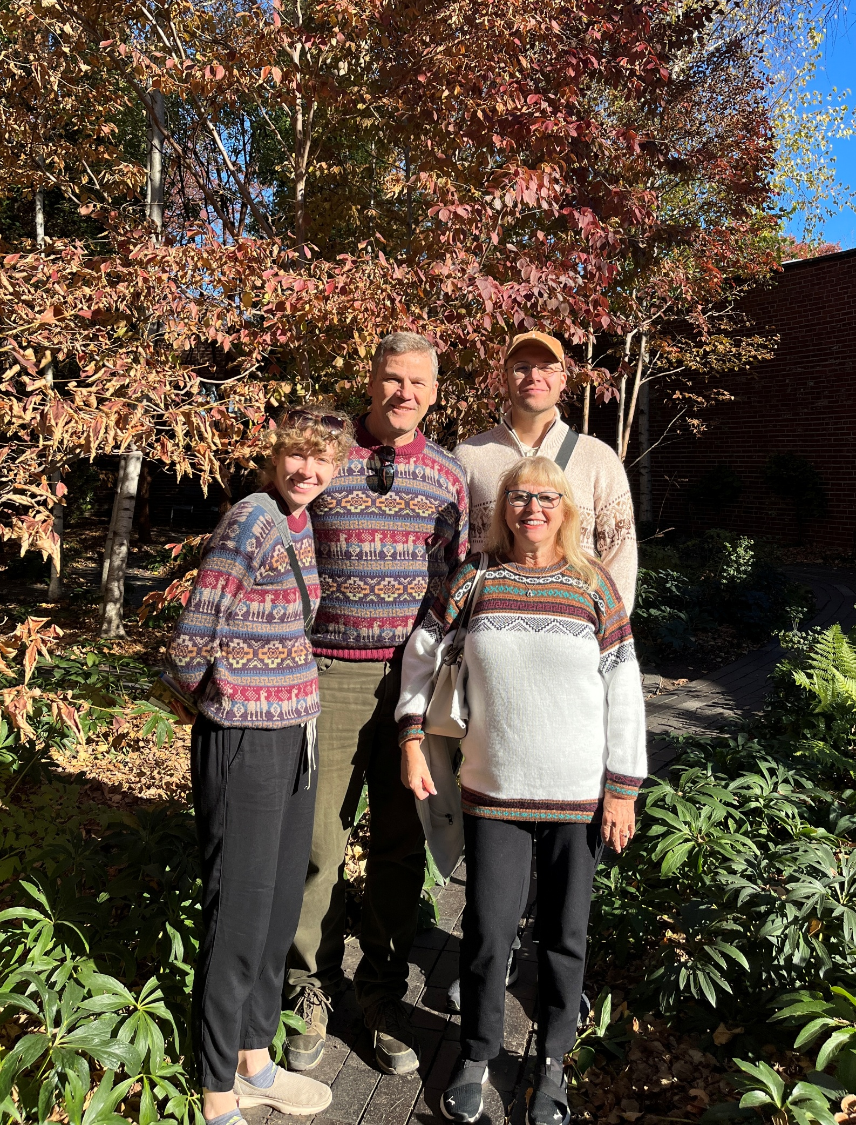
My Family

Slide 4
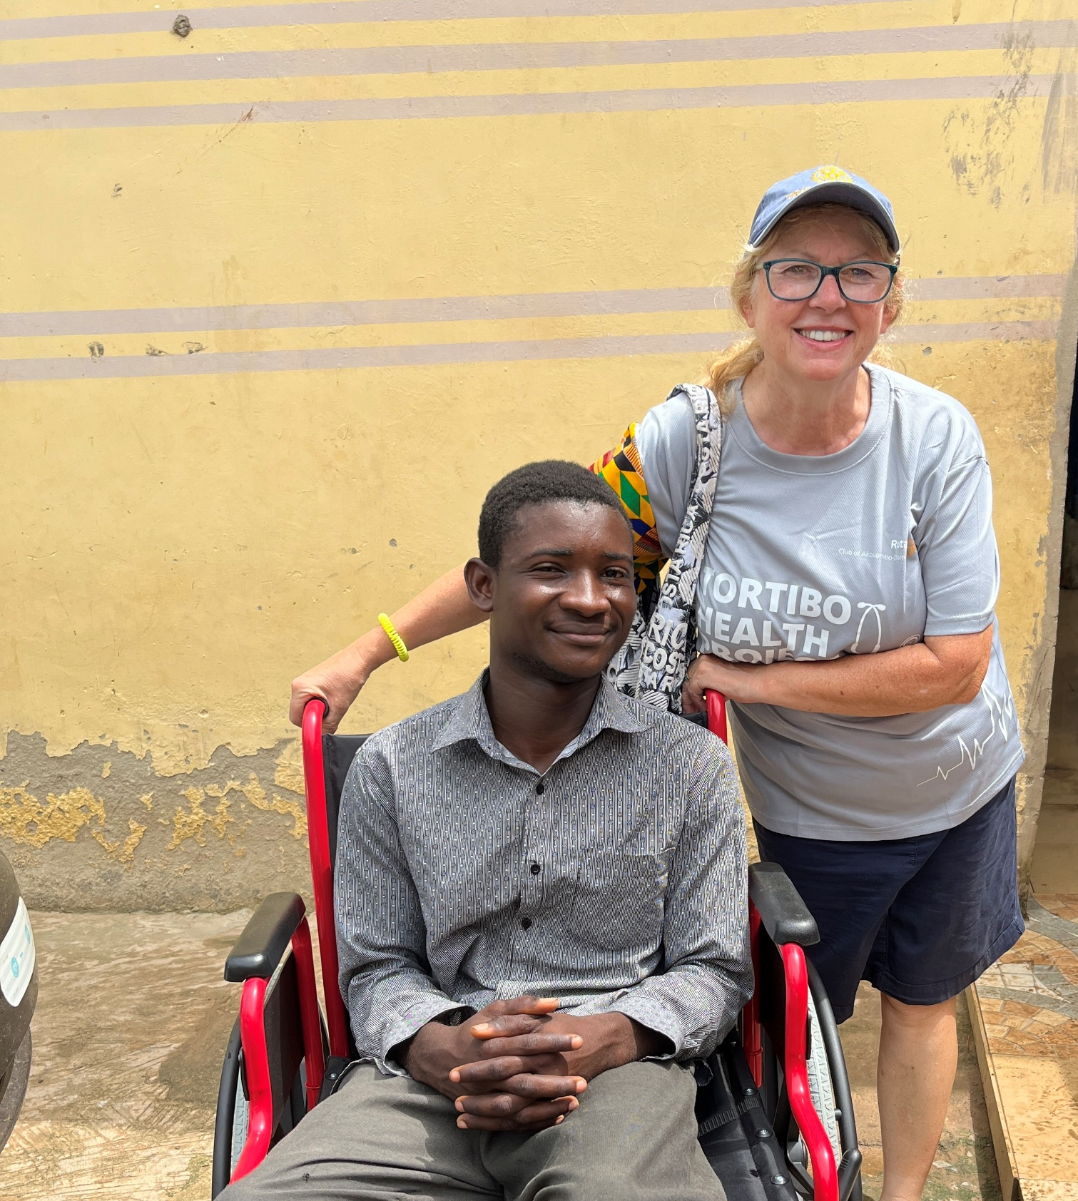
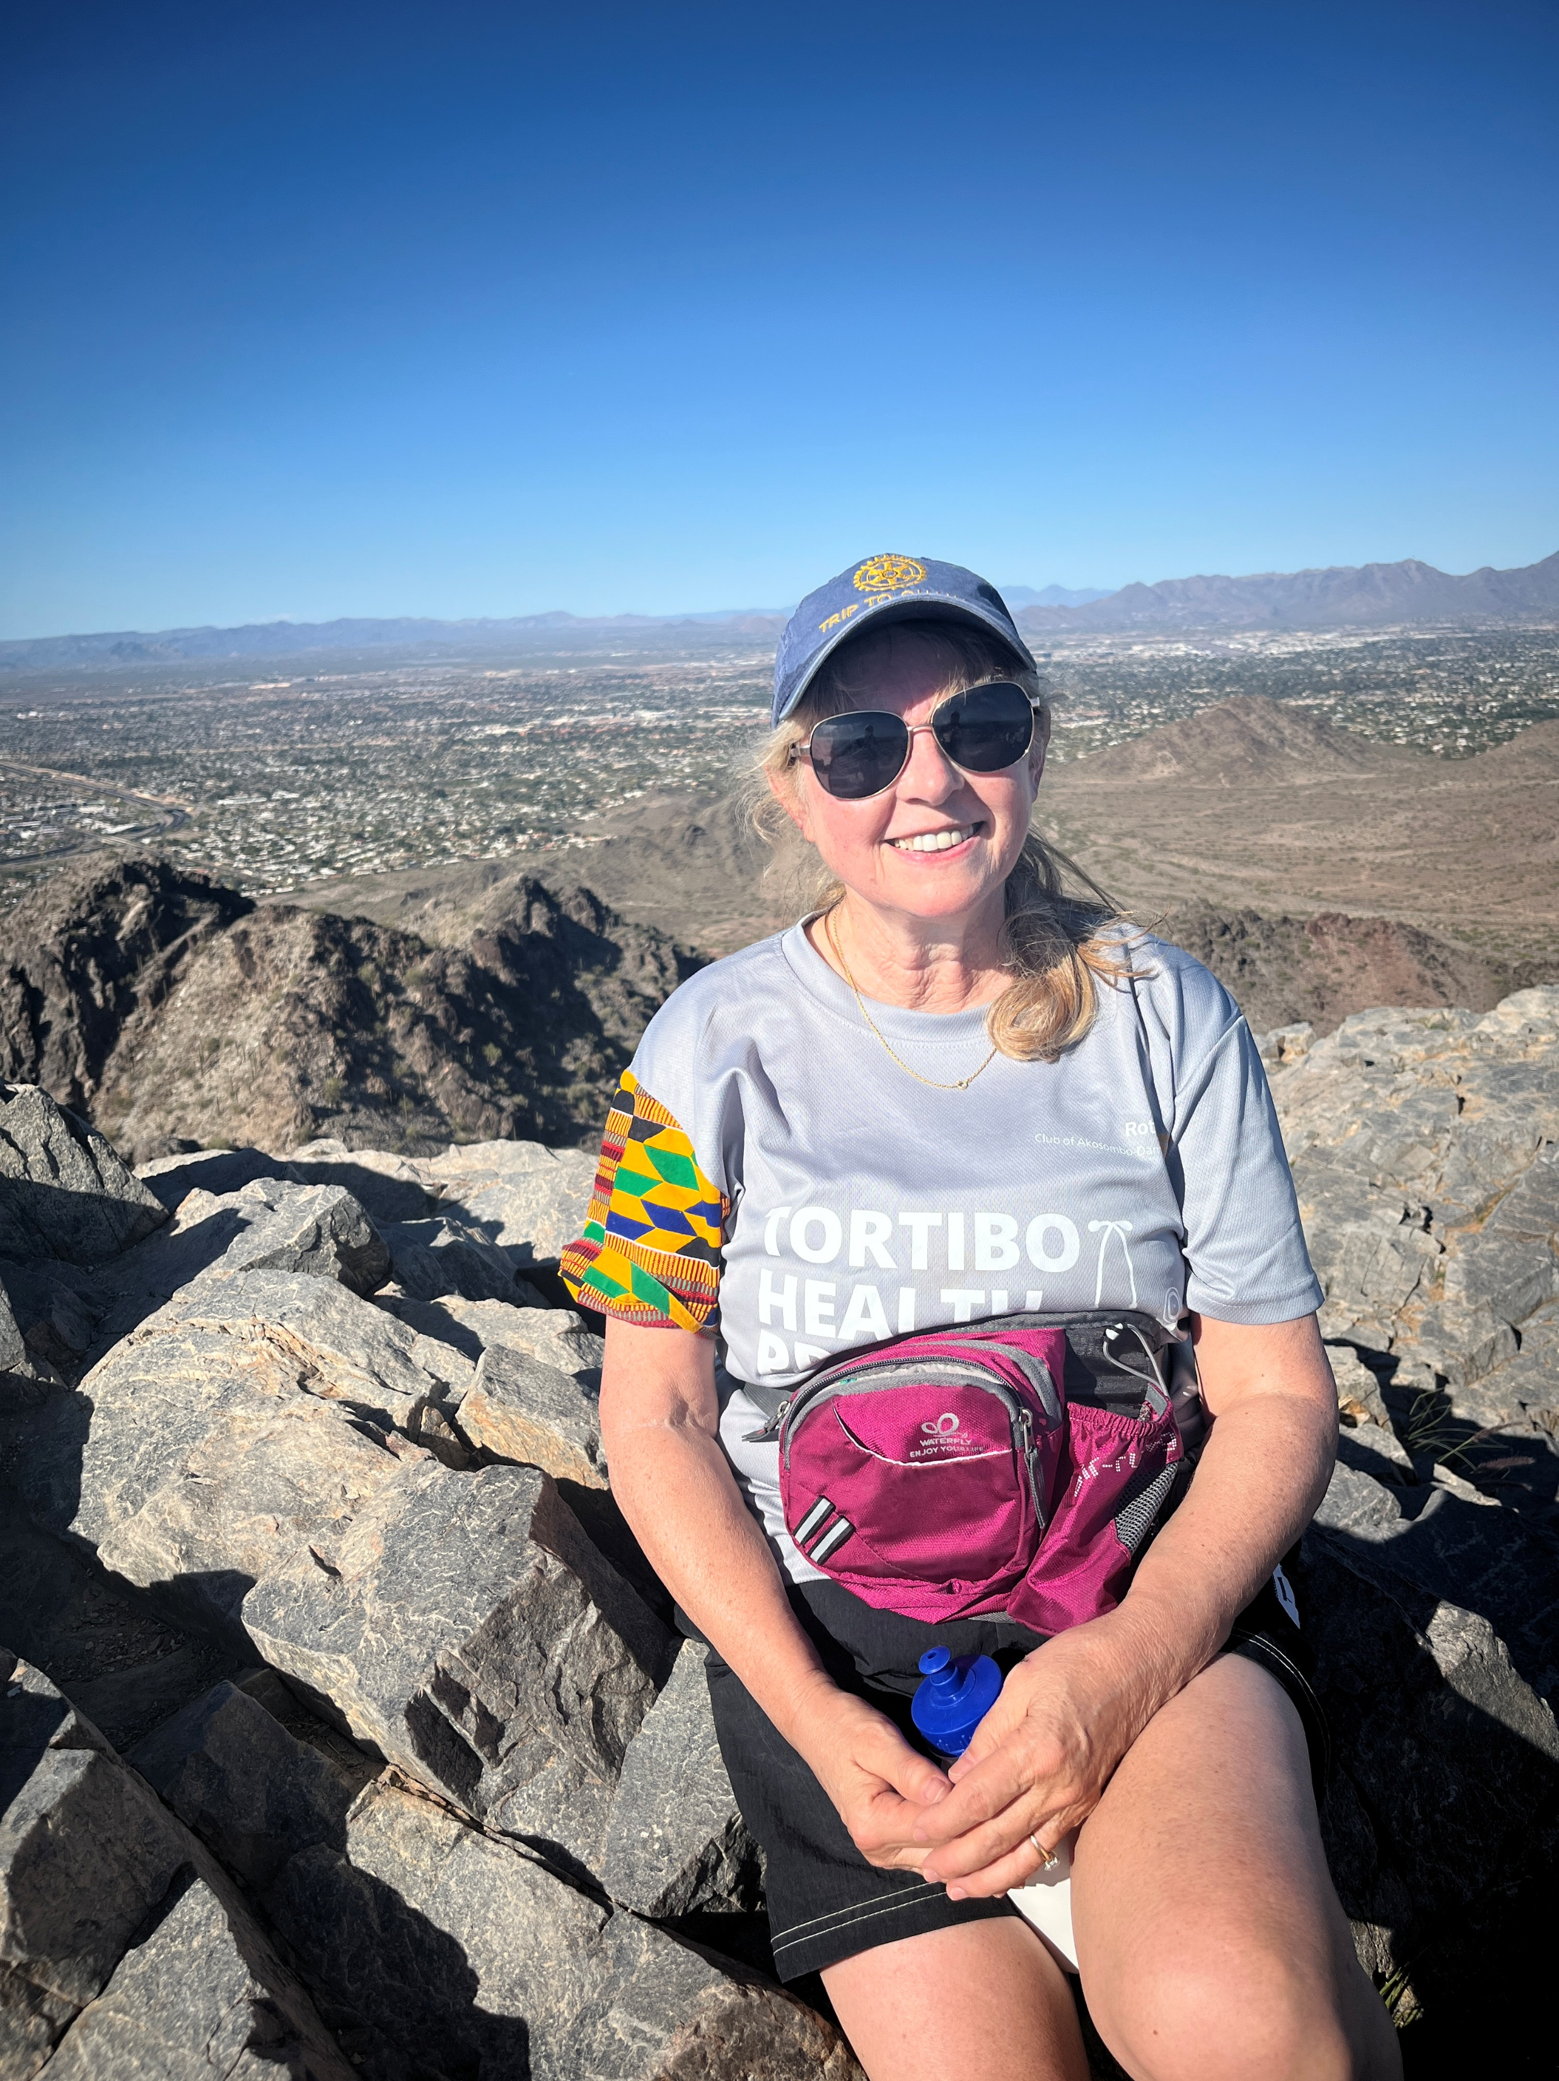
Helping Others & Hiking

Slide 5
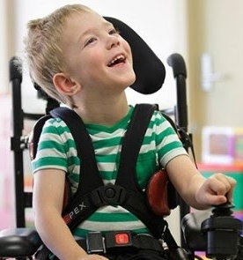
Joined Rotary in Dec. 2014 to help Ukraine with wheelchairs

