Slide 1
The Air We Breathe: It Is Not What It Used To Be!
Dr. Russ Schnell
Senior Scientist
National Oceanic and Atmospheric Administration
Boulder, Colorado USA 80305
Twin Peaks Rotary Club,
January 25, 2024

Slide 2
Questions for You?
How thick is the Earth’s Atmosphere?
(About 15 km. Visualize it as thick as a paper page on a large globe)
2. How many pounds of (CO₂) are produced by burning a gallon of gasoline?
(~24 pounds)
How many years does a molecule of (CO₂)
stay in the atmosphere?
(from 100 to ~1,000 years)

Slide 3
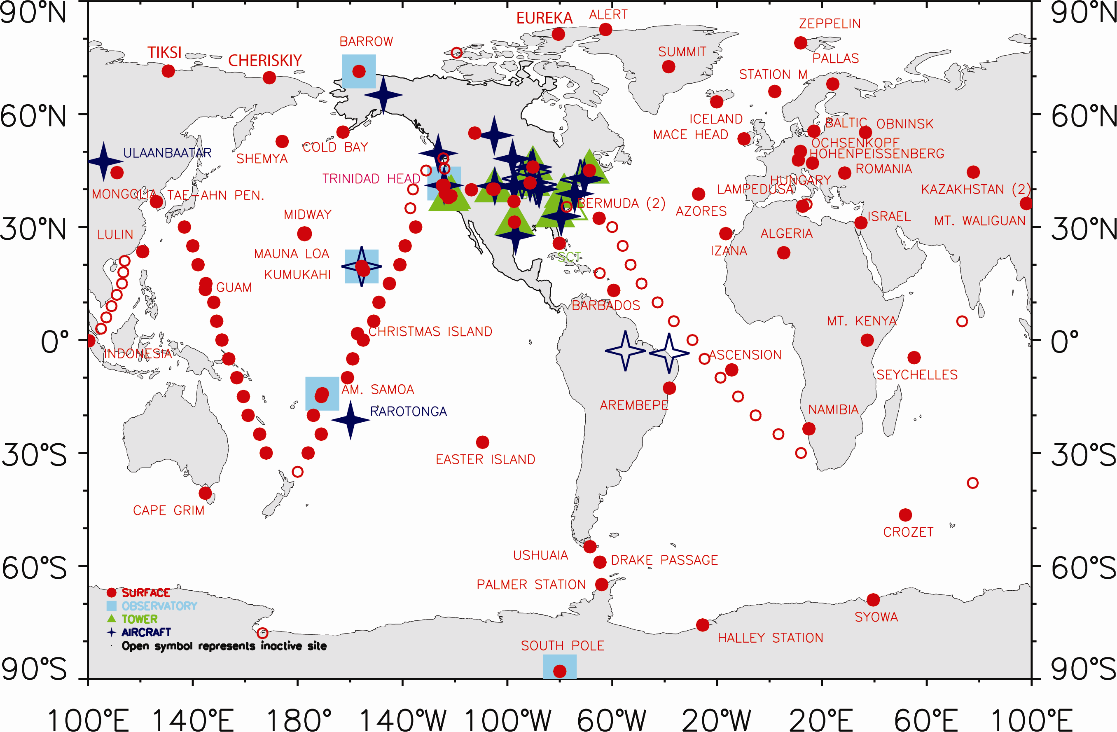
Where NOAA Measure 80 gasses in the Atmosphere
Notes:
3

Slide 4
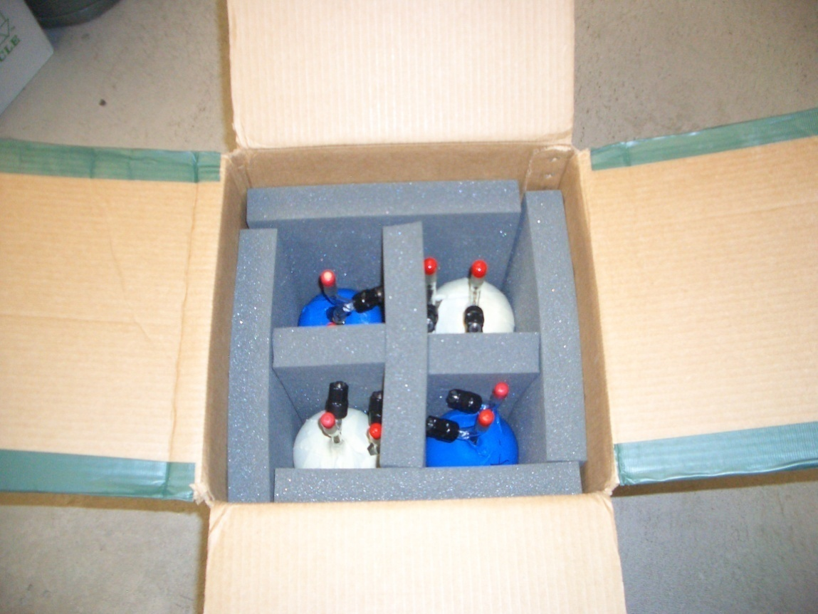
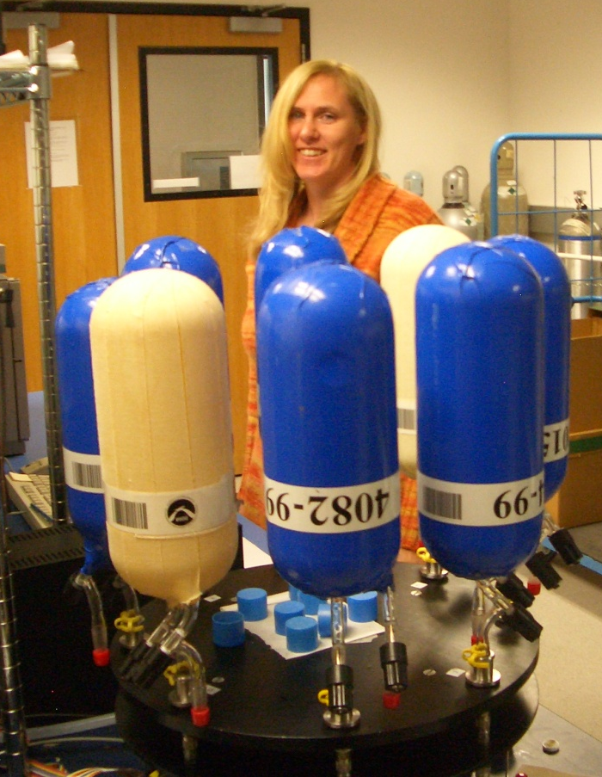
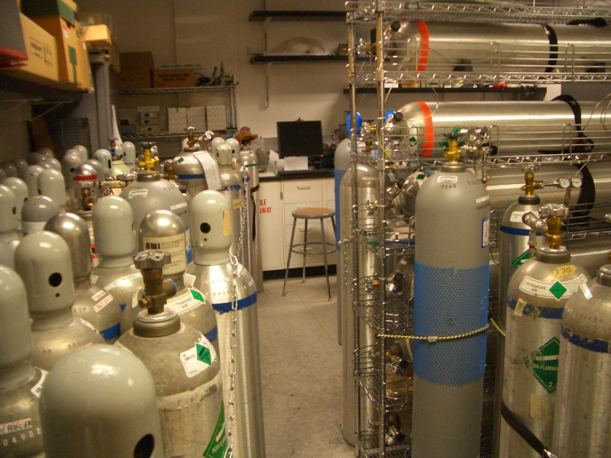
Flask Shipping, Analysis and Calibrations
Shipping Box
Measurement
Calibration Gases

Slide 5
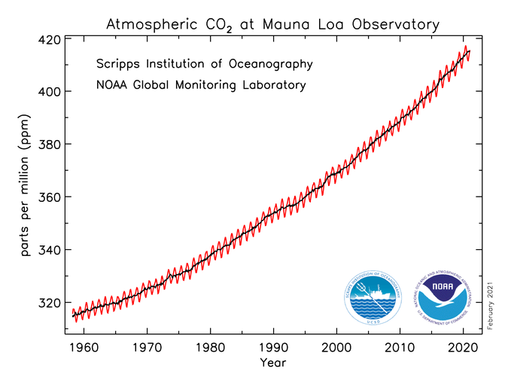
CO₂ from Burning Fossil Fuels and Biomass
CO2 is increasing each year! At 500 ppm the Earth goes into accelerated warming.
Why Care?

Slide 6
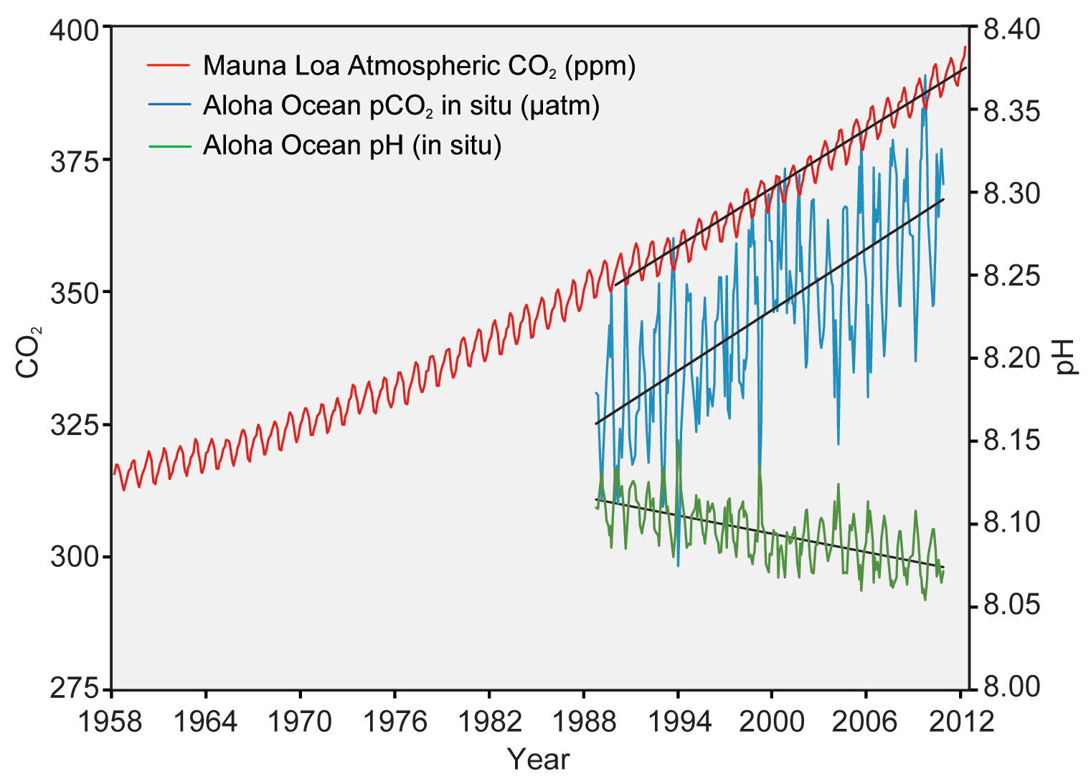

Oceans Absorb CO₂ and Become Acidic
Notes:
The correlation between rising levels of carbon dioxide in the atmosphere (red) with rising carbon dioxide levels (blue) and falling pH in the ocean (green). As carbon dioxide accumulates in the ocean, the water becomes more acidic (the pH declines). (Figure source: modified from Feely et al. 2009).

Slide 7
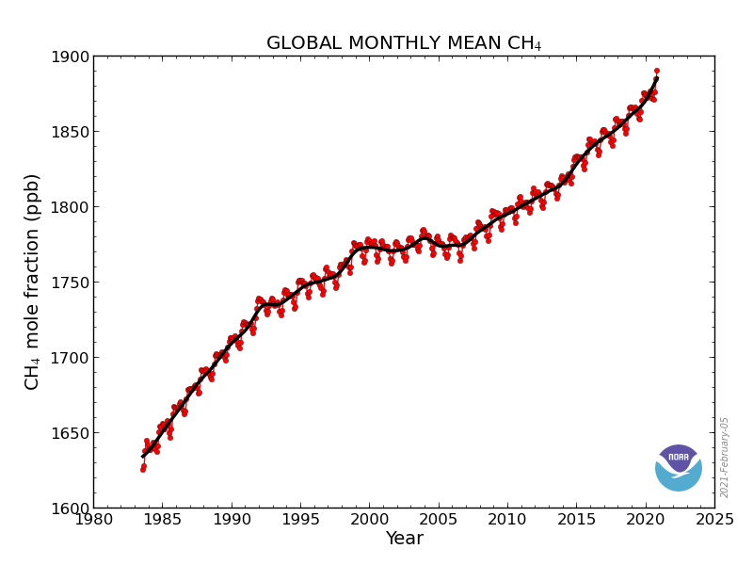
CH₄ from Natural Gas, Combustion, Agriculture & Anaerobic Decay in Tropical Wetlands
Note the Recent Accelerating CH₄ Increase

Slide 8
Permafrost Methane Blast Crater, Yamal Gas Field, Russia, 2021
Is this a start to a Tipping Point for methane?
Man

Slide 9
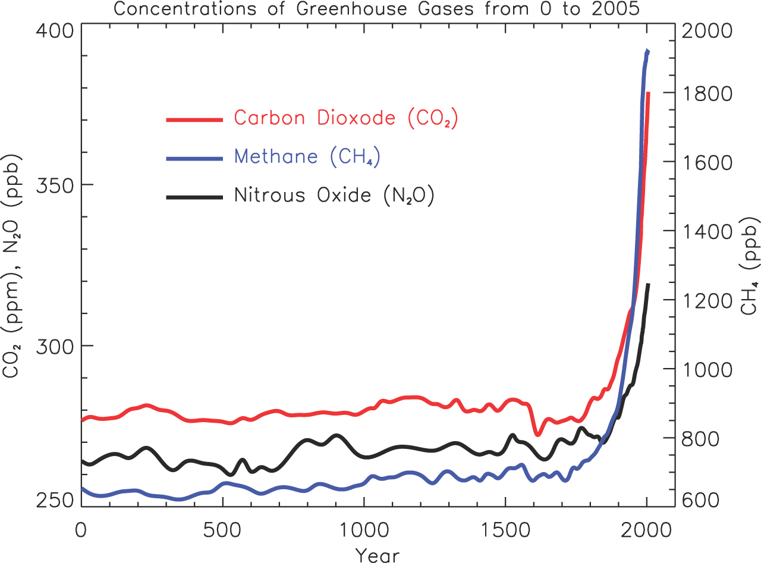
Greenhouse Gases, Past 2000 Years
Industrial Revolution

Slide 10
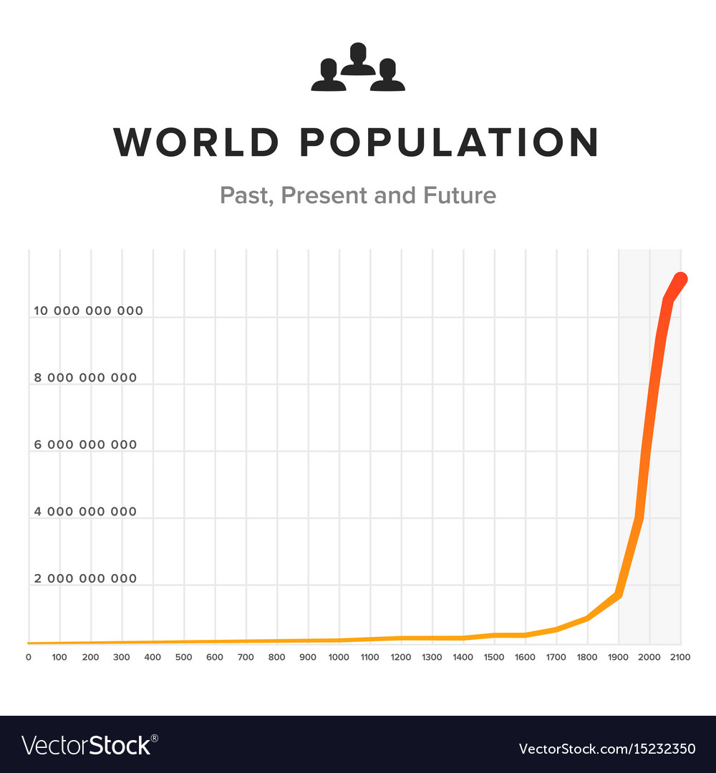
Human Population
2100
Industrial Revolution
Billions
1000 Year 1800

Slide 11
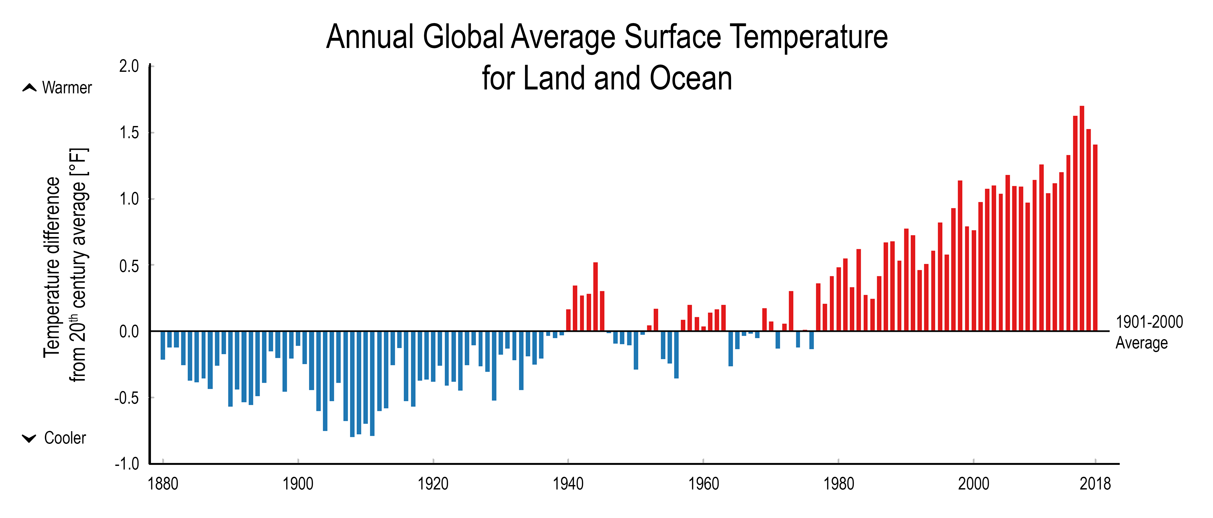
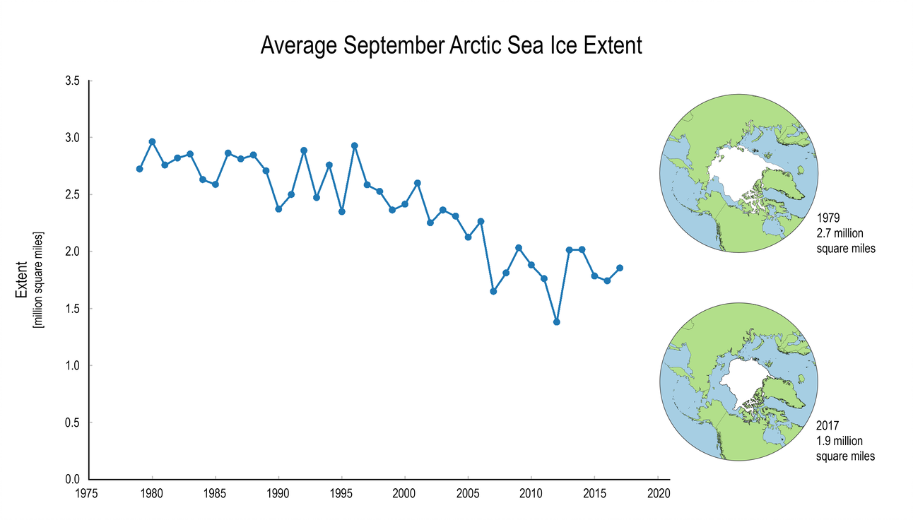
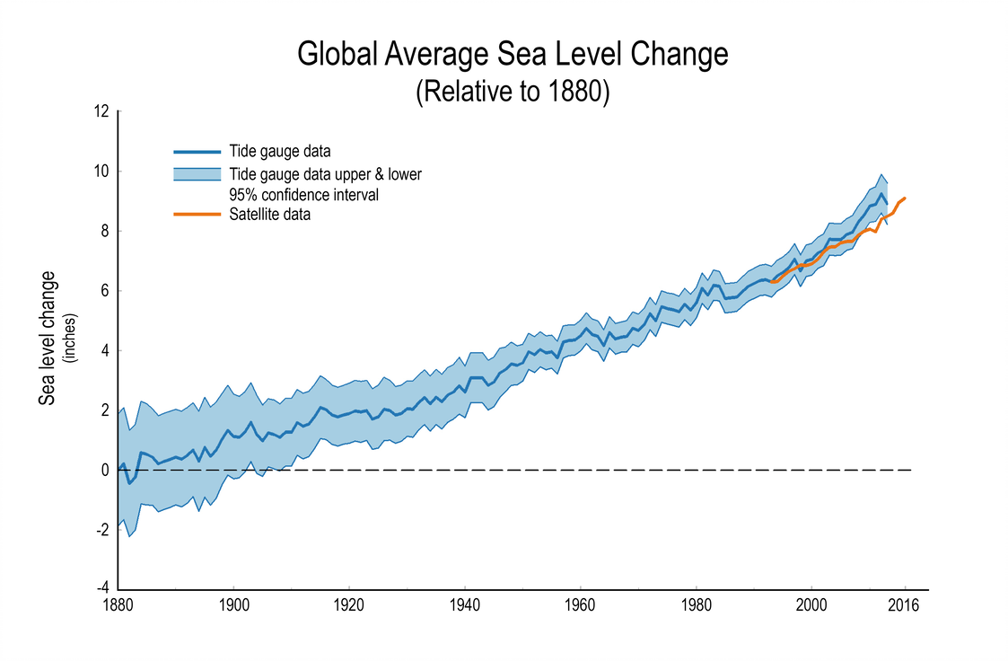
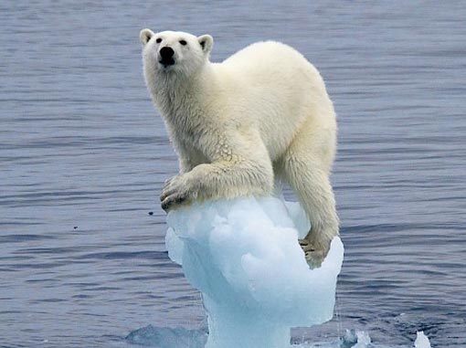
Some Indicators of Climate Change
Temperatures Are Rising
Arctic and Antarctic Sea Ice is Shrinking
1900
1950
2018
1980
2017
Sea LeveI
Is Rising
1900
1950
2018

Slide 12
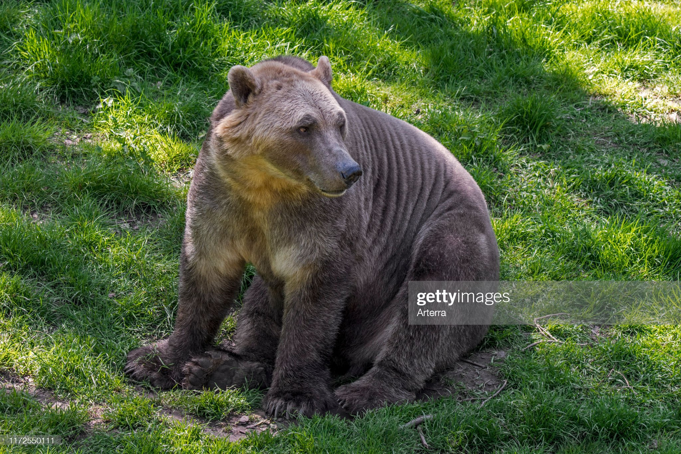
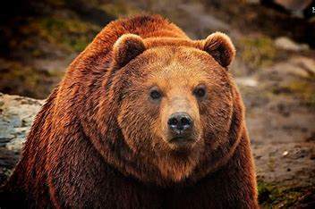
Polar and Grizzly Bears are interbreeding
Polar Bear Father
Grizzly Bear Mother
Make Big Baby = Pizzly Bear

Slide 13
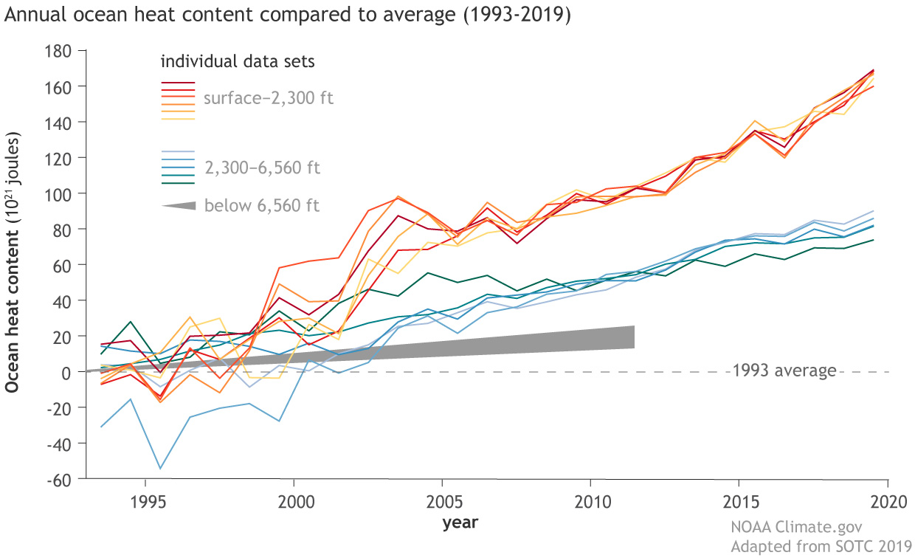
90% of global heating is going into ocean water!
Hurricanes get their energy from warm seawater

Slide 14
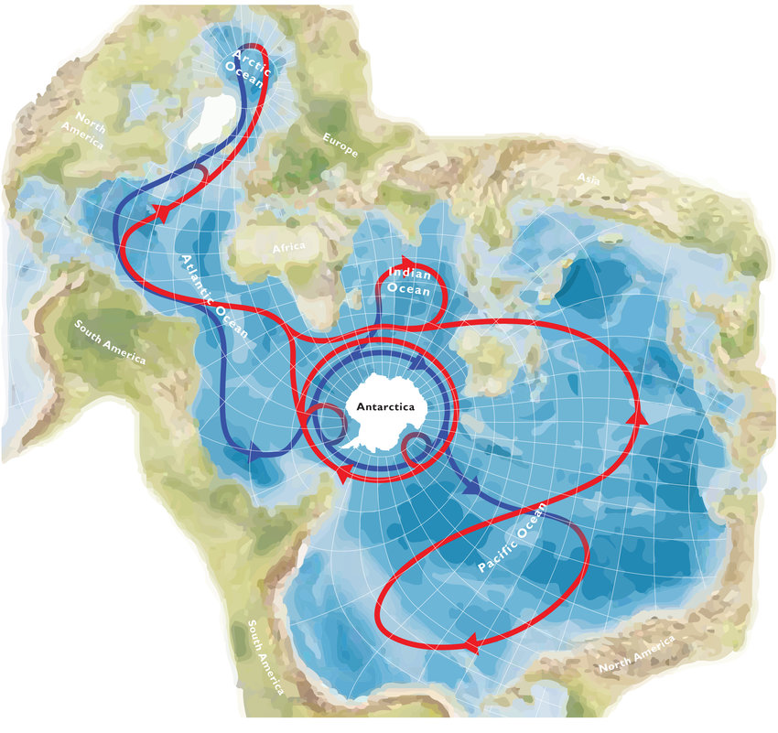
Ocean Currents Bring Warmer Water to Antarctica Red = upper layer
Blue = lower layer
Arctcic Ocean
Europe
Asia
Indian Ocean
Atlantic Ocean
South America
Pacific Ocean
North America

Slide 15
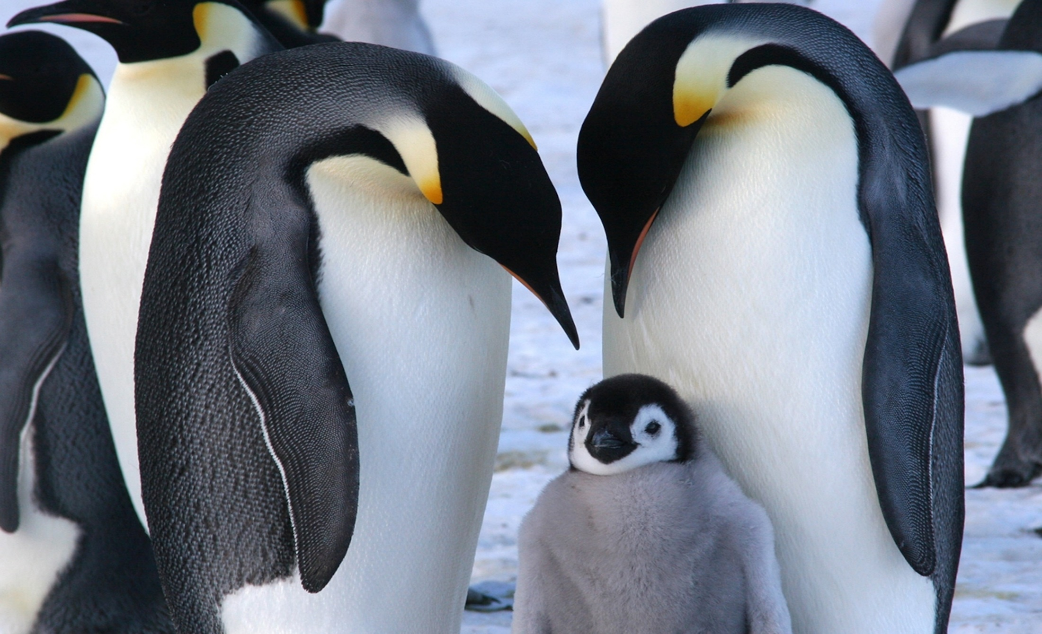
In 2022, 95% of Emperor Penguin chicks
drowned as their home ice melted!

Slide 16
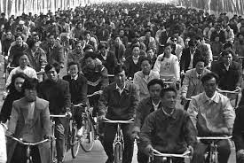
Bicycle Transport, Beijing, 1986.

Slide 17
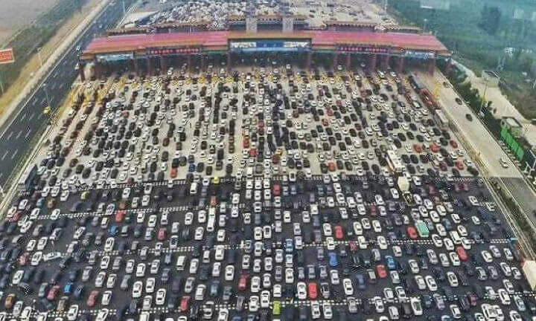
50 lane traffic Jam in China In 2010

Slide 18
7 degrees F!
Temperatures
and CO2 Emissions

Slide 19
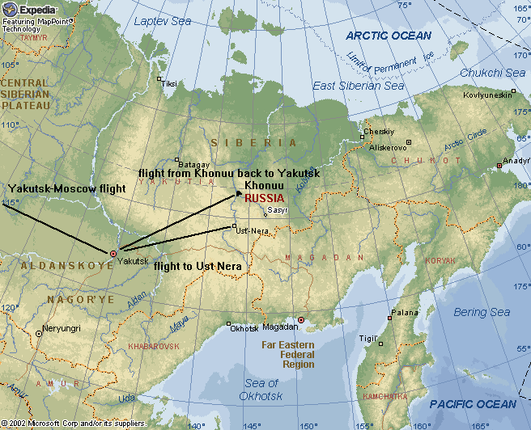
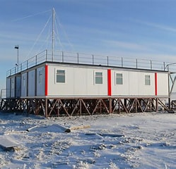
Cooperative Programs at Tiksi and Cherskyi, Siberia
Paid for by US National Science Foundation and NOAA

Slide 20
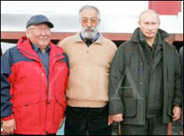
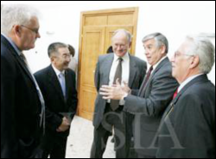
2010 Grand Opening of the Tiksi Station
Putin
Schnell
US scientists were not allowed to be within10 miles of Putin. He had his own visit under heavy security.

Slide 21
Thank You For Your Time and Attention
END

