Slide 1
Diabetes Prevention and treatment
Mayra Serrano, DrPH(c), MPH, CHES
Senior Manager, CCARE
City of Hope
Division of Health Equities

Slide 2
Diabetes in the US
34.2 million (1 in 10) people have diabetes
1 in 5 don’t know they have diabetes
88 million adults (1 in 3) have prediabetes
More than 8 in 10 don’t know they have prediabetes
Type 2 diabetes accounts for approximately 90-95% of all diagnosed cases of diabetes
Diabetes is the 7th leading cause of death in the United States
Notes:
In the last 20 years, the number of adults diagnosed with diabetes has more than tripled as the American population has aged and become more overweight or obese

Slide 3
Every 24 Hours…
4557 adults are diagnosed with diabetes.
136 people begin treatment for end-stage renal disease.
200 nontraumatic lower-limb amputations are performed.
641 people die from diabetes, or diabetes is a contributing cause of their death.
CDC. National Diabetes Statistics Report 2014: Estimates of diabetes and its burden in the United States, 2014. Atlanta, GA: U.S. Department of Health and Human Services, Centers for Disease Control and Prevention, 2011. Available at http://www.cdc.gov/diabetes/pubs/statsreport14.htm
.
Notes:
The numbers are grim. In the United States, diabetes takes a toll each and every day.
Every 24 hours:
More than 5,200 new cases of diabetes are diagnosed.
133 people begin treatment for end-stage renal disease (kidney failure).
180 nontraumatic lower-limb amputations are performed.
More than 600 people die from diabetes (or diabetes contributes to their cause of death).

Slide 4
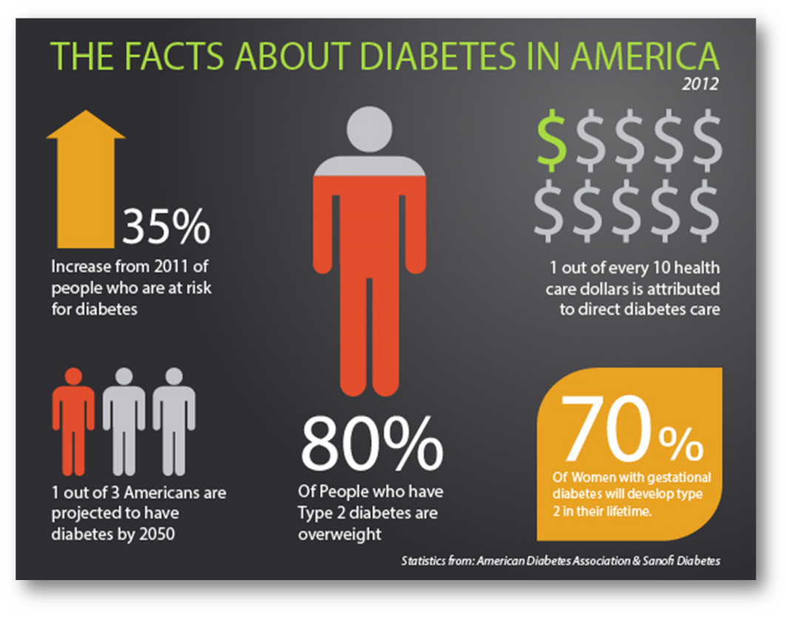
Diabetes Statistics
https://www.cdc.gov/diabetes/images/library/socialmedia/diabetes-infographic.jpg

Slide 5
Comparing Los Angeles with the US
https://diabetes-2-commhealth.hub.arcgis.com/
Notes:
Diabetes is a nationwide concern, with particularly high rates in the South. Diabetes affects 9% of Los Angeles County residents (highlighted in green), which is much higher than some of our neighbors in the West.

Slide 6
Age-adjusted Prevalence of Diagnosed Diabetes Among US Adults
1994
CDC’s Division of Diabetes Translation. United States Surveillance System available at http://www.cdc.gov/diabetes/data

Slide 7
Age-adjusted Prevalence of Diagnosed Diabetes Among US Adults
2000
CDC’s Division of Diabetes Translation. United States Surveillance System available at http://www.cdc.gov/diabetes/data

Slide 8
Age-adjusted Prevalence of Diagnosed Diabetes Among US Adults
2015
CDC’s Division of Diabetes Translation. United States Surveillance System available at http://www.cdc.gov/diabetes/data

Slide 9
Age-adjusted Prevalence of Obesity and Diagnosed Diabetes Among US Adults
Age-adjusted Prevalence of Obesity and Diagnosed Diabetes Among US Adults
1994
2000
2015
Obesity
(BMI ≥30 kg/m²)
No Data <14.0% 14.0%–17.9% 18.0%–21.9% 22.0%–25.9% > 26.0%
1994
2000
2015
Diabetes
No Data <4.5% 4.5%–5.9% 6.0%–7.4% 7.5%–8.9% >9.0%
CDC’s Division of Diabetes Translation. United States Surveillance System available at http://www.cdc.gov/diabetes/data

Slide 10
Number and Percentage of U.S. Population with Diagnosed Diabetes, 1958-2015
CDC’s Division of Diabetes Translation. United States Diabetes Surveillance System available at http://www.cdc.gov/diabetes/data
Notes:
Methodology
Number and percent of the U.S. population with diagnosed diabetes were obtained from the National Health Interview Survey (NHIS, available at http://www.cdc.gov/nchs/nhis.htm) of the National Center for Health Statistics (NCHS), Centers for Disease Control and Prevention (CDC) for years. Conducted continuously since 1957, the NHIS is a health survey of the civilian, noninstitutionalized population of the United States. The survey provides information on the health of the United States population, including information on the prevalence and incidence of disease, the extent of disability, and the utilization of health care services. The multistage probability design of the survey has been described elsewhere (1,2,3). Estimates for years 1958-1979 were obtained from published data (4) and estimates from 1980 forward were derived directly from the NHIS survey data.
References
1. Massey JT, Moore TF, Parsons VL, Tadros W. Design and estimation for the National Health Interview Survey, 1985-1994. Hyattsville, MD: National Center for Health Statistics. Vital and Health Statistics 1989;2(110).
2. Botman SL, Moore TF, Moriarity CL, Parsons VL. Design and estimation for the National Health Interview Survey, 1995–2004. National Center for Health Statistics. Vital and Health Statistics 2000;2(130).
3. Parsons VL, Moriarity C, Jonas K, et al. Design and estimation for the National Health Interview Survey, 2006–2015. National Center for Health Statistics. Vital Health Stat Vital and Health Statistics 2014, 2(165).
4. Harris MI: Prevalence of noninsulin-dependent diabetes and impaired glucose tolerance. Chapter VI in Diabetes in America, Harris MI, Hamman RF, eds. NIH publ. no. 85-1468, 1985.

Slide 11
https://www.cdc.gov/diabetes/data/statistics-report/diagnosed-diabetes.html

Slide 12
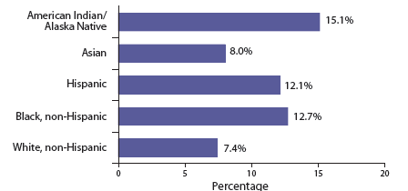
Percentage of US Adults Ages 18 or older with Diagnosed diabetes, by Race and Ethnic Group, 2013-2015
Diabetes 2017 Report Card, CDC

Slide 13
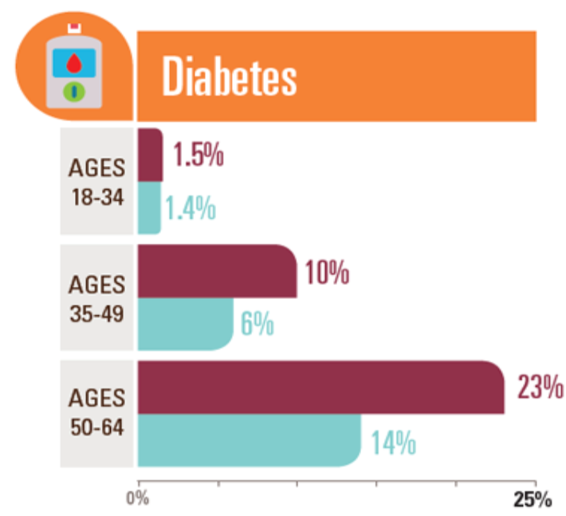
Diabetes Among African Americans
Notes:
https://www.cdc.gov/vitalsigns/aahealth/infographic.html

Slide 14
Diagnoses of Diabetes
African American adults are 60% more likely than non-Hispanic white adults to have been diagnosed with diabetes by a physician.
In 2016, non-Hispanic blacks were 2.3 times more likely to be hospitalized for lower limb amputations as compared to non-Hispanic whites.
In 2017, African Americans were twice as likely as non-Hispanic whites to die from diabetes.
Notes:
https://minorityhealth.hhs.gov/omh/browse.aspx?lvl=4&lvlid=18
https://www.cdc.gov/nchs/nhis/shs/tables.htm

Slide 15
Diabetes among Latinos
More than half of Latinos adults are expected to develop type 2 diabetes in their lifetime
Latinos are 2x as likely than non-Hispanic whites to be diagnosed with type 2 diabetes
Among adults of Hispanic origin, Mexicans (14.4%) and Puerto Ricans (12.4%) had the highest prevalence, followed by Central/South Americans (8.3%) and Cubans (6.5%)
Latinos are 50% more likely to die from type 2 diabetes
Latinos are more likely to be diagnosed with diabetes at younger age
Latinos have higher rates of obesity and are less likely to be physically active, leading to an increased risk of developing diabetes
Latinos are more likely to have prediabetes (higher than normal blood sugar levels but not yet high enough to be diabetic), increasing the risk of developing diabetes.
Centers for Disease Control Accessed from: https://www.cdc.gov/diabetes/library/features/hispanic-diabetes.html

Slide 16
Diabetes among Asian Americans and Native Hawaiians/Pacific Islanders
1.6 Million non-Hispanic Asian Americans aged 18 years or older have diagnosed diabetes
Among non-Hispanic Asians, Asian Indians had the highest percentage of diagnosed diabetes followed by Filipinos and Chinese individuals
From 2013-2015, Asian American women were almost 3 times more likely to be diagnosed with diabetes compared to non-Hispanic white women
In 2018, Native Hawaiians/Pacific Islanders were 2.5 times more likely to be diagnosed with diabetes, as compared to the non-Hispanic white population.
In 2018, Native Hawaiians/Pacific Islanders were 2.5 times more likely than non-Hispanic whites to die from diabetes.
In 2014, American Samoans had the highest diabetes rate among surveyed Pacific Islander sub-populations. Their rate was 2.8 times higher than the national white population.
CDC and the U.S. Department of Health and Human Services Office of Minority Health
Notes:
Being overweight is a risk factor for Type II diabetes, but most Asian-Americans are not overweight, so they may not think they are at risk. Since people of Asian descent have less muscle and more fat than other groups, they can develop diabetes at a younger age and lower weight. Extra body fat tends to be visceral. Researchers now suggest that people of Asian heritage get tested if their BMI is 23 or greater (normal range is 18.5-24.9) because even within the normal range individuals can have too much visceral fat (https://www.cdc.gov/diabetes/library/spotlights/diabetes-asian-americans.html).
https://minorityhealth.hhs.gov/omh/browse.aspx?lvl=4&lvlid=48
*additional resource from 2015: https://www.nih.gov/news-events/news-releases/more-half-asian-americans-diabetes-are-undiagnosed

Slide 17
Diabetes prevalence by age
https://www.cdc.gov/pcd/issues/2019/18_0681.htm
Notes:
According to the most recent surveillance data, the prevalence of diabetes among U.S. adults aged ≥65 years varies from 22 to 33%, depending on the diagnostic criteria used.
The epidemic of type 2 diabetes is clearly linked to increasing rates of overweight and obesity in the U.S. population, but projections by the Centers for Disease Control and Prevention (CDC) suggest that even if diabetes incidence rates level off, the prevalence of diabetes will double in the next 20 years, in part due to the aging of the population
The incidence of diabetes increases with age until about age 65 years, after which both incidence and prevalence seem to level off
Older adults with diabetes have the highest rates of major lower-extremity amputation (9), myocardial infarction (MI), visual impairment, and end-stage renal disease of any age-group. Those aged ≥75 years have higher rates than those aged 65–74 years for most complications.
Deaths from hyperglycemic crises also are significantly higher in older adults (although rates have declined markedly in the past 2 decades). Those aged ≥75 years also have double the rate of emergency department visits for hypoglycemia than the general population with diabetes (10).

Slide 18
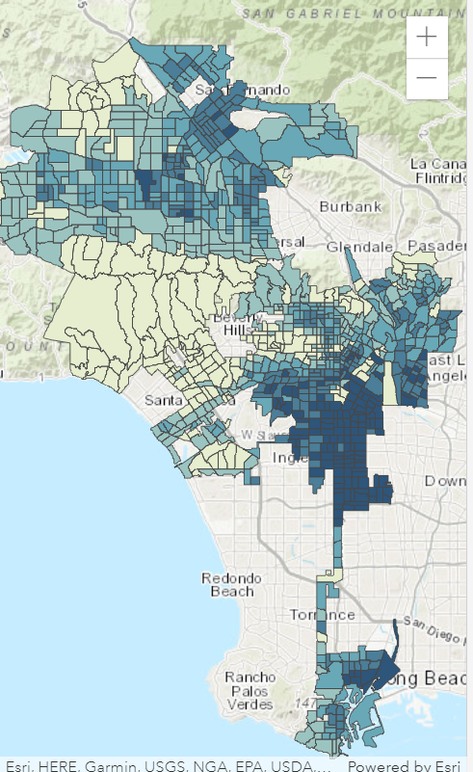
Percent of Population with Diabetes, Los Angeles & Obesity in Los Angeles
https://diabetes-2-commhealth.hub.arcgis.com/
Notes:
Diabetes in Los Angeles
The geography of the city shows us how some parts of the city have higher rates of diabetes and other qualities than others. The dark red areas have the highest percentages of people living with diabetes, and the yellow areas have the lowest.
These other maps show other data about poor health and how common they are in Los Angeles. The darker colors represent higher rates of the issue. We see that there is a strong relationship between poor health, poor lifestyle choices, and diabetes.

Slide 19
What is Diabetes?
Diabetes is a chronic disease where your blood glucose (sugar) is too high.
How does this happen ?
Glucose comes from the food you eat and is needed to fuel our bodies.
Your blood always has some glucose in it because your body needs glucose for energy. But having too much glucose in your blood is not healthy.
The pancreas located near the stomach makes insulin, which plays a role in moving glucose to muscles, liver cells and fat. Cells take the glucose and turn it into energy.
If you have diabetes, the pancreas fails to make enough insulin or the muscle, fat or liver cells fails to respond to the insulin properly
Glucose builds up in your blood and cannot get into your cells.

Slide 20
What is Diabetes?
As a result….
When glucose builds up in the blood instead of going into cells, it can cause two problems:
Right away, your cells may be starved for energy.
Over time, high blood glucose levels may hurt your eyes, kidneys, nerves or heart.
If your blood glucose stays too high, it can damage the nerves and blood vessels leading to complications such as heart disease, stroke, blindness, kidney disease, nerve problems, gum infections, and amputation

Slide 21
What Is Diabetes?
High blood sugar occurs in those with diabetes because:
The pancreas does not make enough insulin
OR
The cells of people with diabetes do not respond to insulin normally.
Notes:
Type 1 and type 2 diabetes affect almost 26 million Americans. Diabetes is a serious disease in which the pancreas does not make enough insulin OR cells do not respond to insulin normally, leading to high blood sugar. Type 2 diabetes accounts for 90%–95% of the cases of diabetes.
Type 1 diabetes (formerly known as insulin-dependent or juvenile-onset diabetes) is an autoimmune disease that destroys insulin-producing beta cells. Type 1 diabetes can occur at any age, but onset usually begins in childhood or the young adult years.
Formerly known as non-insulin-dependent or adult-onset diabetes, type 2 diabetes is related to insulin resistance. The pancreas continues to make insulin, but the insulin is not used well by other body tissues. Eventually, insulin production decreases.
Gestational diabetes is a form of glucose intolerance diagnosed in some women during pregnancy. Gestational diabetes occurs more frequently among African Americans, Hispanic/Latino Americans, and American Indians. Like type 2 diabetes, gestational diabetes mellitus is also more common among obese women and those with a family history of diabetes.

Slide 22
What are the different types of diabetes?
The three main types of diabetes are:
Type 1 diabetes
If you have type 1 diabetes, your body does not make insulin, so you must take insulin every day.
Type 2 diabetes
This is the most common type of diabetes.
With type 2 diabetes, your body does not make enough insulin or is not able to use its own insulin correctly.
Gestational diabetes
Gestational diabetes happens only during pregnancy.
Gestational diabetes can cause health problems for the baby and the mother if not controlled.
Notes:
Type I diabetes – the cells in the pancreas that make insulin are destroyed.
Usually diagnosed in children and young adults
Known as juvenile diabetes.
Affected by hereditary
Sometimes there are no symptoms
Must get insulin from shots or a pump everyday because the body makes little or no insulin (need insulin daily to survive)
Type 1 diabetes accounts for about 5%
Type 2 diabetes – the body does not produce enough insulin or the cells ignore the insulin.
Most common form of diabetes, accounts for about 90% to 95% of all diagnoses.
Usually occurs in adulthood but diagnosis is increasing in the younger generation (used to be known as the “adult onset diabetes”)
Affects many children
Body is incapable of responding to insulin
May need to take insulin or pills to help your body’s supply of insulin work better.
Rates rising due to increased obesity and failure to exercise and eat healthy
More common in African Americans, Latinos, Native Americans, and Asian Americans/Pacific Islanders, as well as the aged population.
Gestational diabetes – type of diabetes that occurs when women are pregnant.
Blood sugar levels are high during pregnancy
High risk of type II diabetes and cardiovascular disease
It also raises their child’s risk for being overweight and for getting type II diabetes.
Pre-diabetes – above average blood glucose levels, not high enough to be classified under type I or type II diabetes
- Starts with unhealthy eating habits and lack of exercise

Slide 23
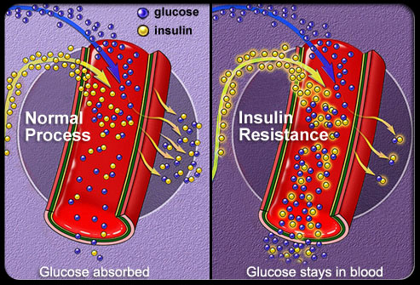
Normal Process VS. Type II Diabetes

Slide 24
Diabetes Is a Serious Disease
Diabetes is one of the top 10 leading causes of death in the United States.
Diabetes is a leading cause of:
Blindness
Nontraumatic lower-leg amputation
Stroke
Heart attack
Kidney damage
Periodontitis
Notes:
Diabetes takes a large toll on health and quality of life. The disease is a leading cause of major health problems, including blindness, lower-leg amputation, stroke, heart attack, kidney damage, and tooth loss.

Slide 25
Diabetes Complications
The risk of periodontal disease is two to three times higher in adults with diabetes.
About one third of people with diabetes have severe periodontal disease.
60%–70% of people with diabetes have mild to severe nervous system damage.
Almost 30% of people ages 40 and over with diabetes have impaired sensation in their feet.
Diabetes is the leading cause of new cases of blindness among adults ages 20–74 years.
CDC. National diabetes fact sheet: National estimates and general information on diabetes and prediabetes in the United States, 2011. Atlanta, GA: U.S. Department of Health and Human Services, Centers for Disease Control and Prevention, 2011. Available at http://www.cdc.gov/diabetes/pubs/factsheet11.htm.
Notes:
Diabetes can cause many serious complications, including:
Risk of oral health complications, such as periodontal disease, is two to three times higher in adults.
Nervous system damage is common—almost 30% of people with diabetes ages 40 years of age and older have impaired sensation in their feet.
Risk of blindness—diabetes is the leading cause of new cases of blindness among adults ages 20 to 74 years.

Slide 26
Risk Factors for type 2 diabetes You can do a lot to lower your chances of getting diabetes.
Being of Alaskan Native, American Indian, African American, Hispanic/Latino, Asian American or Pacific Islander descent.
High blood pressure.
Having cholesterol levels that are not normal.
Having had gestational diabetes or giving birth to at least one baby weighing more than 9 pounds.
Having a history of cardiovascular disease.
People who drink one or more sugary drinks a day have a 26% higher risk of developing type 2 diabetes than those who drink no more than one sugary drink per month.
Notes:
People who consume sugary drinks regularly—1 to 2 cans a day or more—have a 26% greater risk of developing type 2 diabetes than people who rarely have such drinks. [14] Risks are even greater in young adults and Asians. (https://www.hsph.harvard.edu/nutritionsource/healthy-drinks/sugary-drinks/)

Slide 27
Risk factors for type 2 diabetes
High blood pressure: Taking medicine for high blood pressure or having a blood pressure of 140/90 mmHg or higher.
High cholesterol: HDL cholesterol of 35 mg/dL or lower and triglycerides of 250 mg/dL or higher
Lack of physical activity: People who are active less than three times a week
Having polycystic ovary syndrome (PCOS)
Personal history of heart disease or stroke

Slide 28
Common symptoms of diabetes
Diabetes often goes undiagnosed because many of its symptoms seem so harmless.
Early detection of diabetes symptoms and treatment can decrease the chance of developing the complications of diabetes.
If you have one or more of these diabetes symptoms, see your doctor right away.

Slide 29
Can type 2 diabetes be prevented?
Research has shown that people at risk for type 2 diabetes can prevent or delay type 2 diabetes by losing a little weight, making moderate changes to their diet and physical activity.

Slide 30
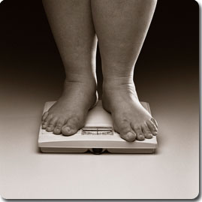
Reduce your risk of type 2 diabetes You can do a lot to lower your chances of getting diabetes
Lowering blood pressure and cholesterol levels helps you stay healthy
Talk with your doctor about whether you need medication to control your blood pressure or cholesterol levels
Reach and maintain a reasonable body weight
Being overweight can keep your body from making and using insulin properly. Excess body weight can also cause high blood pressure
Aim for a long-term goal of losing 5 to 7 percent of your total body weight.

Slide 31
Reduce your risk of type 2 diabetes
Be physically active (30 minutes 5 days a week)
If you are not active, you should start slowly.
Increase your physical activity. Aim for at least 30 minutes of exercise most days of the week
Some ways to work extra activity into your daily routine include the following:
Take the stairs rather than an elevator or escalator
Park at the far end of the parking lot and walk
Get off the bus a few stops early and walk the rest of the way
Walk or bicycle whenever you can
Make wise food choices most of the time
By making wise food choices, you can help control
your body weight, blood pressure, and cholesterol.

Slide 32
Reduce your risk of type 2 diabetes
Balancing calories
Enjoy your food, but eat less
Avoid oversized portions
Foods to Increase
Make half your plate fruits and vegetables
Make at least half your grains whole grains
Switch to fat-free or low-fat (1%) milk
Foods to Reduce
Compare sodium in foods like soup, bread and frozen meals- and choose the foods with the lower numbers
Drink water instead of sugary drinks
Limit alcohol intake

Slide 33
3 Sources of Energy The energy to move and think comes from the foods people eat and drink
All foods turn into glucose and glucose gives us energy
Carbohydrates- affects blood sugar quickly.
Proteins- has no immediate effect on blood sugar.
Fats- Monounsaturated and polyunsaturated fats are the healthiest.

Slide 34
Reducing your Risk of Type 2 Diabetes
Losing weight
Obesity is a leading risk factor for diabetes.
If you’re overweight or obese, start making small changes to your eating habits and get more physical activity.
Eating healthy
Choose vegetables, whole grains (such as whole wheat or rye bread, whole grain cereal, or brown rice), beans, and fruit.
Read food labels to help you choose foods low in saturated fat, trans fat, and sodium.
Limit processed foods and sugary foods and drinks.
Getting active
Aim for 30 minutes of physical activity most days of the week and limit the amount of time you spend sitting.

Slide 35
Screening Guidelines for Diabetes
Age ≥45 years without other risk factors Family history of T2D CVD Overweight BMI ≥30 kg/m² BMI 25-29.9 kg/m² plus other risk factors* Sedentary lifestyle Member of an at-risk racial or ethnic group: Asian, African American, Hispanic, Native American, and Pacific Islander | Dyslipidemia HDL-C <35 mg/dL Triglycerides >250 mg/dL IGT, IFG, and/or metabolic syndrome PCOS, acanthosis nigricans, NAFLD Hypertension (BP >140/90 mm Hg or therapy for hypertension) History of gestational diabetes or delivery of a baby weighing more than 4 kg (9 lb) Antipsychotic therapy for schizophrenia and/or severe bipolar disease Chronic glucocorticoid exposure Sleep disorders† in the presence of glucose intolerance
Screen at-risk individuals with glucose values in the normal range every 3 years Consider annual screening for patients with 2 or more risk factors
*At-risk BMI may be lower in some ethnic groups; consider using waist circumference.
†Obstructive sleep apnea, chronic sleep deprivation, and night shift occupations.
BMI = body mass index; BP = blood pressure; CVD=cardiovascular disease; HDL-C = high density lipoprotein cholesterol; IFG = impaired fasting glucose; IGT = impaired glucose tolerance; NAFLD = nonalcoholic fatty liver disease; PCOS = polycystic ovary syndrome; T2D, type 2 diabetes.

Slide 36
Testing for Diabetes
Normal | High Risk for Diabetes | Diabetes
FPG <100 mg/dL | IFG FPG ≥100-125 mg/dL | FPG ≥126 mg/dL
2-h PG <140 mg/dL | IGT 2-h PG ≥140-199 mg/dL | 2-h PG ≥200 mg/dL Random PG ≥200 mg/dL + symptoms*
A1C <5.5% | 5.5 to 6.4% For screening of prediabetes† | ≥6.5% Secondary‡
*Polydipsia (frequent thirst), polyuria (frequent urination), polyphagia (extreme hunger), blurred vision, weakness, unexplained weight loss. †A1C should be used only for screening prediabetes. The diagnosis of prediabetes, which may manifest as either IFG or IGT, should be confirmed with glucose testing. ‡Glucose criteria are preferred for the diagnosis of DM. In all cases, the diagnosis should be confirmed on a separate day by repeating the glucose or A1C testing. When A1C is used for diagnosis, follow-up glucose testing should be done when possible to help manage DM.
FPG, fasting plasma glucose; IFG, impaired fasting glucose; IGT, impaired glucose tolerance; PG, plasma glucose.

Slide 37
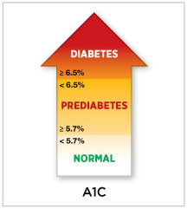
Testing for Diabetes
Fasting Plasma Glucose (FPG)
Patients must fast for 8 hours
Doctors draw blood and determine the amount of glucose in the blood
This is measured in mg/dl
Hemoglobin A1C
Common blood test used to diagnose and gauge how well you’re managing your diabetes
Test result reflects your average blood sugar level for the past two to three months.
Measure in %

Slide 38
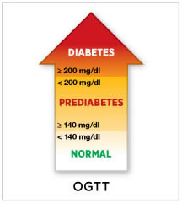
Testing for Diabetes
Oral Glucose Tolerance Test (OGTT)
Doctors measure how well your body reacts to average dose of sugar
Patients will be drawn 2 hours before and after consuming pre-mixed beverage with sugar
Blood glucose levels are measured to see how body reacted
This is measured in mg/dl

Slide 39
Key Message to Prevent Diabetes Complications: Control the ABCs
A1c: Blood glucose control
B: Blood pressure control
C: Cholesterol (Blood lipid) control
S: Smoking (and use of other tobacco products) cessation (and don’t start)
Preventive care practices for eyes, kidneys, feet, teeth, and gums
CDC. National diabetes fact sheet: National estimates and general information on diabetes and prediabetes in the United States, 2011. Atlanta, GA: U.S. Department of Health and Human Services, Centers for Disease Control and Prevention, 2011. Available at http://www.cdc.gov/diabetes/pubs/factsheet11.htm.
Notes:
The Guide, while delving into each specialty section of PPOD in detail, also has a strong emphasis on the basics of diabetes management—controlling the ABCs. The Guide underscores the importance of each PPOD provider teaching his or her patients about controlling the ABCs of diabetes.

Slide 40
Metformin
It has been prescribed to more than 120 million people around the world.
A prospective observational study of nearly 20,000 people with type 2 diabetes mellitus found that the use of metformin was associated with 24% less mortality from any cause compared to patients who were not taking metformin
It is a standard treatment for people at high risk of developing type 2 diabetes:
Prediabetes
Obese
Older than 60 years
Women with previous gestational diabetes.
Notes:
Metformin works by:
Reducing the amount of glucose (sugar) produced by the liver
Decreasing the amount of glucose your body absorbs
Increasing the effect of insulin in your body
Insulin is a hormone that helps your body eliminate excess sugar from your blood. This reduces blood sugar levels.
The most common side effects that can occur with metformin therapy include:
It produces a modest loss of weight in the short term.
Normalizes hypertension
Reduces cardiovascular risk
Improves heart failure
GI issues

Slide 41
Thank you/Acknowledgement
CCARE Team
Dr. Rick Kittles
Dr. Kimlin Ashing
Alejandro Fernandez
Marisela Garcia
Katty Nerio
Health Equities Team

Slide 42
Thank You!
Questions?
maserrano@coh.org

