Slide 1
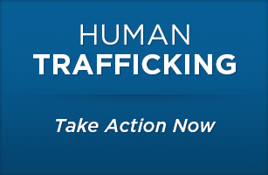
Child Victims of Human Trafficking
The Conversations that Lead to Action

Slide 2
One recent study found that as many as 20% of sheltered homeless youth had experienced trafficking victimization in their lifetimes
Curtis et al. (2008). Commercial sexual exploitation of children in New York City: Vol. 1. The CSEC population in New York City: Size, characteristics, and needs. Center for Court Innovation; Gragg et al. (2007). New York prevalence study of commercially sexually exploited children. Westat.

Slide 3
Data provided by LVMPD

Slide 4

116 Victims Identified
82 had a history of running away
3 were 13 years old or younger
102 of the children were local to Las Vegas

Slide 5
106 JUVENILE VICTIMS IDENTIFIED IN 2020
Data provided by LVMPD

Slide 6

106 Victims Identified
63 had a history of running away
5 were 13 years old or younger
75 of the children were local to Las Vegas

Slide 8


Slide 9
2020 Highlights
BUYER Arrests & Citations (misdemeanor)
2019 = 230
2020 = 336
Online Project (started 3/10/2020)
13 Ads placed
1,242 Buyers identified
50 felony Arrests

Slide 10


Our Children are Vulnerable and can become victims of both sex and labor trafficking!

Slide 11


Slide 12
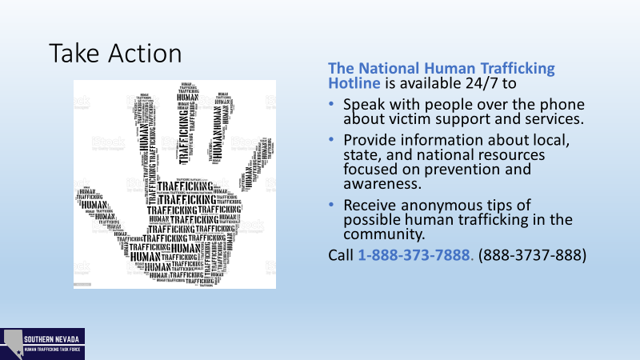

Slide 13
Elynne Greene
702-828-3266
To Sign up for emails…
Send an email to
Elena Ruhland
e14980r@lvmpd.com

