Slide 1
District 5280
Los Angeles Region
Rotarians Fighting Human Trafficking

Slide 2
Shocking Statistics U.S. State Department
.
96% of trafficked victims in the U.S. are female
82% of trafficked victims in the U.S. are trafficked for sex
The three states with the most human trafficking activity are TX, NY & CA
California Against Slavery reported San Francisco, Los Angeles and San Diego are three of the 10 worst child sex trafficking regions in the entire country
Transportation of victims between Las Vegas and Los Angeles

Slide 3
AnD More…
It is estimated that 150,000 victims are currently held as commercial sex slaves in the U.S.
50% of trafficked victims are minor children, with an average age of just 12 years old, and being purchased for sex an average of 5 times per day
7 years is the average lifespan of a child once taken

Slide 4
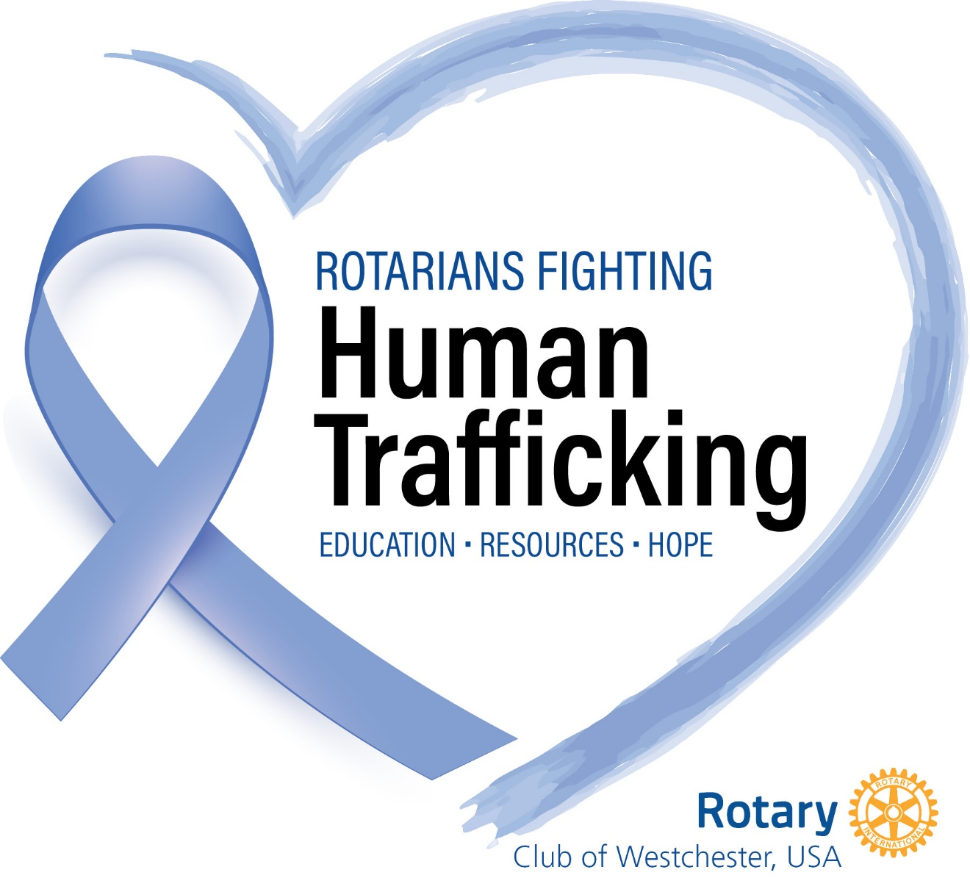
www.RotariansFightingHumanTrafficking.org

Slide 5
Our mission
We are Rotarians collaborating with law enforcement agencies, elected officials and non-profit organizations assisting victims of human trafficking (composed of both sex trafficking and labor trafficking.)

Slide 6
District 5280
New Cause-Based Rotary Club
Rotary Club of District 5280
Rotarians Fighting Human Trafficking

Slide 7
Come, join the fight and make a difference!

