Slide 1
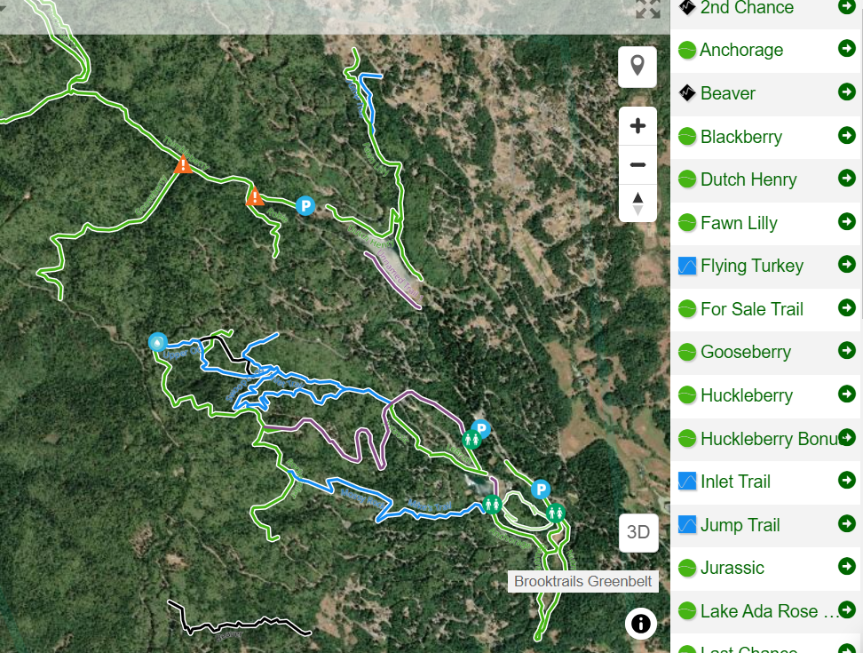
Willits Area Cyclists and Brooktrails
WAC is a 501(c)(3) nonprofit dedicated to making mountain biking a reality in our community. Riding a bike in the woods is a great way to get outdoors, exercise, de-stress, hang out with friends and have fun. All you need is a bike, a helmet and some local trails.
Brooktrails Greenbelt Lands total 2,500 acres covering forested canyons and hillsides interspersed with neighborhoods and residential developments.
Informal trail network existed for many years, mostly using old logging grades. WAC has worked with Brooktrails Township to expand this into a network of almost 20 miles of multi-use non-motorized trails covering a variety of terrain.

Slide 2
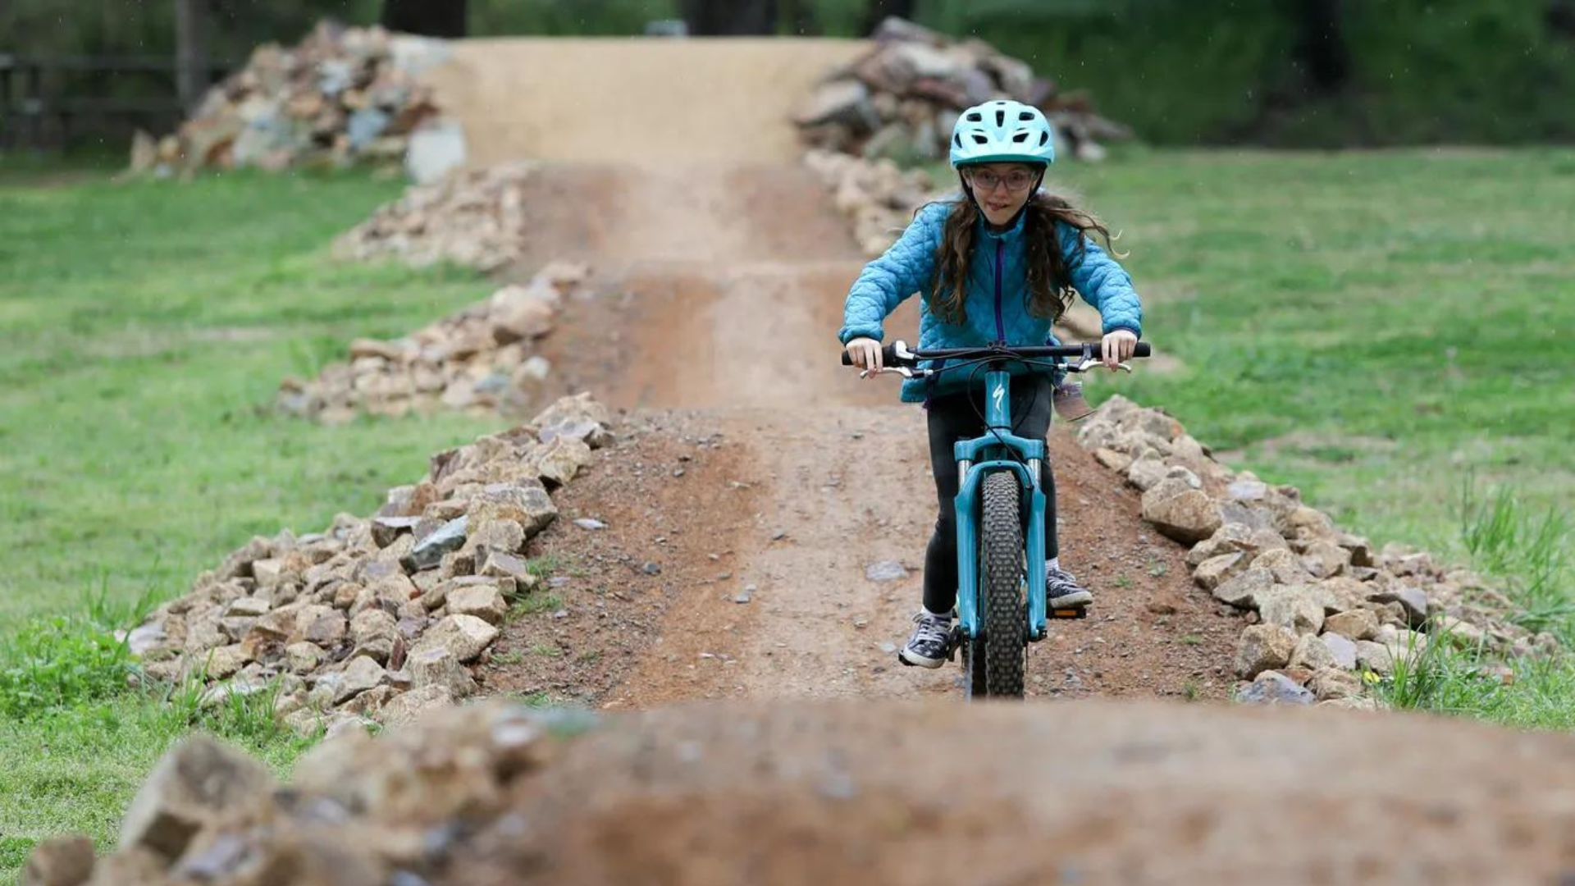
Photo Credit: Adam Serf
Healthy People, Healthy Communities
Many studies have found improved mental health outcomes for people of all ages who spend time outdoors.
Trails, especially those accessible without lengthy travel, offer one of the lowest barrier-to-entry ways for people to integrate time in nature into their schedules.
Versatility – well-designed trails can be used for moderate or intensive physical exercise
“Since scientists have gained access to data sets, sometimes capturing an entire country’s population of medical records and hospital data, we are finding that patient diagnoses and chronic illness risk are often related to where an individual lives and their proximity to green spaces,” said Kondo. “And that’s a correlation that is likely to strengthen as we conduct more studies.”
- Michelle Kondo, research social scientist with the USDA Forest Service's Northern Research Station

Slide 3
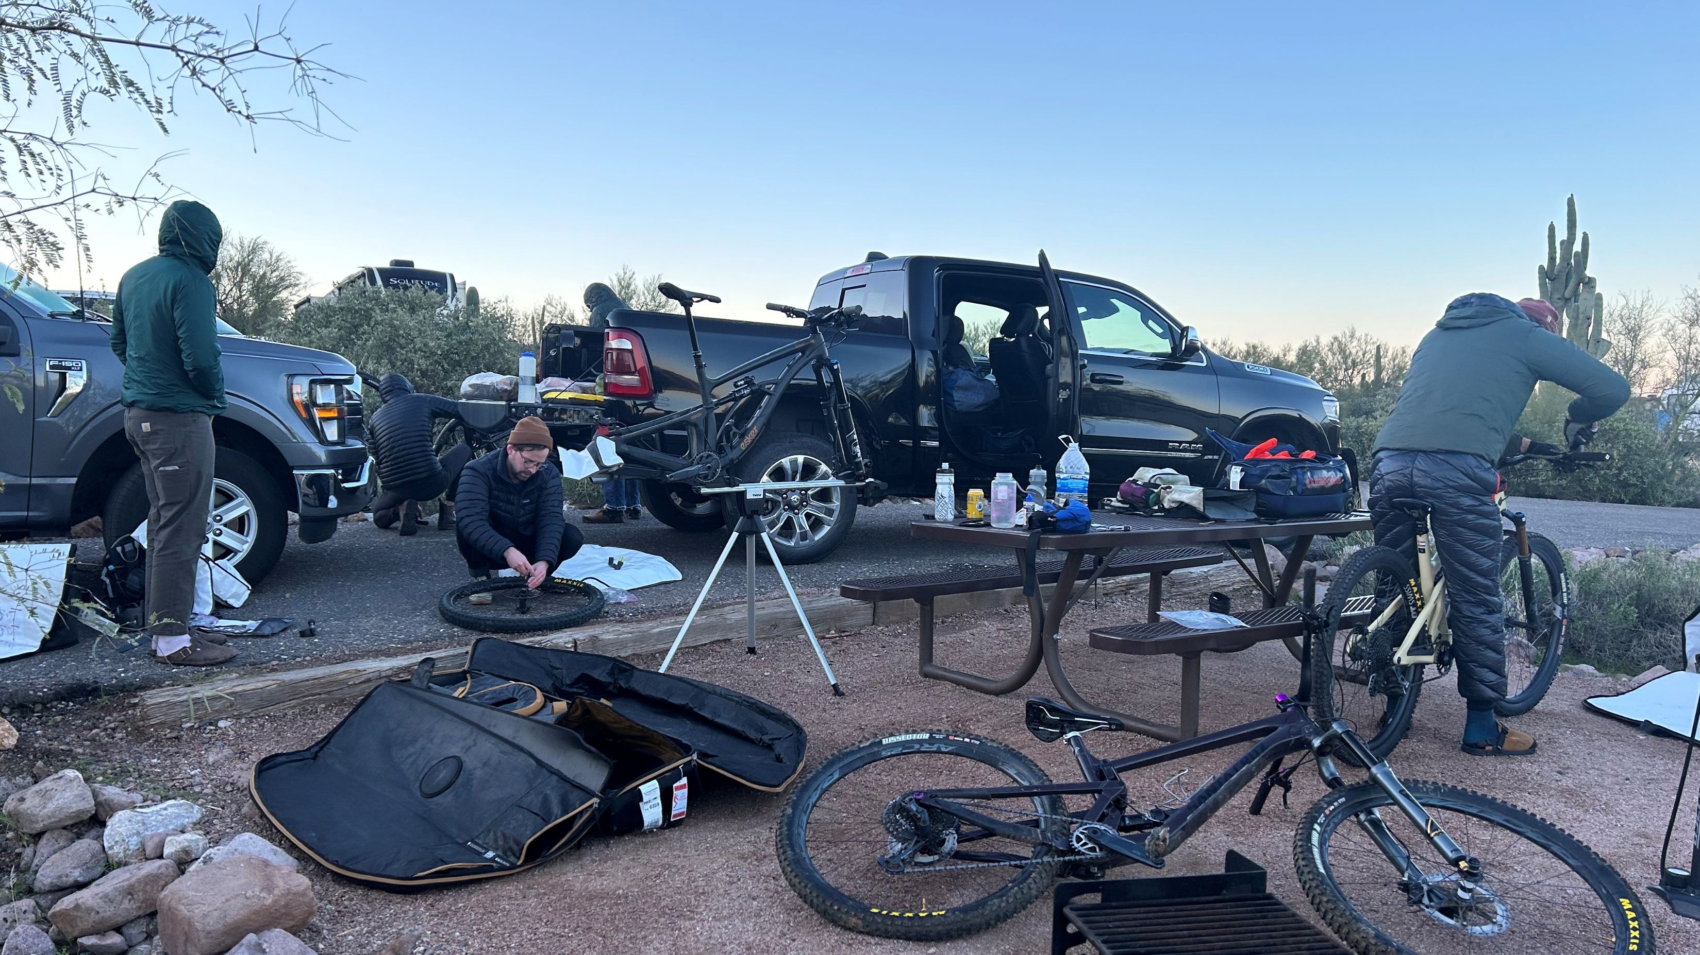
Photo Credit: Simon Apostol
Economy and Tourism
Encourage visitors to small towns in rural locations.
Destination locations get put on the map, and quality of life helps attract new residents and businesses.
COVID-19 reinforced the importance of outdoor recreation as a resilient tourist draw.
“The economic effects of trails and greenways are sometimes readily apparent (as in the case of trailside businesses) and are sometimes more subtle, like when a company decides to move to a particular community because of amenities like trails. There is no question, however, that countless communities across America have experienced an economic revitalization due in whole or in part to trails and greenways.” – Rails to Trails conservancy

Slide 4
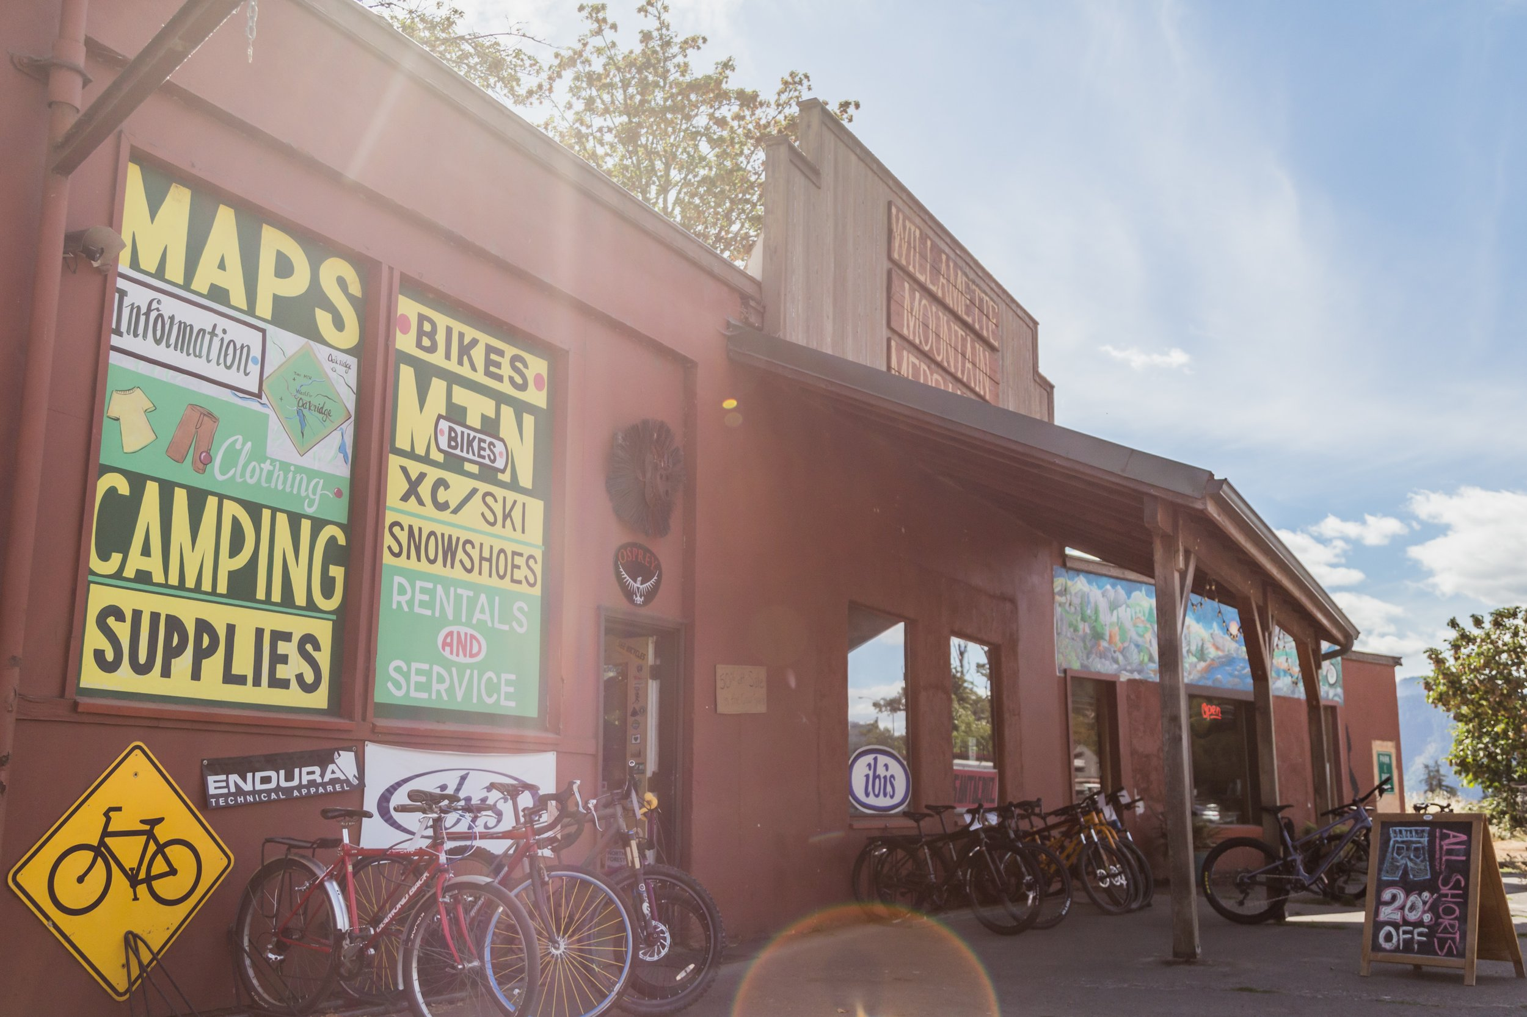
Eonomic Impact from Outdoor Tourism- Case Study: Oakridge, OR (2014):
Collapsed timber economy, major economic issues.
Study estimated 10,000+ trips to Oakridge by Mountain Bike tourists in 2014. Day trippers spent $20/day/person on average, and weekend visitors $50-$63 per person/day.
$2,351,000 - $4,914,000 annually to local economy
Found that mountain bikers are enthusiastic and likely to repeat visit locations more than other types of outdoor tourists.
Revitalized business community including outdoor guide service, bike shop, bakery, etc.
Viewed as a catalyst for bringing more businesses, tourism, and permanent residents.
Photo Credit: Oregon Timber Trail

Slide 5
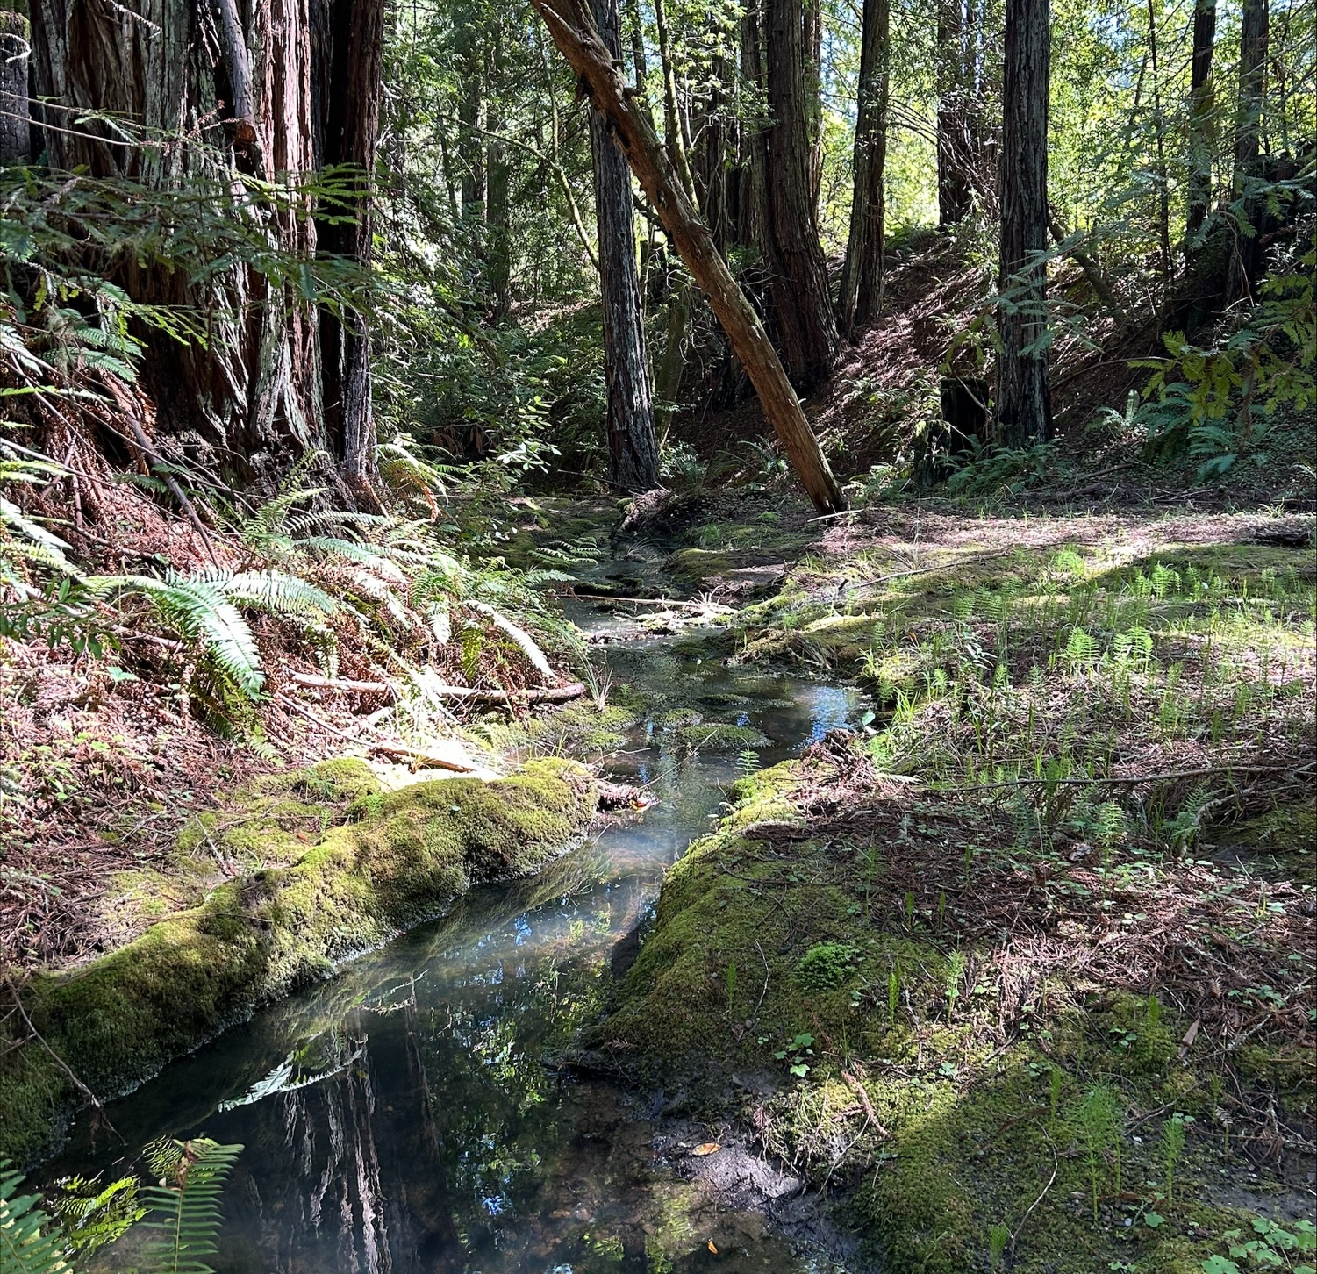
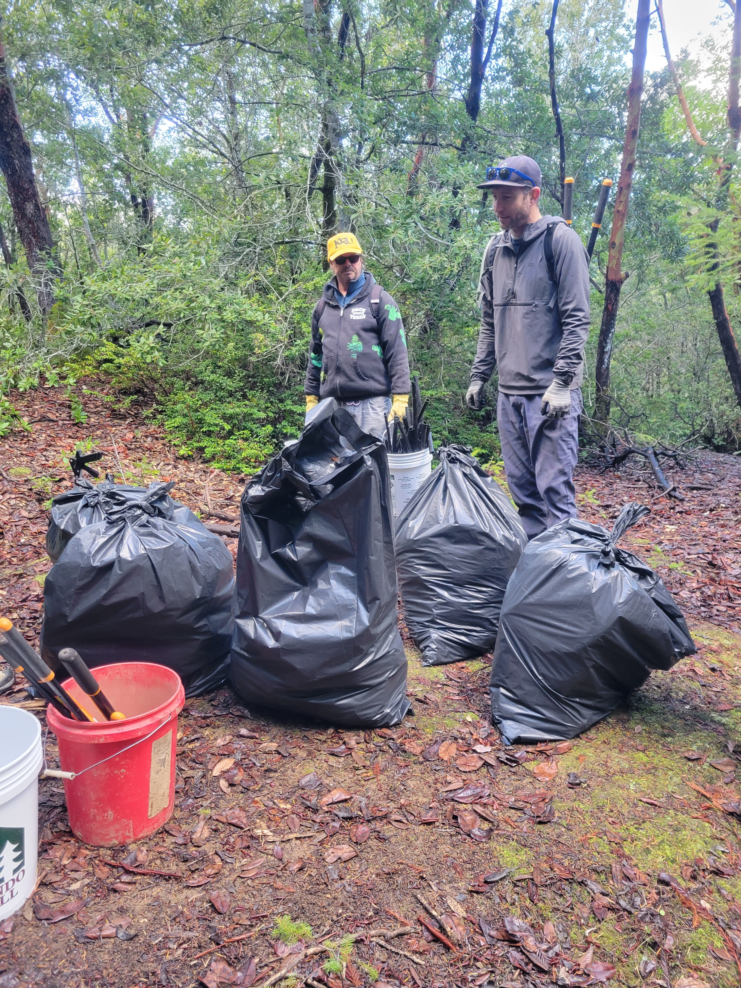
Environmental Stewardship
People who get outside care about nature!
Childhood exposure to nature changes lifelong attitudes and behaviors.
Trails are a simple way for people to experience the outdoors and access landscapes they otherwise wouldn’t.
Trail-building activities encourage environmental stewardship and can be combined with other activities like pulling weeds and installing native plants.
“Substantial evidence from observational and intervention studies indicates that overall time spent in nature leads to increased perceived value for connectedness to nature and, subsequently, greater pro-environmental attitudes and behaviors” - DeVille et al, Department of Epidemiology, Harvard T. H. Chan School of Public Health
Photo Credit: Oregon Timber Trail

Slide 6
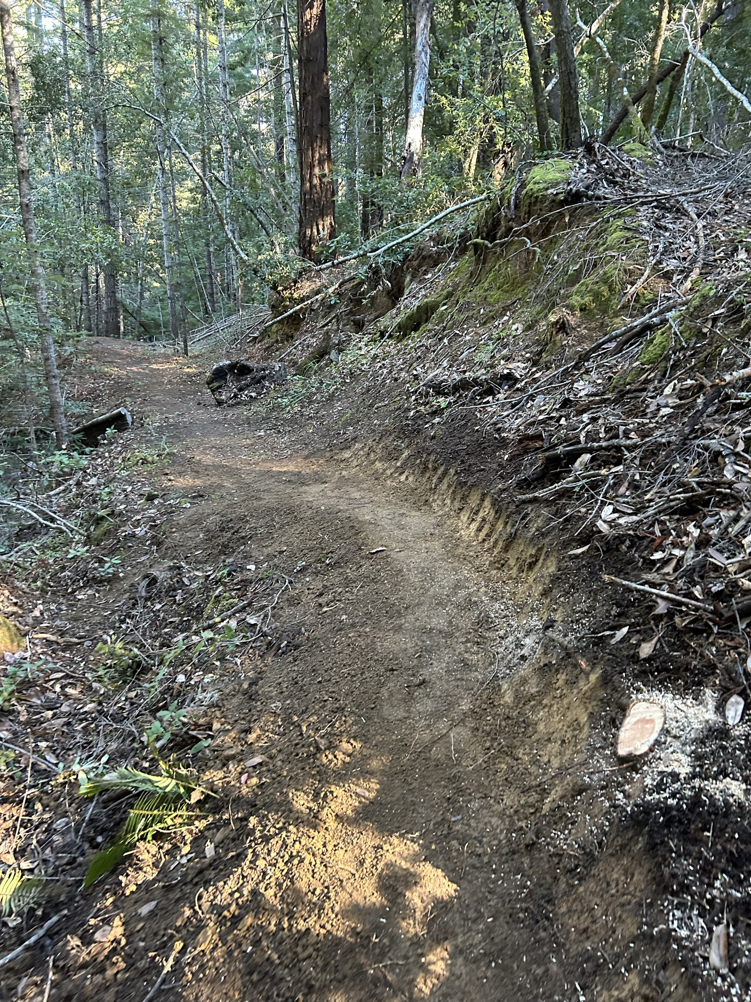
What does good trail access look like?
Proximity/ease of access
Quality and Variety
Skill level
ii. Terrain
Seasonality
Scenery
Primitive to constructed – what is the right balance for the best experience?
Sustainability
Environmental – routing, construction method, review.
Social – what does the community desire?
Economic – cost to maintain the trail and infrastructure. Will this be a burden?
Photo Credit: Oregon Timber Trail

Slide 7
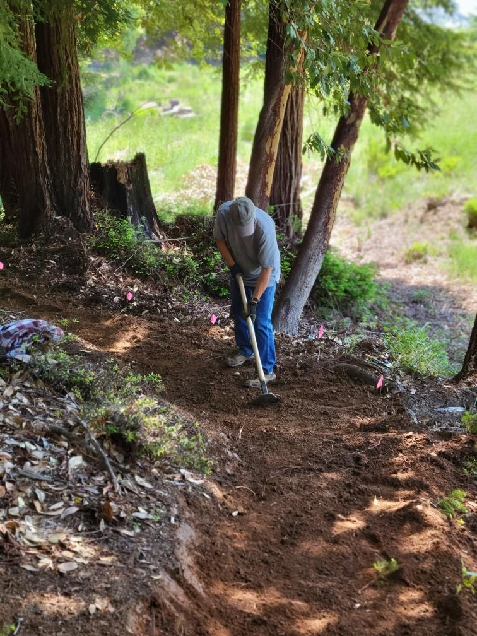
Challenges
Willing landowners – public, private, or nonprofit.
Planning capacity for environmental review, public input, etc.
Funding – often more accessible and higher traffic trails require more intricate and expensive construction.
Trail work is mostly done by volunteers.
Photo Credits: Willits Area Cyclists

Slide 8
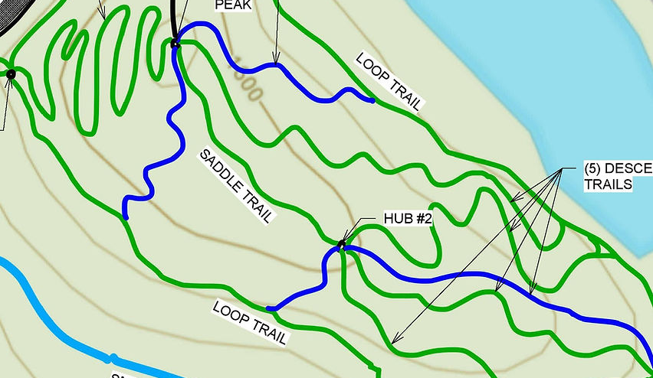
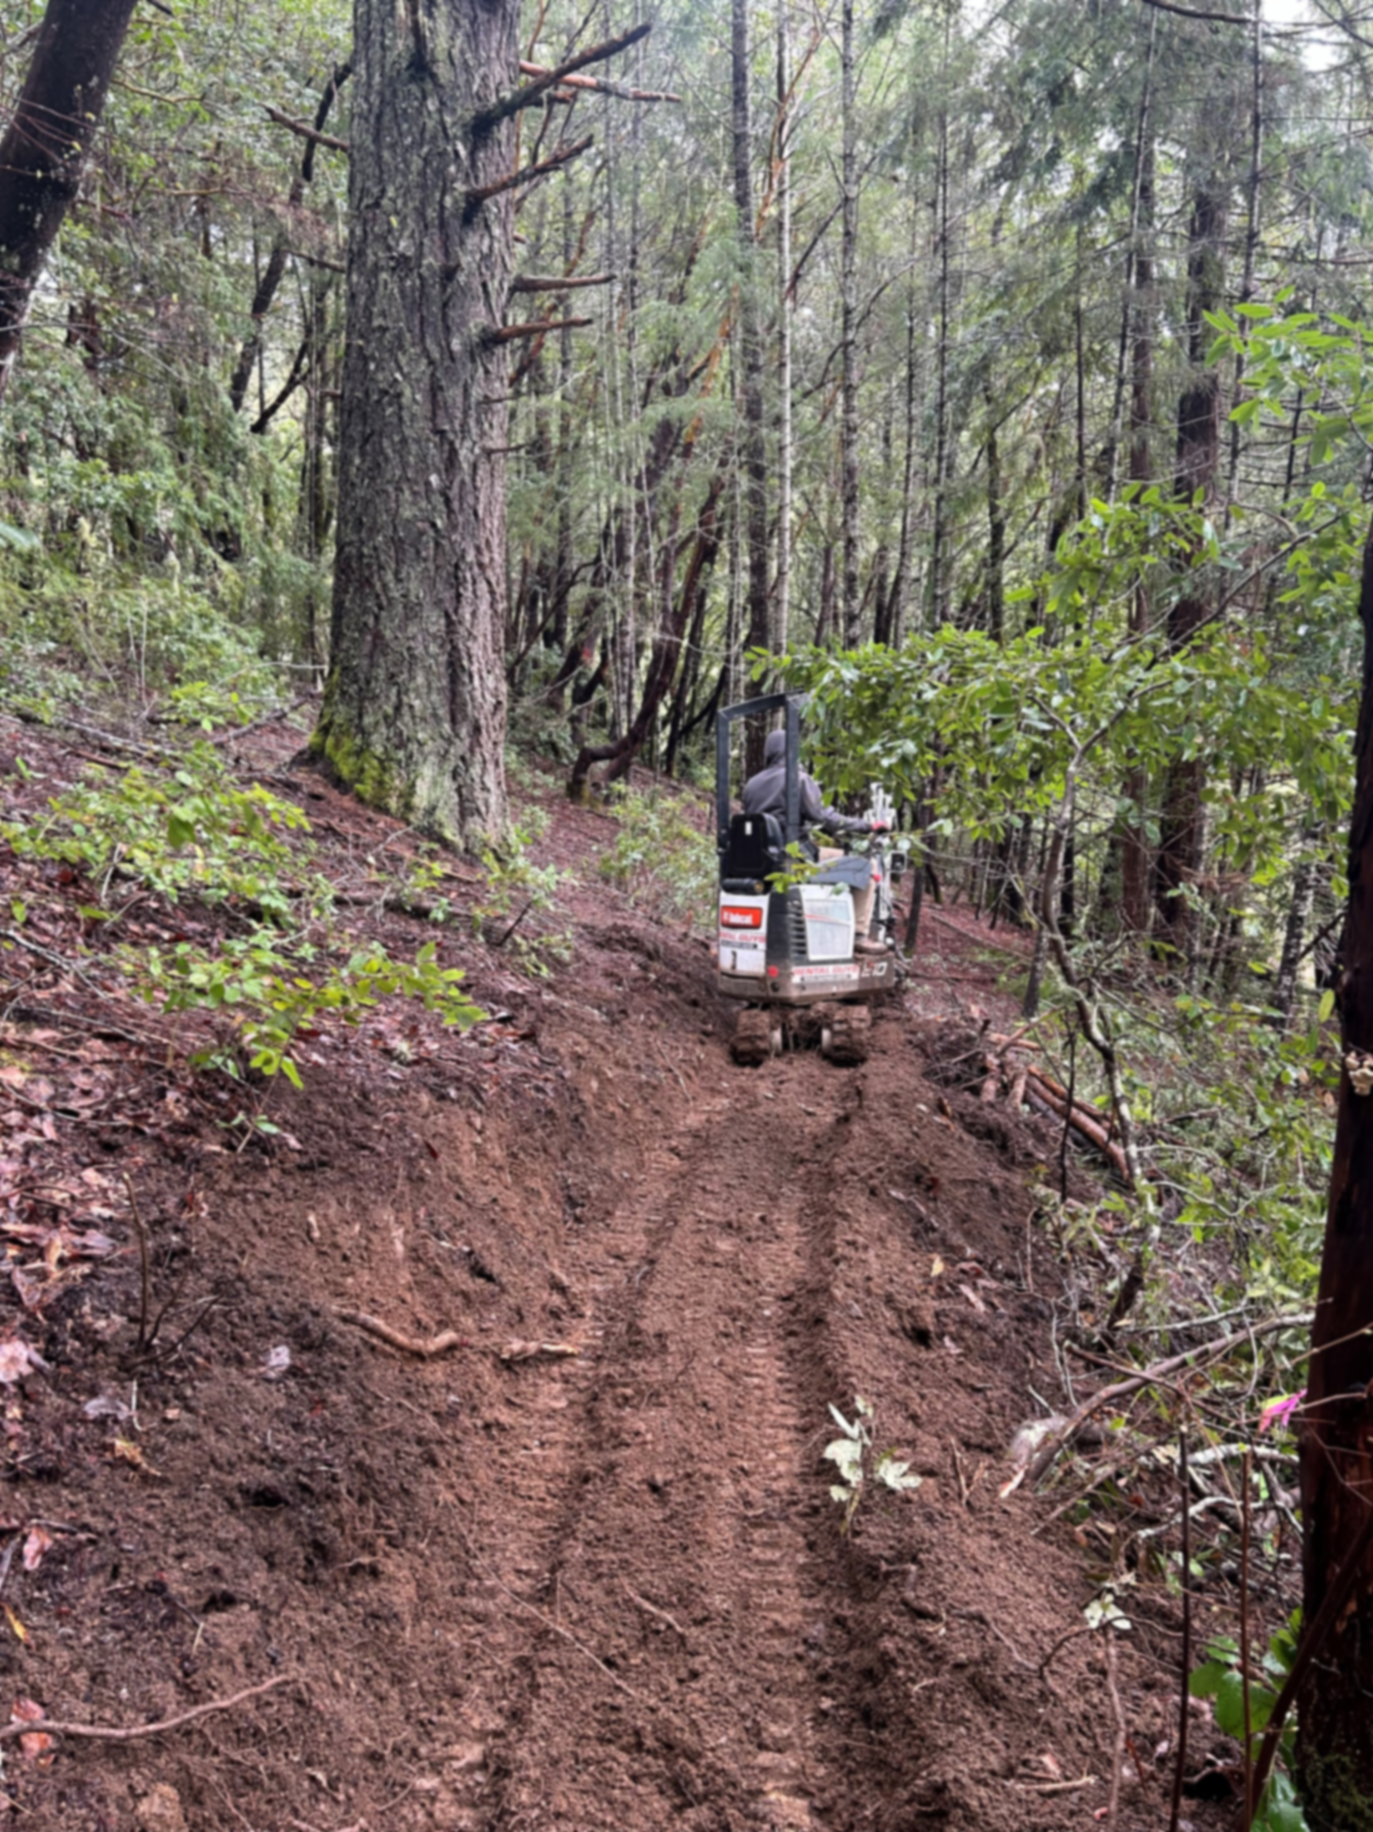
Current Project: Brooktrails Beginner Hill
Ground broken on lower loop (~1 mile) built buy professional operator and volunteers
Projected $50,000 cost, with over 80% remaining. Building sections as funding allows.
Will be the most accessible part of the brooktrails network for hikers and beginner cyclists.

Slide 9
Resources/Citations:
Willits Area Cyclists: https://wactrails.wixsite.com/ride
Headwaters Economics: Adapting To The New Economy: The Impacts of Mountain Bike Tourism in Oakridge, Oregon (https://headwaterseconomics.org/wp-content/uploads/Trail_Study_104-OR-Mtn-Bike-Tourism-Oakridge.pdf)
University of Montana Institute for Tourism and Recreation: Trail Usage and Value - A Helena Case study (https://pricklypearlt.org/wp-content/uploads/2018/02/Trail-Usage-and-Value-Helena-case-study_FINAL-DRAFT-2-3.pdf)
UC Davis Health: https://health.ucdavis.edu/blog/cultivating-health/3-ways-getting-outside-into-nature-helps-improve-your-health/2023/05
DeVille et al, Time Spent in Nature Is Associated with Increased Pro-Environmental Attitudes and Behaviors: https://www.ncbi.nlm.nih.gov/pmc/articles/PMC8305895/
The wellness benefits of the great outdoors – USDA Forest Service: https://www.fs.usda.gov/features/wellness-benefits-great-outdoors
Rails to Trails Conservancy: https://www.railstotrails.org/
The California Mountain Biking Coalition: https://camtb.org/

