Slide 1
January 17, 2023
We are glad you are here
Introductions of our guests.

Slide 2
DID WE INTRODUCE OUR GUESTS??
Today’s In Person Greeter
& Thought for the Day:
Chuck Henschel
Today’s Online Greeter
& Thought for the Day:
TBD
Newly announced 2023-2024 Rotary Theme:

Slide 3
Today – Guest Speaker: Isaias Garcia
Senior Services Volunteer program of Klickitat County
Jan 24 - Guest Speaker:
TBD
Jan 31 – NO NOON MTG
Friendship Gathering / potluck 5:30 – 6:30 pm
Feb 7– Guest Speaker: Jessica Metta
Mid Columbia Economic Development District
Feb 14 – Guest Speaker: Tova Tillinghast
Underwood Conservation District / Tree Fest

Slide 5
Rotary Youth Exchange Students
(Long Term Outbound 2022-2023)
(Long Term Inbound 2022-2023)
Rian Pedersen
Brazil 2022-2023
Auggie Lorincz
Chile 2022-2023
River Hoomans
Austria 2022-2023
Mathis
Inbound from
Ben Salinas
Inbound from Chile
(Short Term 2022)
Bee creative.
Think about your week and identify ways to align with Rotary values of Service Above Self and report to our club members during your introduction.
Madeline Allen
Outbound to Italy

Slide 6
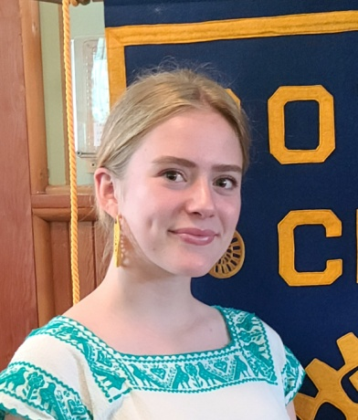
Rotary Youth Exchange Students
(Long Term 2023-2024)
(Short Term 2023)
Che Tillinghast
2023-2024
Helen Hoskins
2023-2024
Lila Witherrite
2023-2024
Siena Clayton
2023-2024
Calvin Rodgers
2023-2024
Genevieve
Kingsford-Smith
2023-2024
The 3 C's of Life
CHOICES, CHANCES, CHANGES
You must make a CHOICE
to take a CHANCE
or your life will never CHANGE.

Slide 7
Bengt Coffin
Rotarian of the Month
January 2023
Thank you so much for your leadership, time and efforts in our Audio Visual Project for the Mountain View Grange Hall improvements.

Slide 8
Bronze Award

Slide 9
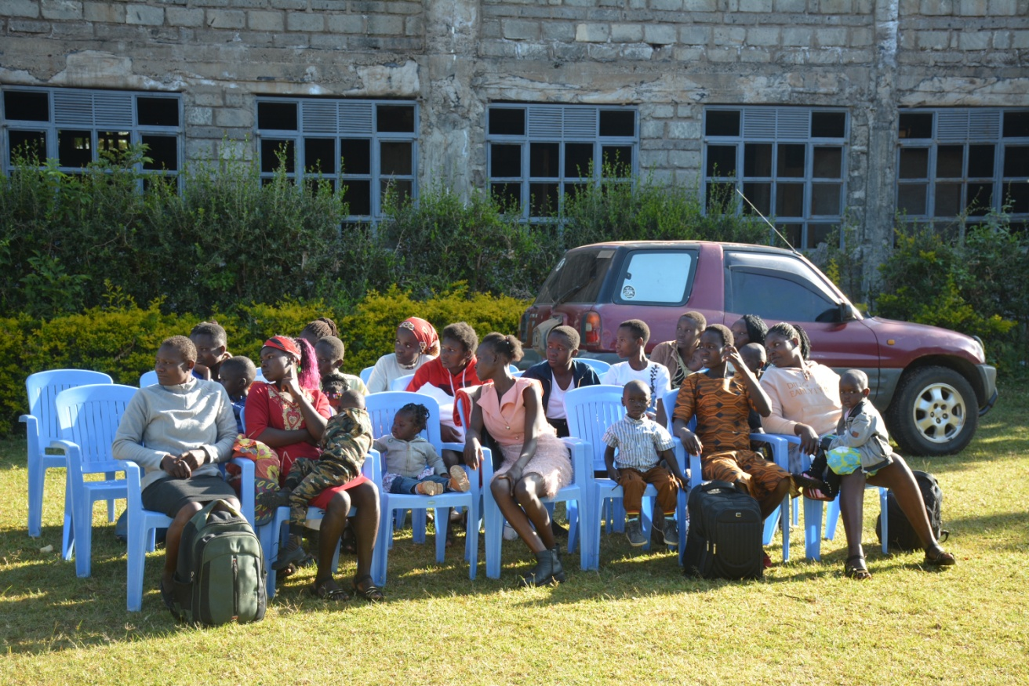
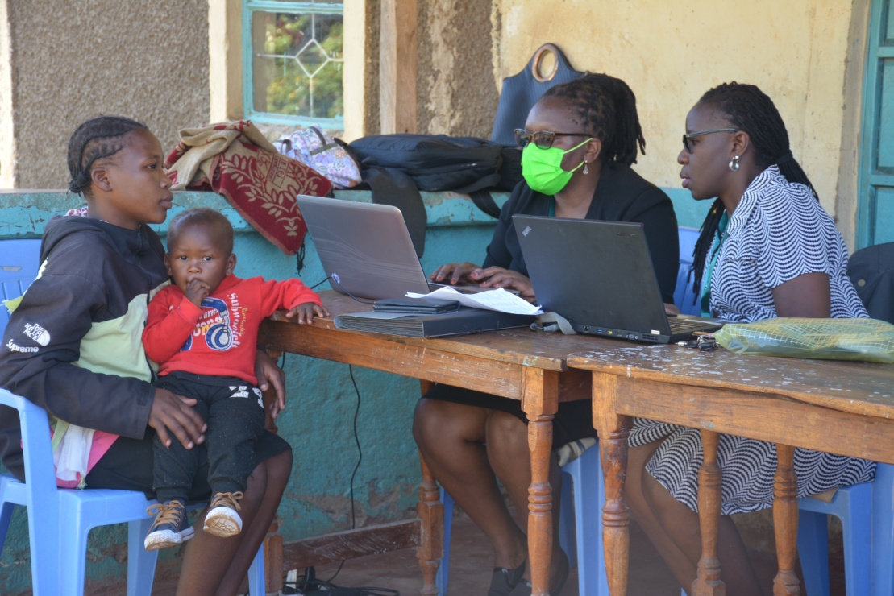
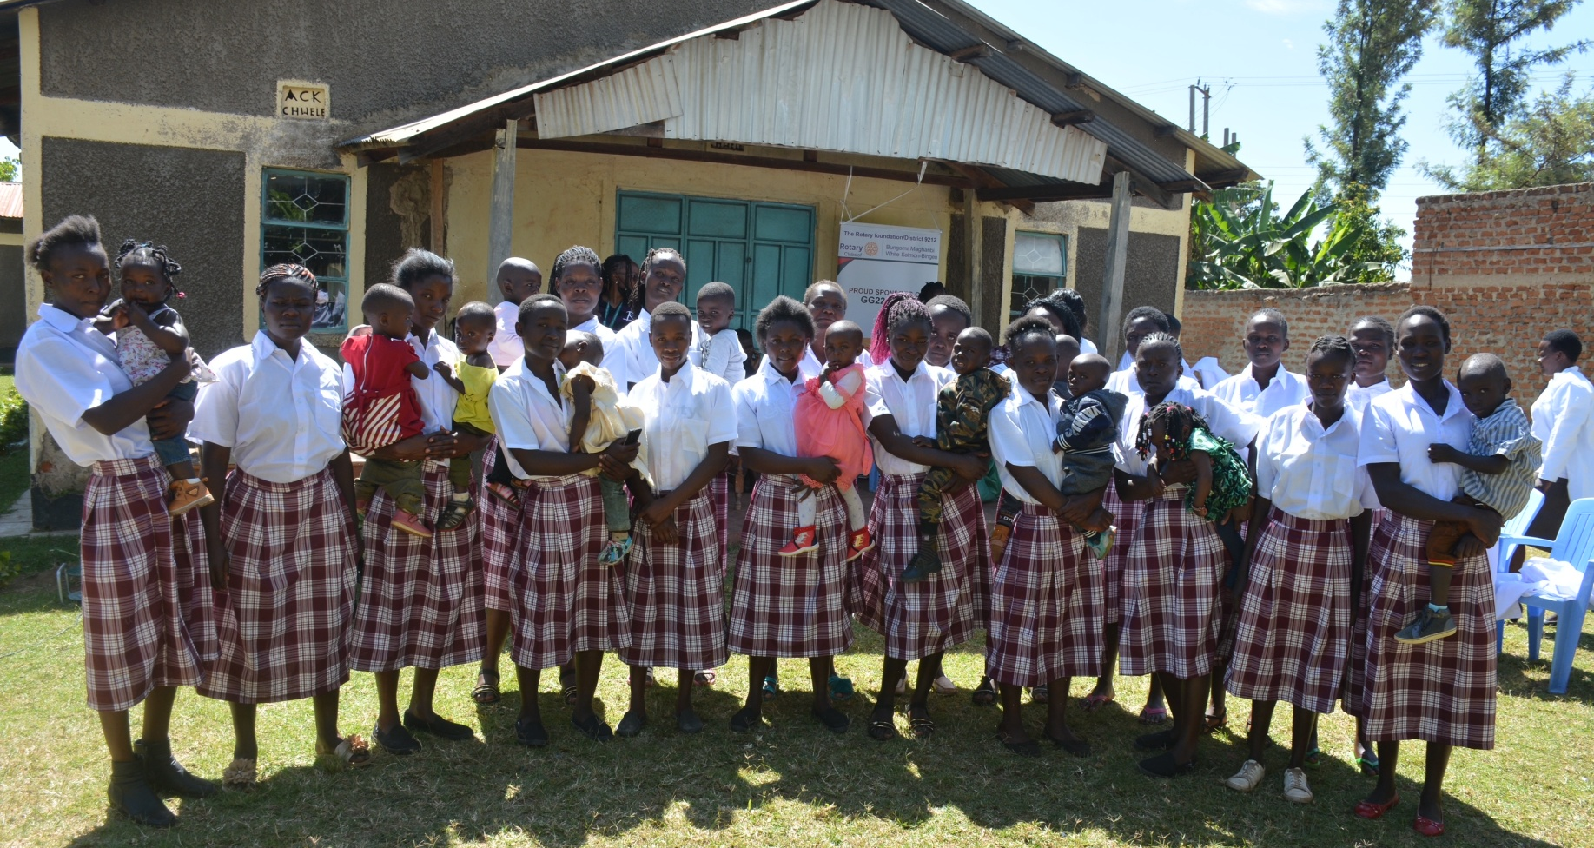
January 2023
Orientation Day
In Kiswahili, 'najijali' means,
"I care for me."
Najijali Project Mission:
Provide teen mothers with a vocational skill and basic life skills training, so they can reach financial independence.
Improve their mental health with therapy and socio-psychological support.
Help reduce teen pregnancies by including reproductive health education and resources. Elevate community awareness of the value of the girl child in the local economy.
Empowering teen mothers to become financially independent. Namwela-Chwele, Kenya

Slide 10
Contact Tammara to RSVP for Olympia on 2/8 and-or Salem on 2/15

Slide 11
Other club or Rotary updates to share?

Slide 12
Happy Bucks
Share your stories
~ family or business news ~
things that make you smile
☺
Buy a ticket at the sign in table for $1 and put in coffee can.
If your ticket is drawn, you dip for a chip.
White chip, sorry, better luck next time. Chip goes to side.
Red chip = Winner, Winner, Chicken Dinner!

