Slide 1
Note: We have hearing devices
For enhanced listening
Lake Oswego Rotary
Club Meeting June 8, 2015

Slide 2
The Pledge
Notes:
Honoring the Flag Day

Slide 3
Welcome Visitors & Guests

Slide 4
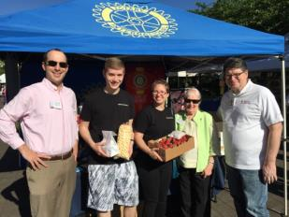
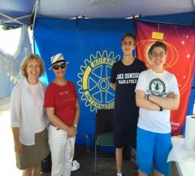
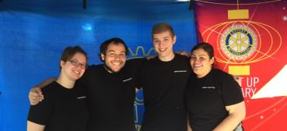
Rotary Day at Farmers Market
Jackie MacGregor
Taylor Mur Jackie MacGregor
Taylor Murdoch
Randy Harvey
doch
Randy Harvey
Lake Oswego, Kruse Way, Rotaract & Interact
Interact
Radhika Subrahmanyan
Johanna Brunson Eric Sasadeusz David Boden
Rotaract
Carmen Nunez
Daniel Spalding
Pedro Nunez
Keisha Shippy
Kruse Way Rotary
Jackie MacGregor
Taylor Murdoch
Randy Harvey

Slide 5
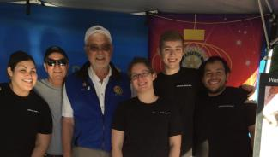
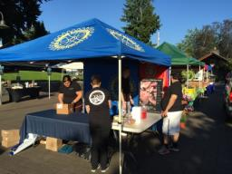
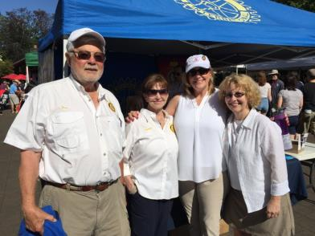
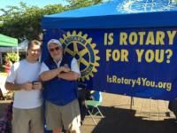
Rotary Day at Farmers Market
Lake Oswego Rotary
Nell Diamond – Chair
Malcolm Mathes
Matthys Heyns
Don Nussmeier
Lynne Larson
Beth Levich
Faye Tarzaban
Bob Liddell
Bob Nemhauser

Slide 6
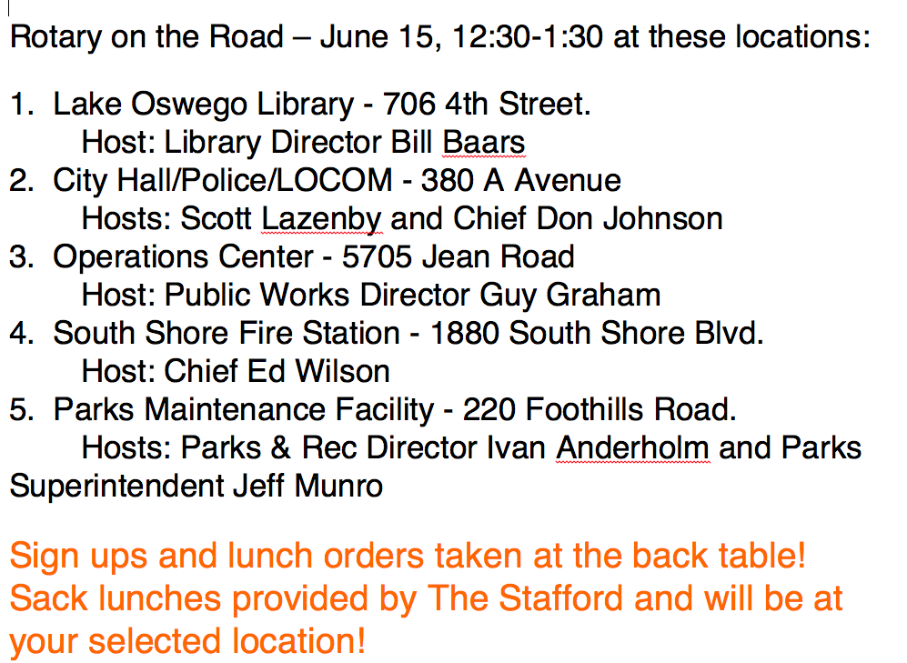
Rotary on the Road - City of Lake Oswego

Slide 7
Transition
Party

Slide 8
Rotary Events
The LORC's Fiction Book Club Tuesday, June 9, 7:00 pm
at Curtis & Jacquie's house, 17022 Crestview Drive, LO, to discuss The Tin Drum, by Gunther Grass. All are welcome!
“Rotary on the Road”, June 15th 12:30 PM
Rotary Lobster Feed and Charity Auction June 20th - 5:00PM
No Rotary Meeting on June 22nd
No Meeting on June 29th – Transition Party that night at 6:00pm

Slide 9
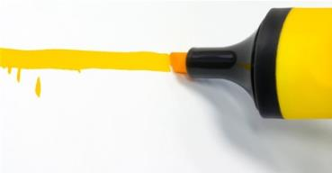
Member Highlights – Jeff Aimonetti

Slide 10
Lobster Feed 2015

Slide 12
Program: Angel Flight
Jake Jacobs

Slide 13
THANK YOU!
Notes:
Next Week’s program: 5 most interesting things in 20 years. Steve Duin
Thank you visitors and guests

