Slide 1
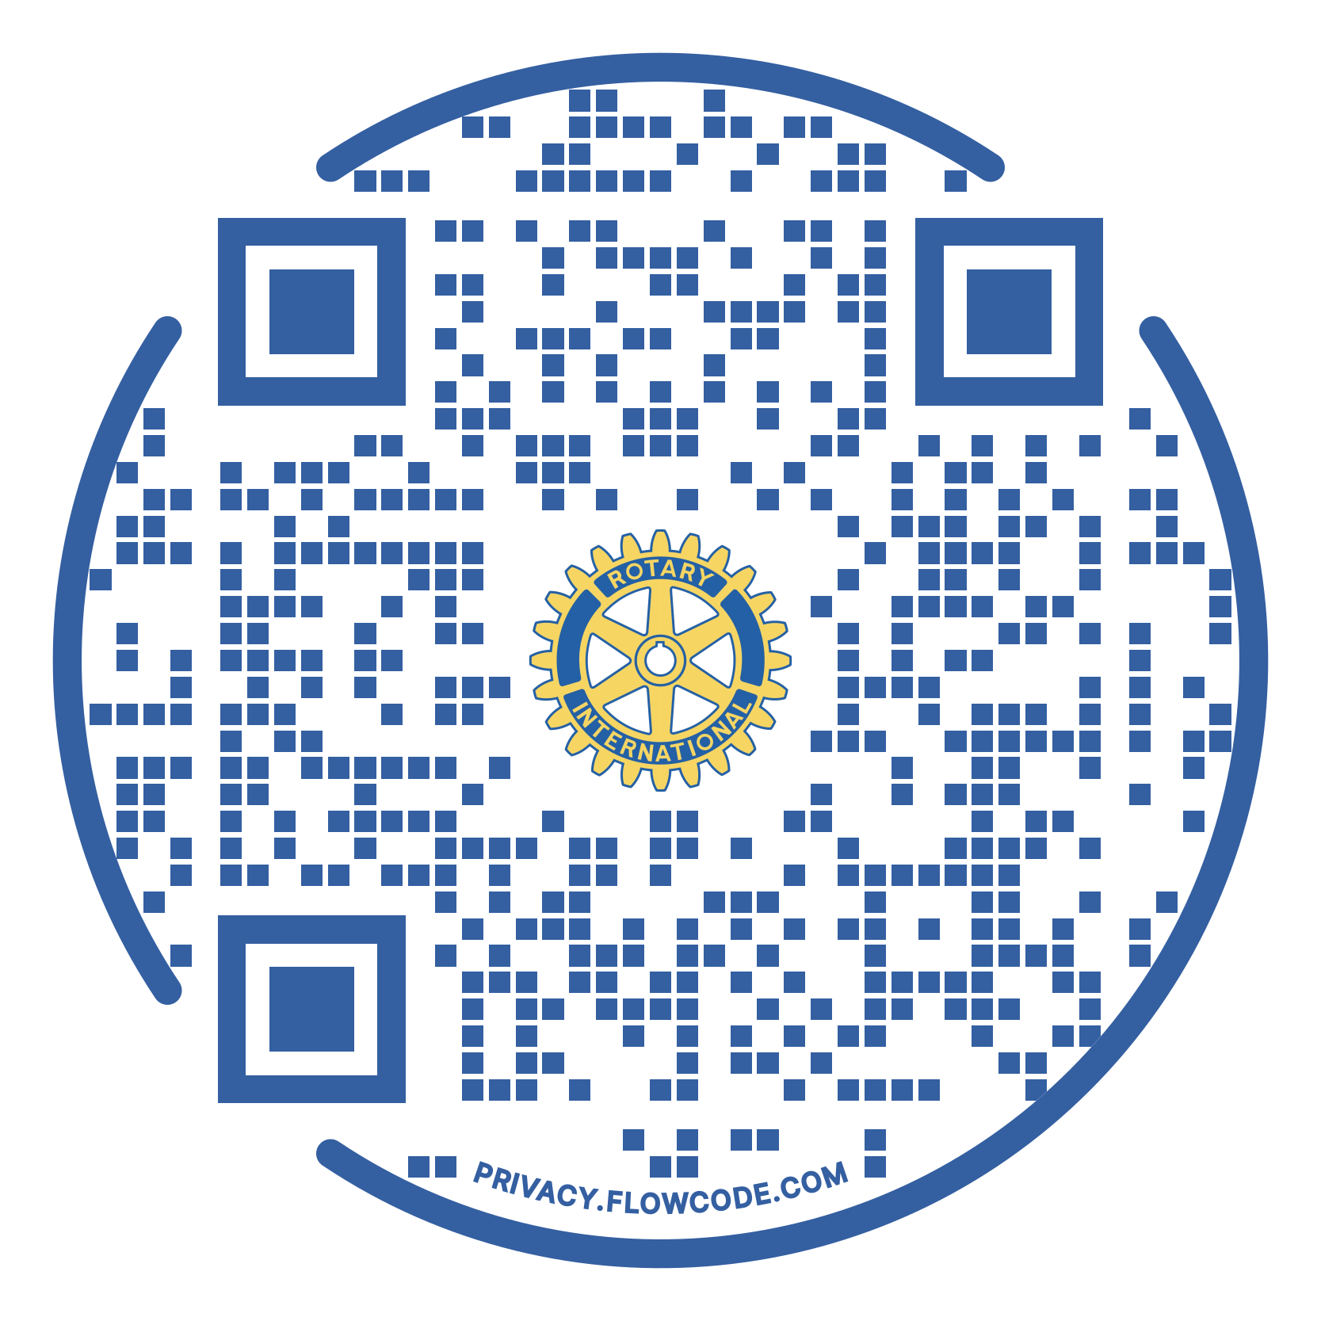
Pasco-Kennewick Rotary
Wine Valley Gala Committee www.pkrotary.org
Dear Friend
The Pasco-Kennewick Rotary Club, a 501(c) 3 nonprofit organization, has a long-standing mission of “Supporting Our Youth” through grants and scholarships for high school and technical school graduates.
Each year we raise funds to support this mission by selling elephant ears at the Benton –Franklin County Fair, the mid-Columbia Duck Race Raffle, our pickleball tournament, and the Wine Valley Gala.
This letter aims to offer you and your company sponsorship opportunities for our indoor Winter Pickleball Tournament, held at the Pacific Clinic, on January 25th & 26th 2025.
Additionally, your sponsorship includes the widely attended Wine Valley Gala, on February 8th, 2025, at Zintel Creek Restaurant & Bar in Kennewick.
We truly appreciate your time and consideration to discuss the fundraiser and our mission. Please do not hesitate to contact me if you have additional questions or need clarification.
Thank you,
Rob Di Piazza
Pickleball; Committee, Chair
(509) 205-4580
P.S. All donations are tax-deductible

Slide 3
Pk Rotary awarded the following scholarships in 23/24:
Academic scholarships $36,500
Vocational scholarships $7,000
We awarded the following grants in 23/24:
Kamiakin Music Booster
Alzheimer’s Association
Friends of Tri-Cities Animal Shelter
Master Gardener
Tri-Cities Community Health
Meals on Wheels
James McGee PTO
Mirror Ministries
Mid-Columbia Science Fair
Crystal Apple Awards
Big Bro Joe
Leprechaun Dash
COPA
Flagpole at Veterans Memorial
KC Help
SHAKE
Columbia Drum and Bugle Corps
Academy of Children’s Theatre
REACH Museum
Goldsbury Police Awards to Pasco and Kennewick

Slide 4


