Slide 1
Rotary Club of Moscow
President’s Mid-Year Update 2024-25

Slide 2
Agenda
Mission
Club Action Plan
President’s Goals
Budget
Grant Programs
Avenues of Service & Committee Volunteering Opportunities
Projects
Membership Initiatives
Public Image
Summary

Slide 3
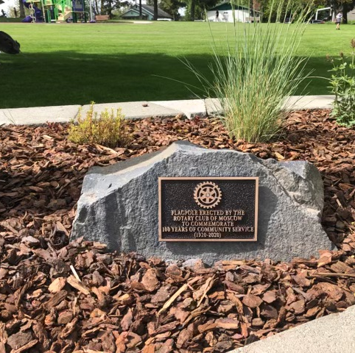
Mission
Mission Statement: The Rotary Club of Moscow is a growing, vibrant club known for its comradery, outreach, and generous contributions to the Moscow and Latah County community.

Slide 4
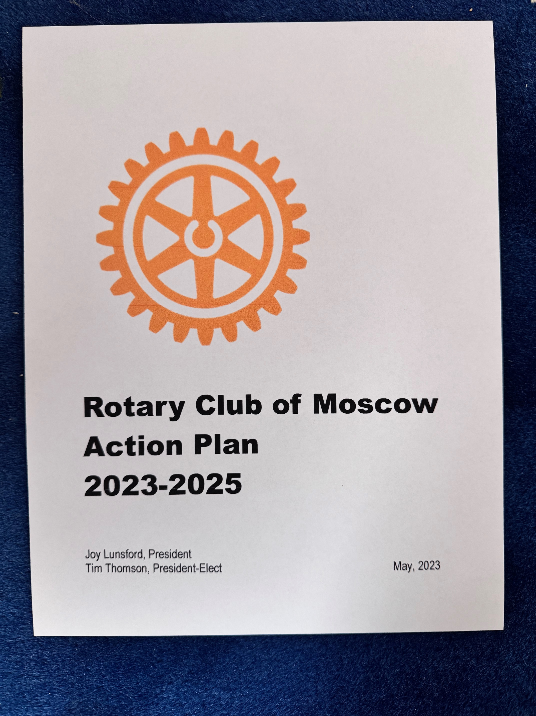
Club Action Plan
1. Increase the presence of our Rotary Club in the community.
2. Increase the membership of our club.
3. Provide multiple and different opportunities for member participation.
4. Contribute to housing, food, and youth programs in our community.
5. Expand the service projects of our club.
6. Maintain the friendliness, comradery of our Moscow Club.

Slide 5
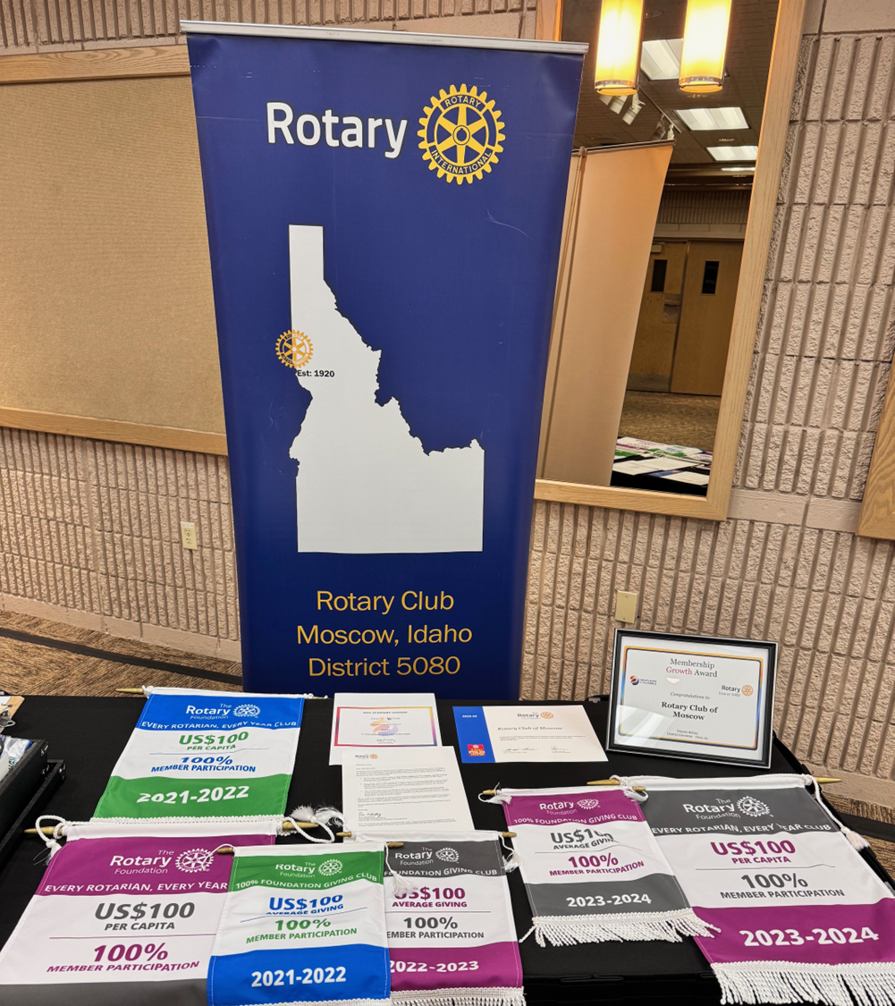
President’s Goals
Membership & Engagement
Increase members to 43 (37 Now)
5 Members’ Sponsorships (1)
5 Members at District Training Events (2)
35 Members to participate in Club Service Activities/Projects (29)
Update Club Action (Strat) Plan (May)
Foundation/Giving from members
$6,000 for Annual Fund ($7,505)
$1,000 for Polio Plus ($705)
$100 per Year “Every Rotarian Every Year” (EREY) (25)
$250 Per Capita average of giving ($203)

Slide 6
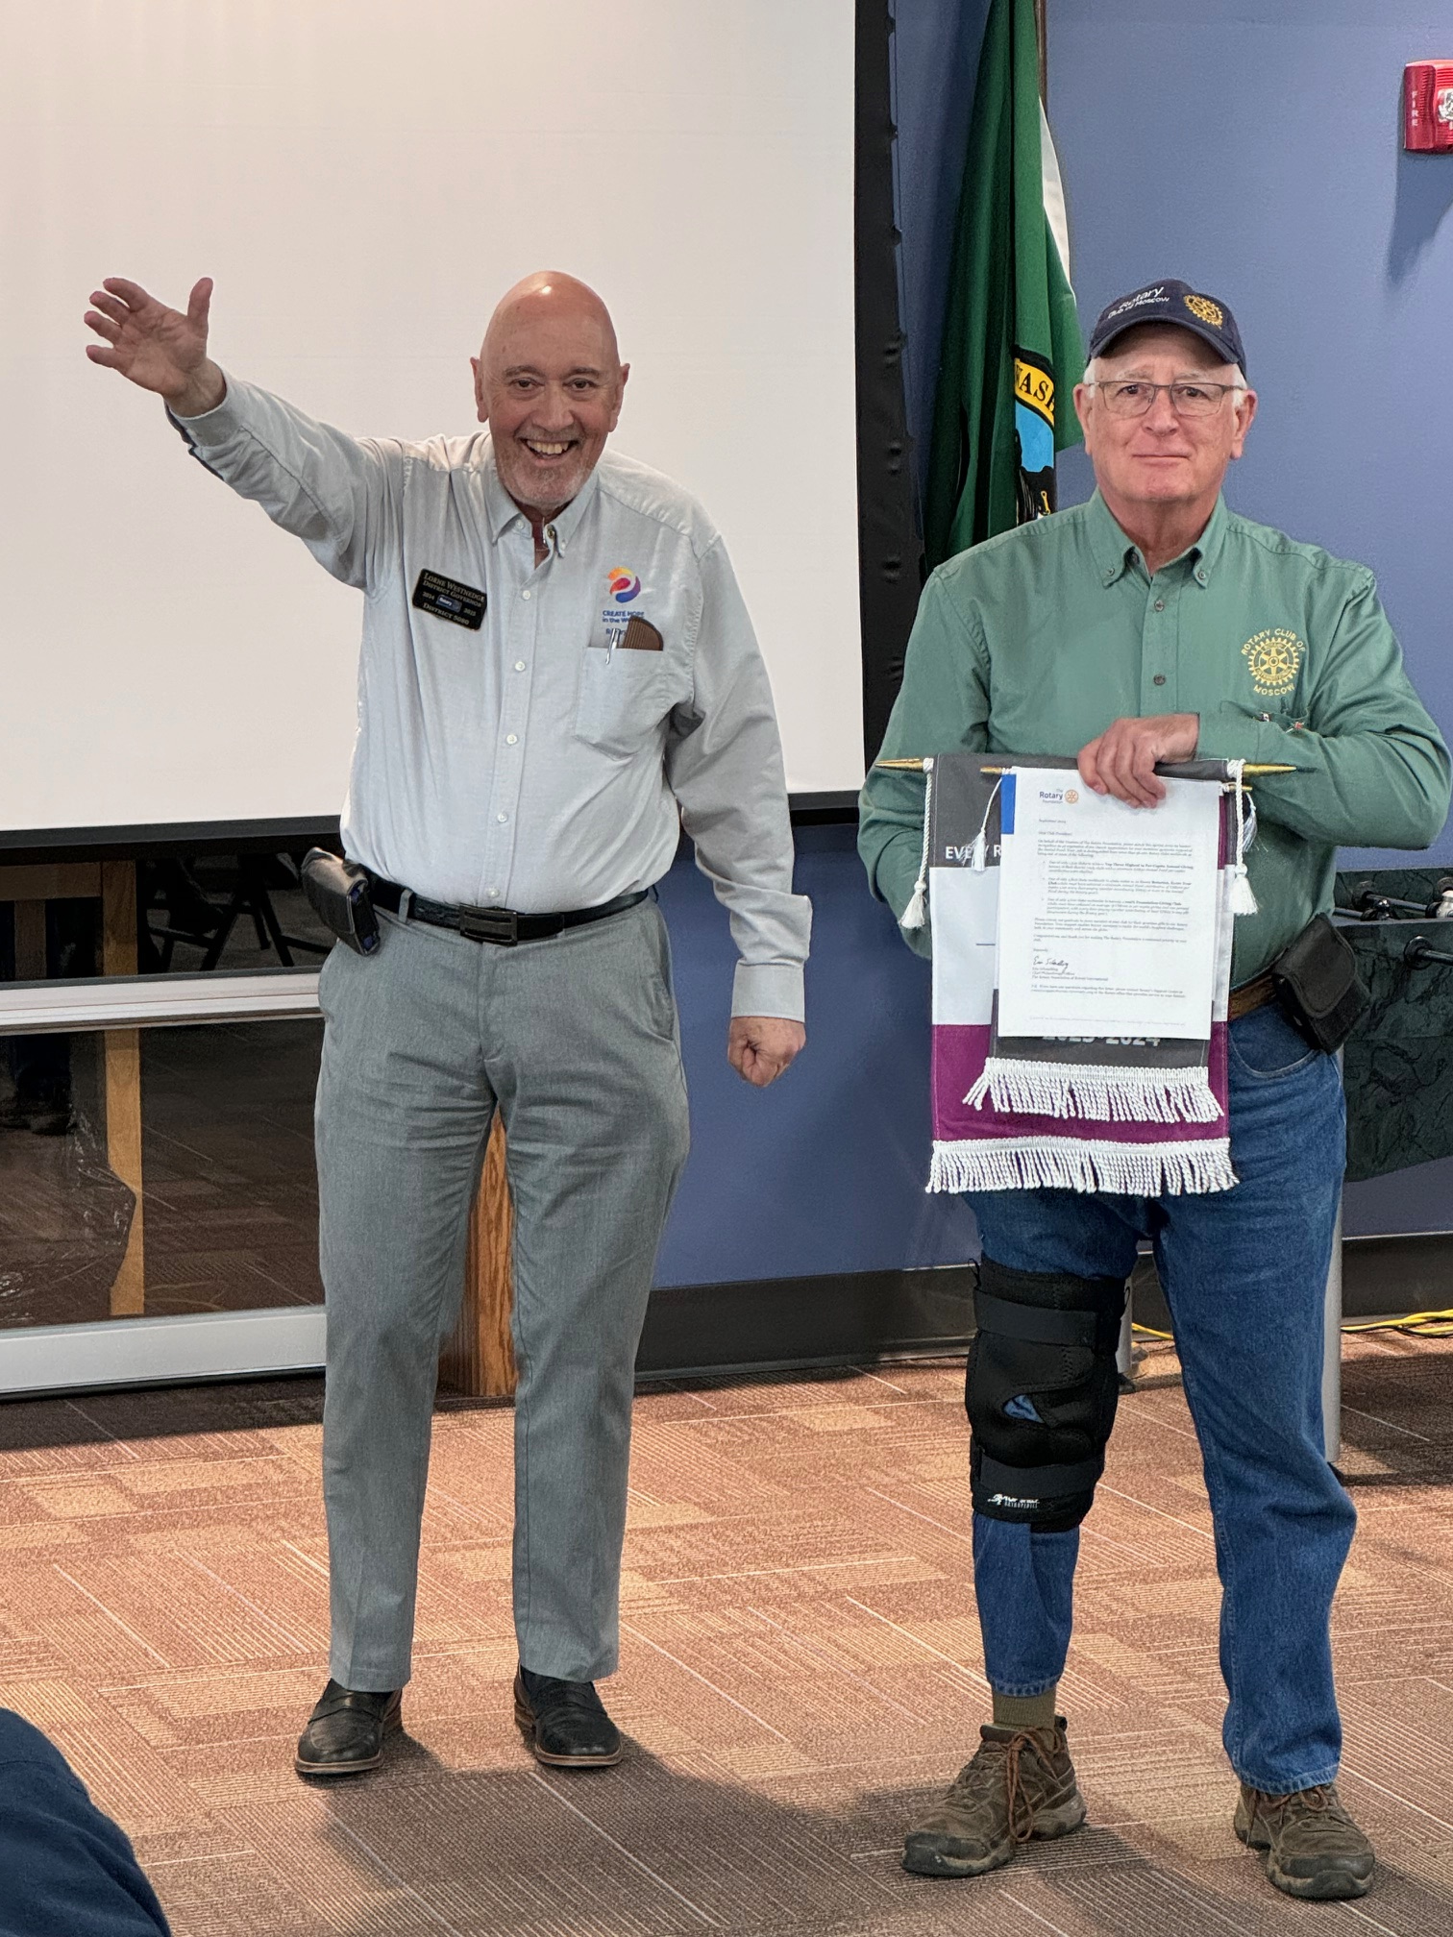
President’s Goals (cont’d)
8 Service Projects (5 Completed)
Young Leaders
Sponsor One Outbound and Inbound Exchange Student (RYE) (1 Inbound/4 Outbound!!)
Sponsor two RYLA students (June)
Public Image
Strategic Plan (May)
Online Presence: 5 Media Stories (1)
5 Social Activities (4)
2 Website and Social Media monthly updates (1)
Community Competitive Grant??? ???
1 Designated District Grant (in work)
RI President Gordon McInally

Slide 7
Club Budget (as of 31 December ‘24)
Operations
Fundraising
Cash: $3,167
Total YTD Revenue: $8,095
Total YTD Expenses: $9,159
2024-25 Financial Plan
Total Revenue: $19,850
Total Expenses: $21,950
Budget Remaining:
Club Expenses: $11,754
Club Service: $ ($50)
Membership: $700
Public Relations: $750
Cash and Investments:
Checking: $16,900
Investments: $10,500
2024-25 Financial Plan
Total Revenue: $56,500
Total Expenses: $58,650
Budget Remaining:
Community Service: $9,531
Vocational: $1,200
Youth Service: $2,218
International: $3,500
Special Projects: $2,457

Slide 8
Financial Issues and Factoids
Kettle Corn Fundraising: $49,405 (Second Year!)
Operations
Coffee Service: $2,160/year
BWPUI Set Up & Take Down: $2,160/year
More Members = More Dues

Slide 9
Grant Programs
$4,200 District Grant
“Learning With Lucky” in partnership with MSD 281; Lena Whitmore Elem
FUNDED!
New District Grant Planning
In the selection phase
Community Grants
Subject to our fundraising accounts, the board will decide after our Kettle Corn fundraiser whether to fund another round of competitive community grants.

Slide 10
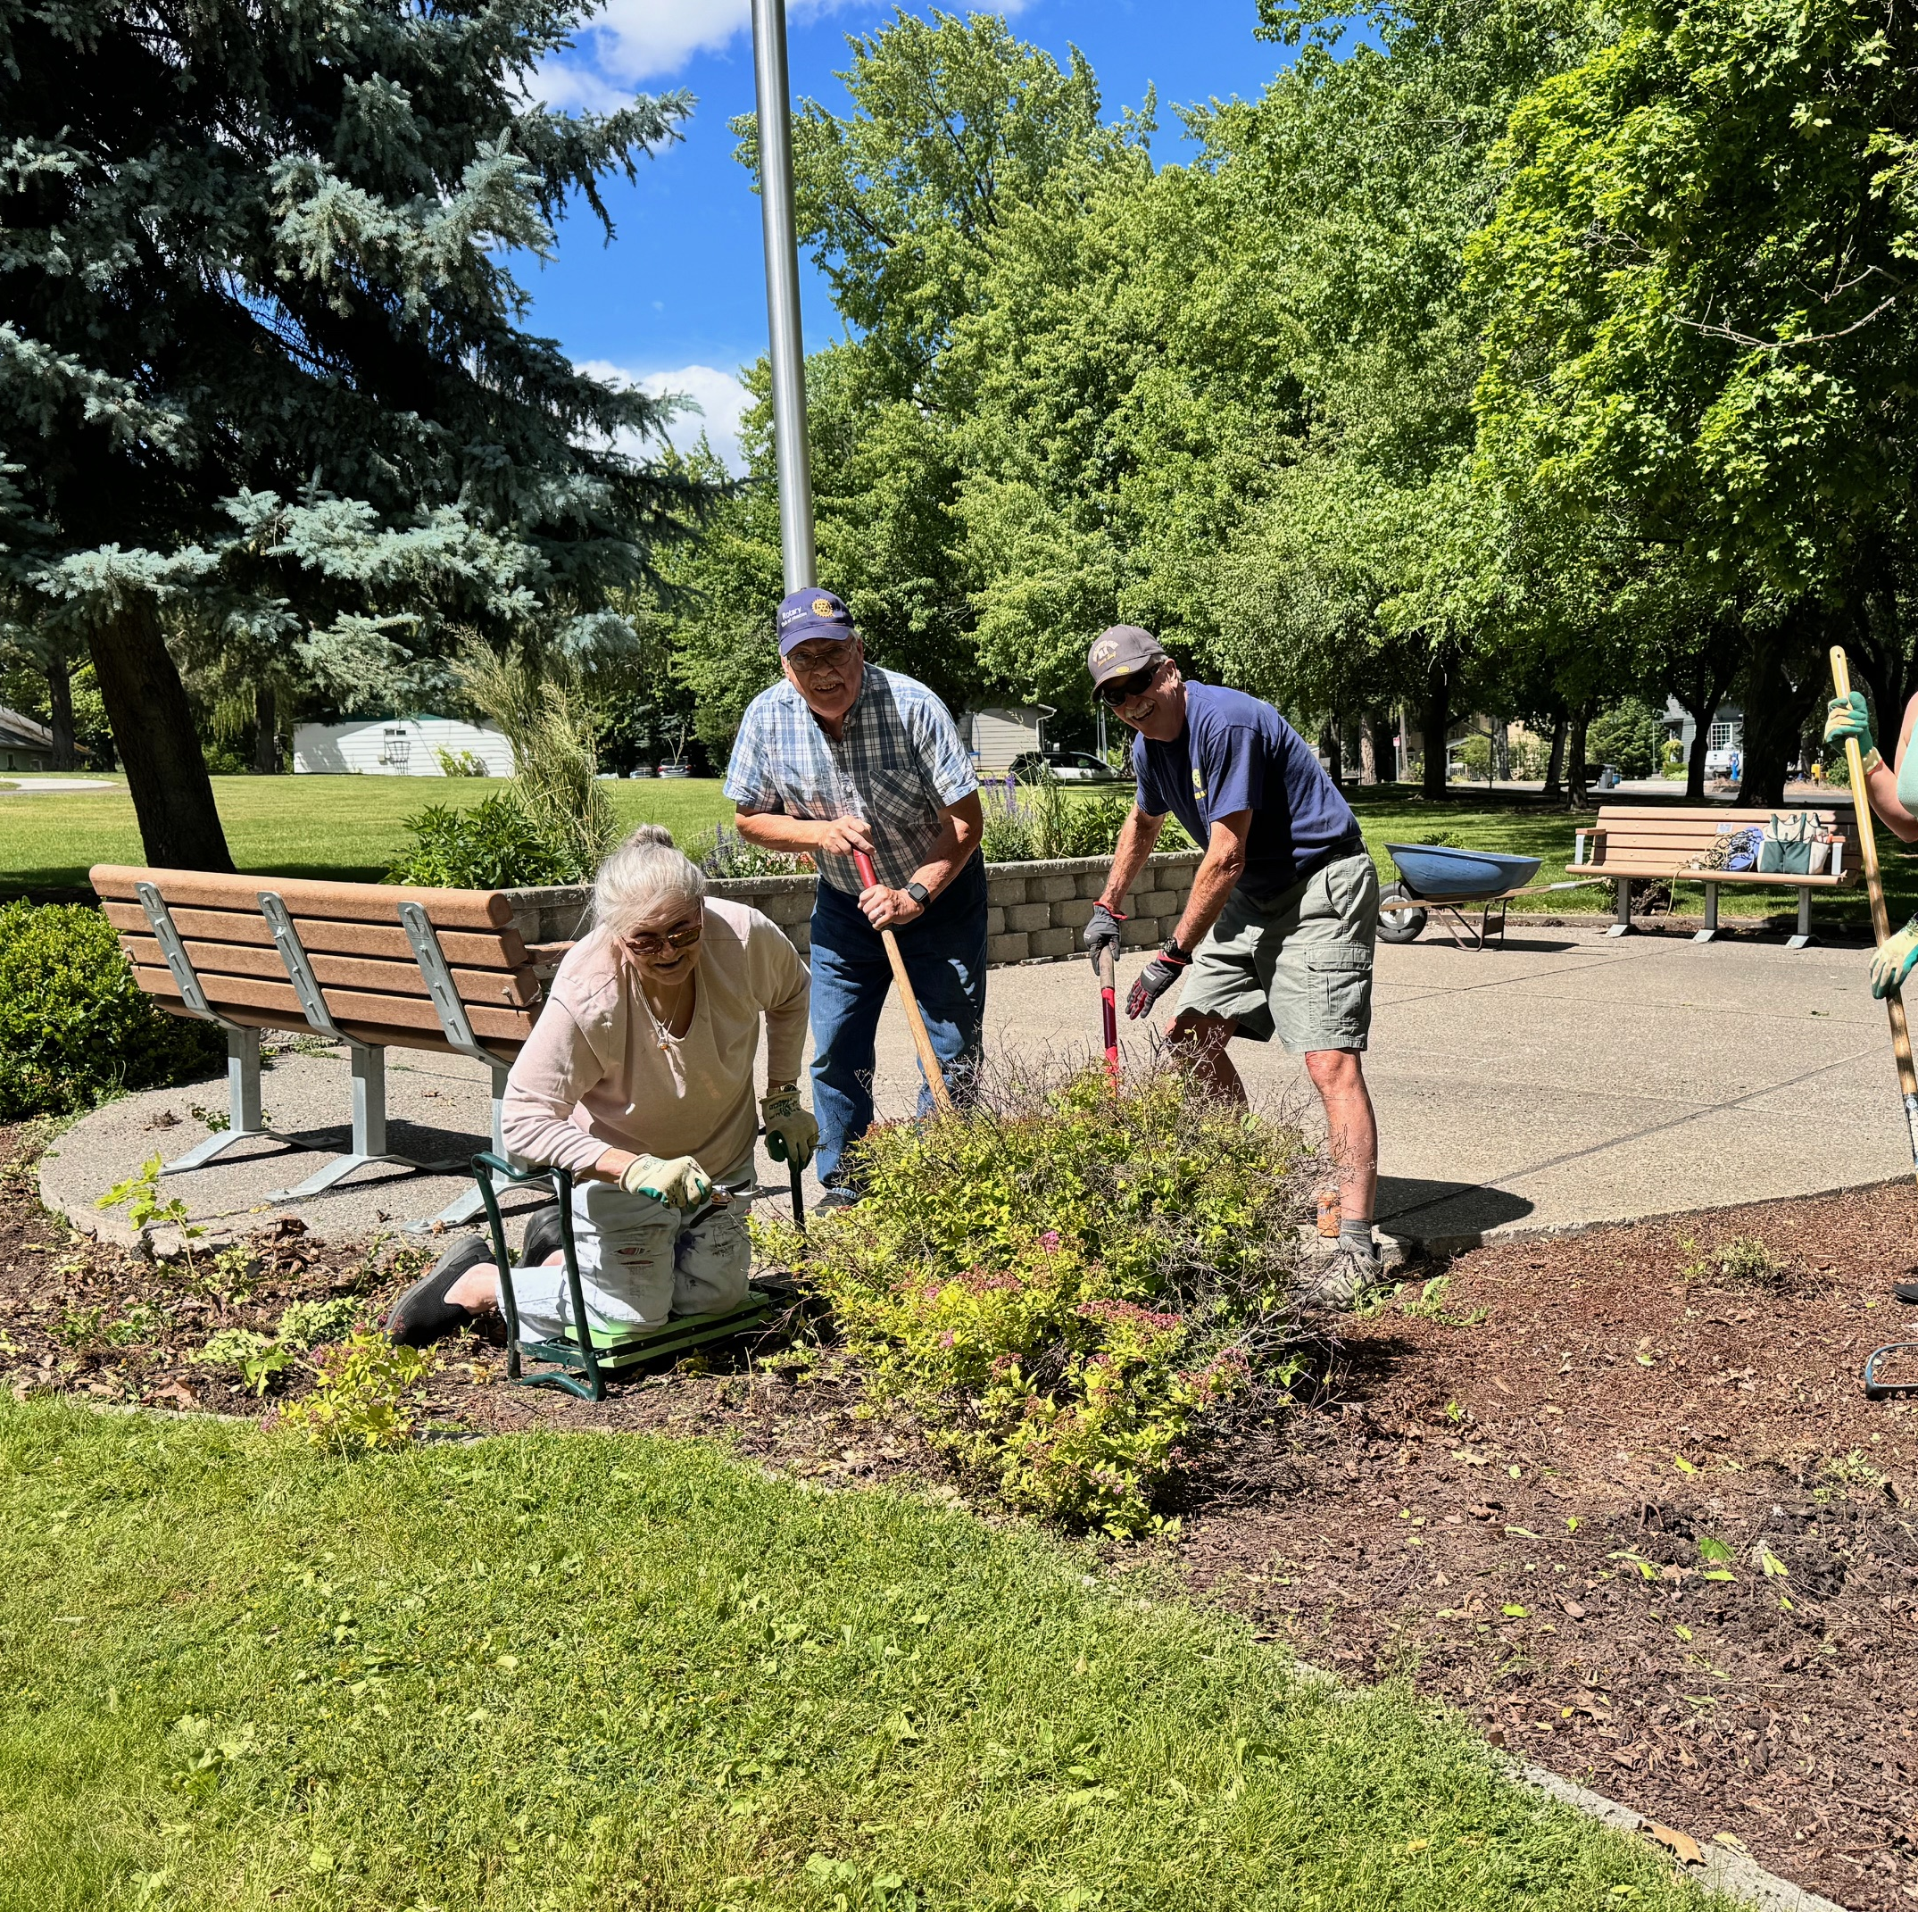
Committee Volunteering Opportunities
Community
Club
International
Youth
Vocational
Finance
Kettle Corn Logistics
Programs

Slide 11
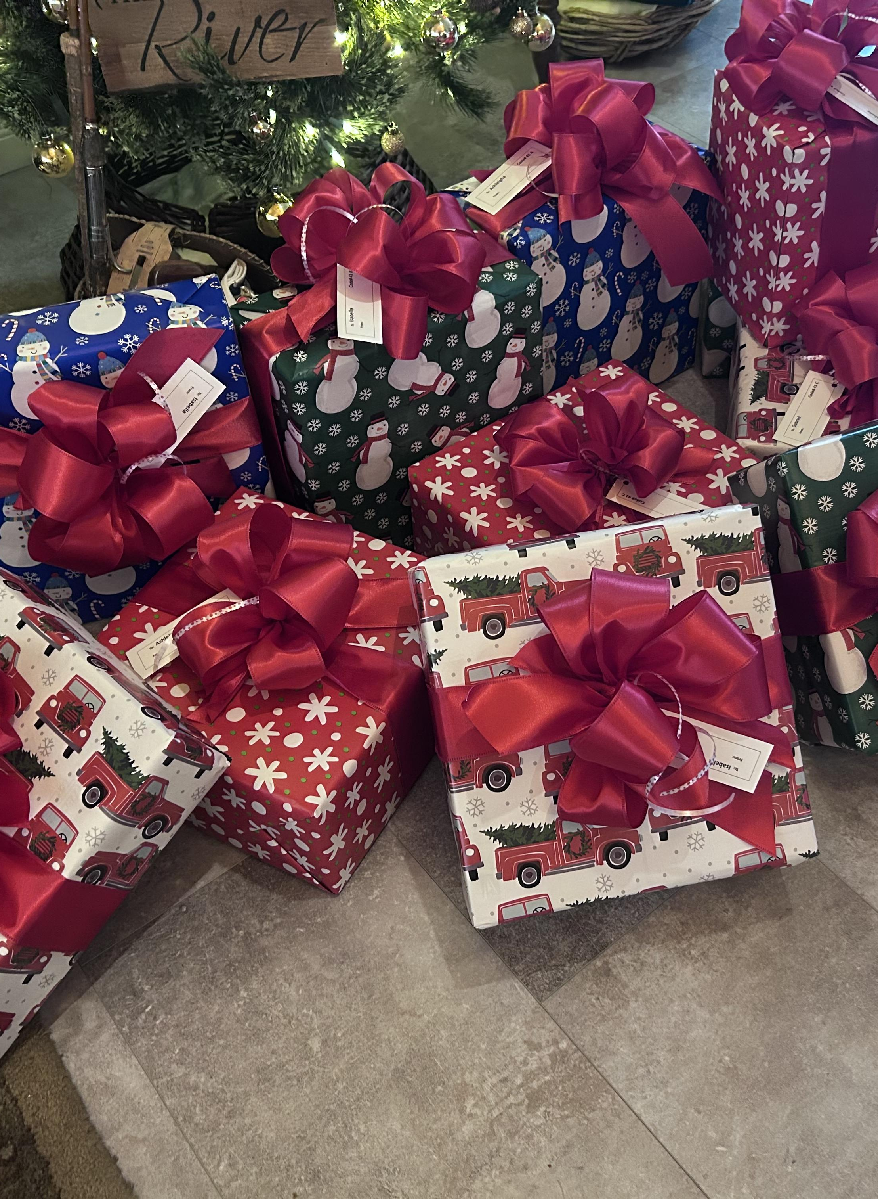
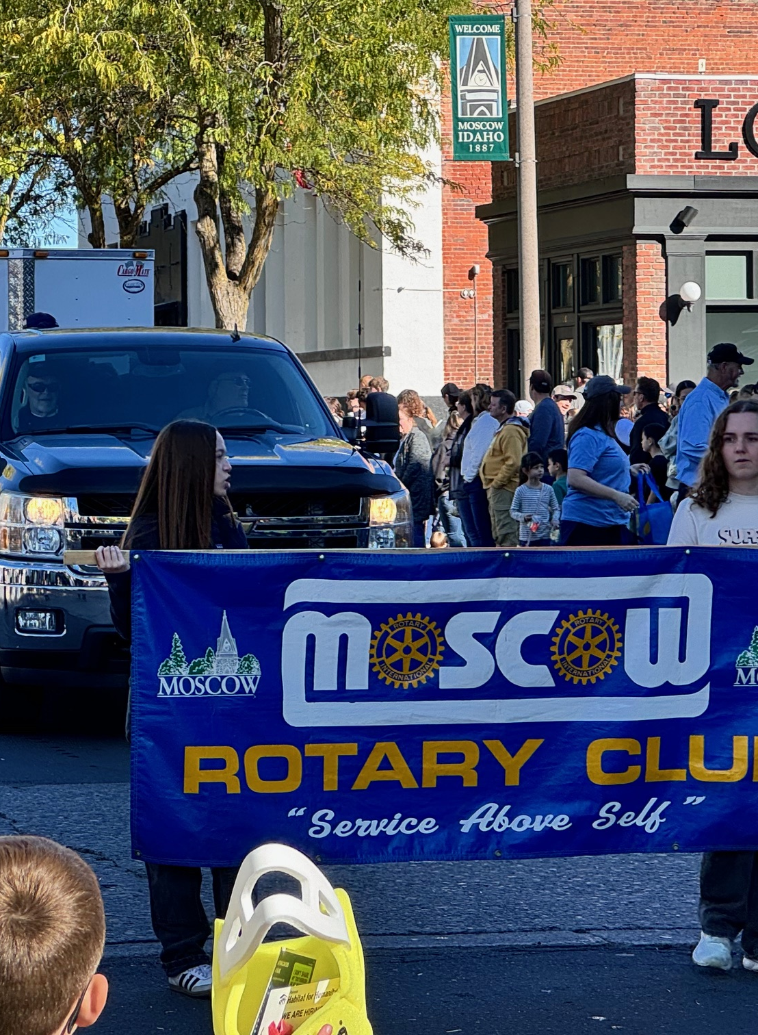
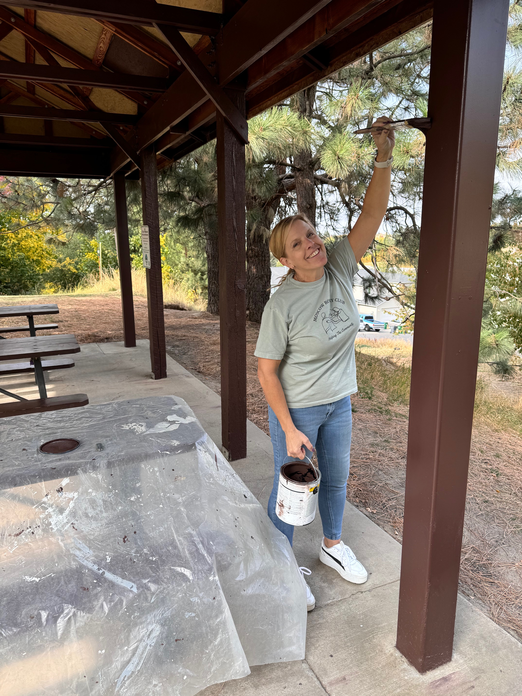
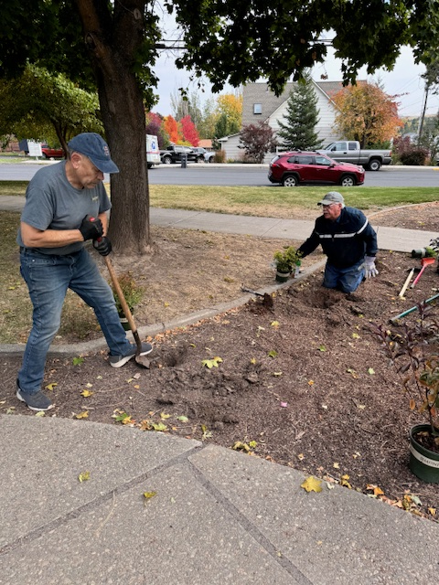
Projects
Special Projects:
Rotary Park Centennial Plaza Development (Phase One)
Shelter Painting
Christmas 4 Kids
County Fair
Homecoming Parade
Arbor Day Tree Planting
Rotary Park Centennial Plaza Development Spring Maintenance
TBD

Slide 12
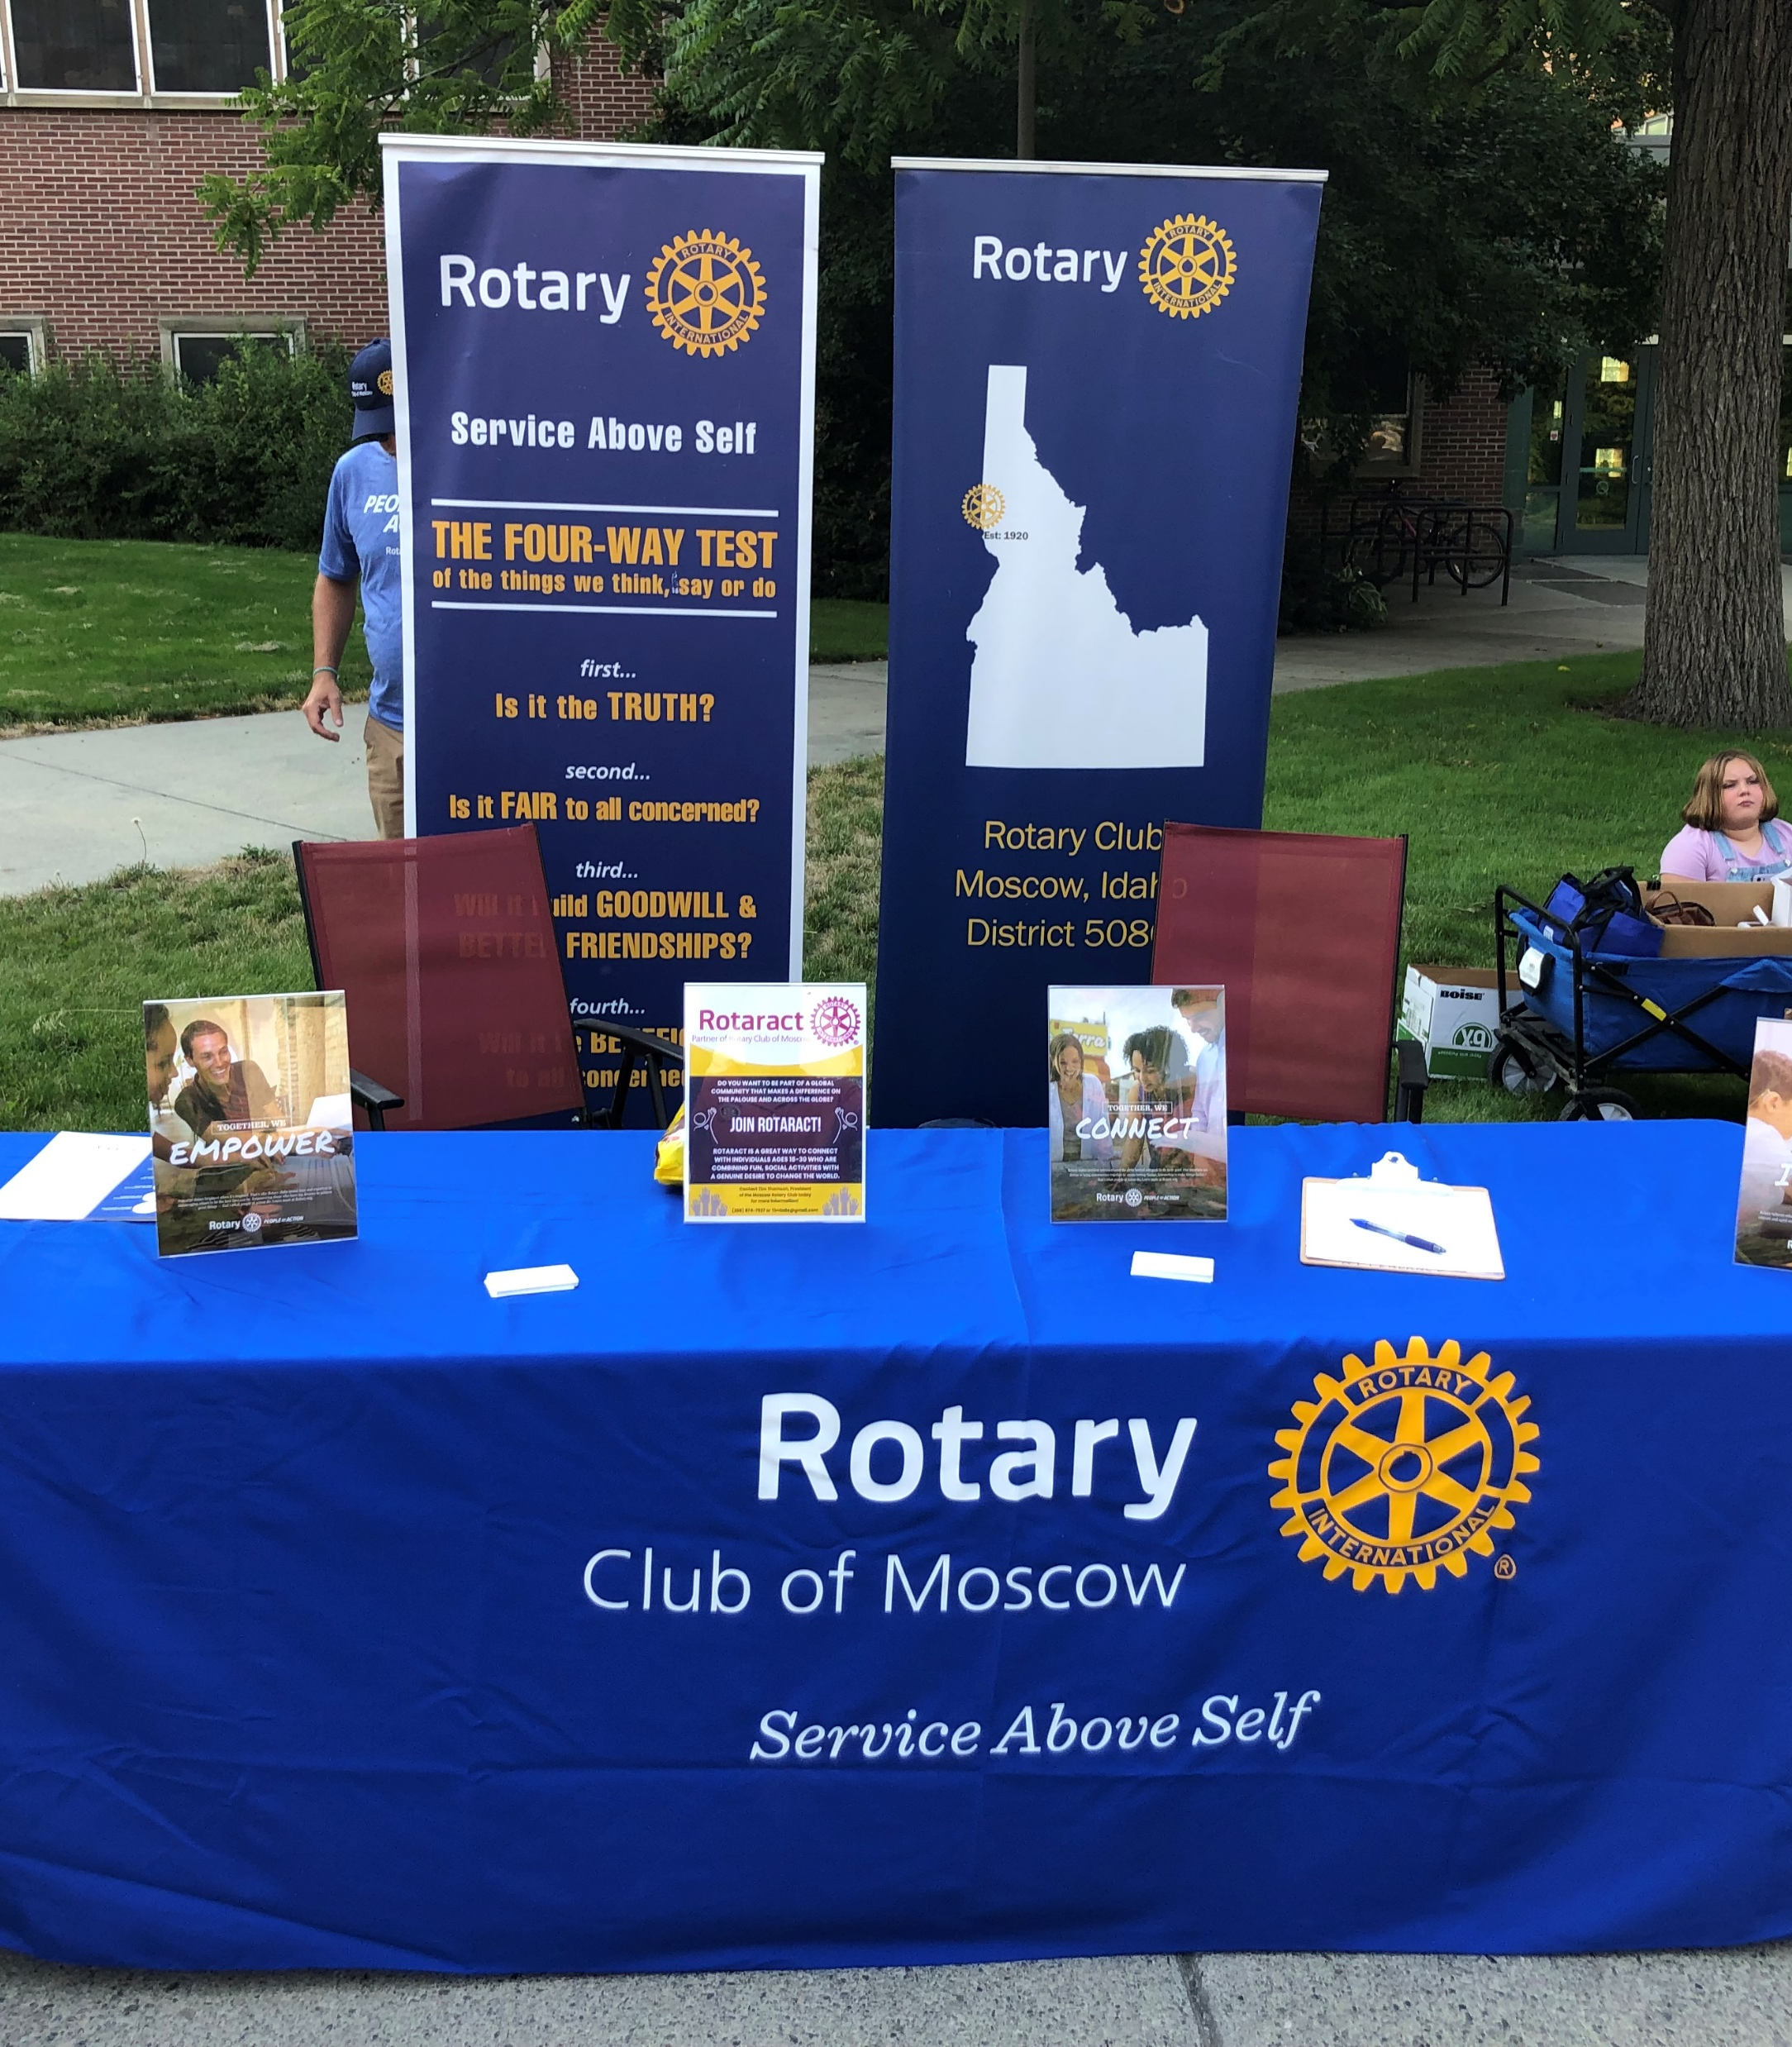
Membership Initiatives
Information Table in Friendship Square at the Moscow Farmers Market (May/June)
Chamber of Commerce monthly meeting (made them all)
Rotary Bingo
Another Chamber Business Afterhours
Done, will ask COC for Meeting Program
Your Ideas are welcomed!

Slide 13
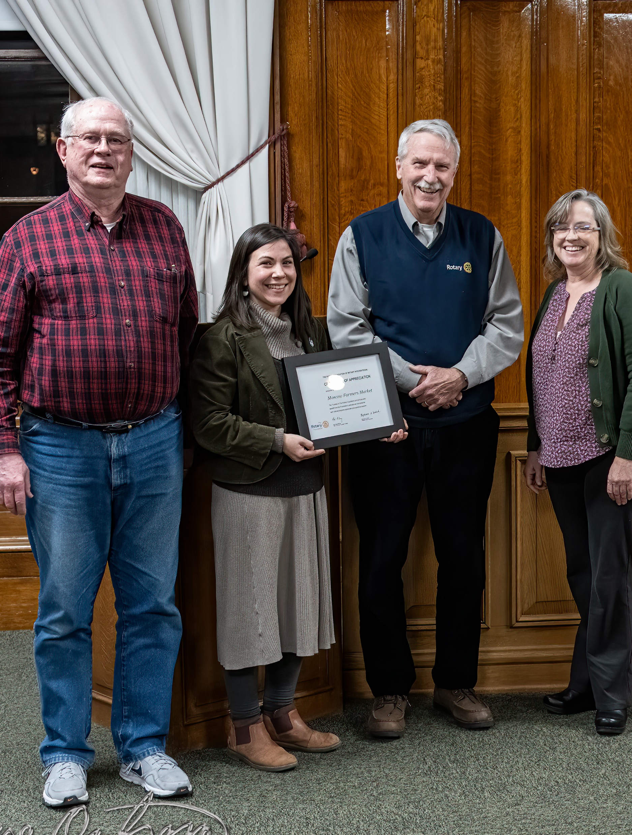
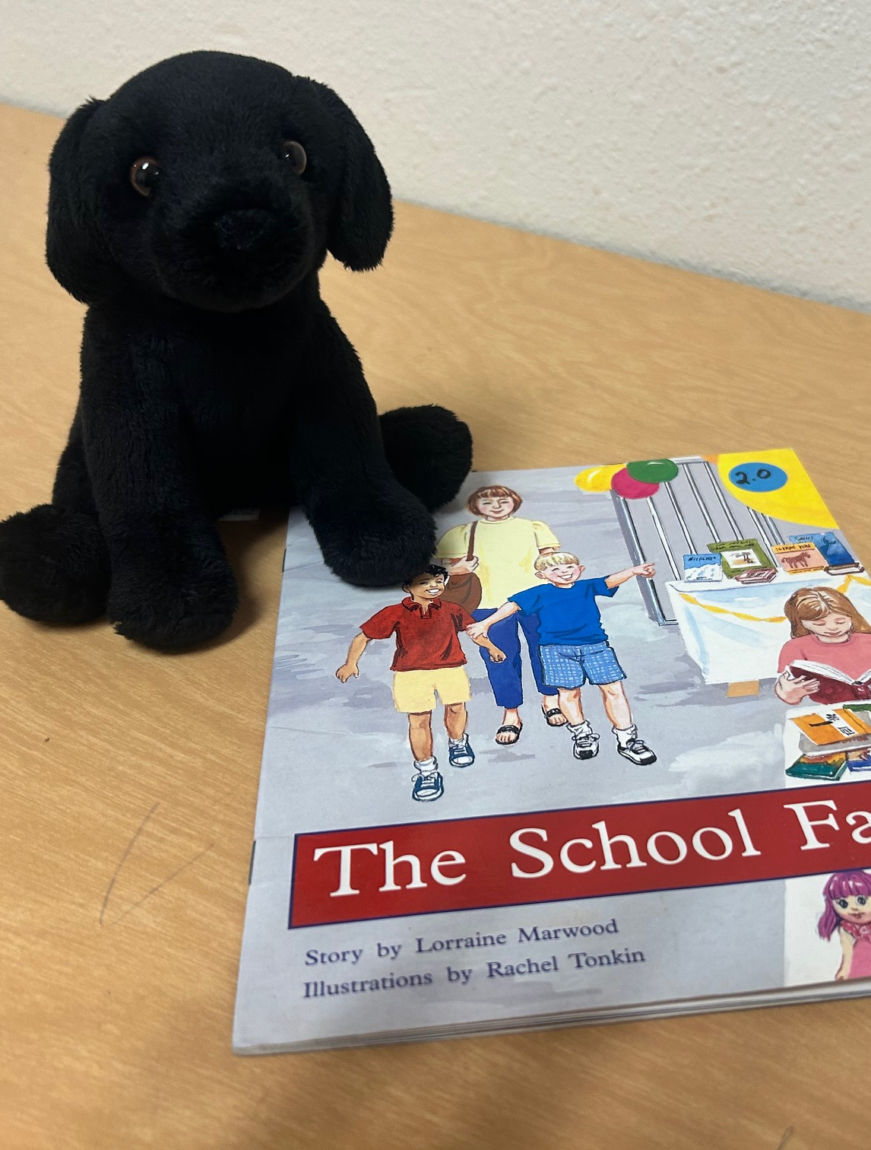
Public Image

Slide 14
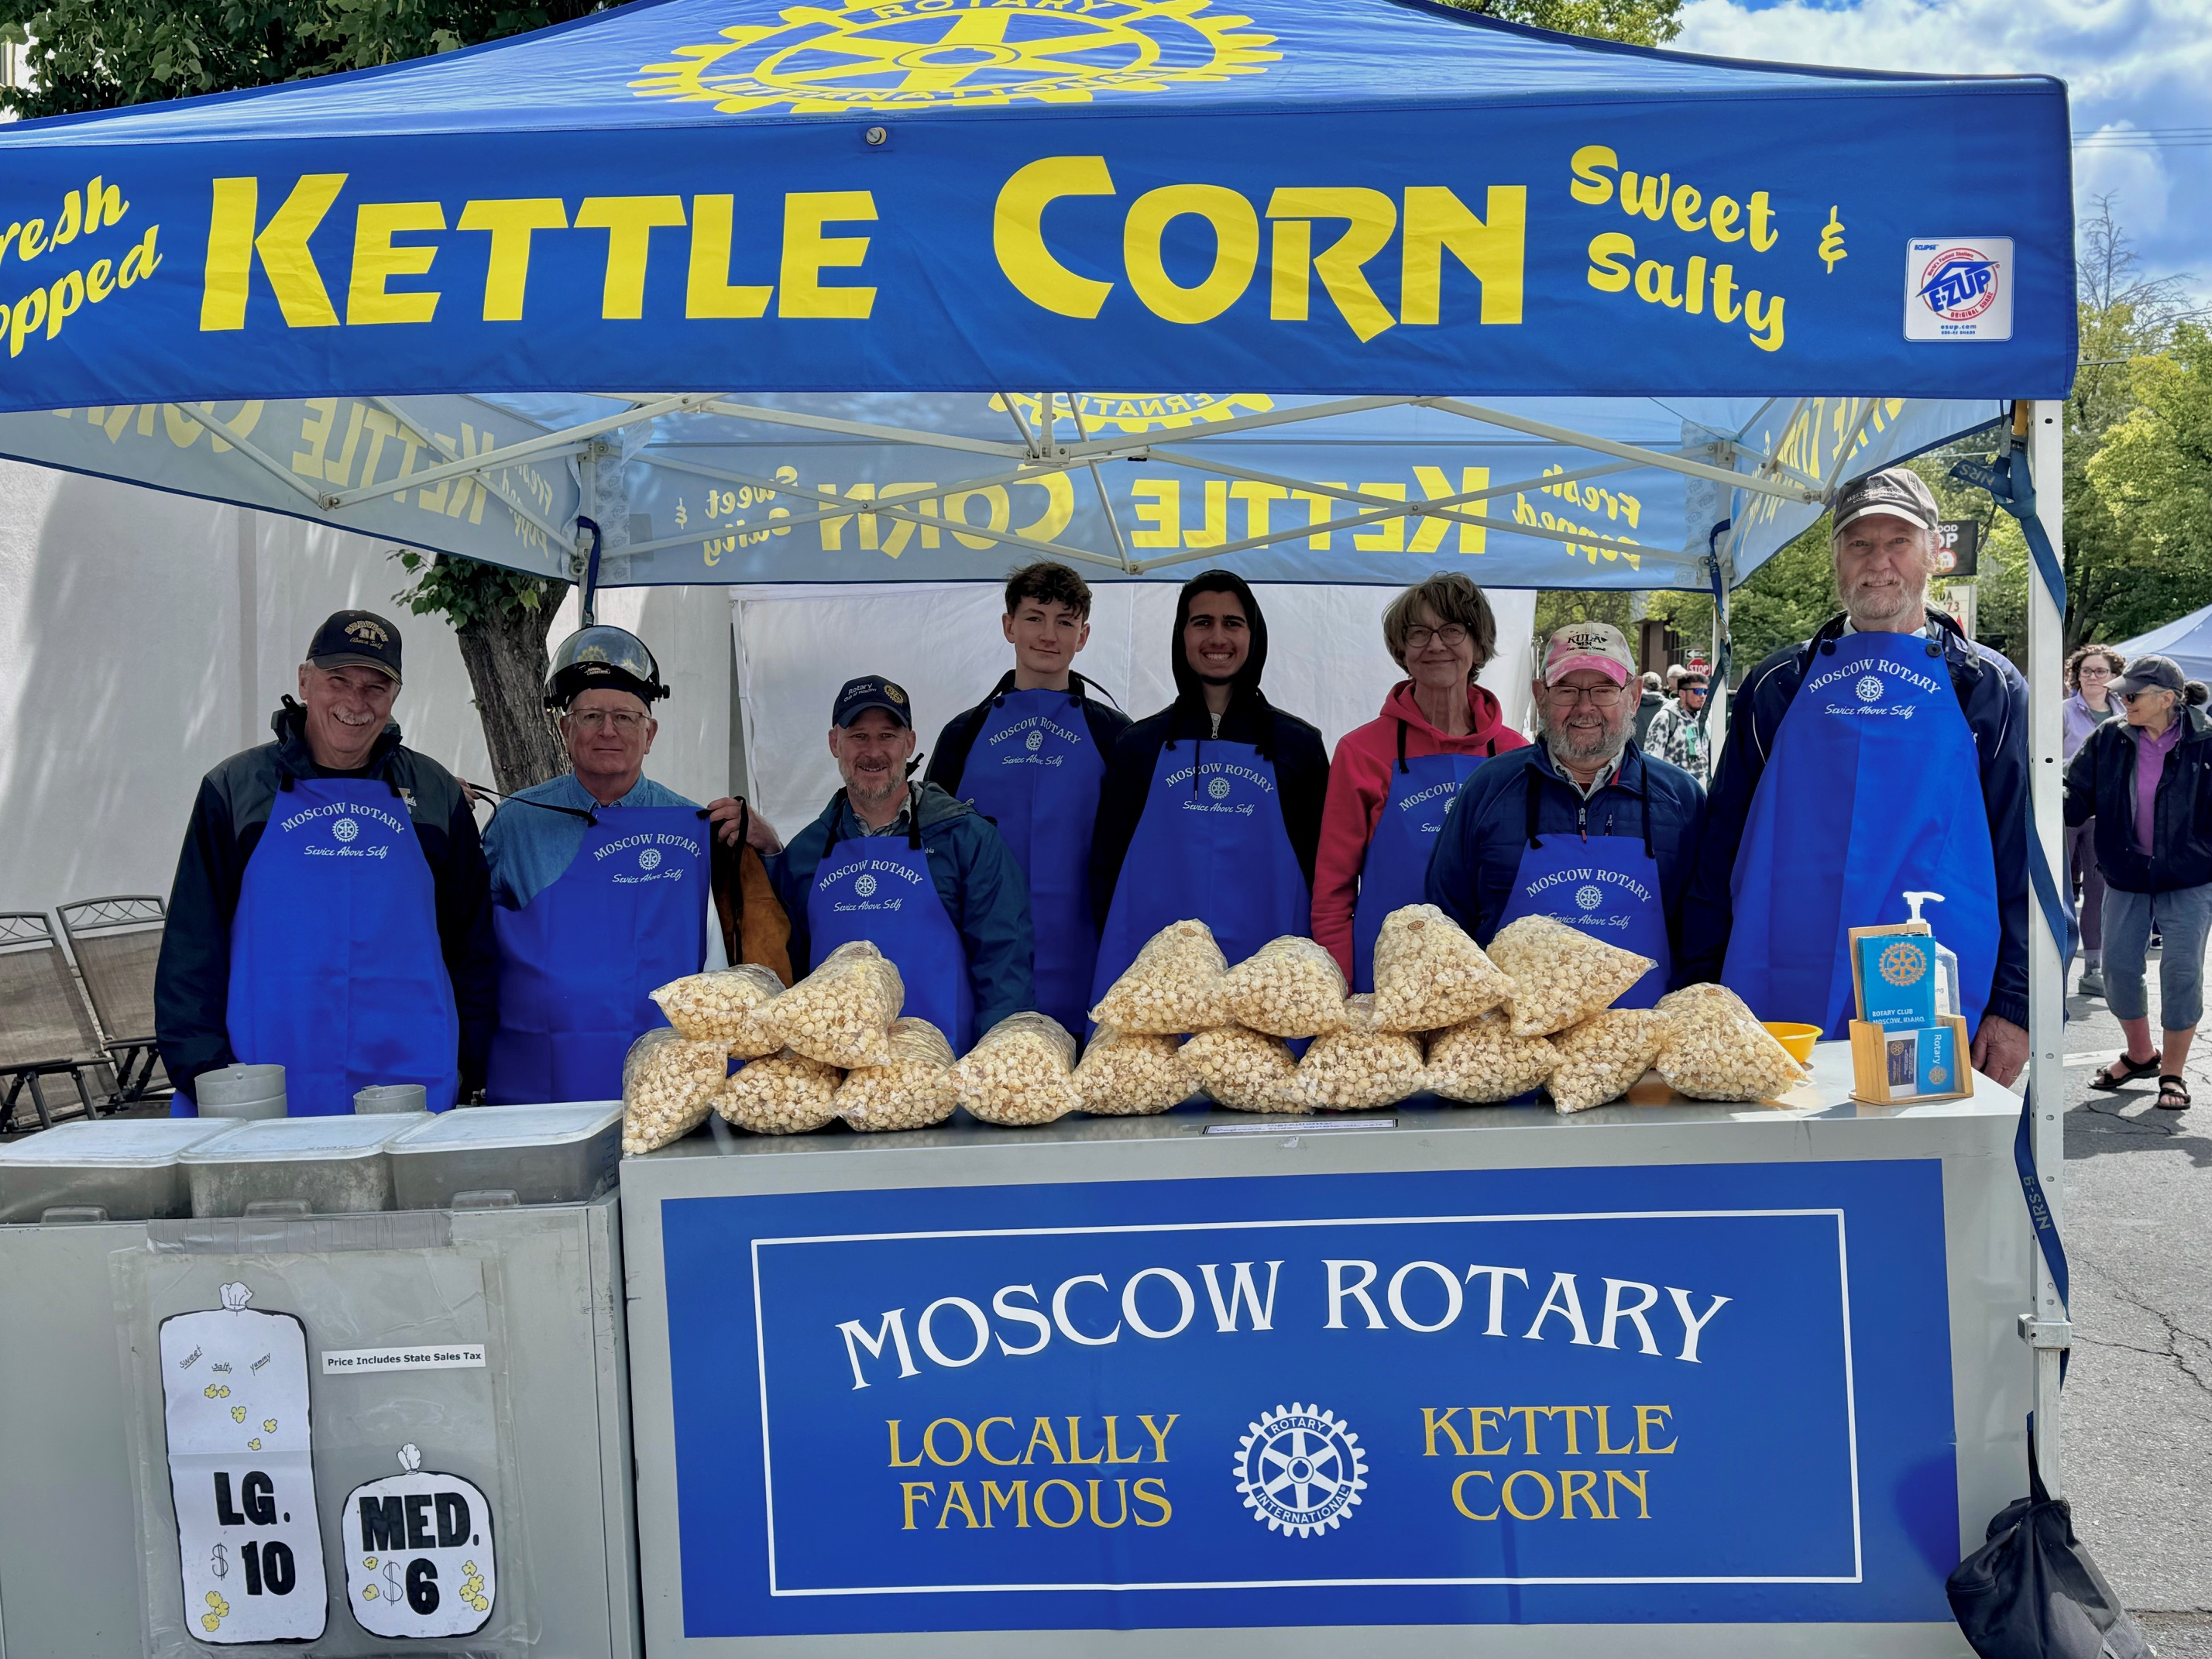
Summary
More Members
More ways to serve
More Projects
More Funds
More Philanthropy
More Visibility
MORE FUN!

Slide 15
The End!

