Slide 1


Your Rotary Foundation

Slide 2
District 5080

Slide 3
What Is the Rotary Foundation?
The charitable partner of Rotary International (RI)
It has its own board of trustees and designated 501(c)(3) status, and is separate from RI’s leadership/board of directors
It is one of the top-rated charities in the WORLD and has achieved a 4-star (the highest) rating through Charity Navigator for the past 15 years
It is recognized for its outstanding stewardship
Notes:
The Foundation transforms donations from Rotarians and friends into local and global humanitarian service projects that change lives.

Slide 4
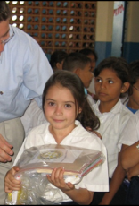
What Is the Rotary Foundation’s Mission?
To enable Rotarians to advance world understanding, goodwill, and peace through the improvement of health, the support of education, and the alleviation of poverty.
The Rotary Foundation helps fund Rotary’s humanitarian activities, from local service projects to global initiatives.

Slide 5







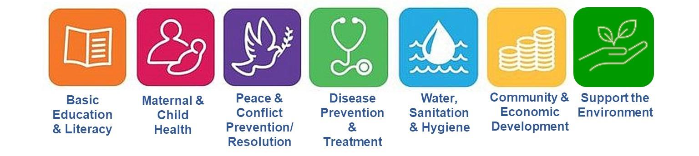

What are the Programs of the Rotary Foundation?
District Grants: Local community and smaller international projects
Global Grants: Larger international projects
Peace Centers: Peace scholarships
Rotary International scholarship programs
Worldwide Polio eradication
It funds projects in Rotary’s 7 areas of focus
Notes:
All of these programs are detailed on the Rotary.org website and there are helpful tools for brining it to the Clubs. A great of example of a recent district grant is the “Express grants” that were $300 each and available to all clubs and Rotaract Clubs.
Global Grants have a club training component that is required prior to application – so that clubs understand the process.
Peace Centers and scholarships were established in 2002 and more than 1,400 have graduated, now working in more than 115 countries. There is even a professional development certificate program intended for working professionals!
Each year, Rotary awards p to 130 fully funded fellowships in the Peace Center alone.
Rotary is a founding partner of the Global Polio Eradication Initiative, reducing polio cases by 99.9% since 1979, contributing more than 2.1 billion and countless volunteer hours.
The Seven Areas of Focus (which recently added the Environment) are:
Basic Education and Literacy;
Maternal and Child Health;
Peace and Conflict Prevention/Resolution;
Disease Prevention & Treatment;
Water, Sanitation & Hygiene;
Community & Economic Development;
Support of the Environment.

Slide 6


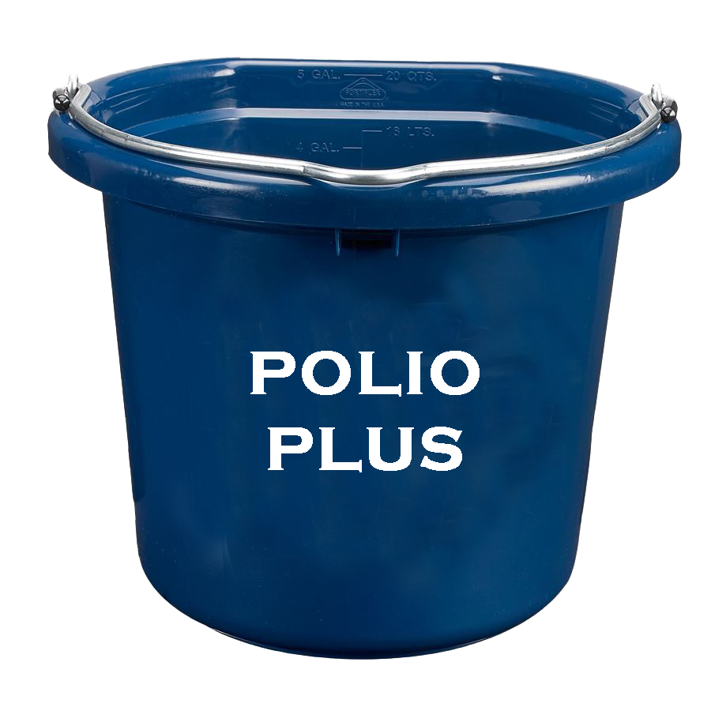
How Do YOU Support the Rotary Foundation?
There are three funds we support through the Rotary Foundation:
  The Annual Fund
  The Endowment Fund
  PolioPlus Fund

Slide 7
The Annual Fund
Each club should have an annual giving goal
  Clubs can become an Every Rotarian Every Year (EREY) club by pledging $25 per member/and an average giving to all funds of $100 per member.
All monies are spent on an annual basis for club projects, peace scholars, etc. Funds gathered this year will be held for three years and the interest generated pays the administrative costs of RI
When the three years funds are released, 47.5% goes to global grants for international projects (see next slide) and 47.5 goes back to our district for distribution. 5% is used for administrative costs.
Notes:
Note that this is where the PHF comes in!
Also note that the interest from the annual fun goes to ay RI costs, not just foundation administration. RI has around 800 paid employees.

Slide 8
The Endowment Fund
Gifts to the endowment are held in perpetuity – forever!
Currently at more than one billion dollars
Funds are professionally invested
Part of the earnings are used each year including interest moved to the Annual Fund to support global grants and money returned to districts
Designate a minimum of $1,000 in your will and become a benefactor
Gifts of $10,000 or more are recognized with membership in the Bequest Society
A way to create your own Rotary legacy
Notes:
Becoming a benefactor is one of the easiest ways to support Rotary – painless for you, and a positive impact when you are gone

Slide 9
The PolioPlus Fund
Dedicated to global polio eradication
Separate from the Annual Fund
2:1 match by the Gates Foundation. So, every dollar donated turns into a $3 donation up to $50 million
Monies donated to PolioPlus also go towards your Paul Harris Fellow
Many districts (including ours) have “The PolioPlus Society”
  Join by pledging $100 per year

Slide 10

How Does It Work?
As A Rotarian:
  Give to the Rotary Foundation
    Every Rotarian Every Year (EREY) Sustainer
    PolioPlus Society ($100 annually)
    Become a Benefactor (give through your will)
    Become a Paul Harris Fellow/Multiple PHF
    Learn about
      Major Donors
      Bequest Society
      Triple Crown Awards

Slide 11

How Does It Work?
Does our Club have it’s own Non-profit (501c3) status?
  If Yes:
    Funds given to our LOCAL foundation do not count towards Rotary International Programs
    Your Club can bring in funds through your local non-profit and then send them to RI in your name for recognition.
  If No:
    If you are a U.S. Club, our Rotary District 5080 has a Non-profit (501c3) status that can be used by Clubs for charitable purposes.

Slide 12
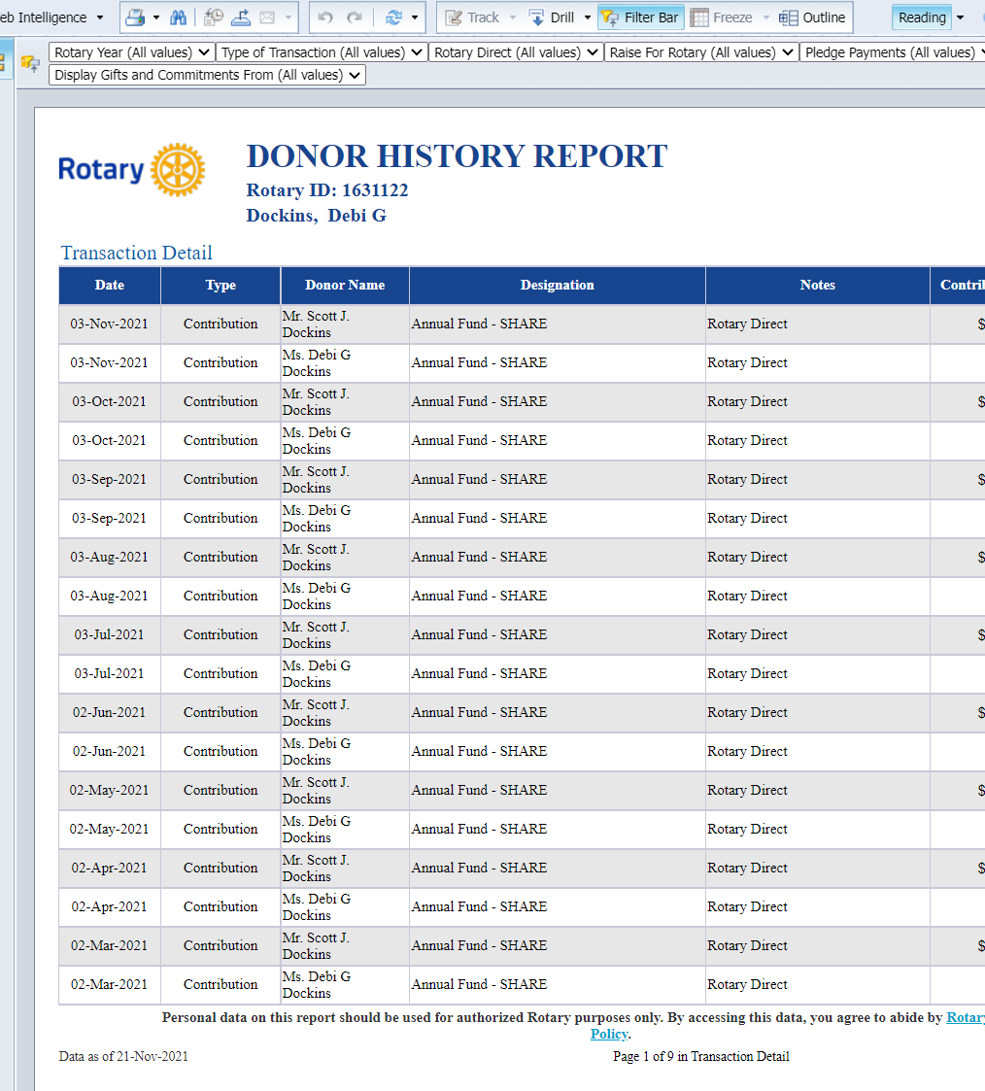
As A Rotarian…..
Monthly transaction reports
and donor history is available online

Slide 13

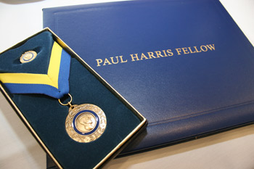
How Does It Work?
As a club
  Participate in the Rotary Grant programs
  Become a 100% EREY Club ($25/member)
  Provide regular updates on giving
  All members have a myRotary account
  Recognize your members for their achievements

Slide 14
As A Club…..
Club officers can set goals by looking at history and current giving.

Slide 15
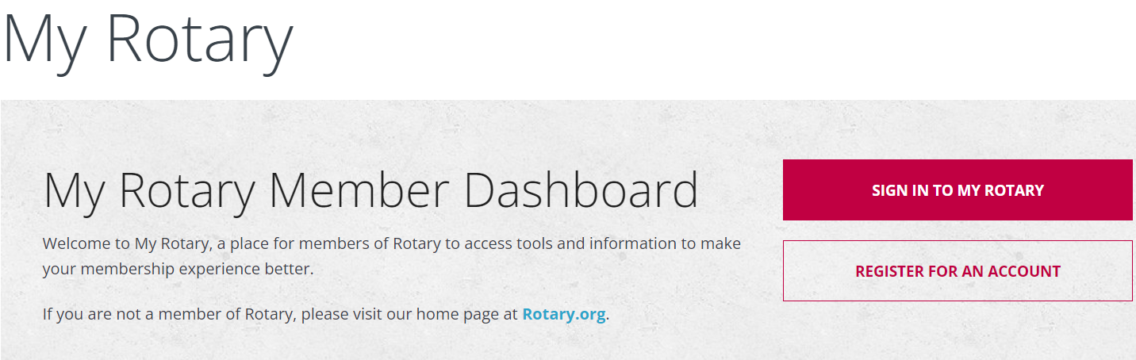
myRotary.org
EVERY Rotarian can register with myRotary.org, set up your own account and check your giving status (They also have a donate button here if you want to keep it simple!)
EVERY Rotarian can connect with the district foundation leaders to learn more about giving and support
EVERY Rotarian can ask their club leaders about their giving and how to support their club

Slide 16
The More You Know…..
Learn More about the specific programs of the Foundation, including:
  District Grants (short-term activities in your community and abroad)
  Global Grants (large and long-term sustainable projects w/ Int’l partners)
  District Grant Scholarships (Promoting peace through scholarships)
  Rotary Peace Centers (Premier education to foster world understanding)
  Support of Rotary Alumni, including
    Ambassadorial scholars, group study exchange participants, Rotary grants to university teachers, peace fellows, youth exchange, Rotaractors, grant recipients and volunteers

Slide 17
Questions?
Presentation updates needed? Contact Debi Dockins, District Trainer: ryla5080@yahoo.com

