Slide 1
Fiscal Year 2022

Slide 2
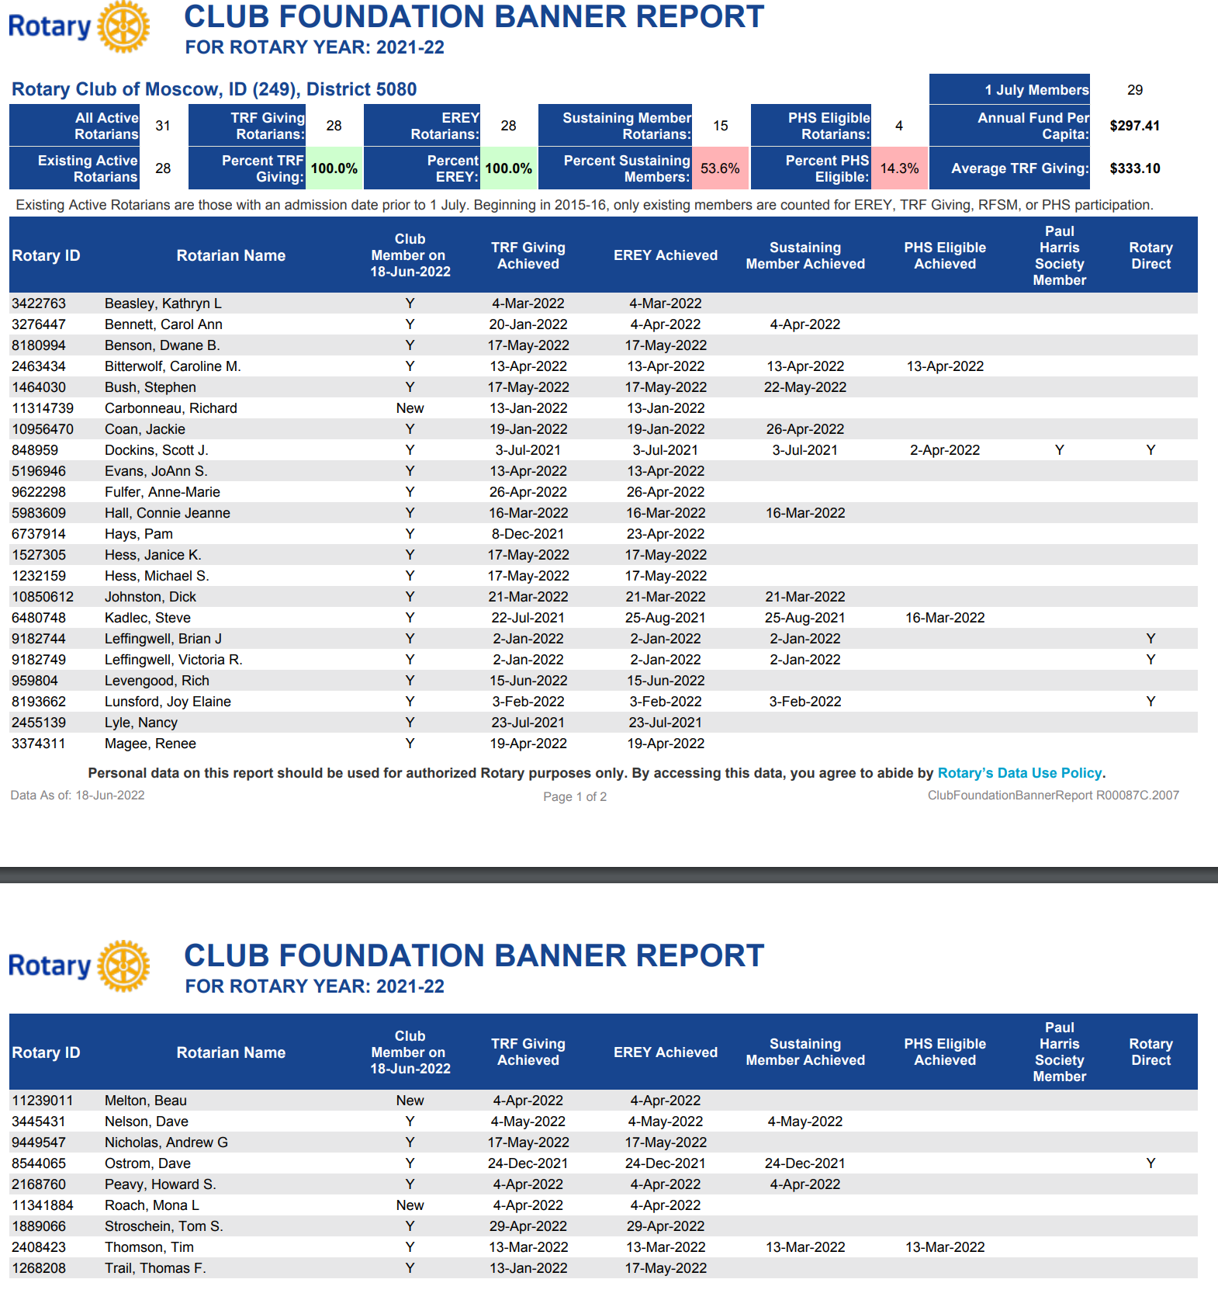

Slide 3
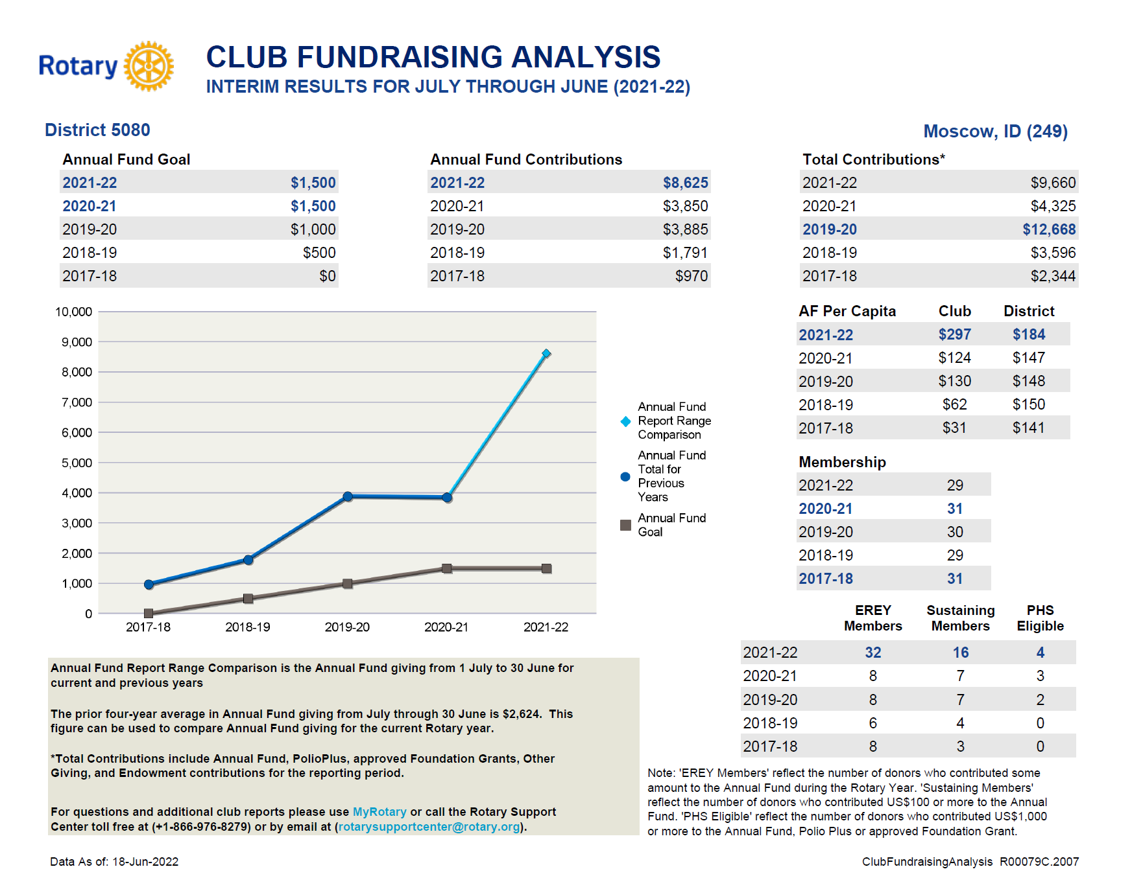

Slide 4
Fiscal Year 2022-23 Goals
My.Rotary Accounts
Direct/Scheduled Donations
EREY Recognition
Rotary Grants

Slide 6
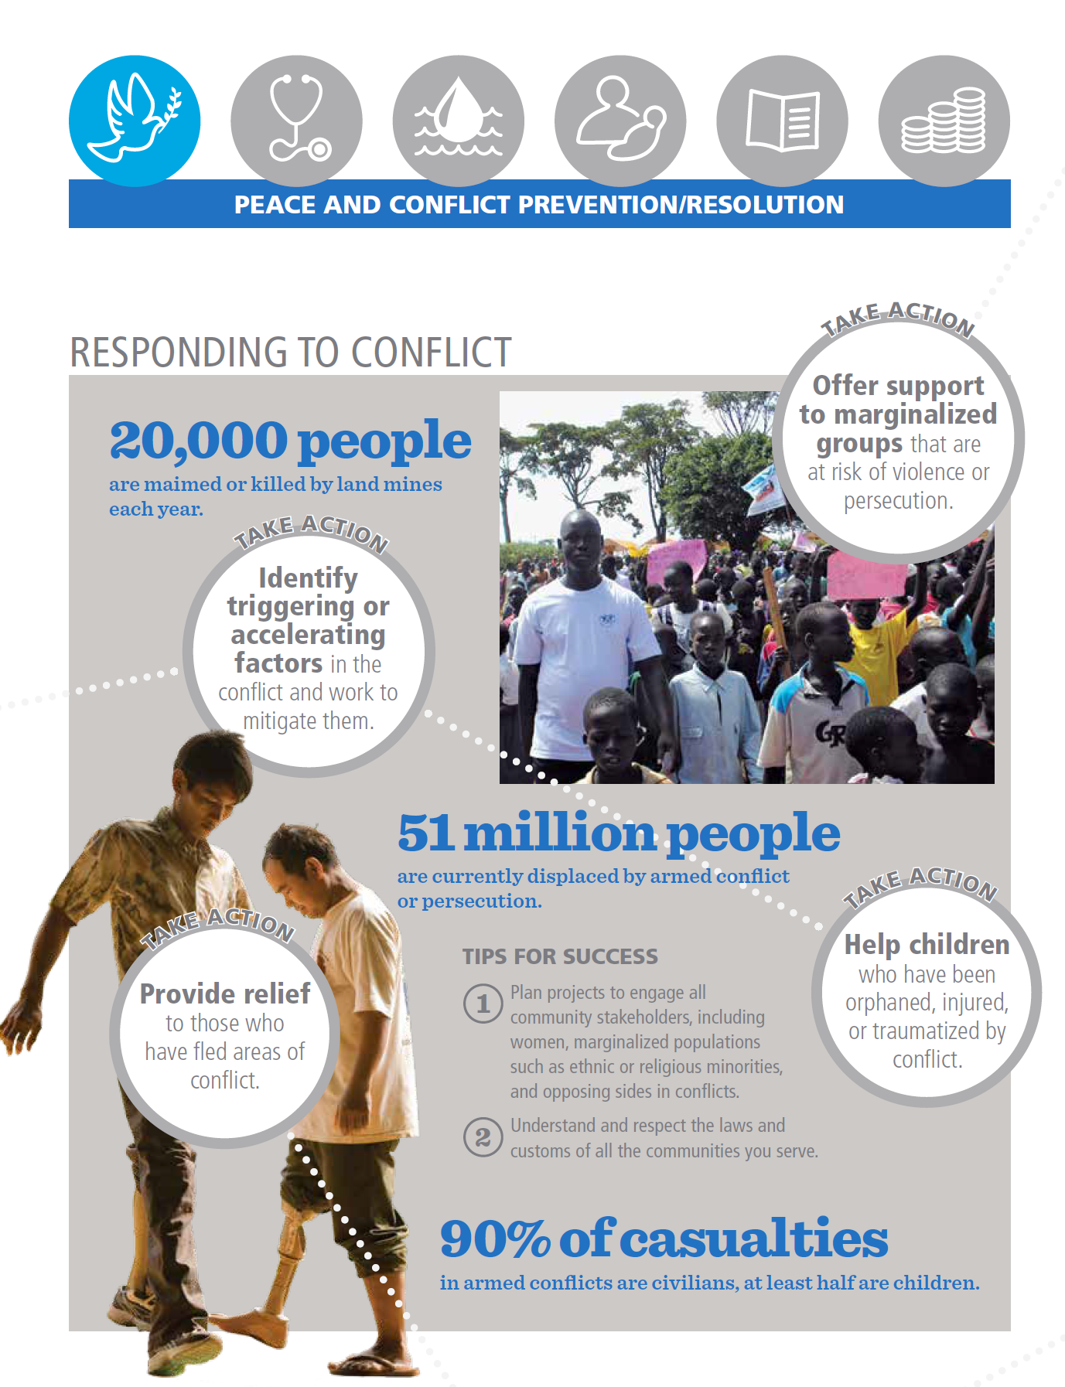

Slide 7
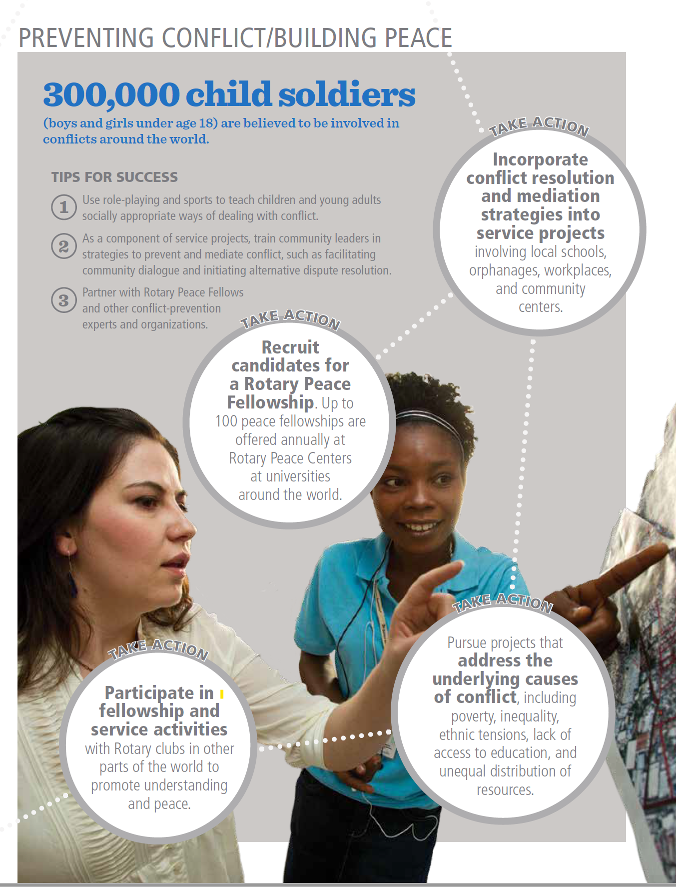

Slide 11
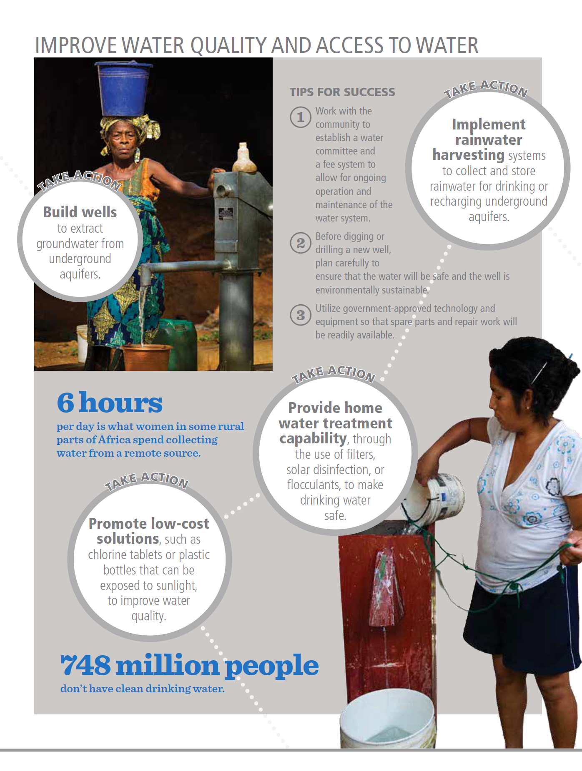

Slide 15
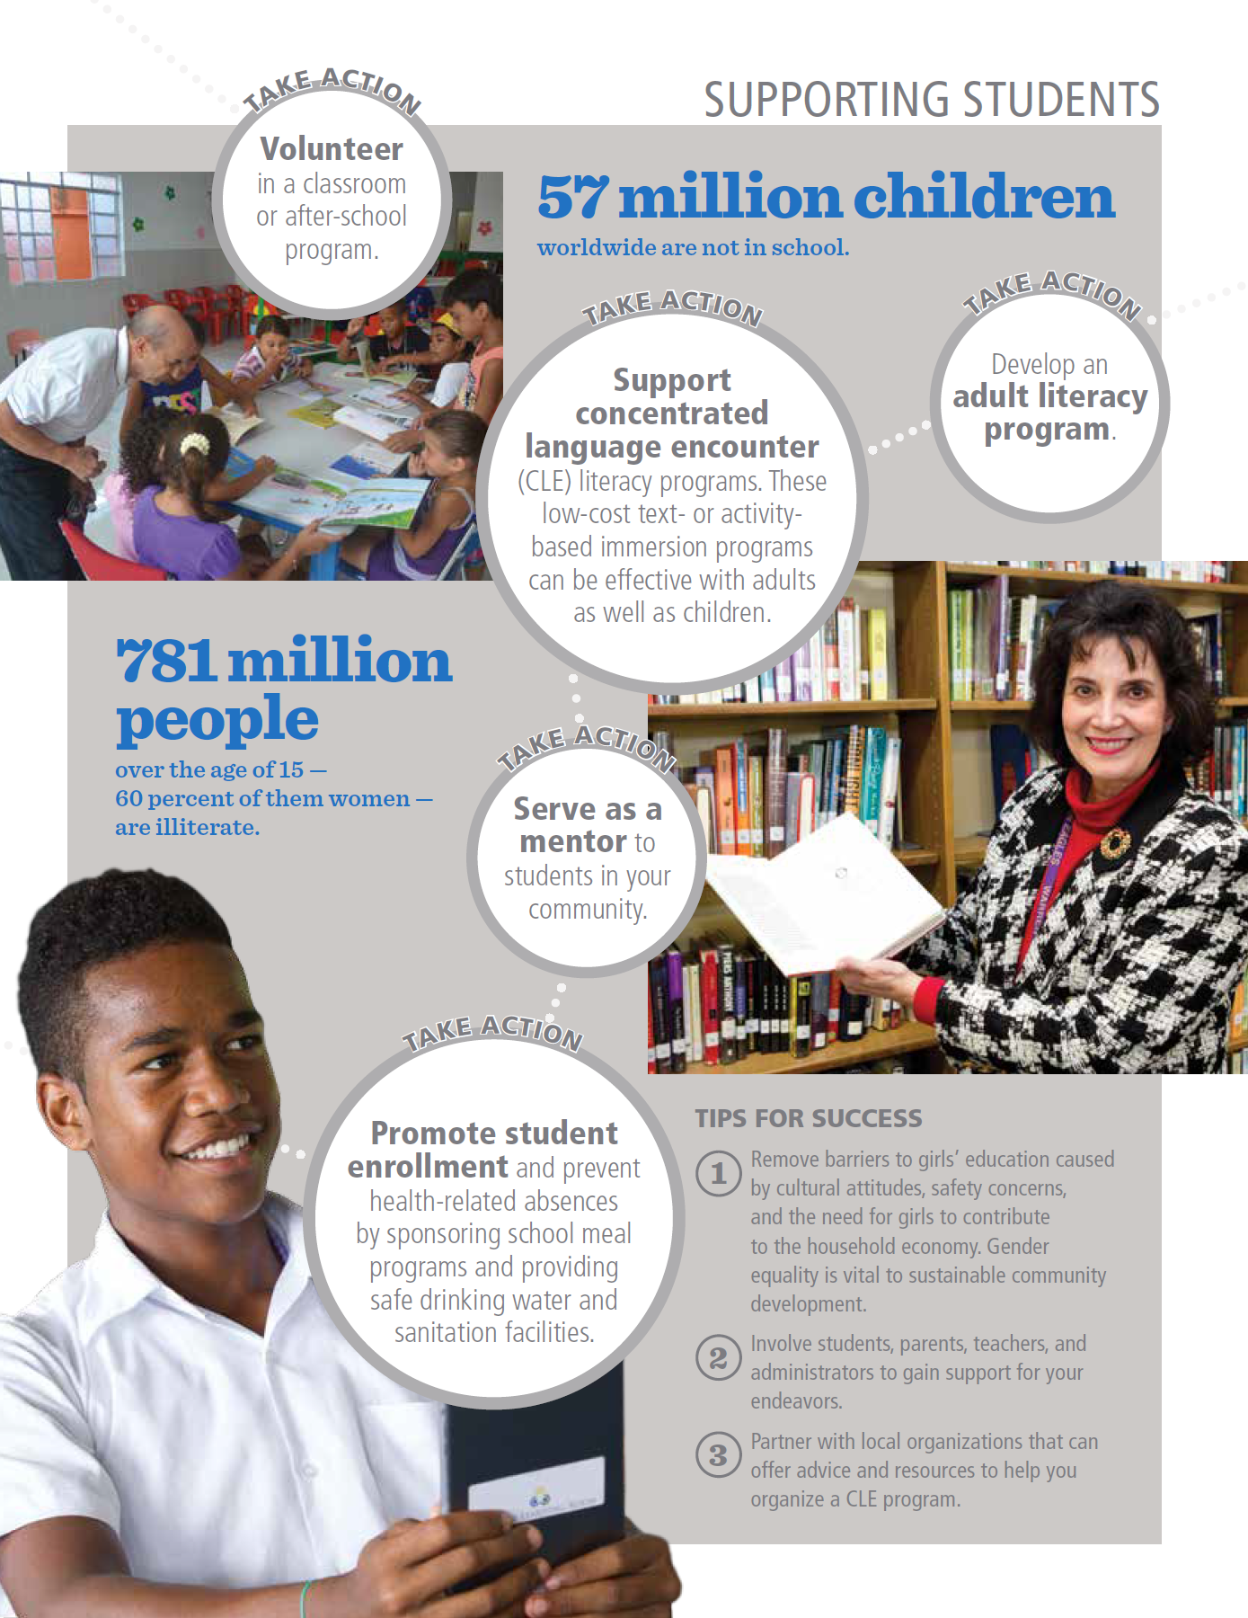

Slide 16
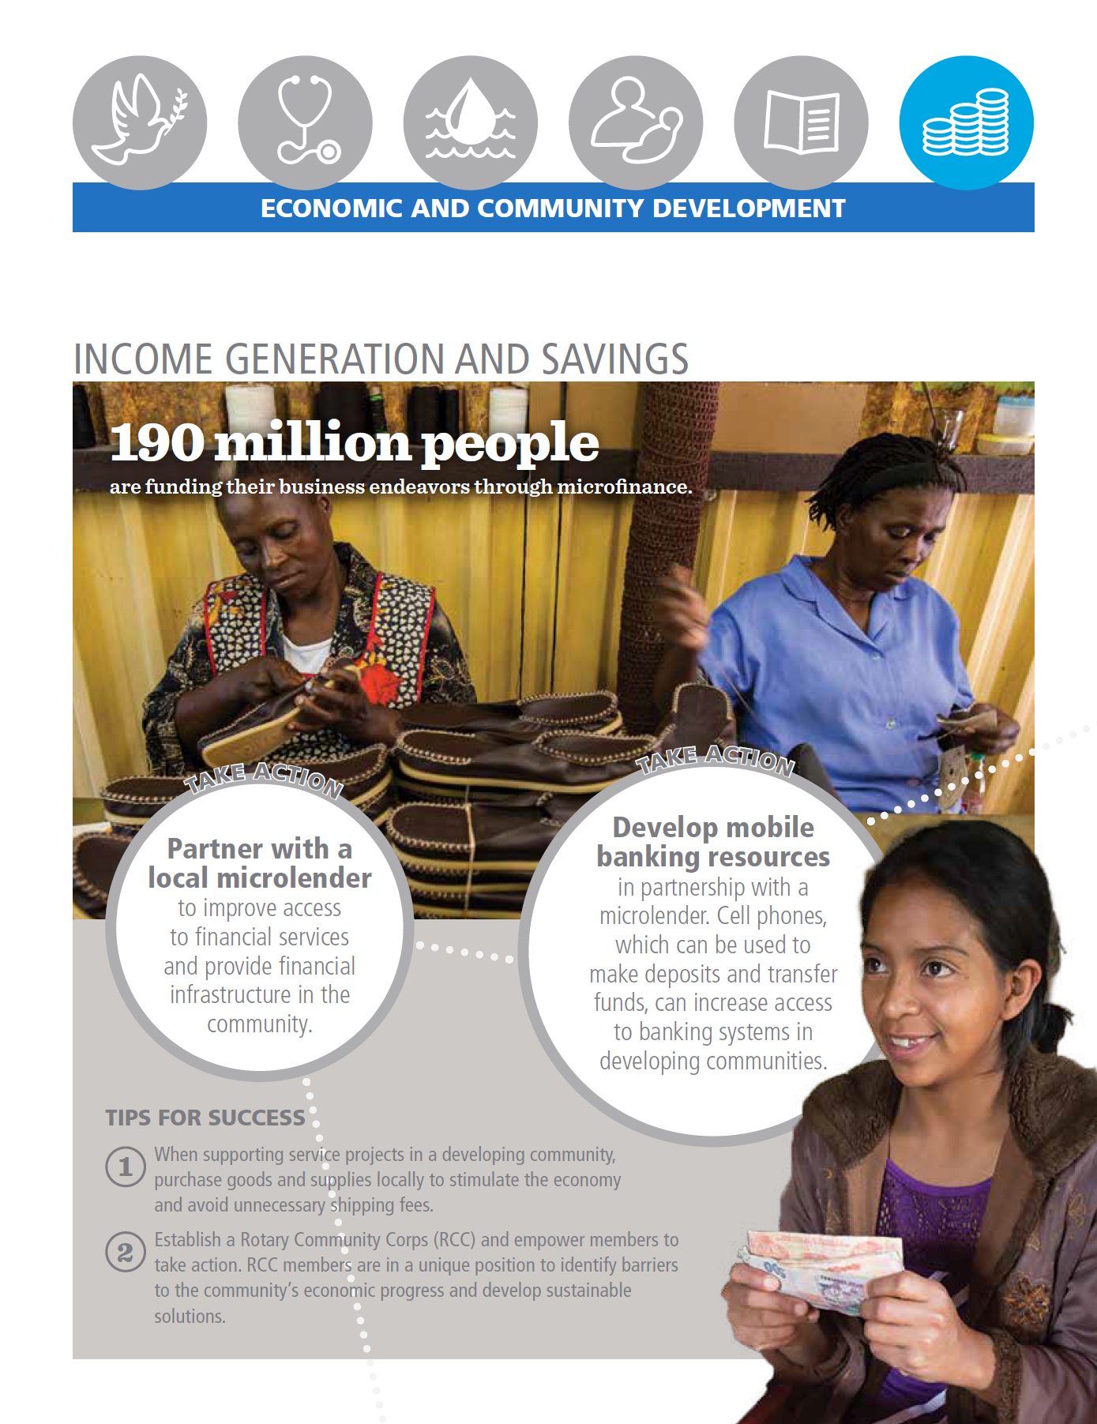

Slide 17
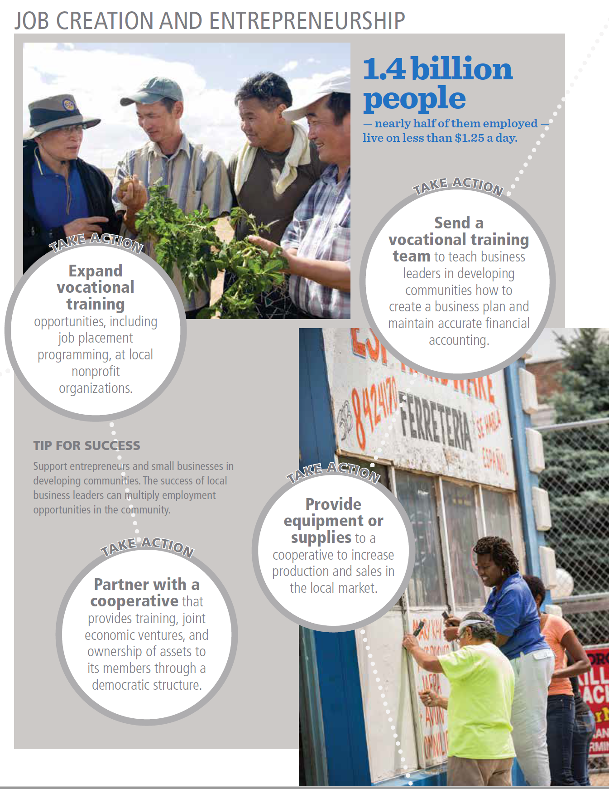

Slide 18
HOW ROTARY WILL HELP PROTECT OUR PLANET
The Rotary Foundation will enable our members and their community allies to take action in these ways:
Protecting and restoring land, coastal, marine, and freshwater resources
Enhancing the capacity of communities to support natural resource management and conservation
Supporting sustainable agriculture, fishing, and aquaculture practices
Addressing the cause of climate change by reducing the emission of greenhouse gases
Strengthening ecosystems and communities affected by climate change
Supporting education initiatives that promote behavior that protects the environment
Advocating for sustainable consumption to build an economy that uses resources more efficiently
Addressing environmental justice issues and public health concerns

