Slide 1
Rotary Fellowships

Slide 2
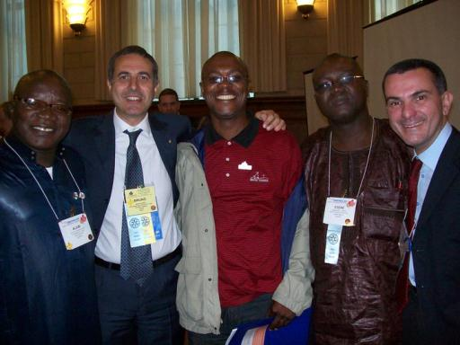
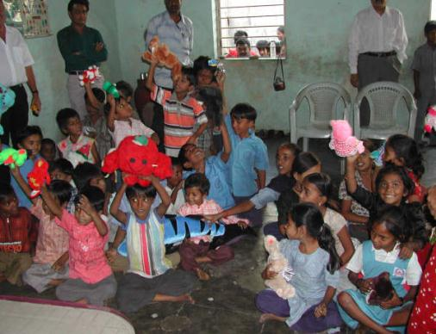
What are Rotary Fellowships?
Groups of Rotarians, their family members as well as participants and alumni of all Rotary programs who connect to explore shared interests in:
    Recreational Activities
    Hobbies
    Sports
    Vocations
    Rotary History & Culture
Rotarian Lawyers Fellowship
Doll Lovers Fellowship
Notes:
Rotary Fellowships are international, independently organized groups of Rotarians, family members of Rotarians, and program participants and alumni who share a common hobby, recreational interest, or profession. Rotary Fellowships give their members the opportunity to have fun, make new friends around the world, and enhance their experience in Rotary.
Rotary Fellowships began informally in 1928 when Rotarians with a shared interest in the international language Esperanto joined together. In 1947, a group of Rotarian boating enthusiasts began flying the Rotary flag from their crafts, calling themselves the International Yachting Fellowship of Rotarians — which now holds the distinction of being the oldest Rotary Fellowship. The scope of fellowships has changed significantly over the years, but their purpose remains the same: to unite Rotarians in friendship and provide opportunities to enjoy favorite recreational activities, hobbies, sports, vocation, and most recently Rotary history and culture.

Slide 3
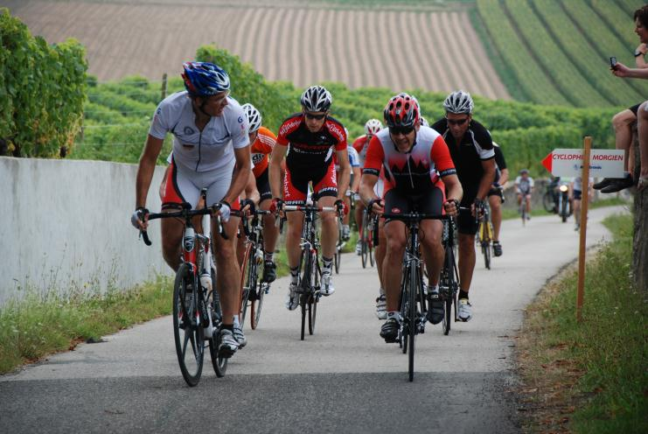
Examples of Rotary Fellowships
More than 70 Rotary Fellowships are now officially registered with Rotary International.
Internaitonal Fellowship Cycling to Serve
Notes:
Many fellowships also use their special interests to serve others. For example, the Fellowship of Canoeing Rotarians has organized cleanups of polluted rivers; members of the International Computer Users Fellowship of Rotarians have hosted training sessions for Rotarians and the general public; and members of the International Fellowship of Rotarian Scuba Divers join local Rotary clubs to undertake service projects on each of their diving trips.
Currently, there are more than 70 official Rotary Fellowships registered with RI. One really good example of Rotary Fellowships organized around both a recreational activity and community service is the Fellowship Cycling to Serve. Through cycling activities, this Fellowship works to promote international understanding and peace.

Slide 4
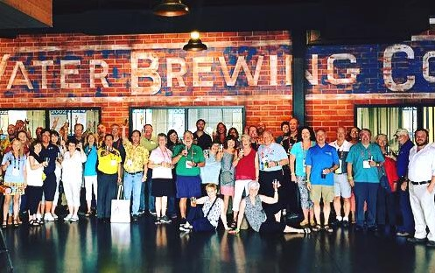
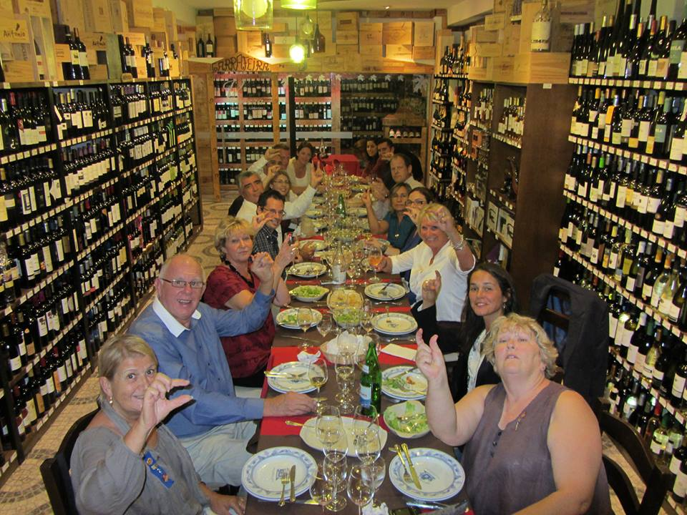
Examples of Rotary Fellowships
BREW Fellowship
Rotarian’s Wine Appreciation Fellowship
Notes:
Another great example is the BREW (Beers Rotarians Enjoy Worldwide) Fellowship, which donates 25% of their annual membership revenue to the Water and Sanitation Rotarian Action Group. During the 2017 RI Convention in Atlanta, BREWS donated US $2500 to WASRAG in support of water and sanitation projects.
The Wine Appreciation Fellowship is a learning tool for those who are interested in expanding their knowledge and sharing ideas regarding all aspects of wine appreciation.
The fellowship has an email newsletter and members are encouraged to visit our interactive wine website (www.rotarywine.net) frequently for updates, features, articles and information on wine events and trips. Annual meetings are held at the RI International Conventions and are some of the most popular events of the whole Convention.

Slide 5
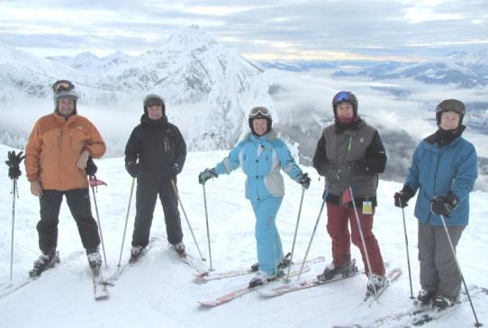
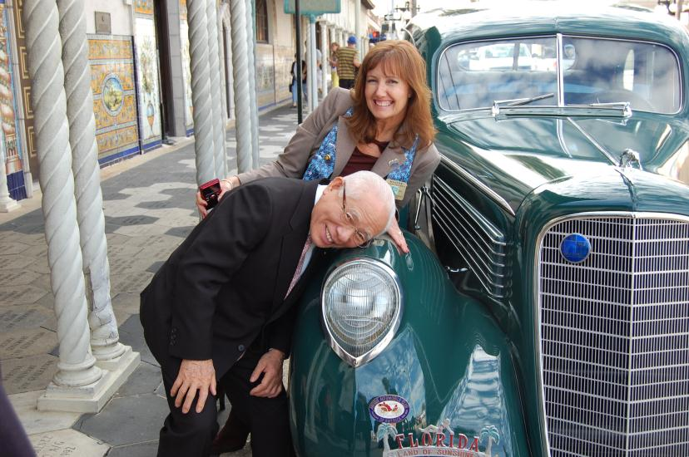

Examples of Rotary Fellowships
Skiing Fellowship
Antique Automobiles Fellowship
Yachting Fellowship
Notes:
Here we see just a small sampling of Rotary Fellowships:
Skiing Fellowship
Antique Automobiles Fellowship
Yachting Fellowship

Slide 6
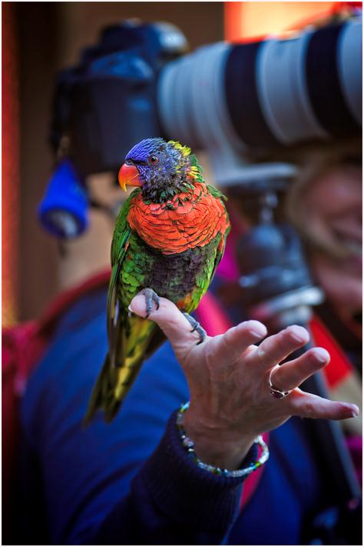
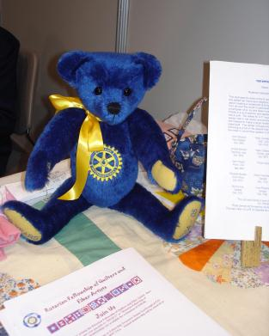
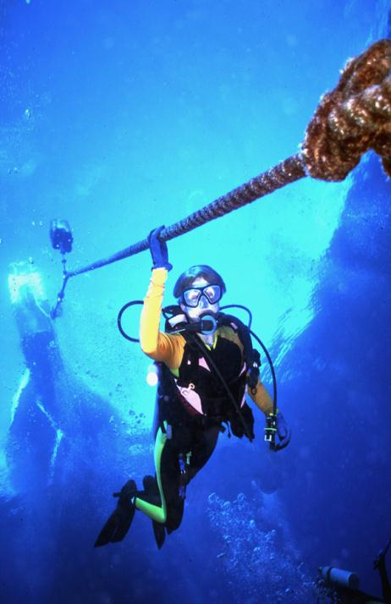
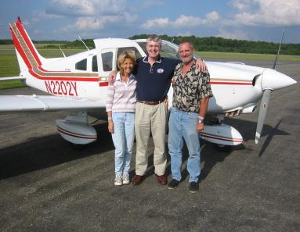
Examples of Rotary Fellowships
Rotarian Fellowship of Quilters and Fiber Artists
International Fellowship of Rotarian Photographers
Fellowship of Rotarian Photographers
International Fellowship of Rotarian Scuba Divers
International Fellowship of Flying Rotarians
Notes:
….and a few more.
Photography Fellowship
Fellowship of Quilters and Fiber Artists
Fellowship of Scuba Divers
International Fellowship of Flying Rotarians

Slide 7
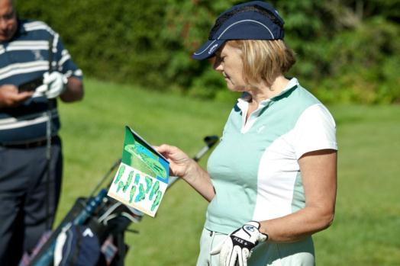
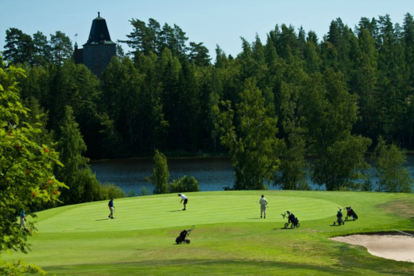
Examples of Rotary Fellowships
The International Golfing Fellowship of Rotarians(IGFR) hosts tournaments around the world.
Golfing Fellowship
IGFR maintains connections with 13 different chapters from Lithuania to the United States.
Golfing Fellowship
Notes:
While most day-to-day fellowship activities may take place online or through correspondence, the most successful fellowships facilitate regular opportunities for members to interact in person. For example, many of the sporting fellowships hold regional matches and world tournaments. Fellowships related to travel or excursions plan destination trips, while vocational fellowships often plan get-togethers at professional conferences and seminars. These types of activities will help maintain existing members’ interest in the fellowship and in Rotary, and will also attract new members.

Slide 8
Get Involved

Slide 9
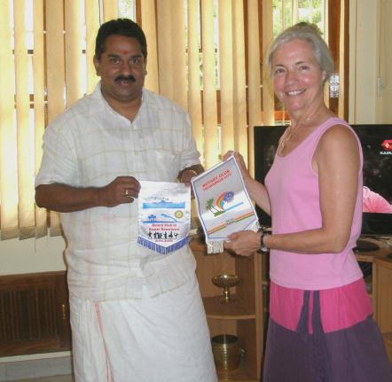
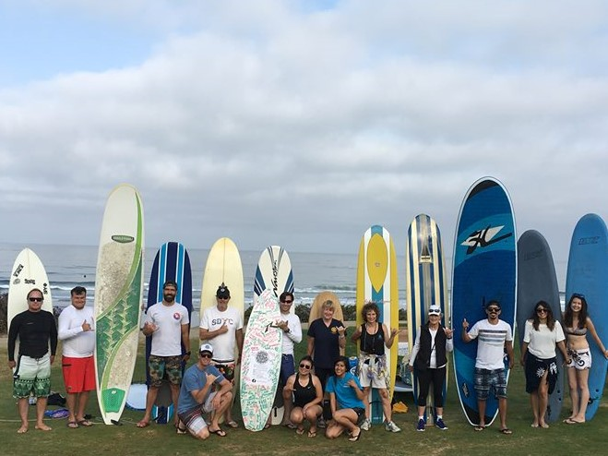
Benefits of Rotary Fellowships
Fellowships engage the family of Rotary through shared interests
Surfers Unite Rotarian Fellowship
International Travel and Hosting Fellowship
Notes:
To recap, Fellowships
Enrich the Rotary experience beyond a club or district;
Encourage engagement with other Rotarians, Rotaractors, program participants, and alumni from a variety of cultures and regions;
Unite people with a common interest from all over the world, which helps facilitate long-term friendships and a better understanding of the world.
Fellowships also further vocational development through acquaintance with others of the same profession.
They also allow individuals to explore new opportunities for service

Slide 10
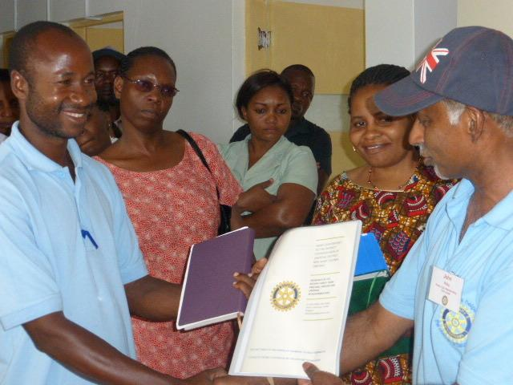
Join a Fellowship
Join a Fellowship by contacting a group that interests you. The full list of Fellowships can be found online: www.rotary.org/fellowships
International Fellowship of Rotarian Doctors and Health Professionals

Slide 11
Promoting Fellowships
Publicize events and activities organized by Fellowships on your club or district website
Invite local Fellowship officers to speak at a club meeting or district conference about their activities and related service work.
Seek out Rotarians who are outstanding in their professions or are enthusiastic about a hobby and encourage them to join fellowships or develop new ones.
Notes:
Promoting Fellowships is a responsibility that we can all share as a way both to grow and promote Rotary.
Publicize events and activities organized by Fellowships on your club or district website
Invite local Fellowship officers to speak at a club meeting or district conference about their activities and related service work.
Seek out Rotarians who are outstanding in their professions or are enthusiastic about a hobby and encourage them to join fellowships or develop new ones.

Slide 12
Organize a new Fellowship
Interested in starting a new international Fellowship on a new topic? Contact RI Staff by writing to Rotaryfellowships@rotary.org.
You will need:
At least 25 potential members, representing at least five countries
Completed application form with a clear explanation of the group’s purpose
Copy of the group’s proposed bylaws
List of proposed officers and their responsibilities
Notes:
Rotary International has established specific policies for forming a Rotary Fellowship. RI rigorously evaluates each prospective group before deciding whether to formally recognize it. However, each fellowship operates independently of RI, with its own rules, dues requirements, and administrative structure.
Here we show just a few of the requirements in the application process. Contact RI staff to get started.

Slide 13
Resources

Slide 14
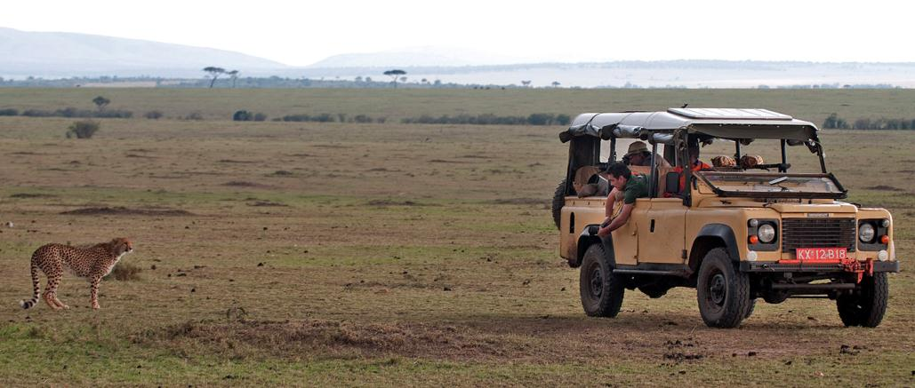
Resources
For general program information, visit www.rotary.org/fellowships. Here you’ll find the following downloadable resources:
  Rotary Fellowships Flier
  Rotary Fellowships Officer Directory
  Rotary Fellowships Application Form
International Fellowship of Rotarian Photographers
Notes:
Outside of the resources listed here, you should look into contacting:
Rotary Fellowship Officers, who can provide a wealth of advice about organizing a new group. Many fellowships have been in operation for decades, and their leaders are knowledgeable about the best ways to structure new groups, promote existing ones, and successfully lead international entities. Consult the Rotary Fellowships Officer Directory for contact information.
Rotary’s Service and Engagement staff handle general inquiries about the Rotary Fellowships program and refer interested Rotarians to specific fellowships. In addition, staff members regularly contact fellowship officers with relevant Rotary news and information about the program, offer advice on issues such as promotion, recruitment, and event planning, and help publicize Rotary Fellowships activities around the world.

Slide 15
Questions?

Slide 16

Contact Rotary International
Rotary Service and Engagement
Email: rotaryfellowships@rotary.org

