Slide 1
Conducting a Rotary Club Meeting
Club President ROLE
Represent – Be professional, respectful and kind always. Have good character and honor your word.
Organize - Be prepared. Have an Agenda. Delegate to club to confirm speakers and email meeting reminder day prior w/details.
Lead – Inspire and empower others. What does this look like?
Enthuse – Your enthusiasm is contagious, and so is the lack of it.

Slide 2
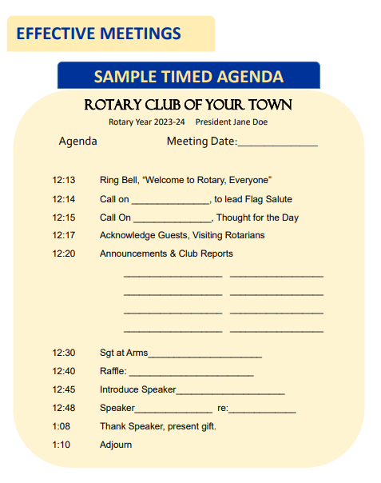
Conducting a Rotary Club Meeting
Why Have an Agenda?
An Agenda can help to:
Lead more effectively
Minimize distractions
Save time
Inspire actionable results
Portray your club in a positive, professional light with guests and speakers.
Help respect everyone’s time

Slide 3
Conducting a Rotary Club Meeting
Monthly birthday Donations for Polio Plus
Check in on Facebook
Happy Bucks (vs fines) everyone participates
Have a birthday party in Feb. to celebrate Rotary’s Birthday or World Polio Day.
Plan a Club Social/BBQ each month to build camaraderie and allow members to get to know each other better.
Have a Club meeting outdoors to discuss service project ideas in your community.
Host a meal packing day in lieu of Club meeting
What FUN ideas does your club incorporate into meetings?
Share with the group

Slide 4
Rotary Club Board Meeting
1. Send out the Agenda early
2. Start and end on time
3. Implement Robert’s Rules of Order.
4. Secretary to take notes/complete detailed minutes
5. Focus on Strategy
6. Give everyone a chance to speak
7. Ensure everyone knows what they are responsible for
8. Build a TEAM Atmosphere

Slide 5
Rotary Club Board Meeting
Call meeting to order
Approve prior month minutes
Secretary/Treasurer reports- Financials
Committee Report outs
Old Business
New Business
Approve new members, updates on projects/fundraisers, donations requested, possible speakers.
Set the date for the next Board meeting
Motion to adjourn

Slide 6
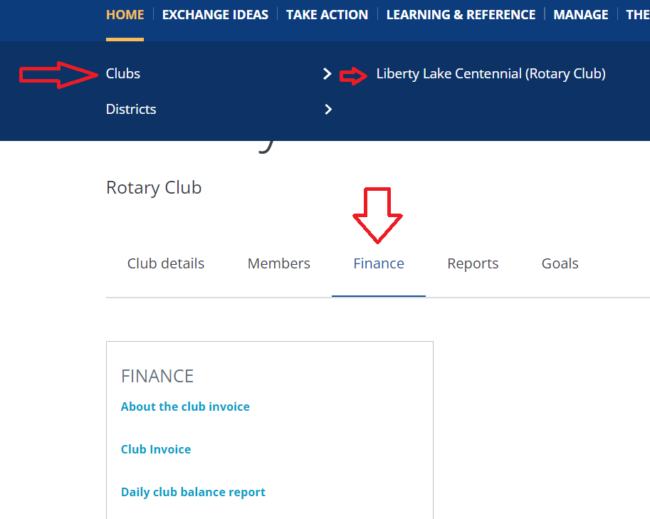
Rotary Club Invoice
How will my club receive the invoice?
If you have reported the email addresses of your club officers and/or your club’s permanent email address, all officers will receive an electronic copy.
How can I access the invoice?
Officers can view the invoice online by signing into www.my.rotary.org
Hover over HOME, then Clubs, before selecting Your club. From there, select Finance and choose Club Invoice.
Notes:
When will my club receive their invoice?
Invoices will be issued to Rotary clubs by the end of July and January, and Rotaract clubs by the end of January.
How much time will I have to review and pay our invoice
Rotary and Rotaract clubs are required to pay the balance upon receipt of the invoice and are subject to termination for nonpayment of dues 120 days after the invoice is issued.
Who can pay the club invoice?
The following Rotary and Rotaract club officers can pay the balance through My Rotary: president, secretary, treasurer, membership chair, Foundation chair, executive secretary/director (Rotary clubs only).

Slide 7
Rotary Club Invoice
Rotary International Dues are due TWICE a year.
You will get a January and a July invoice and payment is due upon receipt.
Notes:
When will my club receive their invoice?
Invoices will be issued to Rotary clubs by the end of July and January, and Rotaract clubs by the end of January.
How much time will I have to review and pay our invoice
Rotary and Rotaract clubs are required to pay the balance upon receipt of the invoice and are subject to termination for nonpayment of dues 120 days after the invoice is issued.
Who can pay the club invoice?
The following Rotary and Rotaract club officers can pay the balance through My Rotary: president, secretary, treasurer, membership chair, Foundation chair, executive secretary/director (Rotary clubs only).

Slide 8
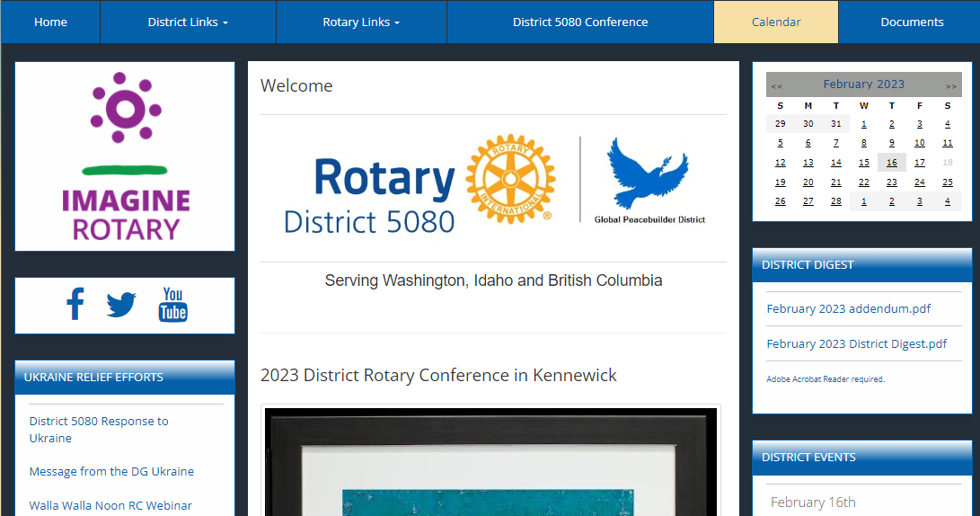
Rotary Dates
Refer to District 5080.org for more info
May 18th- 21st District Conference in Kennewick, WA
April 29th – Spring Assembly
June 15th make sure to donate to Annual giving (Foundation & Polio Plus).
July 1st- 2023 Rotary new year starts.
November – Fall Assembly

Slide 9
Tips for Success: Plan your year AHEAD
1. Create Committee’s/committee chairs. Delegate. You do not have to do this alone. 2. Have a Board and meet monthly 3. Have Budgets and know the HOW and WHY to go about it 4. Know how to run successful Club meetings & board meetings What does this look like? 5. Have Club Goals and a Vision - Do you know where to go to enter in your Club goals?
Questions?

Slide 10
The way to get started is to quit talking and begin doing.
Walt Disney

