Slide 1
Rotary Showcase
2020-2021
The Pandemic Year
Notes:
Welcome to your 2020-2021 Rotary Showcase – a view of Rotary Club projects during the past year that not only happened, and happened well, but were ALSO reported on the Rotary Showcase website. I am your host for this presentation – Debi Dockins, District Trainer.
Sincere thanks to Mayumi van der Pol and her committee for promoting this project which will show the history of our District in words and actions.

Slide 2
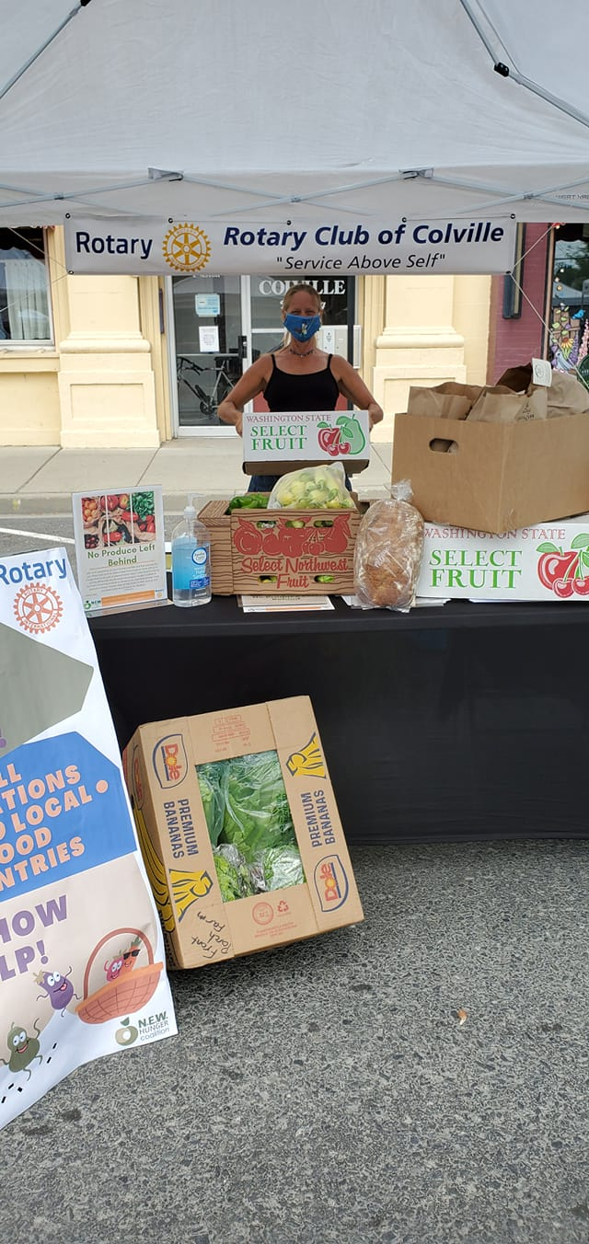
No Produce Left Behind
Rotary Club of Colville
Notes:
No Produce Left Behind
Rotary Club of Colville, WA
Contact: Michelle Dione Loftis Alexis Larson
This club Applied for and received a District Matching Grant of $5,000 for the dual purpose of fighting food insecurity and supporting local farmers.
They purchase produce that had not sold at the end of farmers' markets and donatieit to the Hunger Coalition (a local food bank support system).
By the end of the year the club will have added $10,000 worth of fresh produce to the food bank as well as encouraged farmers to come to the markets, improve their sales and prevent food waste.

Slide 3
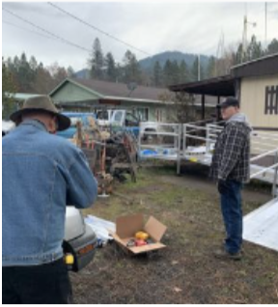
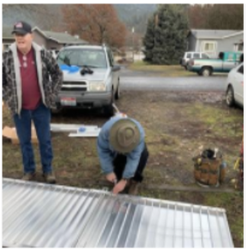
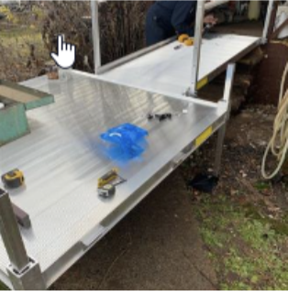
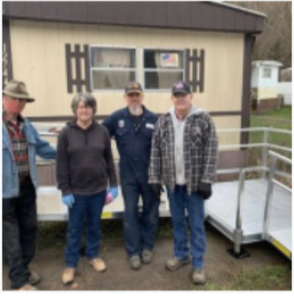
Ramping Up Project
Rotary Club of Orofino
Notes:
Ramping Up Project
Rotary Club of Orofino, ID
Submitted by: Scott McDonald
Orofino Rotary has partnered with the non-profit Disability Action Center NW to install accessibility ramps at qualifying residences in Clearwater County.
The Disability Action Center determines qualifications and program eligibility.
They select the location and ramp configuration.
They order the ramp and deliver it to the construction site. The Orofino Rotary members then install the ramp.

Slide 4
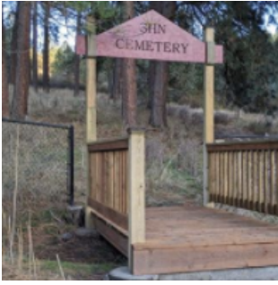
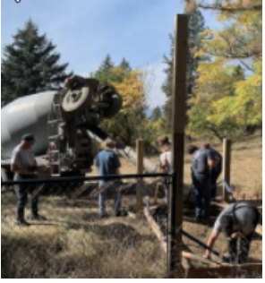
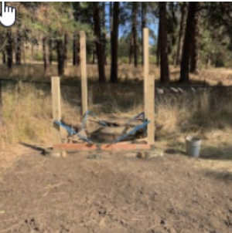
Cemetery Bridge & Fence Project
Rotary Club of Orofino
Notes:
Cemetery Bridge and Fence Project
Rotary Club of Orofino, ID
Submitted by: Scott McDonald
Orofino Rotary ALSO raised funds to construct a pedestrian bridge over a small ravine, allowing easier access to the cemetery at Idaho State Hospital North in Orofino, Idaho.
They installed a steel overhead sign on the bridge,
as well as fencing across the front of the cemetery, to better mark the entrance.

Slide 5
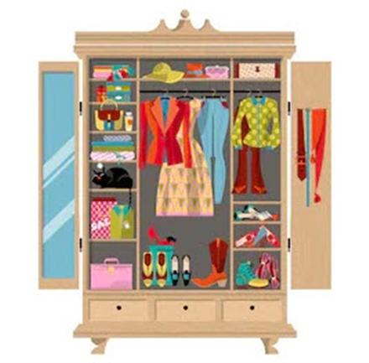
Clothes in the Closet
Rotary Club of Nakusp
Notes:
Clothes in the Closet
Rotary Club of Nakusp, BC
Submitted by: Mayumi van der Pol
The Clothes in the Closet project started in 2019 when the Rotary District 5080 Express Grant became available.
This $500 grant provided five high school students with warm clothing and boots for the winter.
This project created a community partnership.
A teacher assistant identified the students in need and took them out shopping, the high school principal provided extra funding,
and the clothing store generously gave discounted prices for the purchased items.

Slide 6
Clothes in the Closet
Rotary Club of Nakusp
Notes:
Nakusp Online Silent Auction
Rotary Club of Nakusp, BC
Submitted by: Andi Gabb
The Club’s silent auction is the biggest fundraiser of the year for the Nakusp Club. The event has been part of their Wine/Beer Festival.
Each year, the community looks forward to attending this fancy dress-up event, and especially to tasting all the wonderful appetizers. Auction items are generously donated by local businesses and individuals.
When the Wine/Beer Festival was cancelled due to Covid-19, the club decided to opt for an Online Silent auction.
They looked for a user-friendly and affordable platform, and the Golden Rotary Club of BC introduced them to a wonderful platform called 32auctions.com.
With this platform, bidders can see the photos of auctioned items, and the next bidding price. When bidders lose their bids, they are immediately notified via email.
This event was the talk of the Nakusp community!

Slide 7
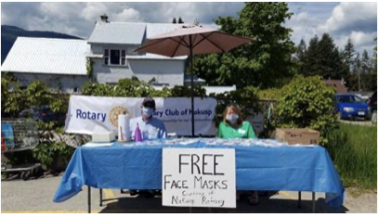
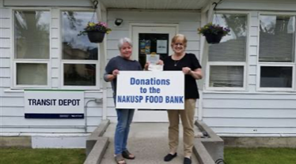
Covid 19 Mask & Food Bank Donation
Rotary Club of Nakusp
Notes:
Covid-19 Mask & Food Bank Donation
Rotary Club of Nakusp, BC
Submitted by: Mary McLaren
The Nakusp club created nearly 100 masks and handed them out to community members in exchange for a food bank donation.
They also received $540, which was donated to the Nakusp Food Bank.

Slide 8
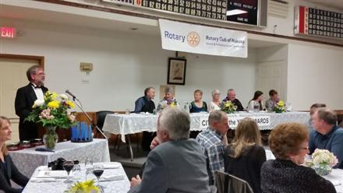
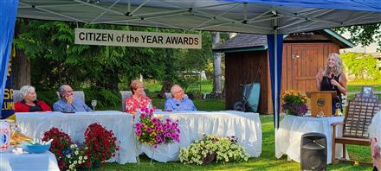
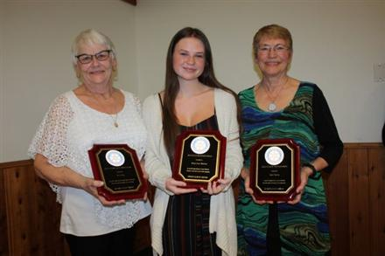
Citizen of the Year Banquet
Rotary Club of Nakusp
Notes:
Nakusp Citizen of the Year Award Banquet
Rotary Club of Nakusp, BC
Submitted By; Dan Nicholson
The Citizen of the Year & Lifetime Achievement Banquet is an annual community highlight!
The Rotary Cub of Nakusp has been hosting this special event for the past 46 years to thank and honour the outstanding volunteers in our community.
Nominations are submitted by community members and, after the recipients are chosen by the selection committee, bouquets of flowers are delivered to them a week prior to the event.
The celebration banquet is normally held at the Legion Hall catered by the Legion ladies. However, because of the Covid-19 restrictions, our club decided to hold the event in the backyard of a Rotarian's home, and scaled down the number of attendees to 25.
In spite of the small gathering, we had a wonderful afternoon with the recipients, their families, and friends.

Slide 9
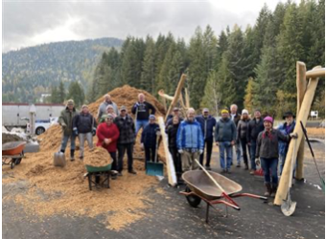
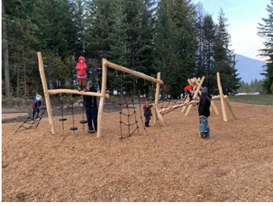
Kokanee Salmon Playground at Rosemont Park
Rotary Club of Nelson Daybreak
Notes:
Playground at Rosemont Park in Nelson
Nelson Daybreak Rotary Club, BC
Submitted by: Sheila C. Hart
The playground consists of climbing and balancing structures for all ages, a swing set with 3 different types of swings, two spinner plates and a mule rider for kids of all ages.
The playground is in the shape of a Kokanee Salmon which is an icon for this area.
The shape was created using 3D Concrete printing and is the first time in history that 3D printed concrete has been used this way.
Several local entities worked with the Club to make the project happen successfully.
Playground is Phase 1 of this Multigenerational Park Project

Slide 10
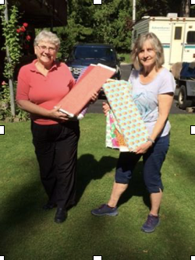
Making Masks
Rotary Club of Nelson Daybreak
Notes:
Rotary Nelson Daybreak Mask Makers
Nelson Daybreak Rotary Club, BC
Submitted by: Sheila C. Hart
Local quilters donated fabrics from their "stash" and the club received a windfall from a Rotarian in Grand Forks, BC who closed her quilt shop and donated her fabric.
With some local fundraising to cover the elastic, and a donation of winter themed fabric, masks were made to honor donors who give to the Rotary Polio Fund.
The Nelson Daybreak Club was also recognized by the Royal Bank of Canada's Random Acts of Canadian fund who made a donation in support of their (earlier mentioned) playground project.
Members of the Rotary Club of Nelson Daybreak, Rotary Partners and Friends of Rotary made 1260 masks which have been distributed to social service organizations in the Nelson area.

Slide 11
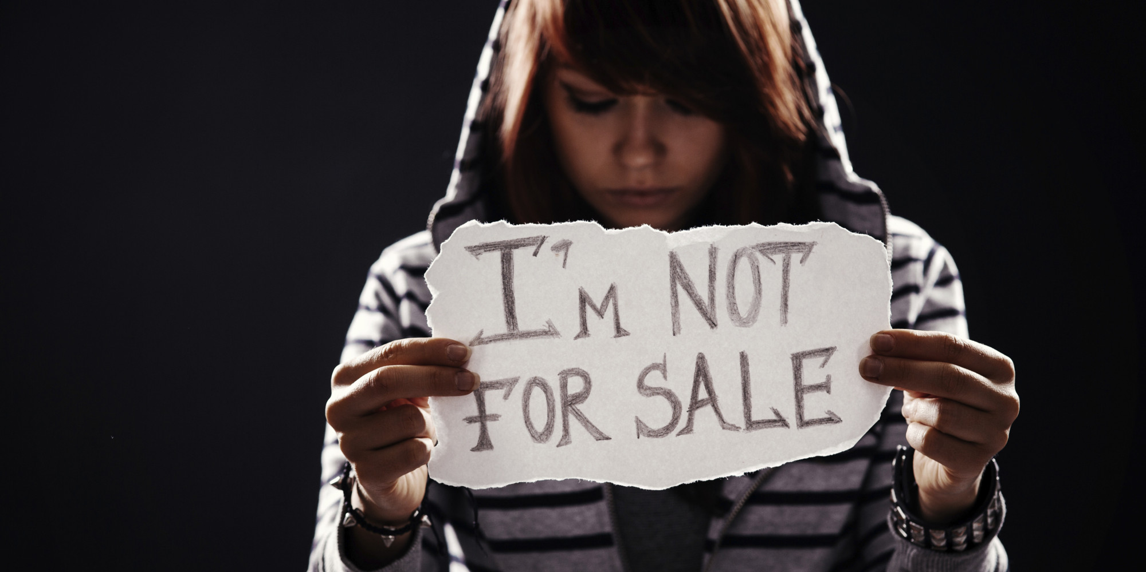
Long Term Mitigation of Sex Trafficking
Rotary Club of Columbia Center
Notes:
Long Term Mitigation of Sex Trafficking
Columbia Center Rotary Club, WA
Submitted by: Don Hart
A Community assessment was been completed using a panel and survey results for the area.
A wide variety of individuals are involved to determine the needs for 3 large school districts in Cities of Kennewick, Richland and Pasco, WA.
Course materials are used in elementary school, junior high school/middle school and High school.
The Approach is based on a proven model used by District 5180 in the Sacramento , CA .

Slide 12
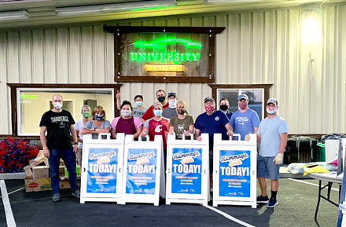
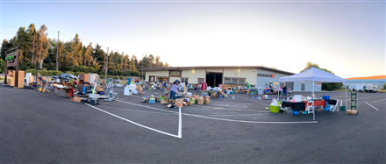
Rummage Sale Fundraiser
Rotary Club of Pullman
Notes:
Rummage Sale Fundraiser
Pullman Rotary Club, WA
Contact: Debi G Dockins Alison Weigley Jess Downs Colleen Hinman
Pullman Rotary partners with a local cancer care non-profit (the NW Cancer Foundation of Hope.)
Together, they held an outdoor rummage sale after receiving approval from local health, law enforcement and city officials.
Because it was during a time when Covid rules were important to observe, they implemented social distancing and masking and sectioned shopping in a huge parking lot.
The group hosted about 375 shoppers and raised more than $4,000.
Proceeds will support local cancer patients, provide Rotary scholarships and support community service projects.
After the event, unsold items were donated to local charities including Goodwill, Alternatives to Violence of the Palouse, Palouse Treasures, and Northwest Center.

Slide 13
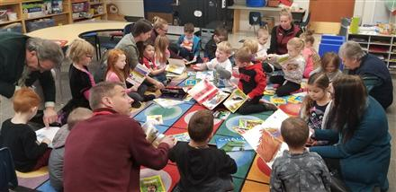
Adopt a Classroom
Rotary Club of Coeur d’Alene Sunrise
Notes:
Adopt a Classroom
Coeur d’Alene Sunrise Rotary Club, ID
Submitted by: Karen Cook
Jennifer Brumley, Coeur d'Alene Sunrise |
Using an Express Grant and club funds, CDA Sunrise invested $500 to provide a classroom library for a new kindergarten teacher at Borah Elementary.
The teacher selected the books and a local bookstore provided a 20% discount.
The Club partnered with the "Opening Books, Opening Doors" program of the Innovia Foundation. Their program goal is to have all students reading at grade level in 3rd grade by 2020.
One club member donated additional books from the recommended reading list and two other club members volunteered for the "Book Buddies" program to read with/to young readers.
The books were delivered on Nov 25th and Rotarians spent time reading with the students.
The project was posted on social media by the club, the Innovia Foundation and School District 271.

Slide 14
We would like to thank
all the clubs
that posted their projects to
Rotary Showcase!
Notes:
Wow, what a great group of projects that were placed on the Rotary Showcase during this past year.
We encourage you to add the projects you and your club are proud of!
Take a look at previous years projects when you visit the site:
Covid Relief in Colville, Wine and Beer Fest in Nakusp, Cranbrooks accessible trail along the ridge of Idle Wild Park, CDA Sunrise Crosswalk Improvement Project and more.
Congratulations to ALL CLUBS who work hard to make a difference in their communities and in the world– it was an interesting year!

