Slide 1
District 5080 foundation
So You Want to be a Foundation Chair?

Slide 2
subhead
Roles and Responsibilities

Slide 3
Read and Understand Foundation Guides and Resources
The Rotary Foundation Code of Policies
The Rotary Foundation Reference Guide.
The Zone 26/27 Resource Guide
Recruit club members to help with Roles and Responsibilities
Foundation Funding/Contributions
Recognition
Grants
Set and Monitor Progress Toward Goals
Contributions
Recognition Levels
Roles | Responsibilities
The Foundation Committee Chair
Notes:
The District Rotary Foundation Committee is responsible for educating, motivating and inspiring Rotarians to participate in the Rotary Foundation programs and fundraising activities in the district. The committee serves as a liaison between The Rotary Foundation and the club members. The District Rotary Foundation Committee will consist of an appointed Chair and Subcommittee Chairs.
Grants Subcommittee
The Grants Subcommittee is responsible for assisting clubs in developing ways to participate in international service projects as well as informing Rotary clubs and/or district project committees planning such projects of the Foundation grants that can help them. The Grants Subcommittee Chair is responsible for reviewing all humanitarian grant applications sponsored by member clubs and the district itself, certifying that all applications are complete and accurate prior to the submission of grant applications to The Rotary Foundation. The District Grants Subcommittee may include additional subcommittees for District Grants Approval.
Foundation Treasurer
The Foundation Treasurer receives all funds from the Rotary Foundation and distributes these funds to Clubs that have applied and approved for District Local and International Grants as well as Express Grants.

Slide 4
Become a Resource Location Expert
Foundation Reports
Guiding members to MyRotary resources for Donation History Report and Donations Page
Become a Champion for the Rotary Foundation
Encourage Rotary Direct enrollment
Encourage EREY and Sustaining Member level contributions
Encourage Paul Harris Society member enrollment
Understand and be able to explain the relationship between Contributions and Grants
Encourage MyRotary enrollment
Roles | Responsibilities
The Foundation Committee Chair
Notes:
The District Rotary Foundation Committee is responsible for educating, motivating and inspiring Rotarians to participate in the Rotary Foundation programs and fundraising activities in the district. The committee serves as a liaison between The Rotary Foundation and the club members. The District Rotary Foundation Committee will consist of an appointed Chair and Subcommittee Chairs.
Grants Subcommittee
The Grants Subcommittee is responsible for assisting clubs in developing ways to participate in international service projects as well as informing Rotary clubs and/or district project committees planning such projects of the Foundation grants that can help them. The Grants Subcommittee Chair is responsible for reviewing all humanitarian grant applications sponsored by member clubs and the district itself, certifying that all applications are complete and accurate prior to the submission of grant applications to The Rotary Foundation. The District Grants Subcommittee may include additional subcommittees for District Grants Approval.
Foundation Treasurer
The Foundation Treasurer receives all funds from the Rotary Foundation and distributes these funds to Clubs that have applied and approved for District Local and International Grants as well as Express Grants.

Slide 5
subhead
2022-2023 Goals and Plans

Slide 6
District Goals
100% Club Participation in Annual Fund
100% Club Participation in PolioPlus
Rotary Direct Enrollment
Express Grants
Paul Harris Society Enrollment and Validation
PolioPlus Society Enrollment
Aligned Club Goals
Rotary Direct Enrollment (% of members )
100% EREY?
100% Sustaining Member?
Per capita contributions (year over year )
PHS and PPS Enrollment (% of members )
Goals
What do we want to accomplish
Notes:
100% Club Participation in Annual Fund
53 of 56 clubs contributed to the Annual Fund in 2020-2021
Zone Annual Fund Goal $200 per capita
100% Club Participation in PolioPlus
32 clubs achieved their stated goal for 2020-2021
9 clubs were unable to contribute.
Rotary Direct Enrollment
This is an ongoing missed opportunity for many Rotarians who both donate and do not donate.
Express Grants
$16,000 in Express Grant funds are available for distribution.
This translates to 40 Grants of $400 issued on a first come, first served basis.
Paul Harris Society Enrollment and Validation
There are a number of Rotarian donors that qualify for Paul Harris Society status but have not enrolled in the Society.
There are also a number of PHS members who have not meet their commitment of regular contributions for a number of years. We wish to reconcile this discrepancy.
PolioPlus Society Enrollment
Under the leadership of Ed Kowitz the newly formed PolioPlus Society has made consistent growth.
Transition to DACdb District Grants Application Process
We will be transitioning to an electronic application for District Grants using DACdb
Training will be available this fall or winter.
2021-2022 Foundation Celebrate and Learn Summit, October 23, 2021 Face 2 Face and Virtual

Slide 7
How Do I ?

Slide 8
Designate New Club Leaders.
Club Administration | My Rotary
Club & Member Data
Update Member Data
| Add, edit, remove club officers|
Foundation Goals and Reports 2022-2023 Year
RC Central 2 (rotary.org)
Goal Center
Global View
Service Activities
Resources (how to in Rotary Club Central)
Reports
Share my Role with Another (Co-Chair)
Delegation | My Rotary
How Do I ?
Transition to New Club Leadership
Notes:
Designating New Club Leaders Club Administration | My Rotary
Each year, the incoming President of the Rotary Club is responsible for updating information on Club Leadership.
Essential positions for each Club are:
President
Secretary
Treasurer
Foundation Chair
Membership Chair
Public Image Chair
Club Service Chair
Foundation Goals and Reports for the 2021-2022 Year RC Central 2 (rotary.org)
Foundation Goals are used to measure the Club’s engagement with the Rotary Foundation Strategic Objectives.
Planned giving for the Annual Fund and the PolioPlus Fund should be entered by the President or Foundation Chair.
Clubs that do not determine their goals by September will be assigned a goal based on past goals and giving history.
Other goals can be documented in Rotary Central to assist in planning for membership growth, budgeting of Club contributions to public charities, and serviced activities.
Share my Role with Another (Co-Chair) Delegation | My Rotary
Clubs that choose to assign Club Leadership roles to more than one individual must choose and designate a lead individual for this role.
However, more than on individual may access the reports and other functions on MyRotary that are normally reserved for the individual with the designated role.

Slide 9
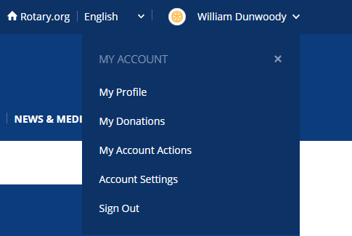
Donor Self-Service | My Rotary
After signing in to MyRotary,
Click on the carrot next to the Rotarian’s name
When the dropdown appears, click on the My Donations link.
The Rotarian will be able to access links allowing.
Viewing a Donor History Report
Print a form for an individual donation that can be mailed to the Rotary Foundation.
Sign up for, change, or delete recurring donations (Rotary Direct)
How Do I ?
Guide Rotarians in Accessing Donation Reports and Changing their Donation Status
Notes:
Donor Self-Service | My Rotary
After signing in to MyRotary.org, click on the carrot next to the Rotarian’s name
When the dropdown appears, click on the My Donations link.
The Rotarian will be able to access links allowing.
Viewing a Donor History Report
Print a form for an individual donation that can be mailed to the Rotary Foundation.
Sign up for, change, or delete recurring donations (Rotary Direct)

Slide 10
Recommended Reports Review
Club Foundation Banner Report
Club Recognition Summary
Paul Harris Fellow and Benefactor Report
Paul Harris Society Report
Club Fundraising Analysis
District Monthly Contribution Report
District PolioPlus Report
How Do I ?
Access and Use Reports for Club Presidents & Foundation Chairs
Notes:
Each of these reports has a purpose but some have more value  than others depending upon the goals and needs of the individual Club.
Club Foundation Banner Report
Club Recognition Summary
Paul Harris Fellow and Benefactor Report
Paul Harris Society Report
Club Fundraising Analysis
District Monthly Contribution Report
District PolioPlus Report

Slide 11
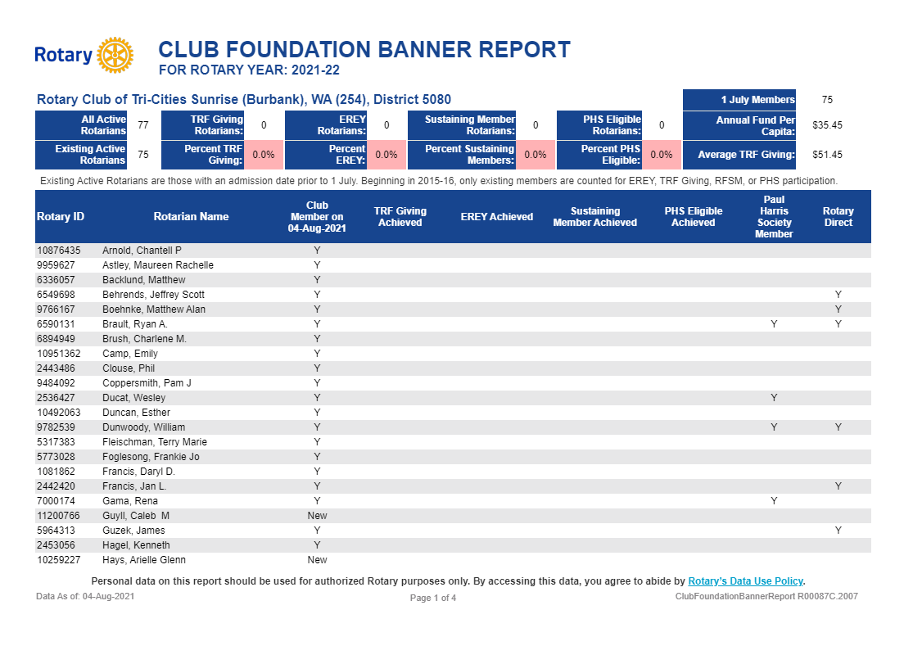
Notes:
Club Foundation Banner Report
Provides a Club summary and individual status of Rotarians regarding:
Club member status
Rotary Foundation Giving Achieved (date)
EREY Achieved (date of minimum $25 donation)
Sustaining Member Achieved (date of minimum $100 donation)
PHS Eligible Achieved (date of minimum $1,000 donation)
Paul Harris Society Member (Y or blank)
Rotary Direct (enrolled in repeating donation) (Y or blank)

Slide 12
Notes:
Club Recognition Summary
Paul Harris Fellow: An individual who contributes US$1,000 (or in whose name US$1,000 is contributed) to the Annual Fund or other approved programs. Multiple Paul Harris Fellow: A Paul Harris Fellow will receive a new pin for each additional US$1,000 personally (or in whose name is) contributed beyond his/her original PHF. Benefactor: A Benefactor is anyone who informs the Foundation in writing that s/he has made provisions in their will, or other estate plan, naming the Foundation’s Endowment Fund (formally called the Permanent Fund) as a beneficiary; or anyone who makes an outright gift of US$1,000 or more to the Foundation’s Endowment Fund.
Recognition Amount: The total Paul Harris Fellow recognition credited to an individual's account. Recognition may be achieved with one's personal contributions to the Foundation, a contribution made on behalf of the account holder, or a transfer of Foundation Recognition Points from a Rotary club, district, or another individual. (Note: gifts to the Endowment Fund are not eligible for Paul Harris Fellow recognition and are not included in this column). For confidentiality reasons, this report will not display recognition amounts greater than 9,000.
Foundation Recognition Points: Awarded in appreciation for personal contributions from an individual or organization. Foundation Recognition Points may be transferred to other individuals to help them achieve their first or multiple PHF recognition. Starting in October 2011, points accumulate 1:1 for every dollar contributed

Slide 13
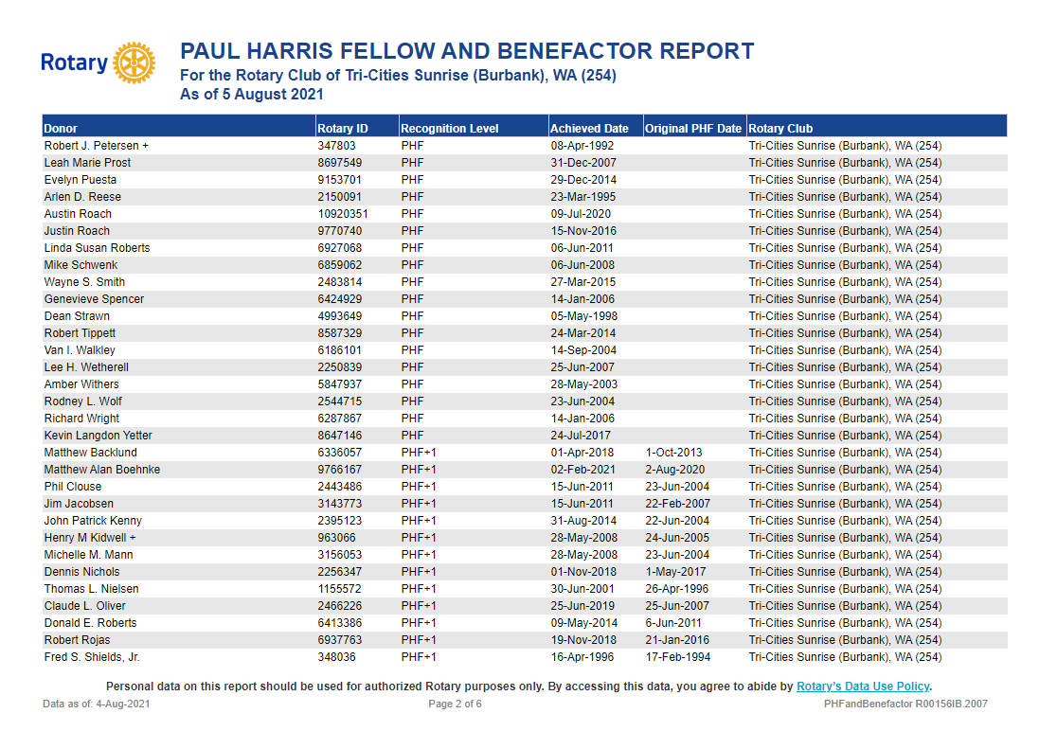
Notes:
Paul Harris Fellow and Benefactor Report
Lists all Paul Harris Fellow awards issued on behalf of the Club.
Lists original PHF date and date of highest level achieved.
Lists level and date of Benefactor status.

Slide 14
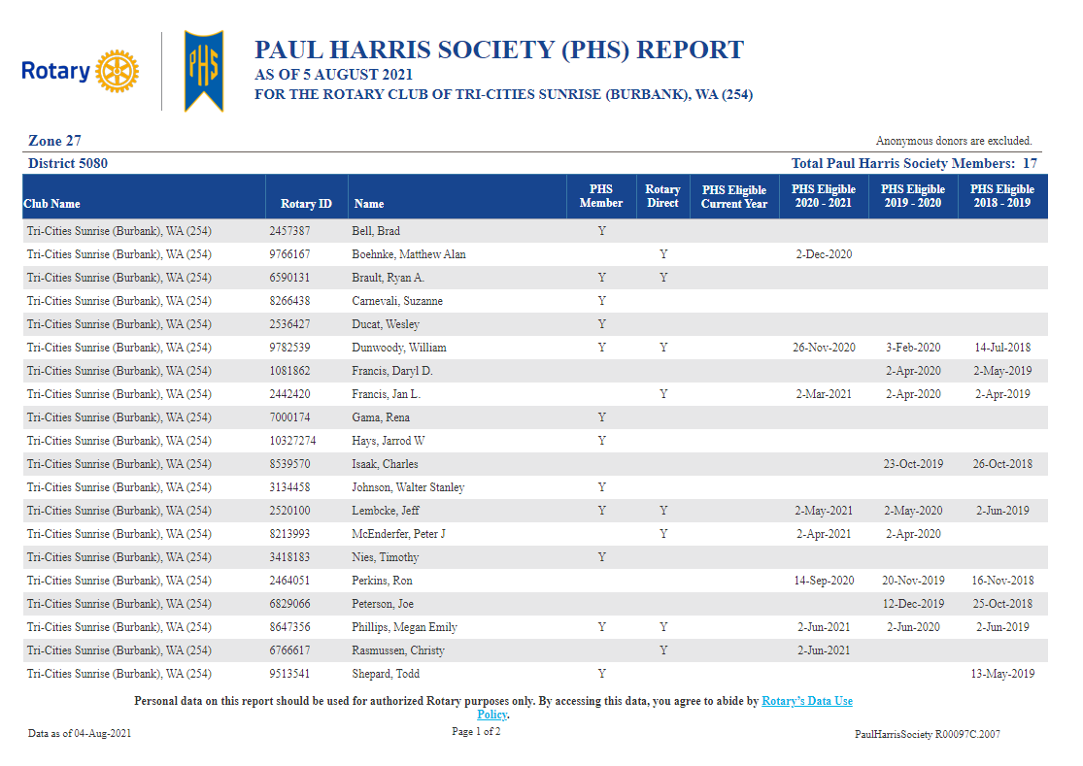
Notes:
Paul Harris Society (PHS) Report
Lists all Rotarians in a Club that are either a Paul Harris Society member or have been PHS Eligible in the current and previous three years.
Identifies members who are enrolled in Rotary Direct.
Examples of needs to reconcile members of the PHS
Member is not listed as eligible for the current and previous three years and is listed as a member of the PHS. This Rotarian is not meeting their commitment to contribute $1,000 year to the Rotary Foundation.
Member is not listed as a PHS member but has regularly been listed as eligible to be a PHS member. These individuals need to be encouraged to join the PHS.

Slide 15
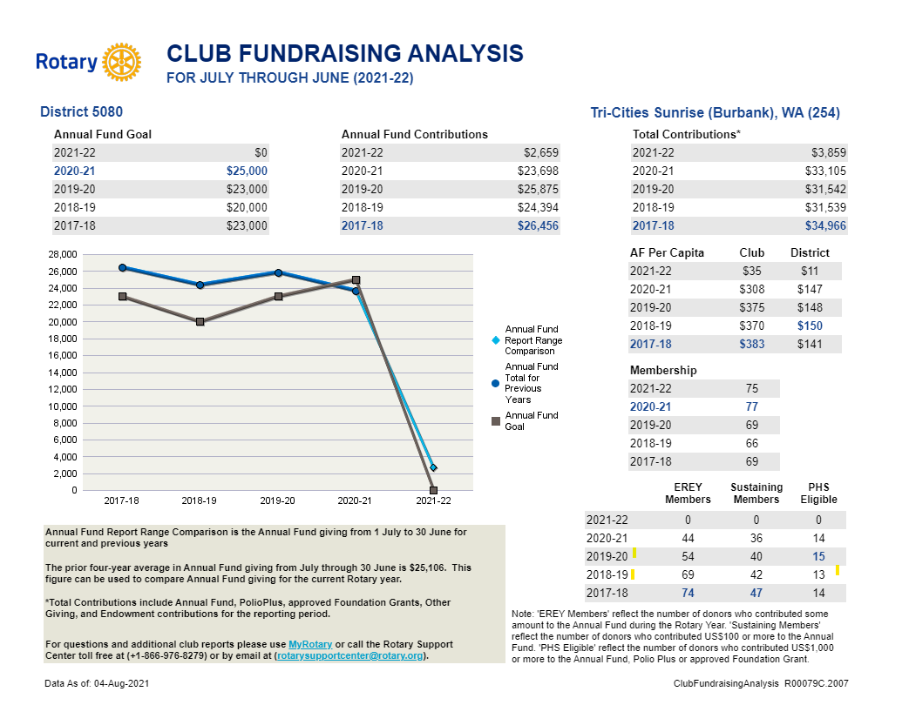
Notes:
Club Fundraising Analysis
Lists a five-year history of Club Foundation Giving according to several classifications.
Light Blue shaded values indicate the highest level of giving in the five-year period.

Slide 16
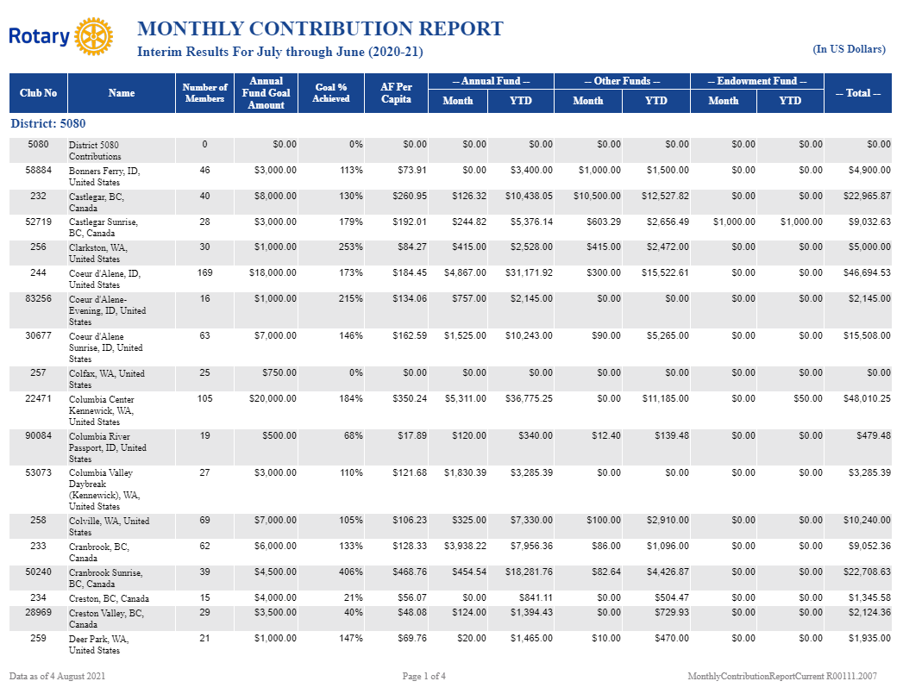
Notes:
Monthly Contribution Report
A District report that lists the monthly and year to date status of each Club regarding Annual and other giving.
Annual Giving Goal and Goal percent achieved for the Annual Fund are listed for each Club.
Annual Fund giving per Capita (Rotarian) is also listed. This value only includes those members who joined prior to the current Rotary Fiscal Year.
Monthly giving and YTD giving for the Annual Fund, Other Funds, and the Endowment Fund are listed by each Club.

Slide 17
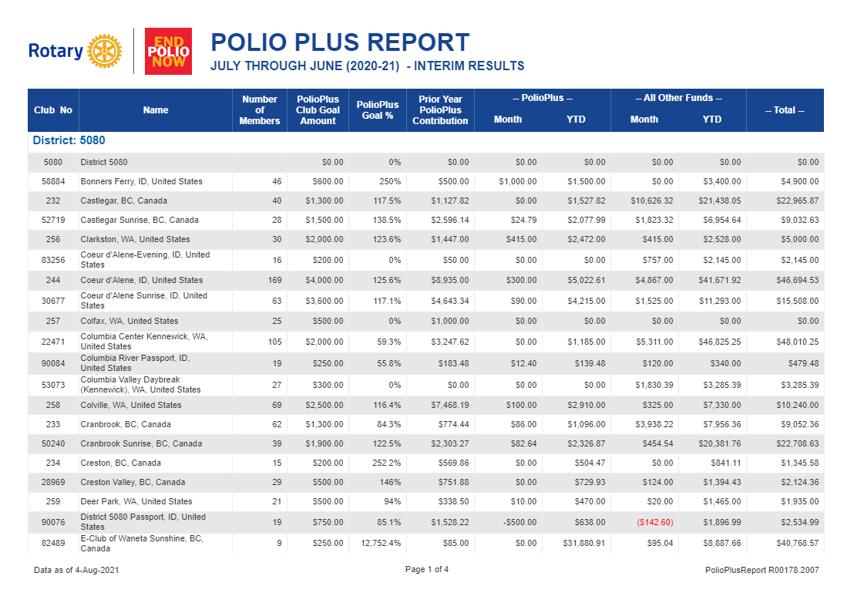
Notes:
Polio Plus Report
A District report that lists the monthly and year to date status of each Club regarding Polio Plus and other giving.
Giving Goal and Goal percent achieved for the Polio Plus Fund are listed for each Club.
Prior Year PolioPlus Contributions are listed for each Club.
Monthly giving and YTD giving for the Polio Plus Fund and Other Funds are listed by each Club.

Slide 18
Review and become familiar with the D5080 Website Foundation pages.
Attend the D5080 Foundation Celebrate and Learn Summit, 4-5 Nov 2022.
Register for and attend Zone 2627 Educational Programs listed in the Big West News
Bookmark Zone 26/27 Foundation Resources
How Do I ?
Access More Information
Notes:
Attend one of the D5080 Area Foundation Leaders Ideas to Actions each quarter.
Attend the D5080 Foundation Celebrate and Learn Summit, October 23, 2021, Coeur d’Alene, ID or virtual. Registration will be available September 6, 2021
Register for and attend Zone 2627 Educational Programs listed in the Big West News
Bookmark Zone 26/27 Foundation Resources

Slide 19
Notes:
Questions or comments/
Aug 6, 2021
Jackie Harvey, Columbia Center RC, announced that Geoff Cochran from TRF will be a speaker at the Columbia Center RC on 11.18.2021 at 12:00. Anyone wishing to attend virtually, please contact her at busyinindy@msn.com
Jerry Sinn, Post Falls RC, inquired about the status of grant funds for those clubs who have approved District Grants. Bill reported that he sent an inquiry to TRF just prior to this meeting and is waiting a reply.
Todd Shepard, Tri-Cities Sunrise RC, recommended clubs hold training sessions for members during Club meetings on accessing and using MyRotary.org and DACdb.com or ClubRunner.com so members can work with these systems to manage their TRF donations, their personal profile, and access pertinent information about the operations of Rotary International, the Rotary Foundation, and their own Club and District operations.
Aug 12, 2021
No inquires or comments.
Aug 26, 2021
Several participants expressed concerns regarding the Grant process, both Global and District, however the District Grant process was specifically mentioned as being too complicated. There is a need to simplify and streamline.
The current process of obtaining signatures is a burden. Print, sign, scan (if available), and send is not efficient. Electronic signatures are preferred.
It was suggested that smaller clubs be allowed and encouraged to share resources for writing grants.
Requiring three certified club members was described as “over the top.” And annual re-certification is a burden that prevents clubs from participating in the grant writing process.

Slide 20
Notes:
Bill will discuss these concerns with the Grants Committee and refer comments, concerns and recommendations, as appropriate, to the RI Grants team for consideration.
Sep 2, 2021
Bill Furey and I discussed several items regarding foundation and grants management.
Sep 7, 2021
New Foundation Leader attended. Multiple questions on what needs to be accomplished for transitional duties (goals, leader assignments) and the value of reports available for Foundation Leaders.
Sep 23, 2021
An inquiry was made regarding the level of District points and the possibility of using these points as a means of encouraging giving by awarding Paul Harris Fellow awards in full or in part to new members. Bill replied that it is possible to do this but to the best of his knowledge this had not been done in the past. Clubs have the authority to do this as well on a club-to-club basis. The link show provides detailed information on using Foundation Recognition Points. | My Rotary
Another inquiry was made as to transferring Foundation Recognition Points. This is covered on the same FAQ sheet referenced previously.
The topic areas for discussion during the next Quarter of 2021-2022, Oct – Dec 2021 will include using the DACdb Grants Module to apply for District Grants (Local and International) and ideas and innovations for management of the Club Foundation Committee and encouraging Rotarian participation in Foundation Giving.

