Slide 2
Plan B Accident & Sickness Benefits
Accident & Sickness Limit $1,000,000
Deductible $0 (zero)
Paid at 100%
This policy covers you for:
Sickness; such as colds and flu
Doctors Visits
Prescriptions
Emergency room visits
Labs, Tests and X-Rays
Inpatient Hospital Stays

Slide 3
Additional Benefits
Allowance of $500 to cover pre-existing conditions
Mental & Nervous : $1,000 for outpatient, $25,000 inpatient
Emergency Dental up to $400 (relief of pain)
Trip Cancellation up to $3000 (prior to departure)
Maximum benefit for Medical Evacuation- $100,000
Maximum benefit for Repatriation- $50,000
Security Evacuation Benefit - $100,000

Slide 4
Chiropractic paid up to $50 per visit up to $500 (or 10 visits)
Emergency Family Reunion benefit of $5000 for flights, meals and hotel if the insured is hospitalized in excess of 4 days and a family member travels to bedside. (no CC points)
Round trip flight benefit of $3000 if the insured must return home due to the death or serious illness of grandparent, parent or sibling. (no CC points)
Sports Coverage up to $25,000- Interscholastic and Community Sports.
Accidental Death & Dismemberment up to $100,000

Slide 5
Personal Liability Coverage
Personal Liability Limit/Claim $500,000
Medical Payment Limit/Coverage Period $5,000
(if you accidentally hurt someone other than yourself)
Additional Living Expense Limit/Coverage Period $5,000
(if you damage your host family’s home so that it is unlivable this covers your stay in a hotel or other lodging)
Unscheduled Personal Property w/Replacement $5,000
(this covers damage to objects such as household furniture or personal effects)
w/ $ 250 deductible per claim for all the above

Slide 6
What are Personal Effects?
If your belongings are lost or stolen, not to worry you are covered!!
Personal effects would be your:
Luggage
Backpack
Purse
Sports bag…..AnD MoRe!

Slide 7
Personal Liability Examples
I broke my host mom’s fine China plate
I broke my host dad’s foosball table
I broke my host family’s flat screen TV
Spilled soda on my host brothers laptop

Slide 8
Primary Exclusions
This is what CISI unfortunately cannot cover:
Routine Physicals and Immunizations
Along with Sports Physicals
Routine Dental Care
Injuries due to operating a motorized vehicle
Vision exams, eye glasses and contact lenses

Slide 9
Enrollment Procedure
Insurance is included in the one price fare.
Everyone will be getting a welcome letter with various instructions, insurance being one of them.
Do not pay for insurance if requested to do so in your welcome letter.
Please forward the insurance instructions to myself at carl.sulkowski@gmail.com or to your outbound coordinator.
Rotary will enroll and pay for the required insurance.

Slide 10
Covid 19
Covid 19 at the moment is covered just like any other sickness.
If the student contracts Covid 19 before they leave it is considered a pre existing condition and there would be no coverage.

Slide 11
In The Event of an Emergency
AXA Assistance, also known as Team Assist, is available for you around
the clock! Anyone can open a case on behalf of the insured if there is an
emergency
Legal Assistance-
lets say you are arrested and need a lawyer, TA will provide you with a lawyer and help you
through the process
Locating a Doctor-
TA will help you locate a doctor in your host country
Medical evacuation-
If you need to be relocated to another hospital or to a hospital back home. TA will help you
with this process
Multi-lingual services are available-
TA has staff members that are fluent in other languages to assist you while you are abroad
Assistance in replacing passports and lost luggage
TA will coordinate with the consulate to provide you with a new passport
Assistance with Prescription drug
shipment/replacement-TA will coordinate with a U.S. pharmacy to replace your medication
(if the drug can not be found abroad)

Slide 12
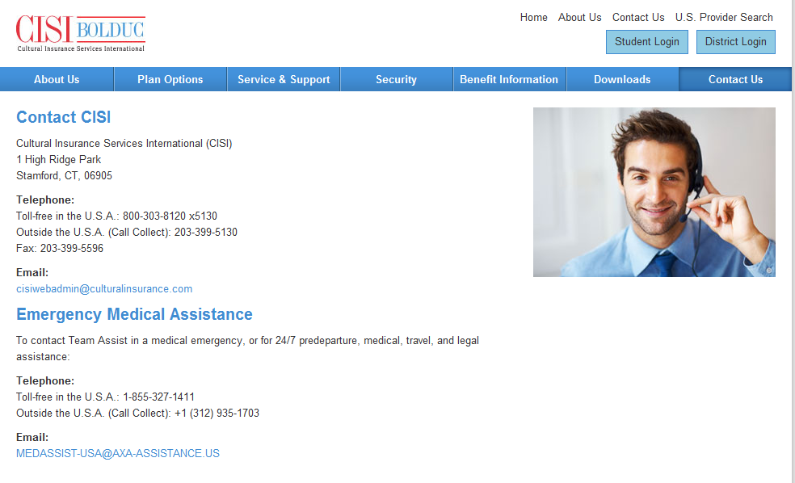
Emergency Contact –Team Assist
Team Assist is available for you around the clock!

Slide 13
How do I find a Doctor abroad?
Outbound students may visit any physician of their choosing and have worldwide coverage on their exchange abroad until the completion of their program or return to the U.S
CISI will pay foreign medical providers directly on behalf of the insured. The doctor or hospital
should submit an itemized bill directly
to CISI

Slide 14
You went to the doctor and they gave you a bill, now what?
Ideally, the doctor or facility will bill CISI directly, BUT……
If you need to pay upfront, please printout the claim form that was emailed to you upon enrollment.
The claim form should be completed in full, have the original bills and receipts attached.
Claims should have the most up-to-date contact details & address
Neat handwriting is KEY!

Slide 15
What if you can’t pay for the bill upfront?
Lets say you are hospitalized and your bill is $7,000-We do not expect for you to pay upfront so…..
If you call Team Assist, they will make arrangements with the hospital to pay in the currency of the country you are in.

Slide 16
What about medication?
Must be prescribed by a doctor or hospital
Pay for medication and submit for reimbursement with completed claim form.
Claim form must be accompanied by a prescription receipt. Receipt must include: Insured’s name, Physician’s name, name of medication and cost.

Slide 17
How to File a Liability Claim
Printout the Personal Liability claim form which can be found on our website (also emailed to the student)
Please fill it out completely!!
Describe the items that were lost, stolen or damaged
For robbery, a police report must be included with the claim form

Slide 18
Where to Send Your Claims
You can:
Mail T0: 1 High Ridge Park – Stamford-CT-06850
Fax To: 203-399-5596
Email To: Claimhelp@CulturalInsurance.com
You may start the process while abroad!

Slide 19
How do I enroll and where are my insurance documents?
You do not need to enroll, your Home District will help you with this step!
Once enrolled you will receive the
following materials via email:
ID Card
Policy Brochure
Claim Form
Consulate Letter
It is very important that you keep your ID Card on you at all times!!

Slide 20
Medical Id Card

Slide 21
Student Portal

Slide 22
Create an Account or Sign In

Slide 23
Student Portal Welcome Screen

Slide 24
Enrollment Documents

Slide 25
Frequently Asked Questions:
I lost my ID card, what do I do?
Simply contact CISI, we will be more than happy to email you a new ID card. Or you may also access your participant portal at anytime!
My host country is Spain, may I visit the neighboring country and still be covered?
Yes, your CISI insurance is valid worldwide, except for your home country. Also, please keep CISI informed of your travels
If a claim is paid by the host family; who does CISI reimburse?
The insured student is reimbursed, unless a receipt is submitted which clearly indicates that the host family has already paid along with a letter from the insured authorizing the host family to be reimbursed

Slide 26
Have A Safe & Fun Time Abroad!!
Arrivederci
Adiós
Au Revoir
Czesc
Tschuss PA

Slide 27
CISI Market Place
AT&T Study Abroad Plans
Keep your current device and number
International Money Cards
Load Cash in your own currency
Avoid opening foreign bank accounts
International Student Exchange (ISE) Identity Cards
Travel discounts
Deductible Reimbursement

Slide 28
Ok, so I faxed/mailed my claim form with my receipts…..
Hang on tight!
All of your friends at CISI are doing their best to process your claims within 2 weeks of submission. This is why it’s very important that you submit the right materials with the right information!
Once we analyze your claim form & match it up with your benefits, we will send you a reimbursement check. Checks are mailed to your address in the U.S since it will be very difficult for you to cash a check abroad. Your parents can always transfer/deposit the money back into your account

