Slide 2
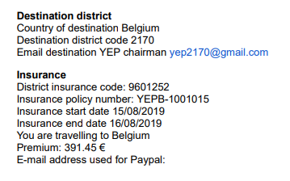
Out of Country Claims – Insurance Card

Slide 3
Out of Country Claims
Who do we contact if something happens?
Depending on the severity of the illness or injury – Parents, Host Parents, YEO, Out-Bound Coordinator
Insurance Carrier – use information provided on the card

Slide 4
Out of Country Claims – Paperwork
Two types of claims (examples from CISI Bolduc):
Personal Liability Claim (loss/damage/theft)
Medical Claim

Slide 5
Out of Country Claims
Need help or have questions:
Lin Klick
250-640-8062
klick@telus.net

