Slide 1
2016-2017 Member Inventory of Interests
Saturday, September 17, 2016

Slide 2
39
Total Responses
Date Created: Sunday, August 14, 2016
Complete Responses: 39

Slide 3
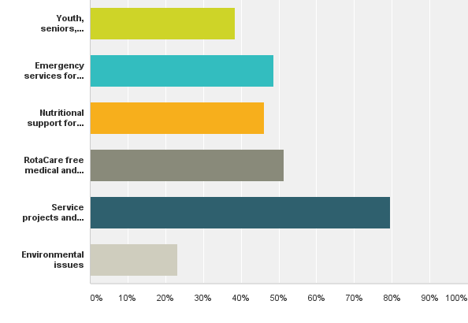
Q1: Community Service:Pertains to activities Rotarians undertake to improve the quality of life in their communities.
Answered: 39 Skipped: 0

Slide 4
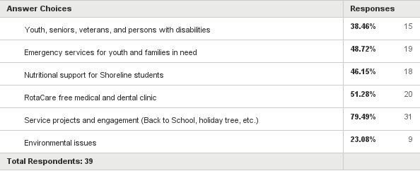
Q1: Community Service:Pertains to activities Rotarians undertake to improve the quality of life in their communities.
Answered: 39 Skipped: 0

Slide 5
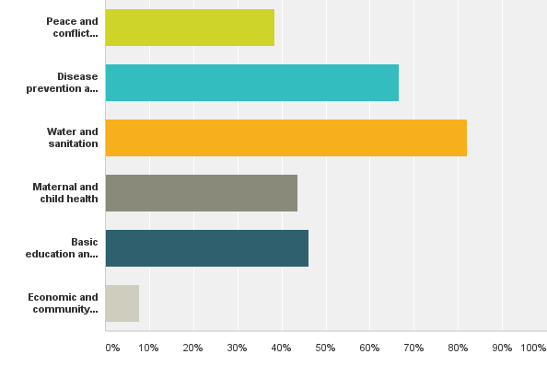
Q2: International Service:Describes the projects that Rotarians undertake to advance peace, understanding, and goodwill.
Answered: 39 Skipped: 0

Slide 6
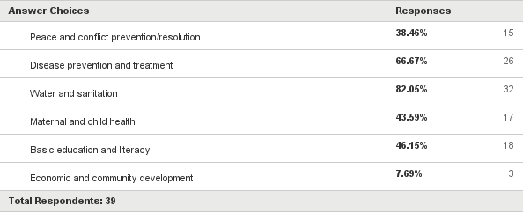
Q2: International Service:Describes the projects that Rotarians undertake to advance peace, understanding, and goodwill.
Answered: 39 Skipped: 0

Slide 7
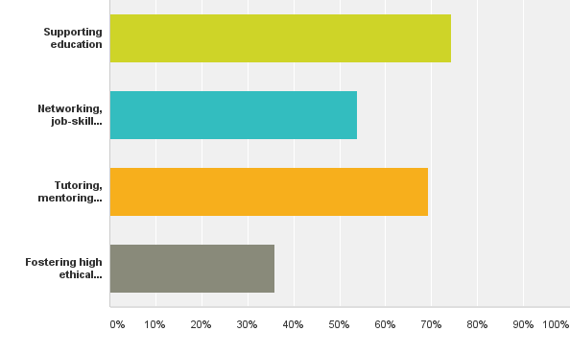
Q3: Vocational Service:Means that we use our professional and business talents and resources to serve others.
Answered: 39 Skipped: 0

Slide 8
Q3: Vocational Service:Means that we use our professional and business talents and resources to serve others.
Answered: 39 Skipped: 0

Slide 9
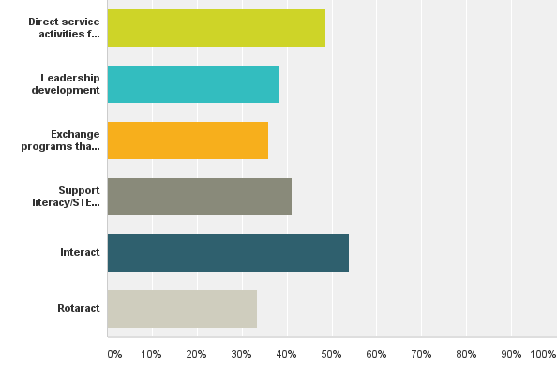
Q4: Youth Services:Recognizes the positive change youth and young adults bring to Rotary and mutually us to them.
Answered: 39 Skipped: 0

Slide 10
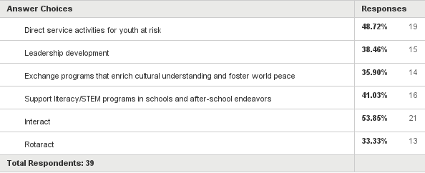
Q4: Youth Services:Recognizes the positive change youth and young adults bring to Rotary and mutually us to them.
Answered: 39 Skipped: 0

Slide 11
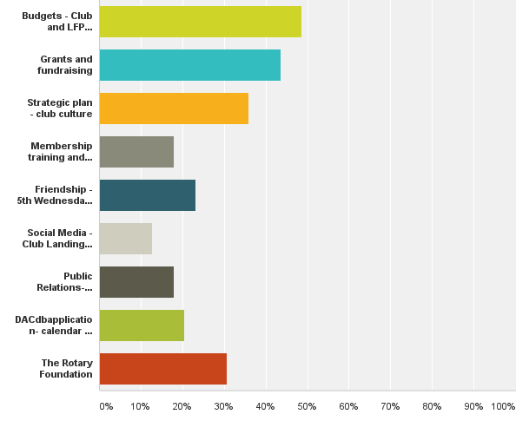
Q5: Club Administration:Involves the necessary activities Rotarians perform to make their club function successfully.
Answered: 39 Skipped: 0

Slide 12
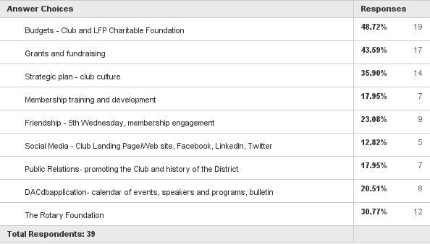
Q5: Club Administration:Involves the necessary activities Rotarians perform to make their club function successfully.
Answered: 39 Skipped: 0

