Slide 1
Mercer Island Rotary International Dance for Peace
We Did It! Now Let’s Take a Look!

Slide 2
What we heard you loved from the Half Marathon
Opportunities for everyone to participate and have a job
• Family healthy activity for the participants
• Good connection to get to know Rotary - small job for each Rotarian - inclusive
• Spirit of cooperation while working with other members in the club - one for all and all for one
• Well organized as a Club - translate organized teamwork for future events
• Quality event - represented MI Rotary well - pride in being a part of a great event
• So many volunteers - it was very festive
• Sense of community with other volunteers and participants
We worked hard to create an event that met this criteria

Slide 3
Promotional Materials Raise awareness to the Rotary Club of MI/mission/membership
Flyers
Yard Signs
Stickers
Table Sponsorship
Postcards
All MI residential households mailing 10,400 Postcards
MI Reporter Article
MI Greet Magazine Article
KMIH On-air promotions and interview
PTA Newsletters
MIPA Newsletter

Slide 4
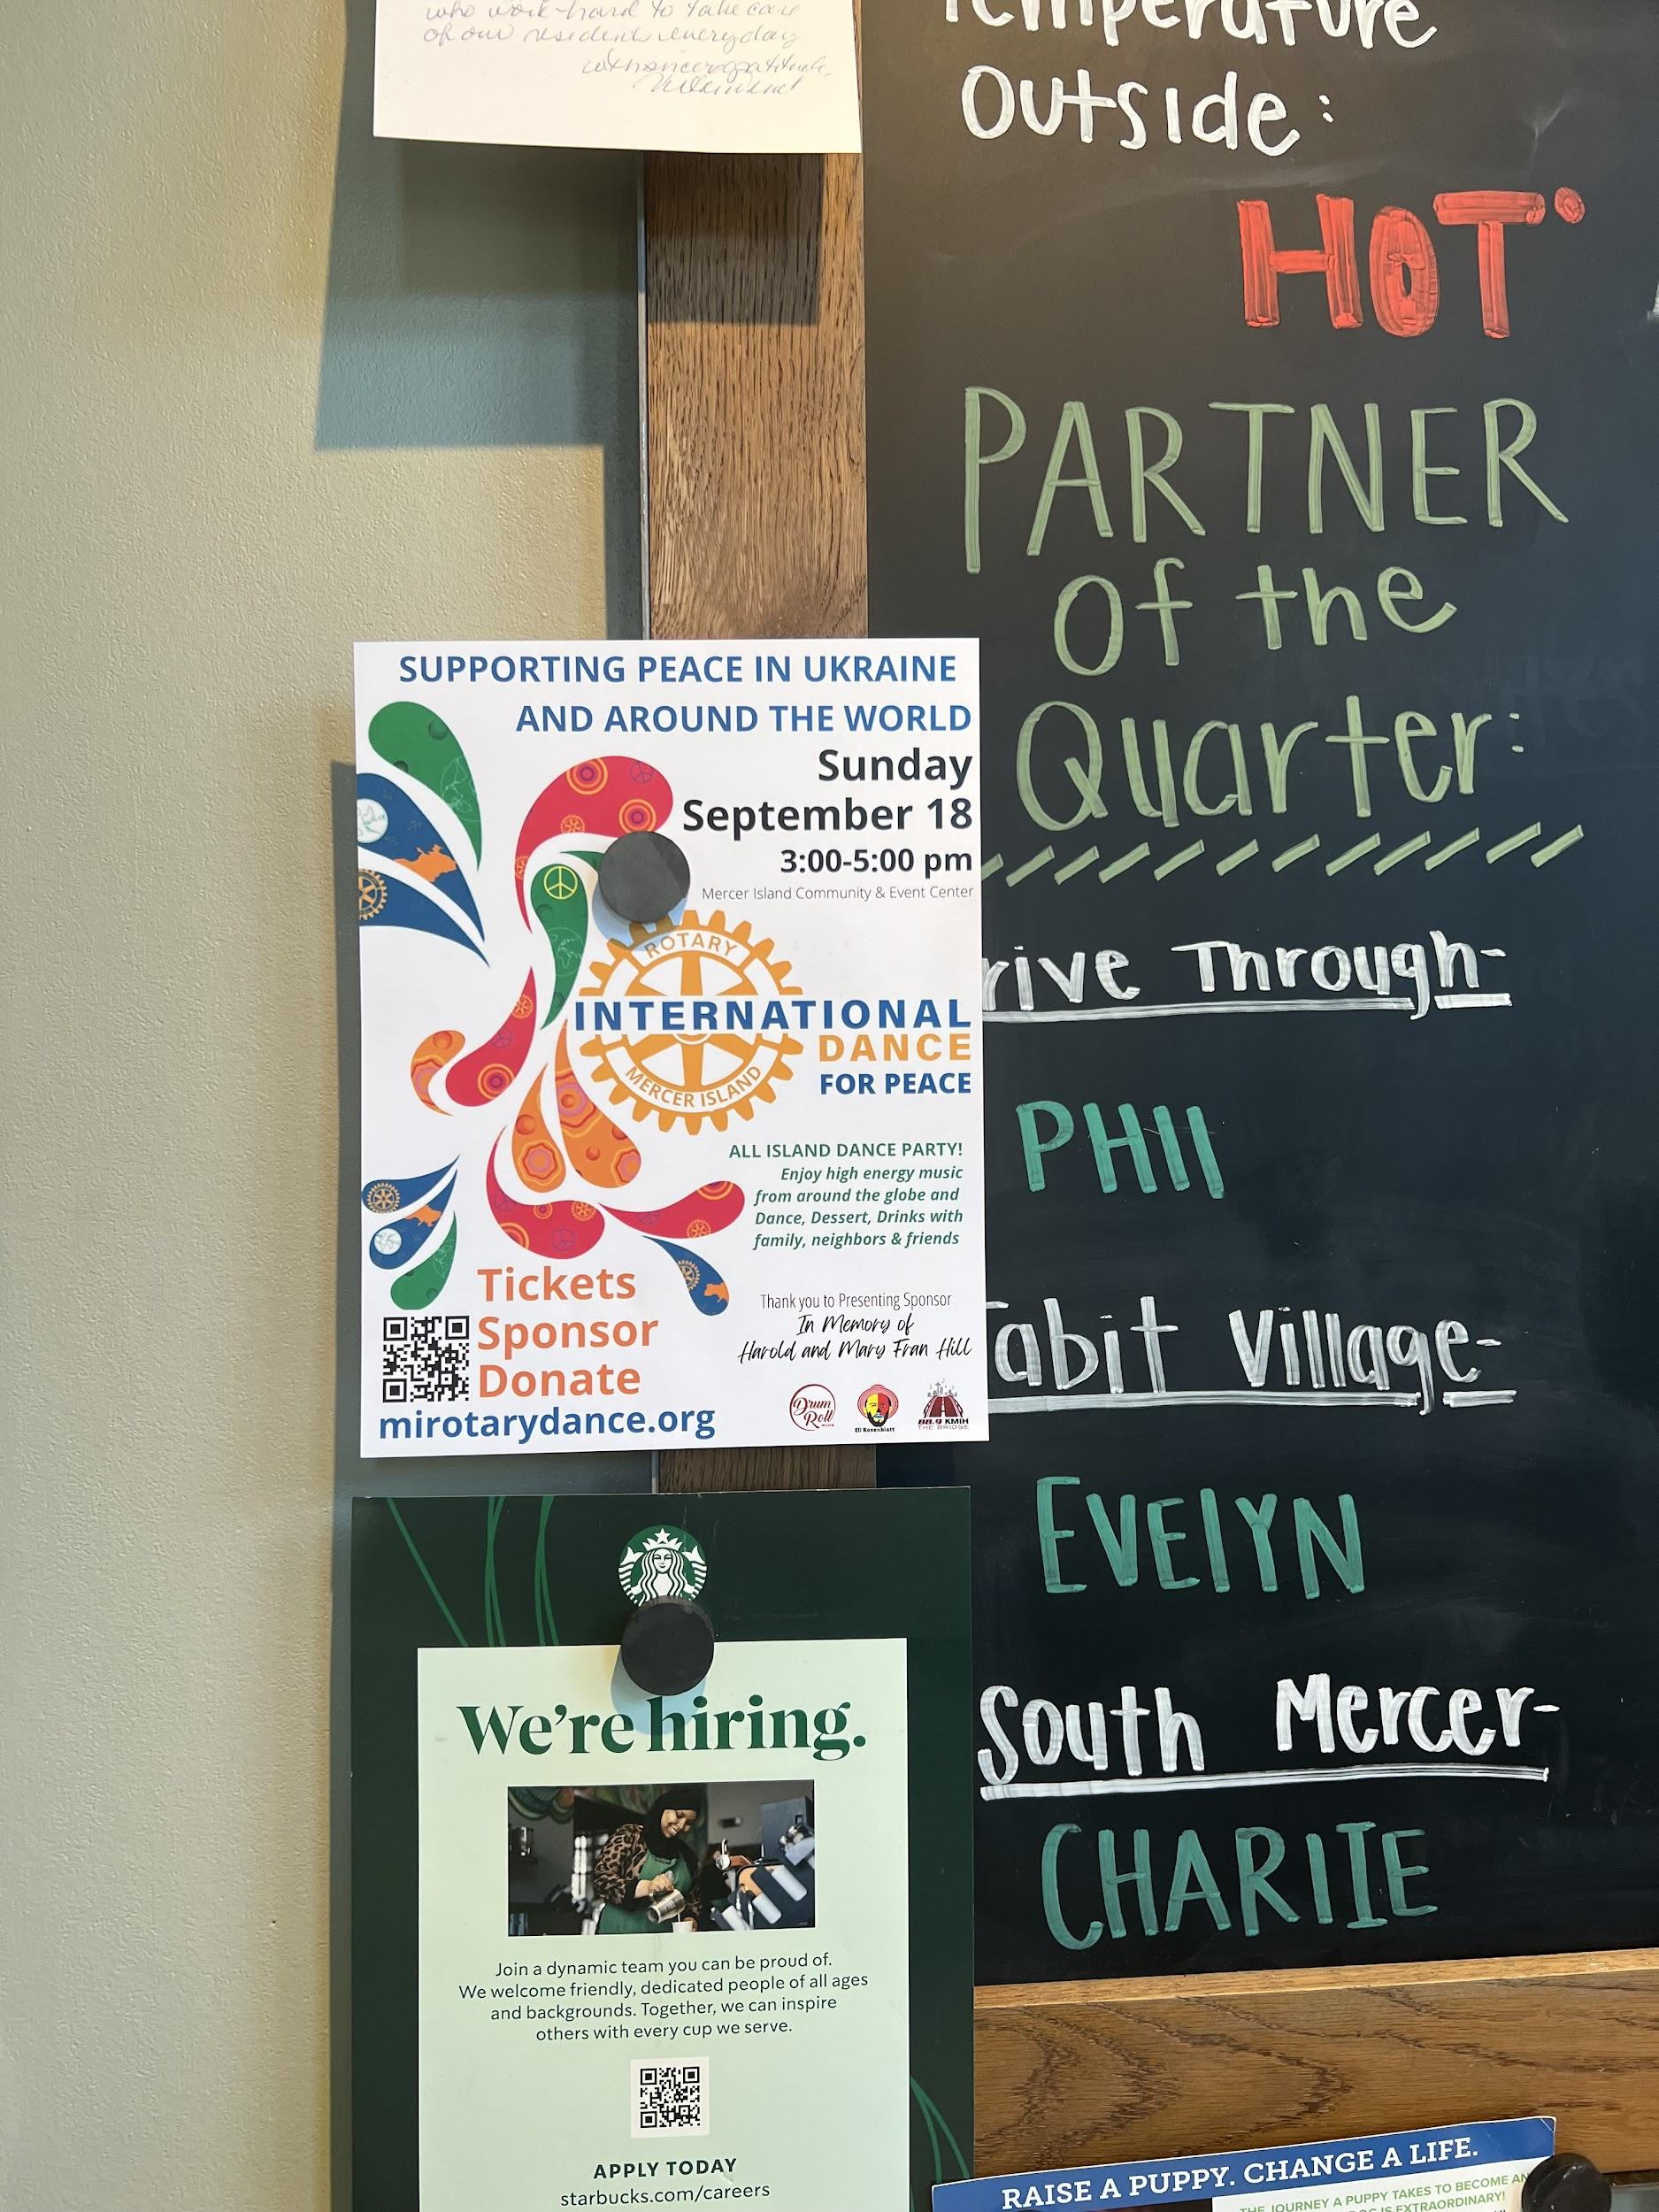
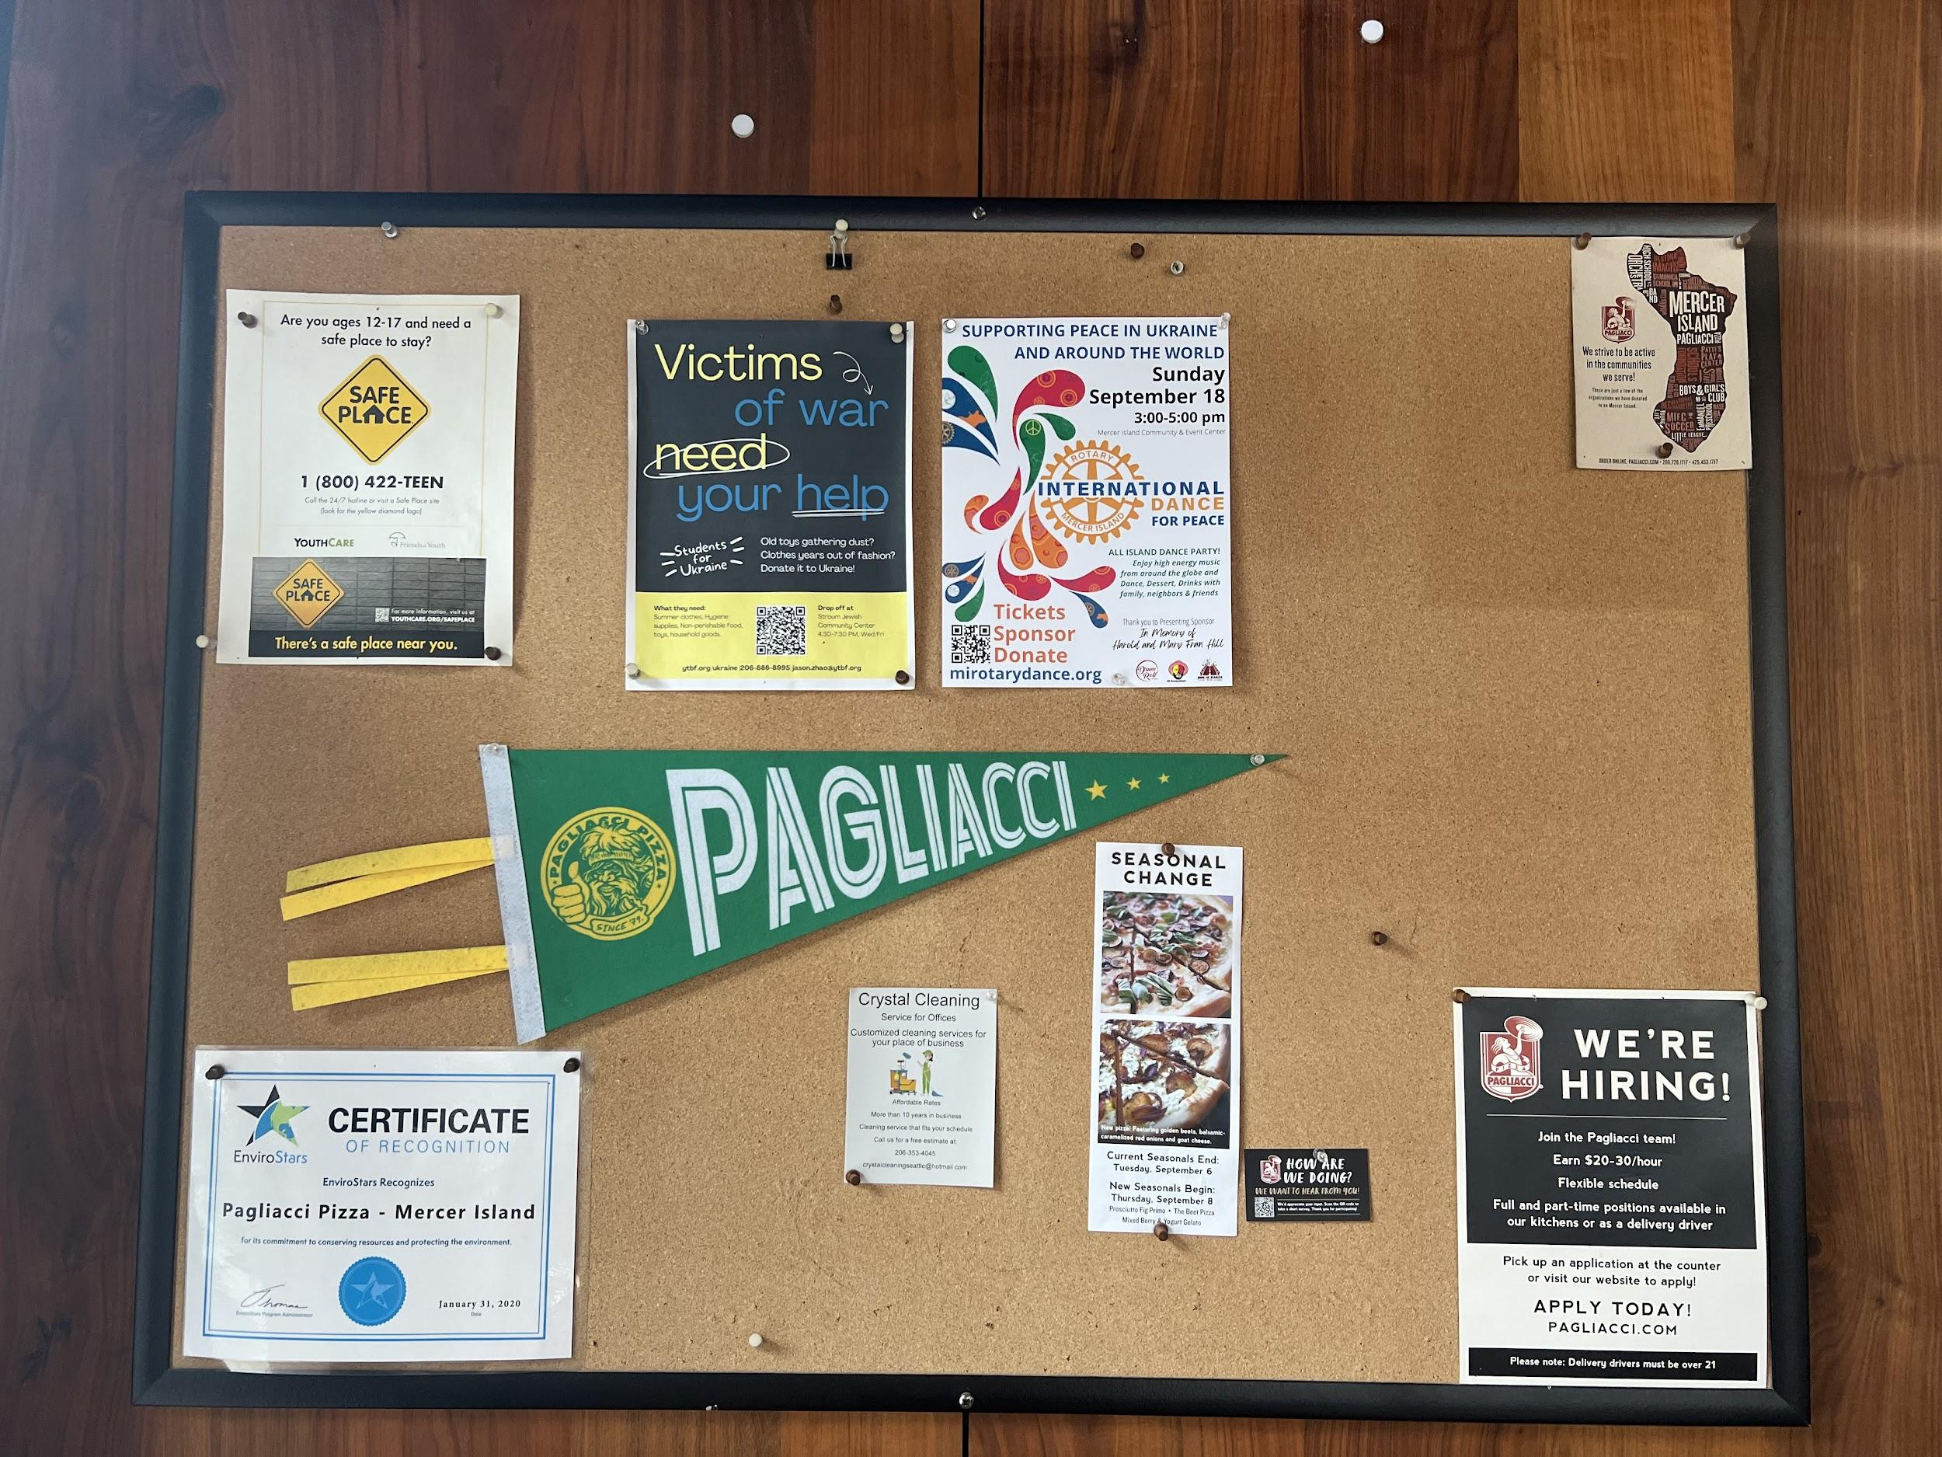
Flyers

Slide 5
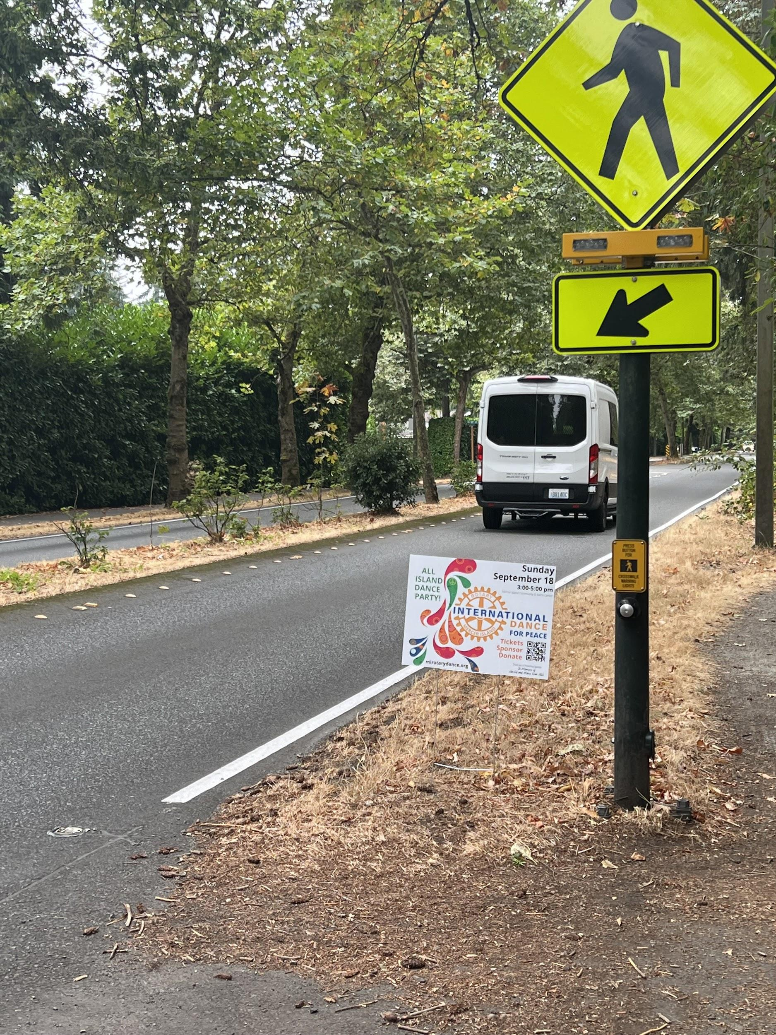
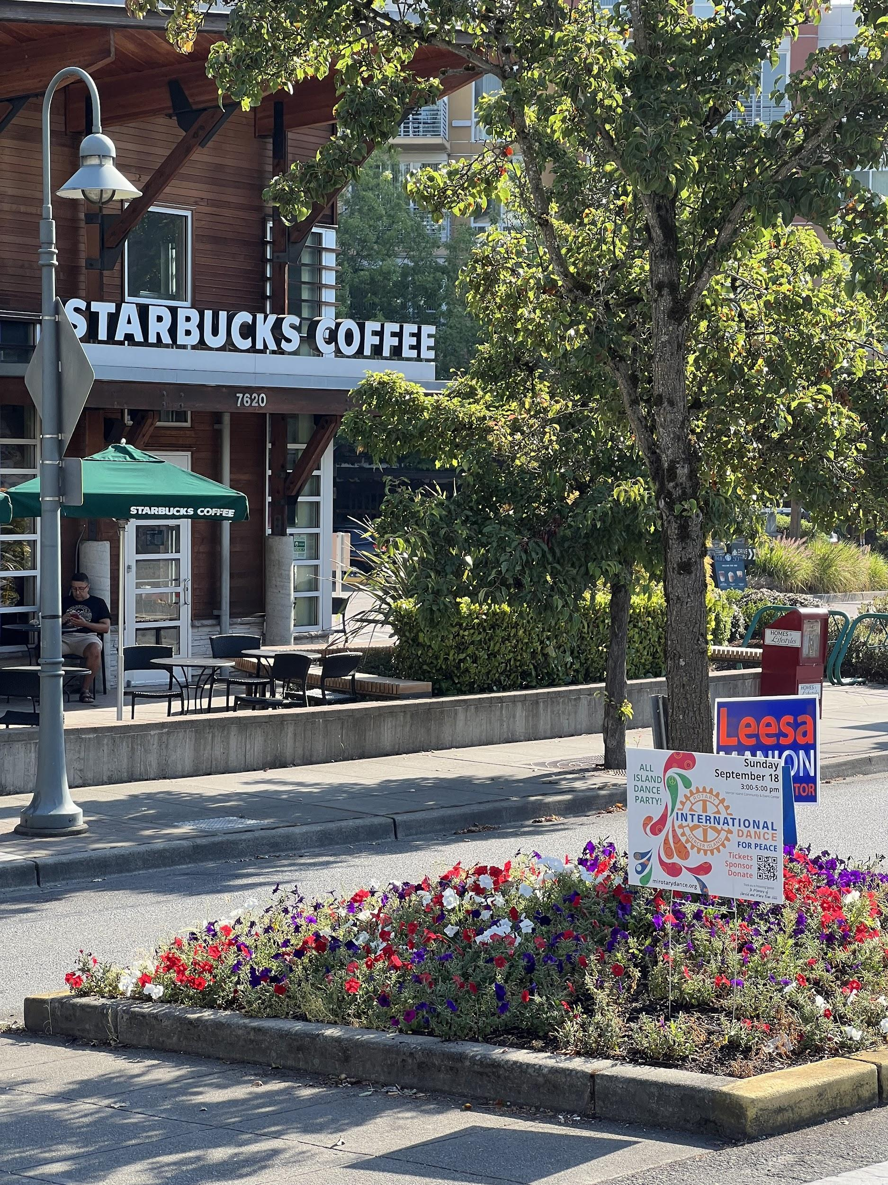
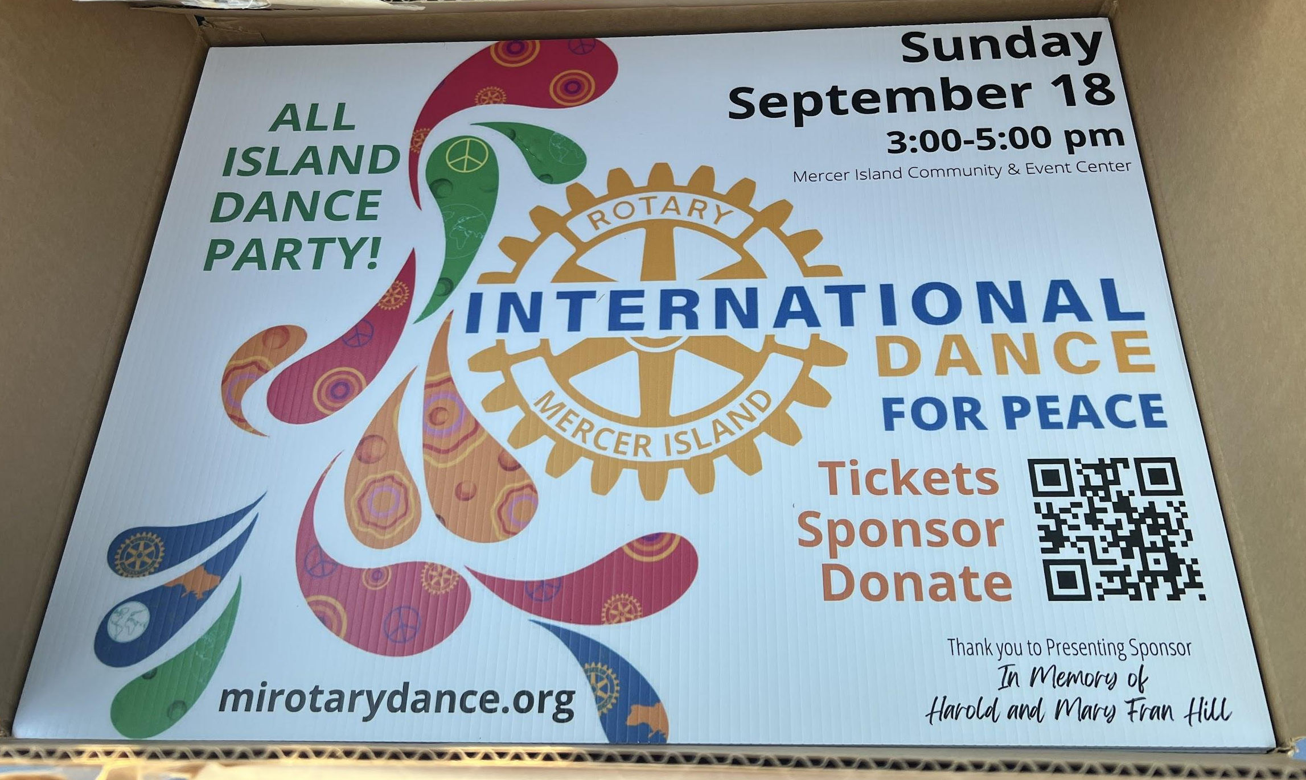
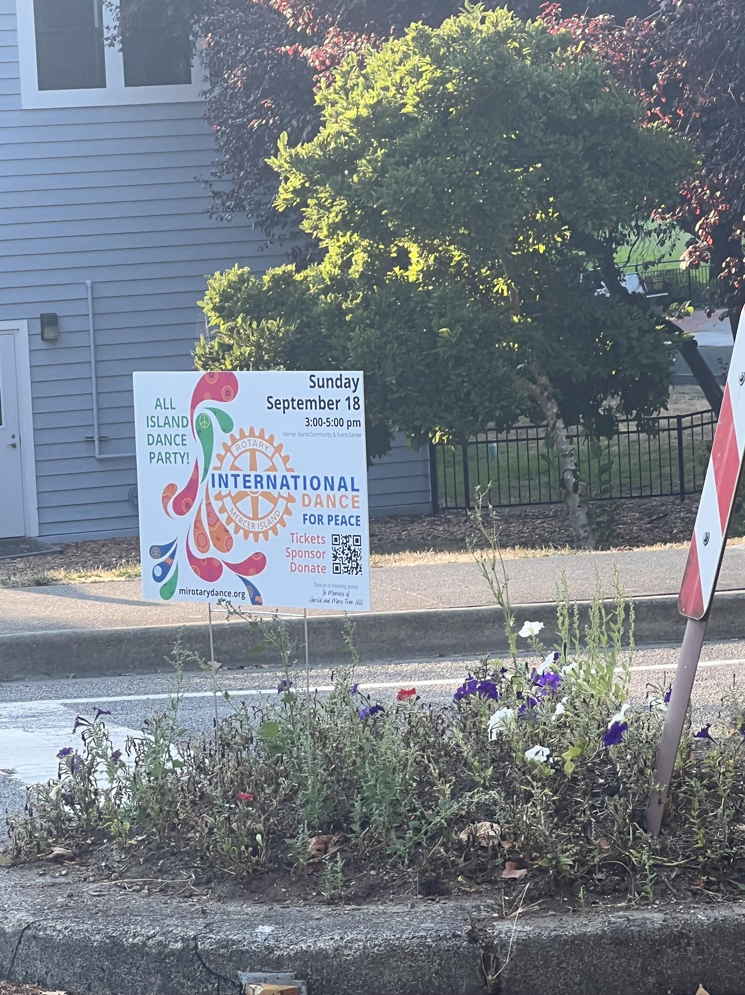
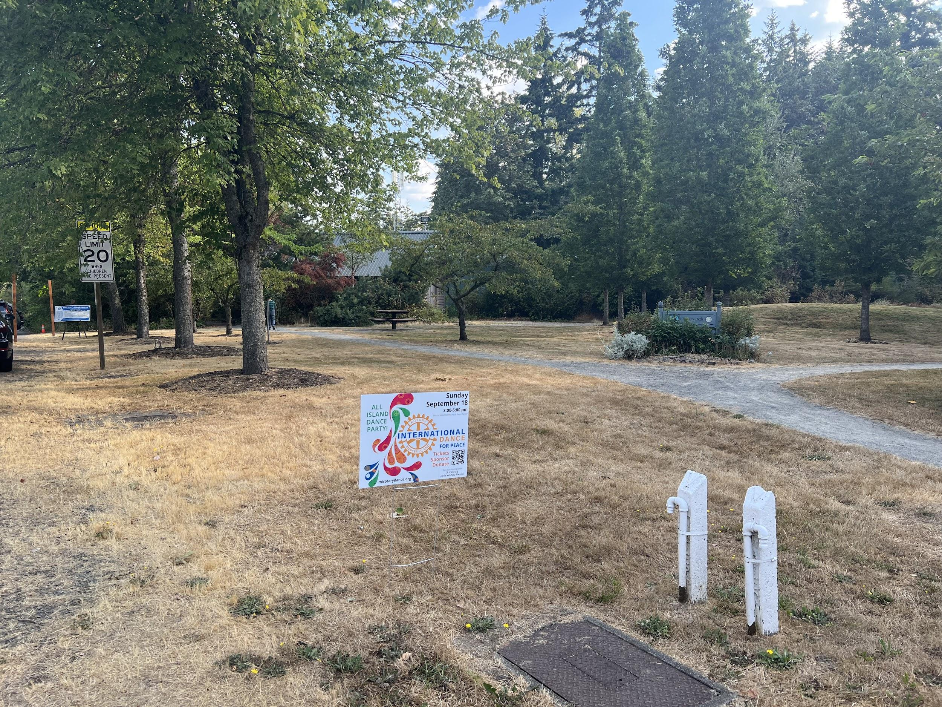
Yard Signs
The Yard Signs in Action

Slide 6
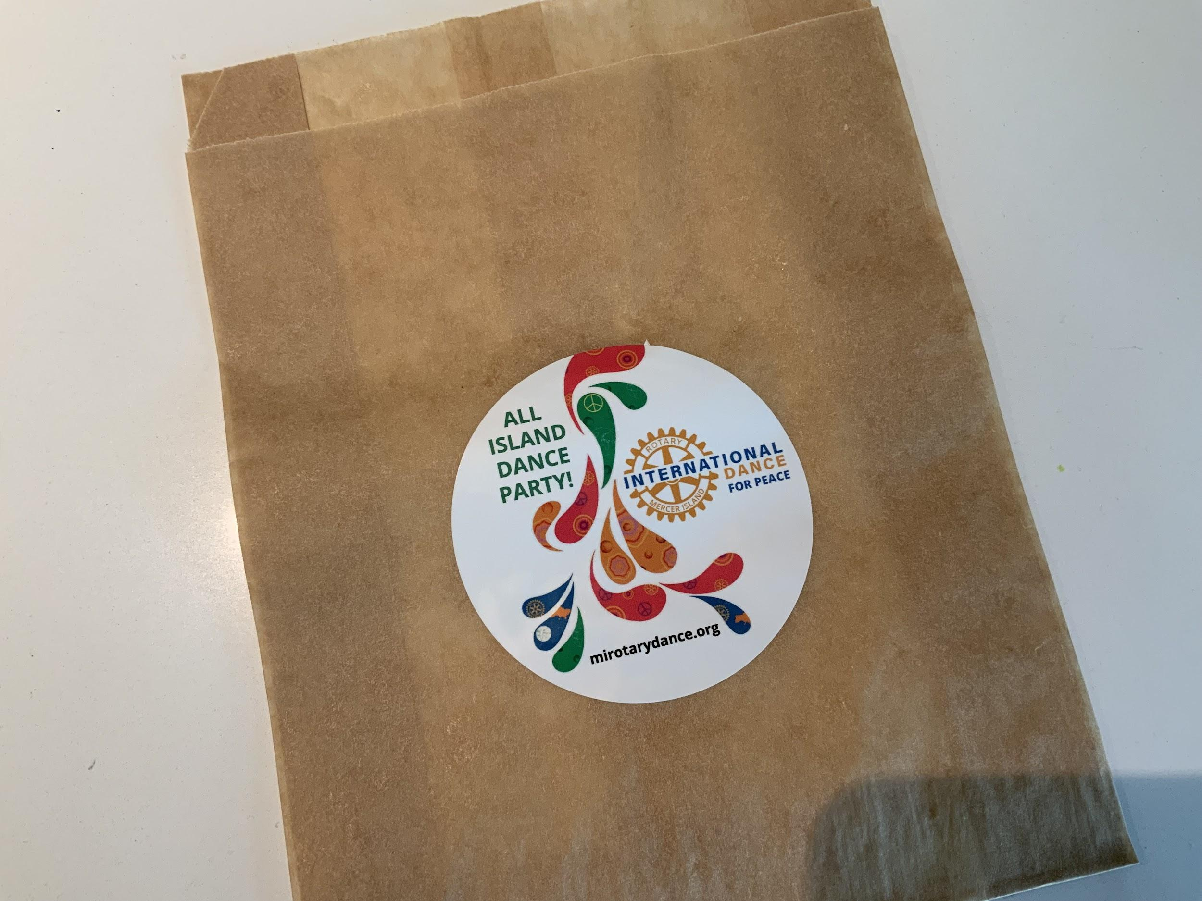
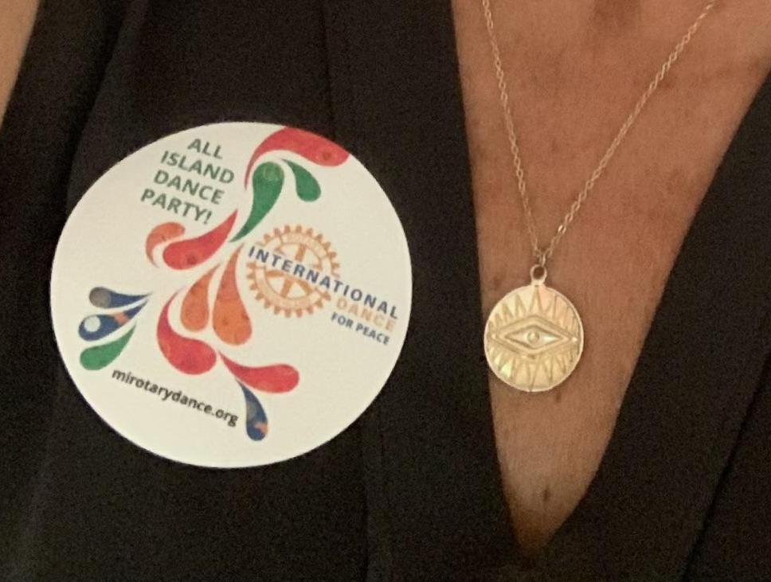
Stickers

Slide 7
Postcards

Slide 8
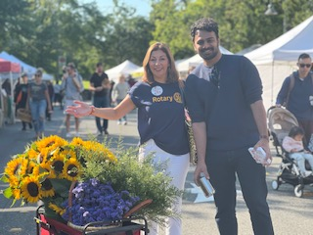
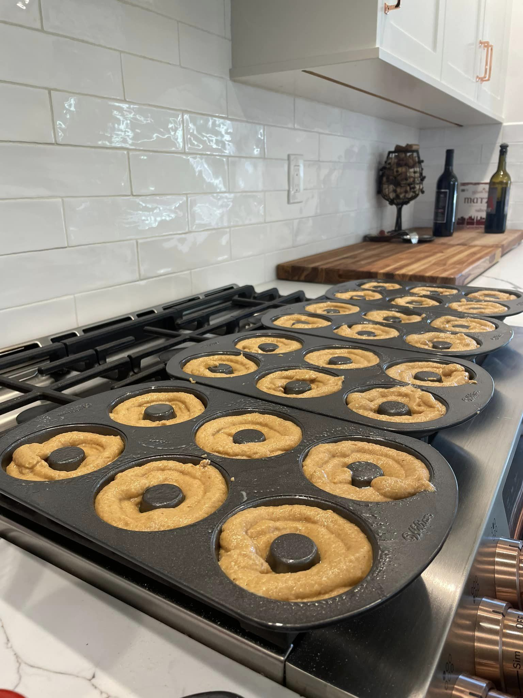
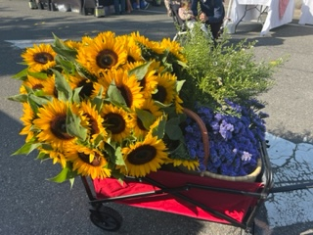
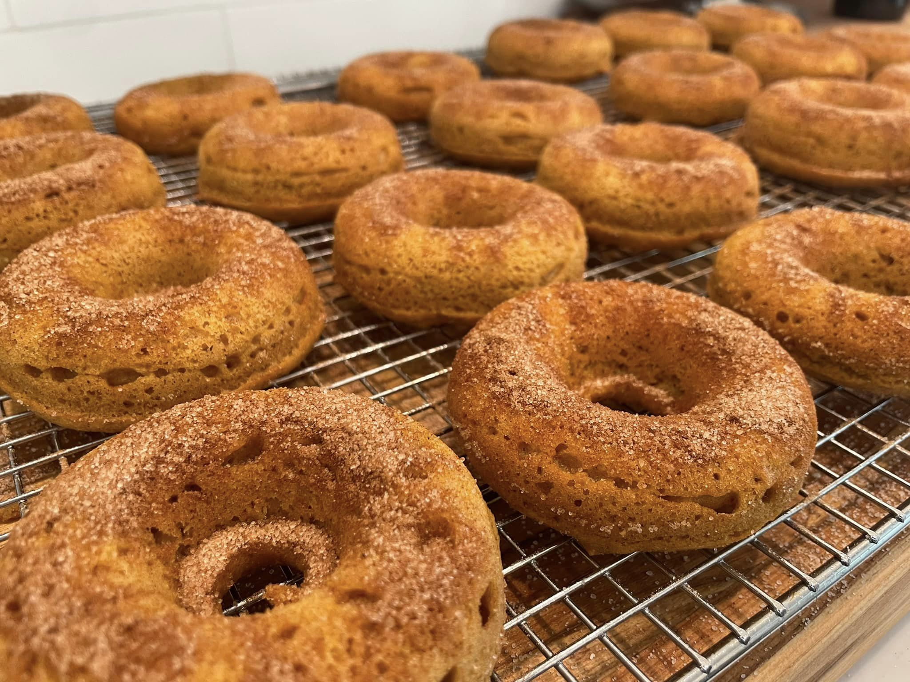
dAy of preperations

Slide 9
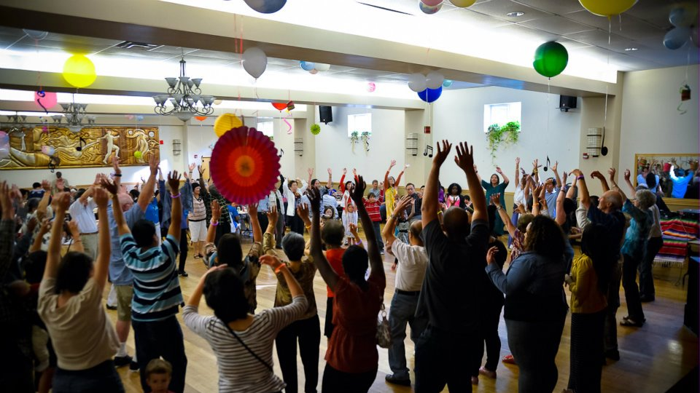
The Vision

Slide 10
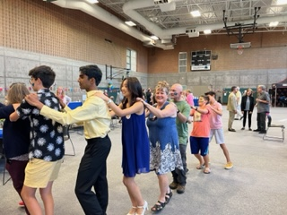
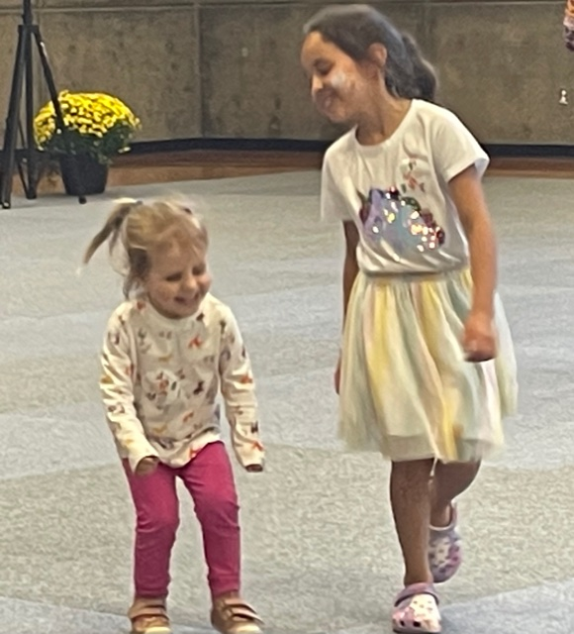
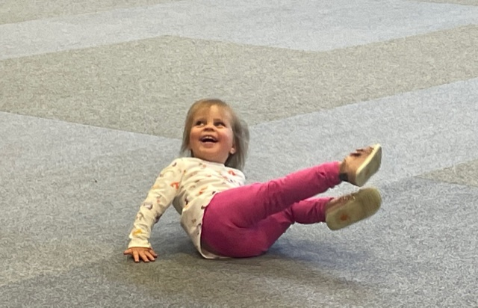
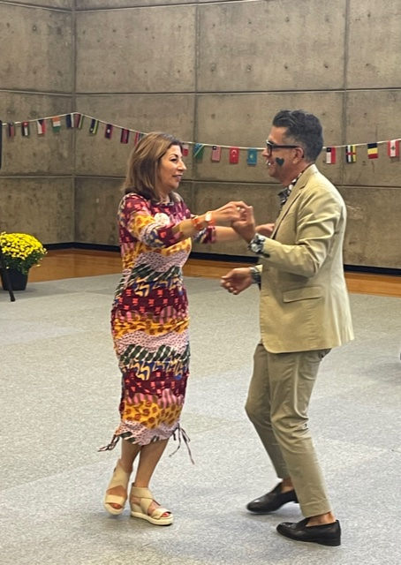
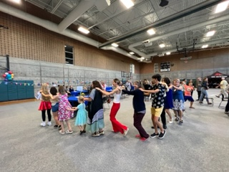
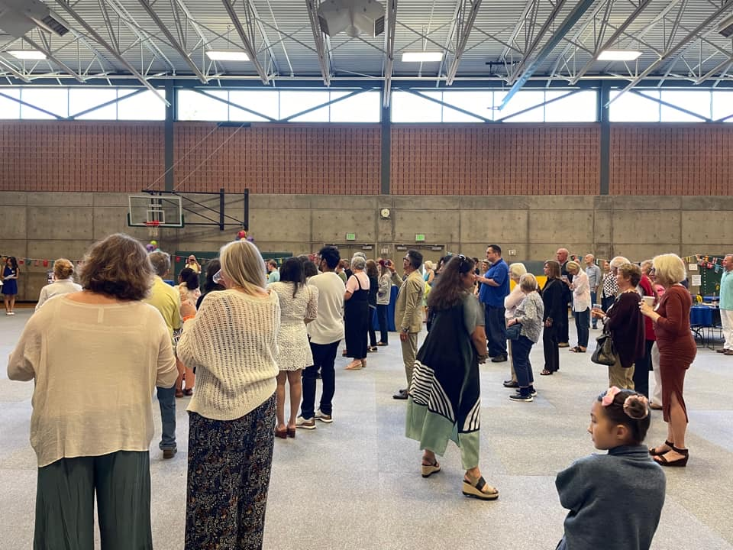
THE REALITY

Slide 11
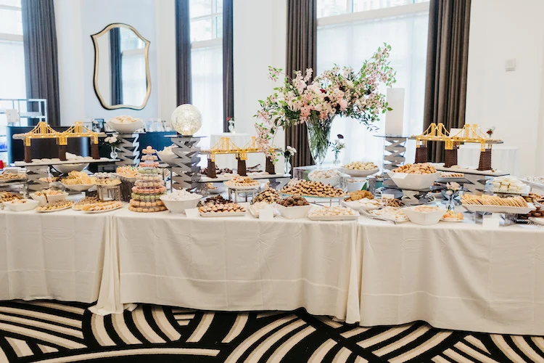
Cookie Table

Slide 12
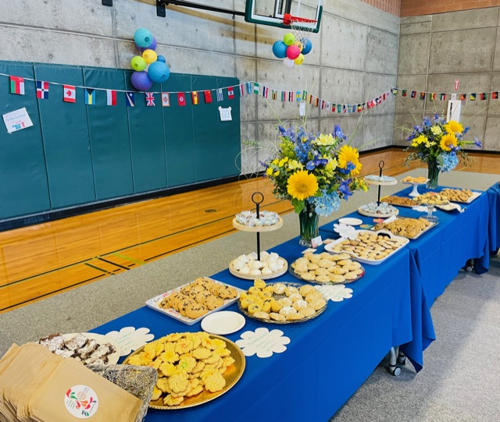
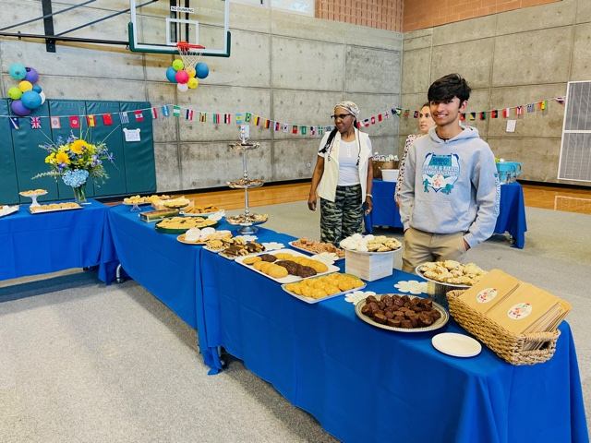
Our Cookie tAble

Slide 13
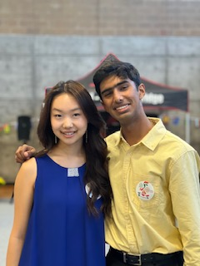
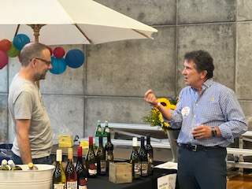
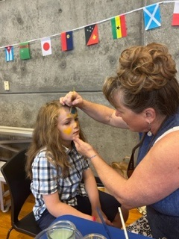
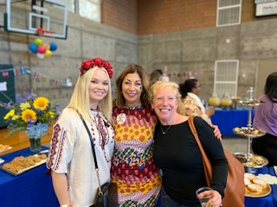

Slide 14
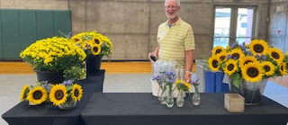
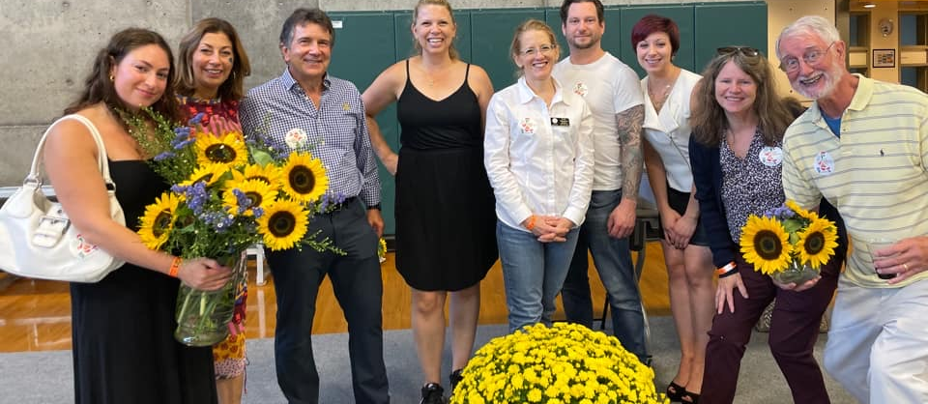

Slide 16
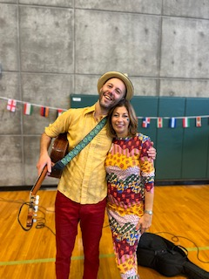
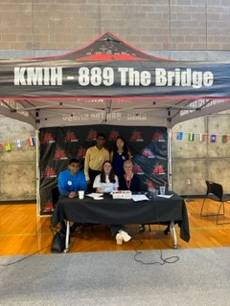
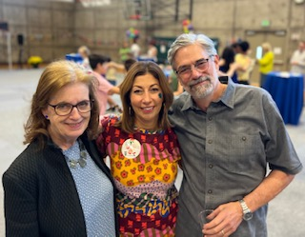
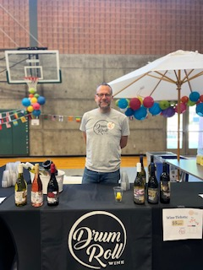
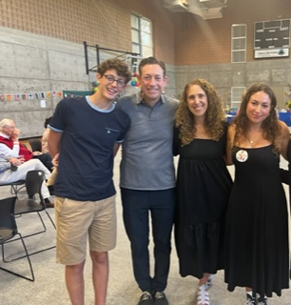
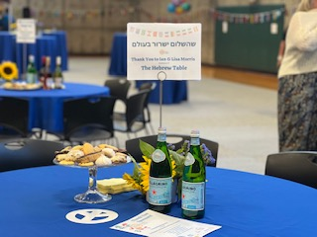
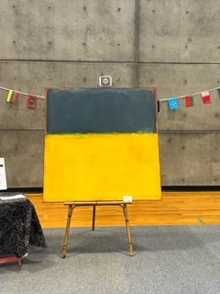

Slide 17
Financial Results
Total Gross Revenue = $27,390.09
Expenses = $9,843.02
Net Operating Revenue = $17,547.07
Donation to Ukrainian Association of Washington State
= $5,450.00

