Slide 2
Program Highlights:
Creation: Dolly Parton launched in 1995
Main Service: Free books mailed to children ages 0-5 directly to their home every month
Global Coverage: US, UK, Canada, Ireland, Australia
Distribution: 178 million books mailed
Getting books into the hands of children and inspiring a love for learning!

Slide 3
Program Highlights
Turnkey: Easy to manage and install as an affiliate and easy for families to enroll their children
Reach: The program reaches more children than any other early childhood book gifting program

Slide 4
Program Highlights:
Quality Book Selection: A National Selection Committee
First selection criteria: age appropriateness
Books are inclusive, diverse and cover feel good topics, author variety etc. Research Backed Results:
Children are kindergarten ready and outperform non-participant peers.

Slide 5
Local Program Info
Who can be an Affiliate:
Affiliate Responsibility:
Pay monthly cost of books
Manage participant database
Engage community (marketing, reaching families and child serving providers, events etc.)
Book Costs:
$2.10 per book
$25.20 per year per child
Costs include shipping
A 501(c)(3) nonprofit or school district

Slide 6
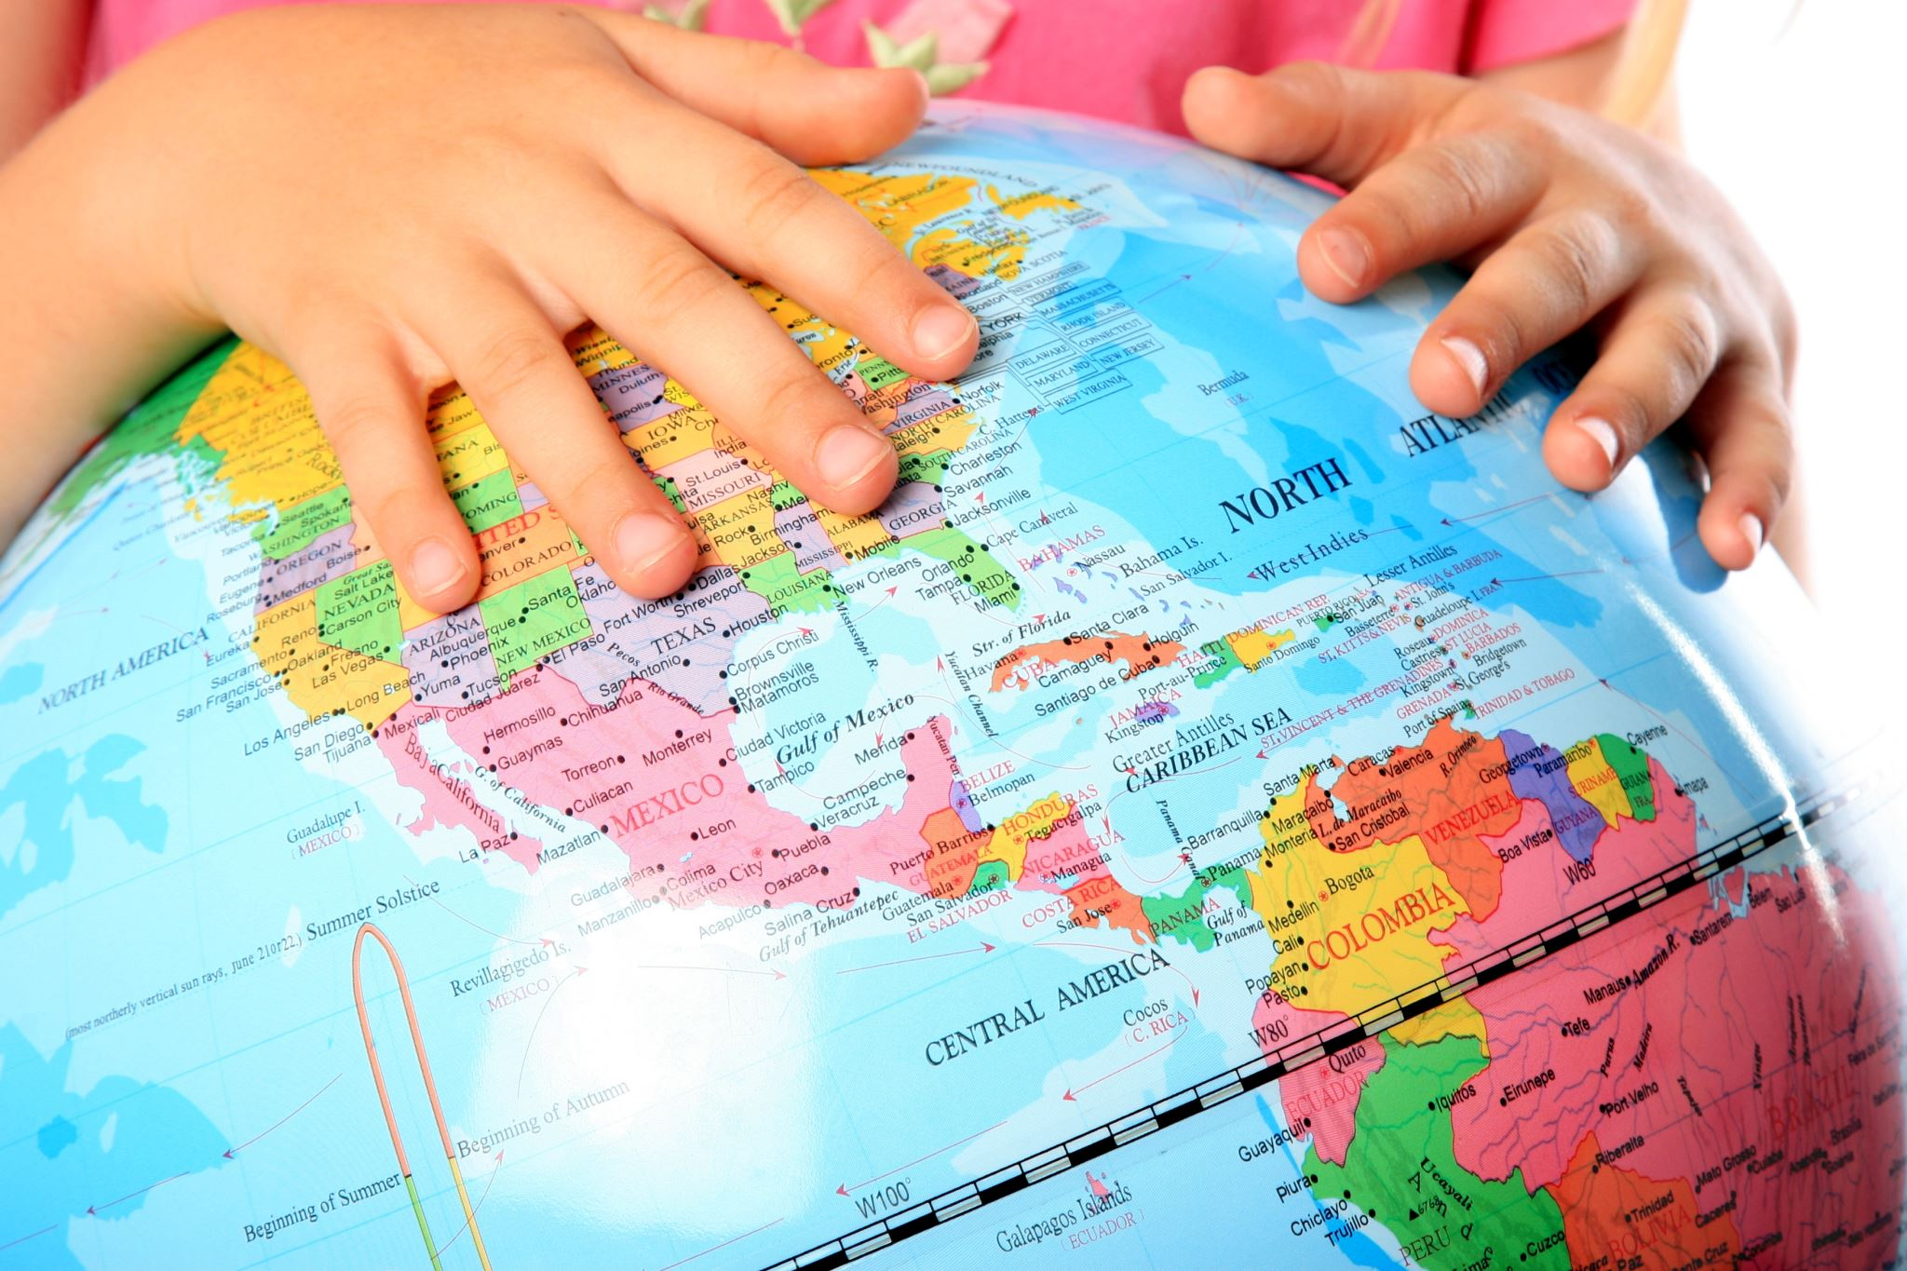
Pierce County:
Total Eligible Population in Pierce County (Age 0-5)
59,728
Gig Harbor & Key Peninsula:
Children ages 0 – 5
2,922

Slide 7
Per Year Cost of Program (Gig Harbor & Key Peninsula)
100% registered | 65% registered | 20% registered
$73,635 per year | $47,880 per year | $14,727 per year

Slide 8
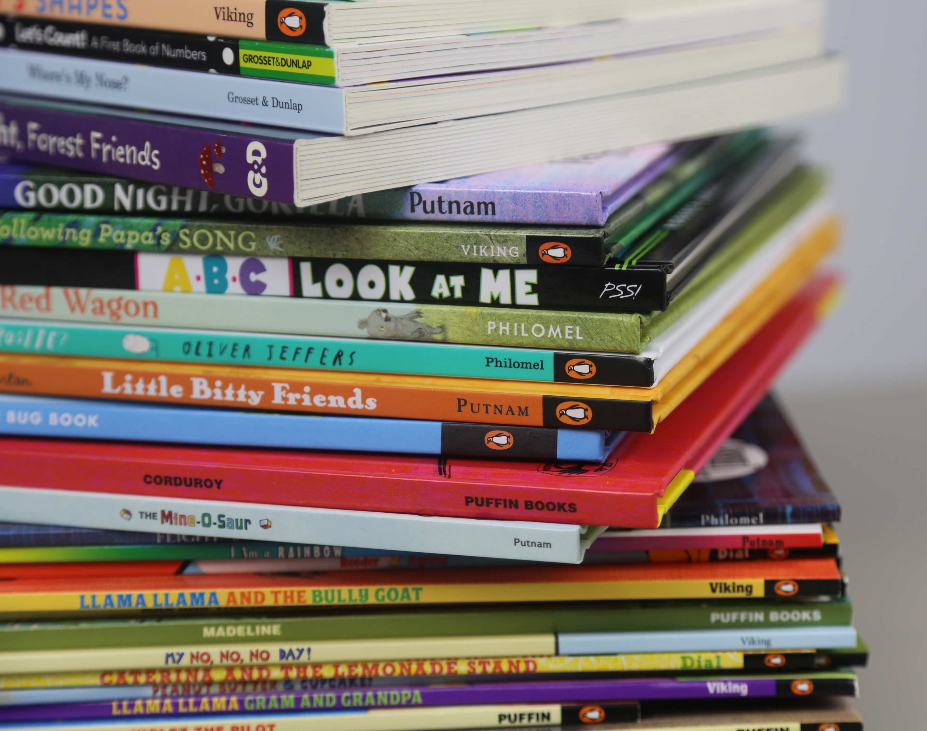
OSPI Contract:
United Way Pacific Northwest received a $2.3 million contract with Washington State Office of the Superintendent of Public Instruction
Expand program to cover all 39 counties
50% Match Funding for all WA affiliates to support monthly book invoices.

Slide 9
Per Year Cost of Program (Gig Harbor & Key Peninsula)
100% registered | 65% registered | 20% registered
$73,635 per year | $47,880 per year | $14,727 per year
50% = $36,818 per year | 50% = $23,940 per year | 50% = $7363.50 Per year

