Slide 1
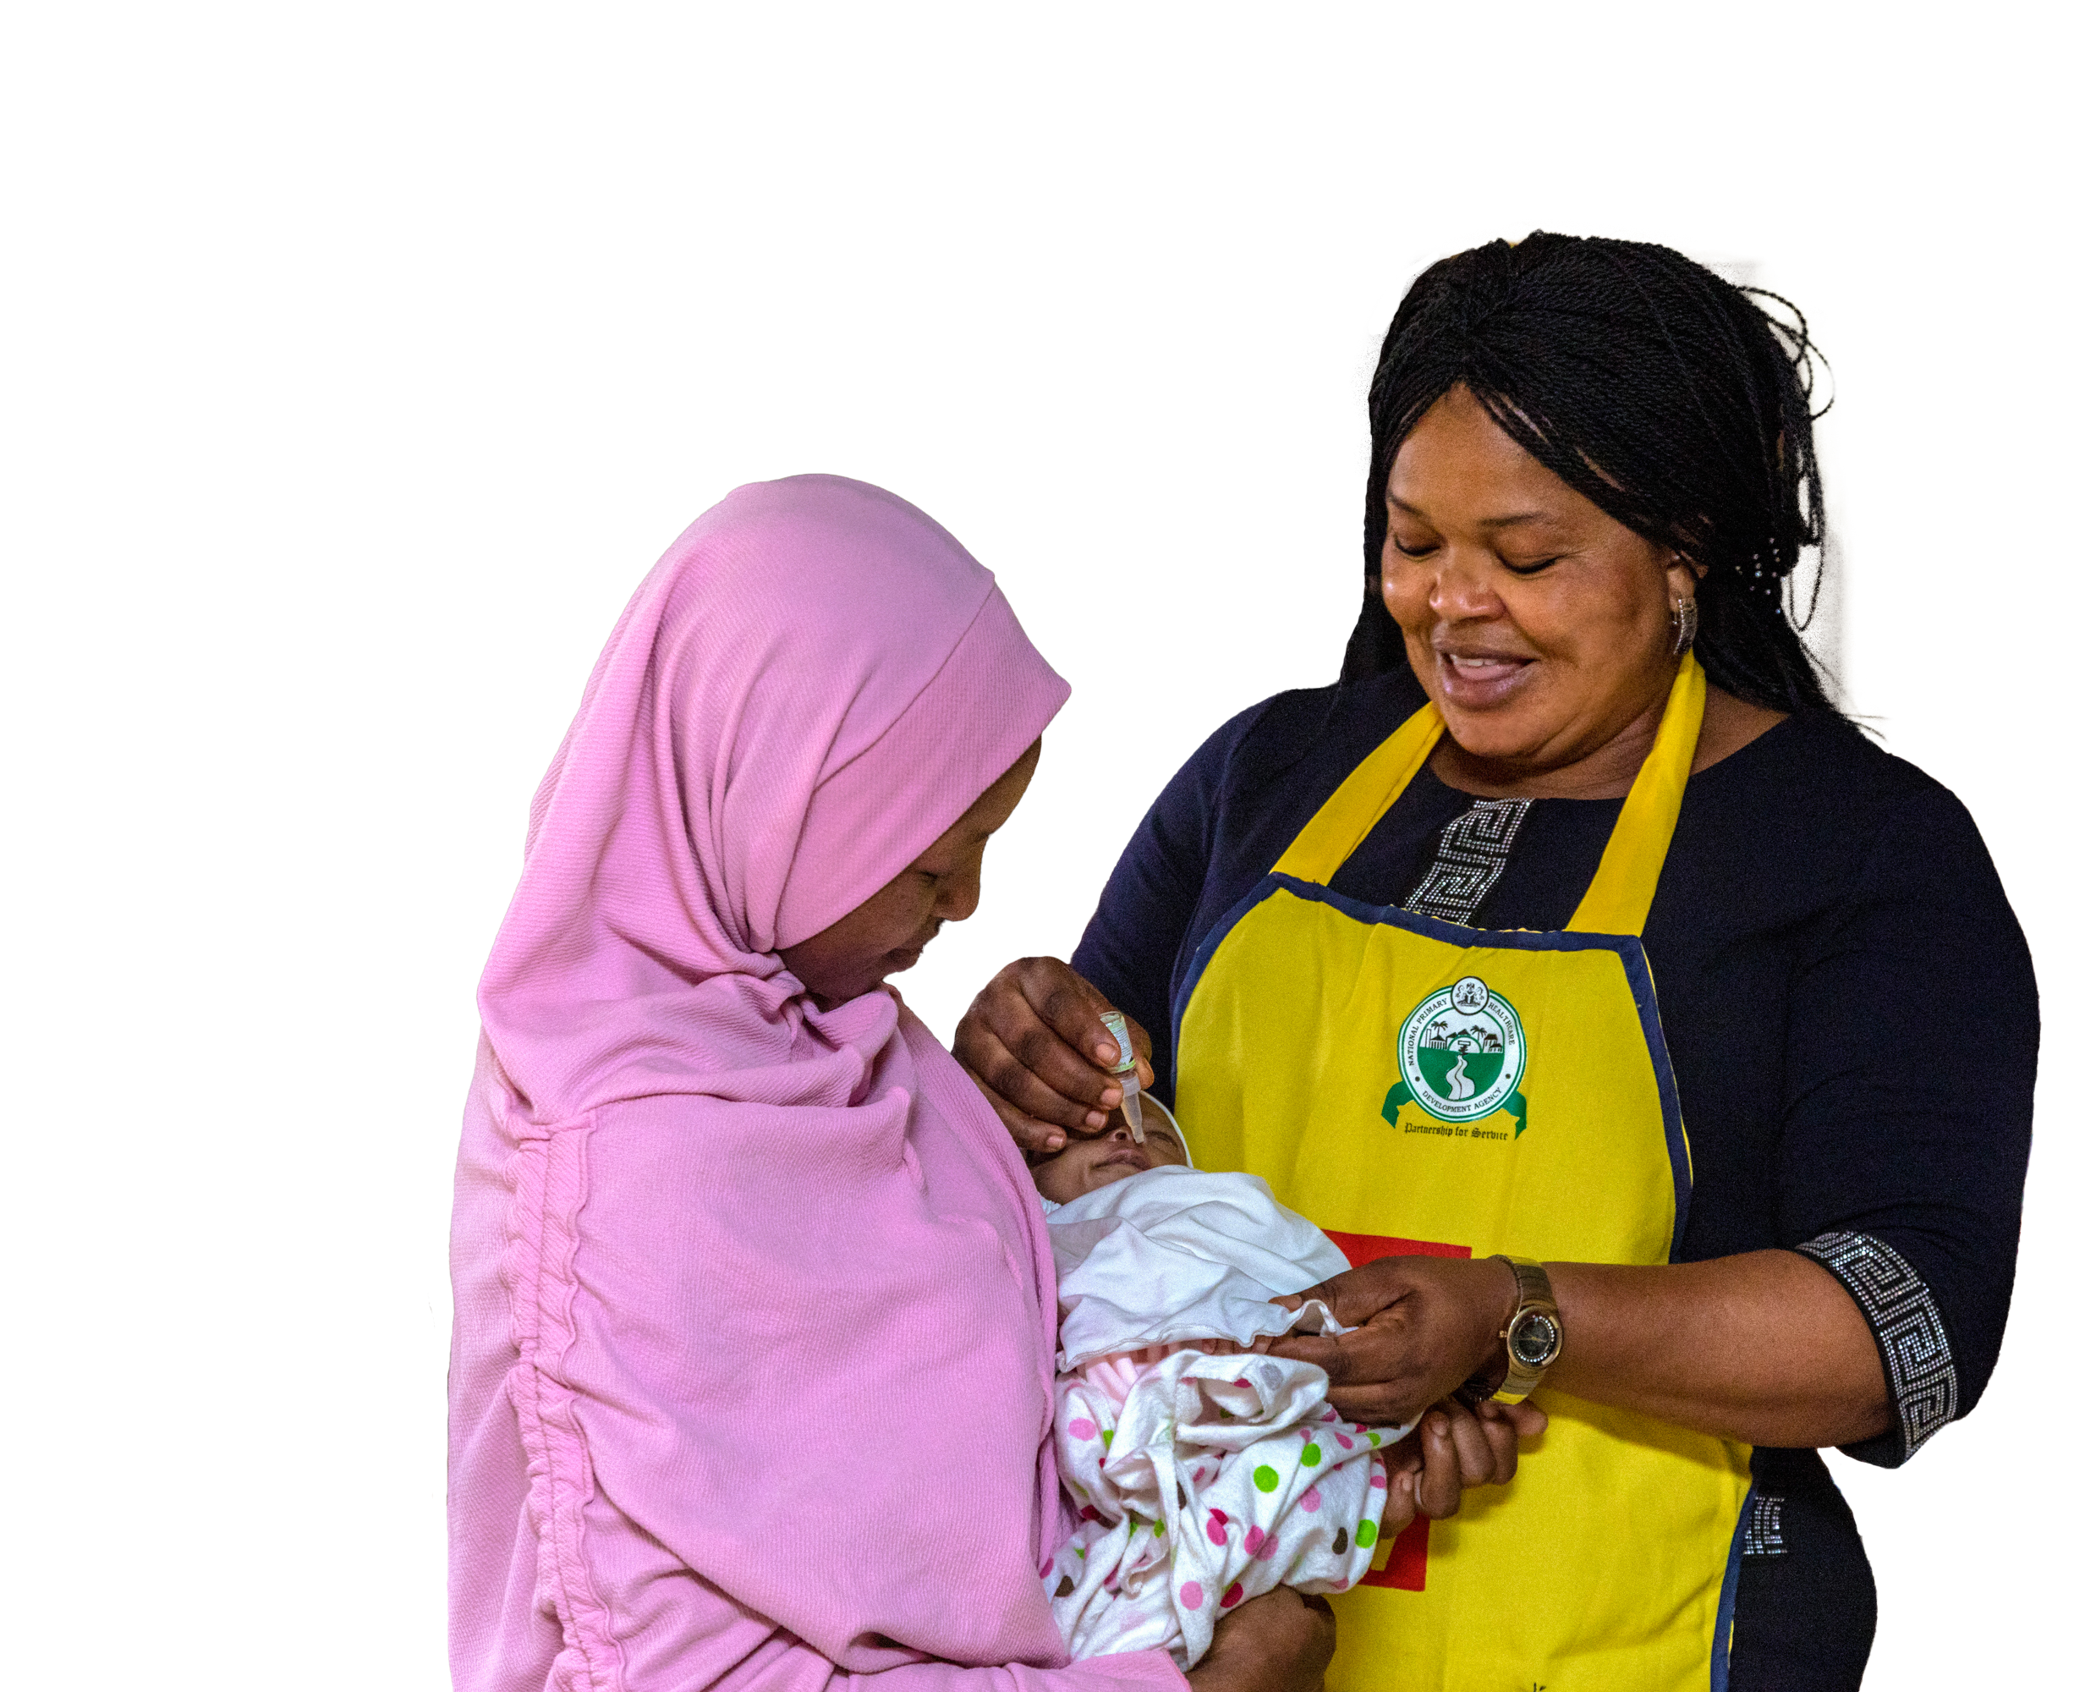
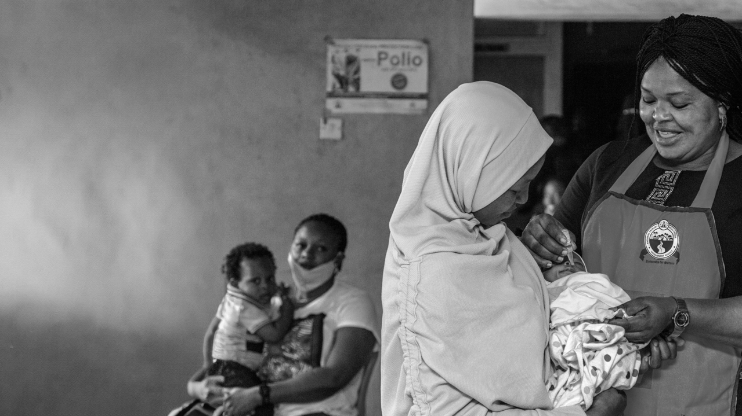

TOGETHER, WE
END POLIO
Notes:
A dedicated health worker, a smiling mother, and a child forever protected from paralysis by the poliovirus — this is what Rotary’s PolioPlus program achieves.
Our ultimate goal of a polio-free world is possible, and with your engagement and support, we can fulfill our promise to protect all the world’s children from this paralyzing disease.

Slide 2
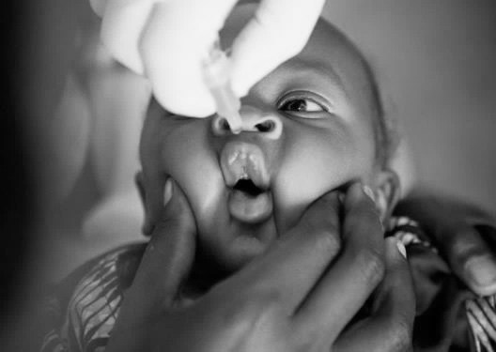
TODAY’S TOPICS
WHAT IS POLIO?
ERADICATION STATUS UPDATE
ROTARY’S ROLE
WHAT WE ALL CAN DO
Notes:
Today, we’ll discuss four main topics:
A brief reminder of what polio is and the partners we work with to eradicate it
An update on the status of those eradication efforts and the progress toward our goal
A description of Rotary’s role in ending polio
How we all can contribute to achieving a polio-free world

Slide 3
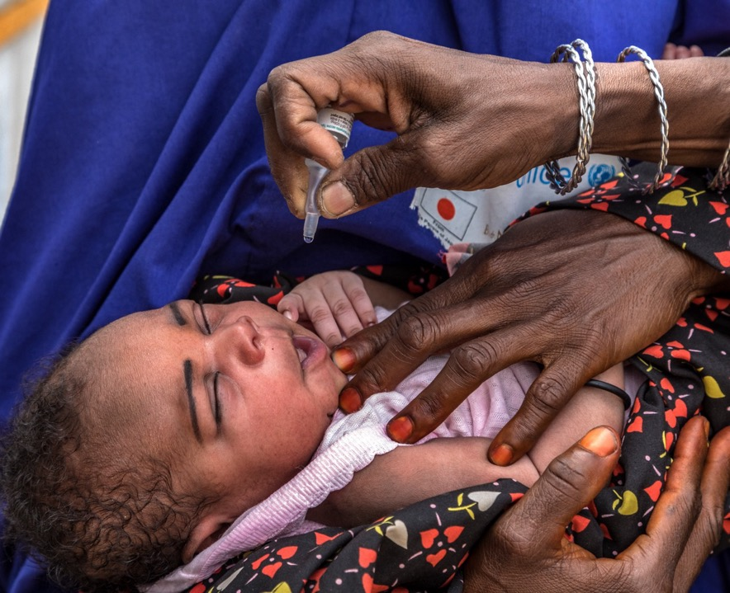
WHAT IS
POLIO?
Polio is caused by the poliovirus and spreads from person to person.
It can attack the central nervous system and cause irreversible paralysis and even death.
It most commonly affects children under age five in areas with poor sanitation.
There is no cure, but polio is completely preventable with a vaccine.
Notes:
First, what is polio? Polio is a highly infectious disease caused by the poliovirus.
It’s spread from person to person — typically through contaminated water — and can cause lifelong paralysis or even death.
It usually affects children under age five and is most prevalent in areas with poor sanitation.
There’s no cure, but polio is completely preventable with a vaccine.

Slide 4






NATIONAL
GOVERNMENTS
OUR
PARTNERS
Notes:
The Global Polio Eradication Initiative or GPEI is a public-private partnership led by national governments with six core partners.
The GPEI was established in 1988, three years after Rotary launched our PolioPlus program.

Slide 5
OUR PROGRESS
More than 3 billion children have been immunized.
More than 20 million people who would otherwise be paralyzed are able to walk.
1988
350,000 cases in 125 countries
2023
12 cases in 2 countries
Notes:
We have made tremendous progress in our eradication efforts. In 1988, there were 350,000 cases of polio in 125 countries.
Now, the wild poliovirus remains endemic in only two countries, Afghanistan and Pakistan. They reported just 12 cases of polio caused by the wild poliovirus in 2023.
Today, five of the six World Health Organization regions are certified free of wild polio and 90% of the world’s population lives in polio-free areas.
This is a major achievement and one to which Rotary and our members have made historic contributions.
Through the efforts of Rotary and our partners, more than 3 billion children have been immunized. This means that more than 20 million people who otherwise would have been paralyzed are able to walk.

Slide 6

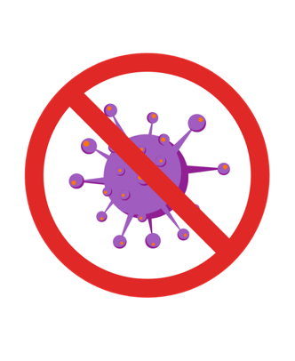
OUR PROGRESS
6
TYPE 1
TYPE 2
TYPE 3
Circulating in Afghanistan and Pakistan
Certified eradicated 2015
Certified eradicated 2019
Notes:
We can also measure our progress by the eradication of two of the three types of wild poliovirus.
Type 2 was certified eradicated in 2015 and type 3 was certified eradicated in 2019.
Today, only wild poliovirus type 1 circulates in Afghanistan and Pakistan.

Slide 7
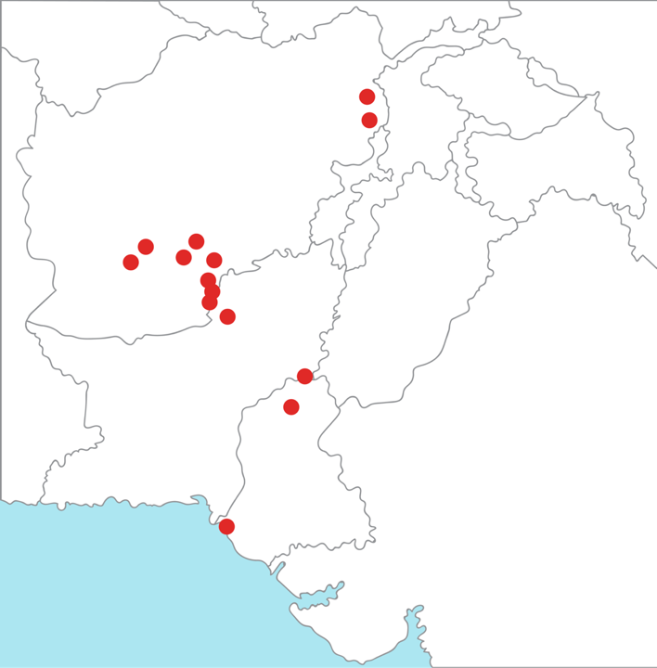
ERADICATION STATUS
Afghanistan
Pakistan
Notes:
The wild poliovirus remains endemic, meaning it has never stopped circulating, in Afghanistan and Pakistan.
In 2023, 12 cases of wild poliovirus were reported from limited geographic areas of these two countries.
The virus tends to be more prevalent in areas of insecurity and conflict.
In 2024, there has been an uptick of wild poliovirus cases due to political instability, ongoing security challenges in some areas, and vaccine hesitation in some communities. Strategies are being implemented to address these challenges.

Slide 8
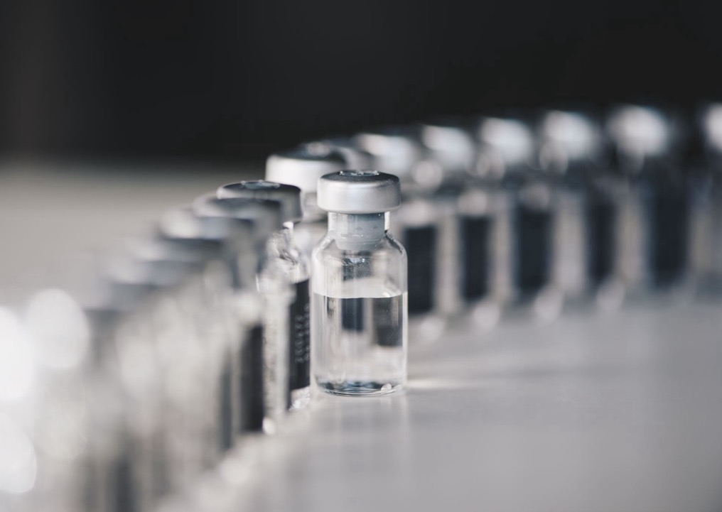
variant poliovirus
In rare cases, the live, weakened virus in the oral vaccine can genetically revert to a form that can cause paralysis in children living in communities with low immunization rates.
A new vaccine is having a positive effect:
This modified vaccine is more genetically stable and less likely to revert.
It’s now being used effectively for all variant poliovirus type 2 outbreaks.
Notes:
In addition to wild poliovirus, the GPEI is addressing outbreaks of variant poliovirus types 1 and 2, with type 2 being the most prevalent.
The unfortunate truth is that in very rare cases, if the live, weakened virus used in the oral polio vaccine circulates in communities with low immunization rates for a long time, it can genetically revert to a form that can cause paralysis.
What’s important to remember is that vaccinated children are protected — which is why it’s critical that we continue to carry out thorough immunization campaigns that reach every child with the vaccine.
We and our partners have also deployed a new tool to address outbreaks caused by a variant poliovirus.
In 2021, the GPEI introduced the novel oral polio vaccine type 2. It’s more genetically stable and far less likely to revert to a form that can cause paralysis.
It is safe and effective and is now being used widely with positive results. As one example, the Democratic Republic of Congo has had a dramatic decline in this type of variant poliovirus since it began using the new vaccine.
There has been an equally dramatic decline in type 1 variant poliovirus which is circulating primarily in the Democratic Republic of Congo by reaching more children with type 1 containing vaccine.

Slide 9
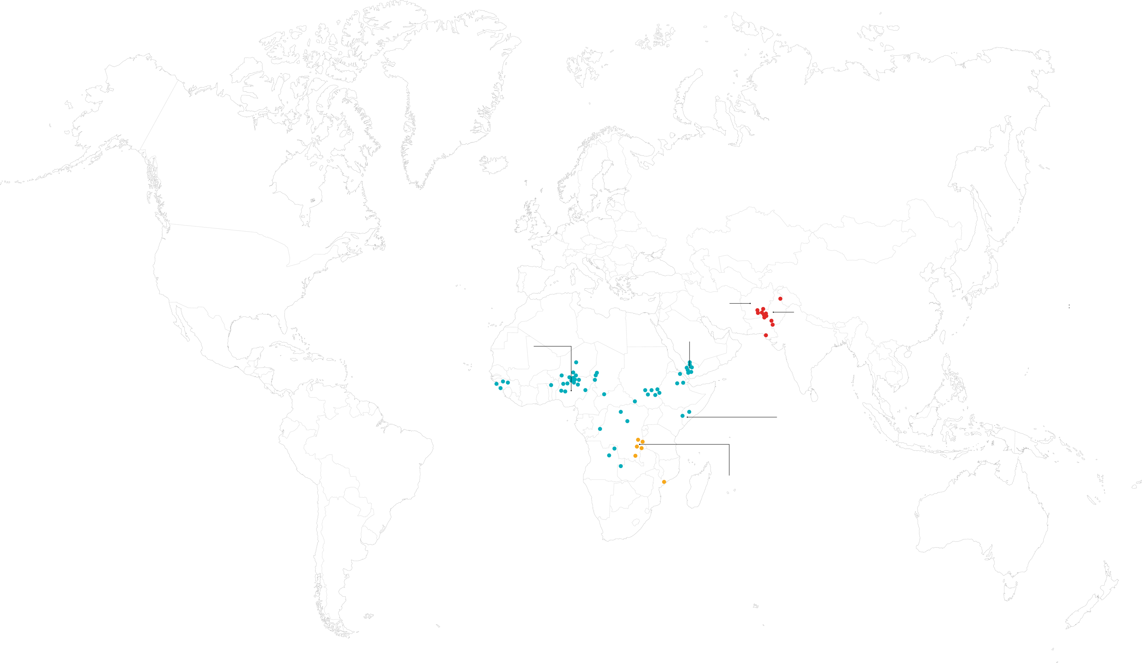
ERADICATION EFFORTS
Afghanistan
Northern Yemen
Pakistan
Northern Nigeria
South-central Somalia
Eastern Democratic Republic of Congo
WILD POLIOVIRUS
VARIANT POLIOVIRUS TYPE 1
VARIANT POLIOVIRUS TYPE 2
Notes:
We are focusing our current efforts on the wild and variant poliovirus in five key areas considered to be the “engines” of transmission.
They are Afghanistan and Pakistan, where we have noted that wild polio is still endemic.
The areas of focus also include northern Nigeria, eastern Democratic Republic of Congo, south-central Somalia, and northern Yemen.
And while these are the major areas of focus, the we are responding to outbreaks wherever they may occur.

Slide 10

POLIO ERADICATION STRATEGYGY
GOAL ONE: Permanently interrupt transmission of all poliovirus in Afghanistan and Pakistan.
GOAL TWO: Stop transmission of variant poliovirus type 2 and prevent outbreaks in polio-free regions.
Notes:
The Global Polio Eradication Initiative’s Polio Oversight Board, on which Rotary is represented by the chair of its International PolioPlus Committee, determined in July 2024 that more time will be needed to achieve goals 1 and 2 of the strategy and extended the timelines to achieve both. They assessed that goal 1 could be achieved by the end of 2027 and goal 2 by the end of 2029. They also considered the additional resources that will be needed to fund activities beyond 2026 and will adopt a revised multiyear budget in October.

Slide 11
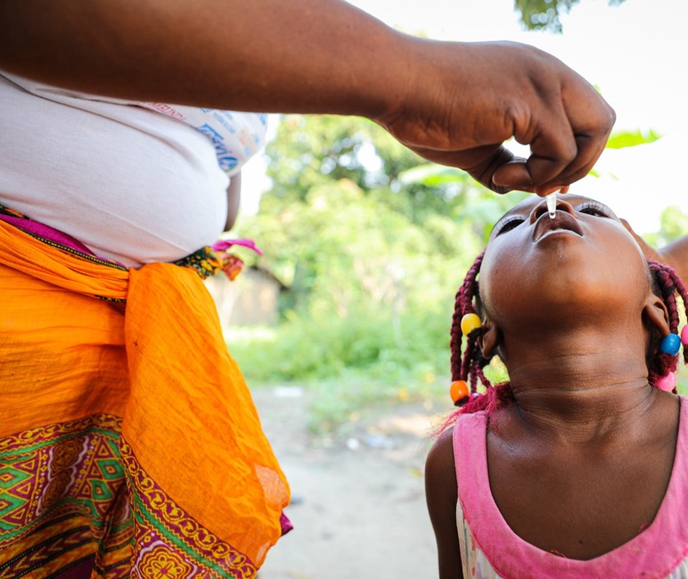
Rotary’s role
ALL ROTARY MEMBERS CAN BE VERY PROUD OF WHAT WE’VE ACCOMPLISHED!
The number of cases has fallen 99.9%.
1.5 million lives have been saved.
20 million volunteers have been mobilized.
We’ve built a health care infrastructure with experienced providers that’s useful far beyond polio eradication.
Notes:
Rotary members can be very proud of what we’ve accomplished by working together.
All the achievements on this slide are in addition to what we mentioned earlier, that more than 3 billion children have been immunized and more than 20 million people were kept from being paralyzed. We’ve also eradicated two of the three types of wild polio and worked to get five of the six world regions certified polio-free.
This all reminds us of how close we are to keeping our promise of realizing a polio-free world for children everywhere.

Slide 12
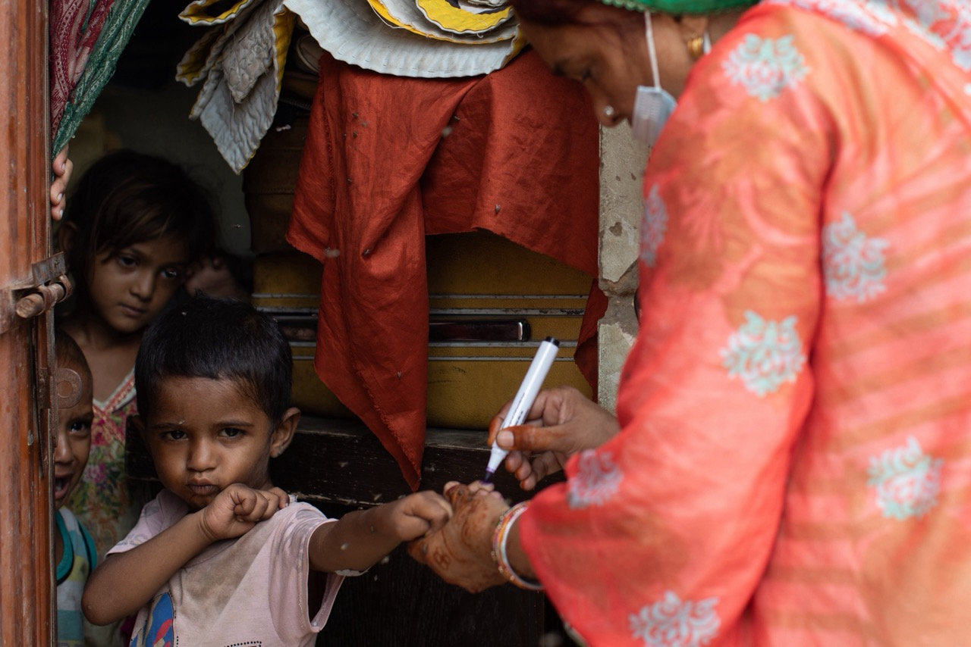
Rotary’s role
RAISING
AWARENESS
FUNDRAISING
ADVOCACY
Notes:
Rotary’s main roles in polio eradication are fundraising, advocacy, and raising awareness through the active engagement of our members.
Rotary members raise funds, immunize children, promote awareness in their communities, and secure support from governments, nongovernmental organizations, corporations, and the public.

Slide 13

ROTARY’s ROLE: FUNDRAISING
We have an annual fundraising goal of US$50 million.
That amount is matched 2-to-1 by the Gates Foundation.
We encourage donations of:
Any amount from individual members
US$1,500 per year from clubs
20% of DDF from districts, which is then matched at 50% by the World Fund
Notes:
Rotary is committed to raising US$50 million per year for polio eradication, and the End Polio Now campaign is the vehicle for that. Through our partnership with the Gates Foundation, every US$1 Rotary commits to polio eradication is matched 2-to-1 (up to US$50 million per year).
We encourage individual members to donate at any level they can. We encourage clubs to contribute US$1,500 per year, and we encourage districts to donate 20% of their District Designated Funds, which are then matched at 50% by the World Fund.

Slide 14

ROTARY’S ROLE: FUNDRAISING
CREATE OR JOIN A POLIOPLUS SOCIETY
Contribute annually to the PolioPlus Fund until the world is certified polio-free.
PolioPlus Society Toolkit:
endpolio.org/resource-center#polioplussociety
Notes:
We also encourage every district to start a PolioPlus Society to raise funds for the End Polio Now campaign.
A PolioPlus Society is a district-led activity. To join a society, members pledge to donate to PolioPlus every year until the world is certified polio-free.
A society toolkit is available in the resource section of the End Polio Now website.

Slide 15
ROTARY’s ROLE: FUNDRAISING
Funding for critical activities in 2023-24
Notes:
We so appreciate the funds that Rotary members raise that result in the Gates Foundation match.
With that money, Rotary funds operational support and technical experts, vaccines, disease surveillance, social mobilization, research, and stipends for hundreds of thousands of volunteers who immunize children going house-to-house to vaccinate children.
In this chart of 2023-24 spending, the category “Other” includes that funding for surveillance, research, and technical experts.
Note to speaker if asked: The 2023-24 figure totals US$145 million because an additional US$5 million was spent in 2022-23 due to a donation from the Church of Jesus Christ of Latter-Day Saints.

Slide 16
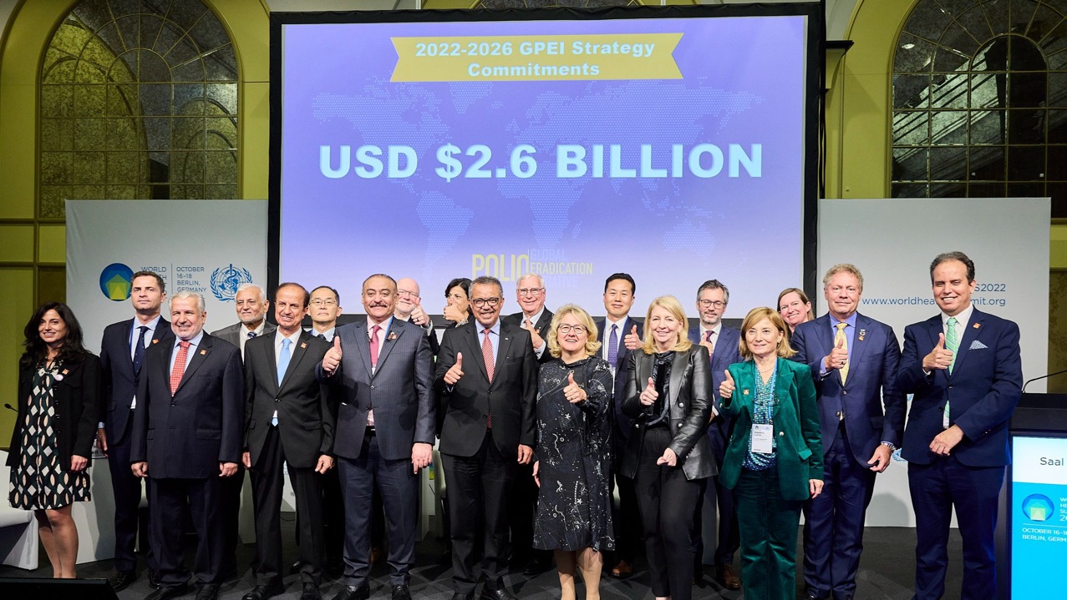
ROTARY’s ROLE:
ADVOCACY
We advocate for funding and political support.
Notes:
Another important aspect of Rotary’s work is advocacy with donor governments, such as Germany, the UK, the U.S., Japan, Canada, Australia, and others that provide critical funding to the GPEI.
Past Trustee Chair Ian H.S. Riseley represented Rotary at the GPEI’s pledging event in 2022 during the World Health Summit in Berlin along with other global leaders.
There are 17 Rotary-appointed national advocacy advisers in the donor countries who engage with their governments to encourage support.

Slide 17
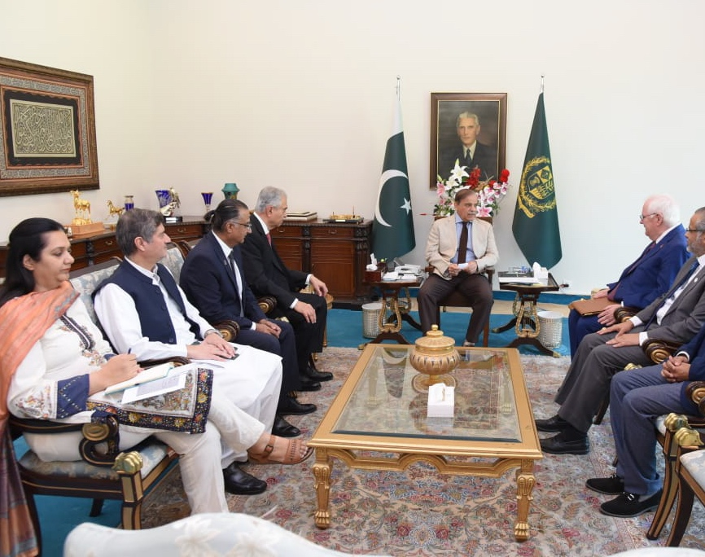
ROTARY’s ROLE:
ADVOCACY
We advocate to sustain the political will toward eradication.
Notes:
Rotary also advocates for officials in countries affected by polio to prioritize eradication efforts, conduct high-quality vaccination campaigns, and stay committed until we end polio.
One example is Rotary leadership meetings with Heads of State. In this photo, Pakistan National PolioPlus Committee Chair and Past Rotary Foundation Trustee Aziz Memon, Past RI Director Faiz Kidwai, International PolioPlus Committee Chair Mike McGovern, and others meet with Pakistan’s Prime Minister to encourage sustained commitment to polio eradication, recognize the work that the government is doing, and encourage accountability and leadership.
There are 24 national PolioPlus committee chairs who engage with government leaders in countries where polio is endemic, where outbreaks have occurred, or where there is a high risk of an outbreak occurring.

Slide 18


ROTARY’s ROLE: RAISING AWARENESS
Notes:
Raising awareness is another important role for Rotary. We encourage all members to help their communities learn about the threat of polio and Rotary’s historic role in the eradication effort.
Although this work can occur throughout the year, World Polio Day on 24 October and World Immunization Week in April are two key times to engage people and boost Rotary’s public image. Sample social media posts, event toolkits, and other materials are available on endpolio.org.

Slide 19
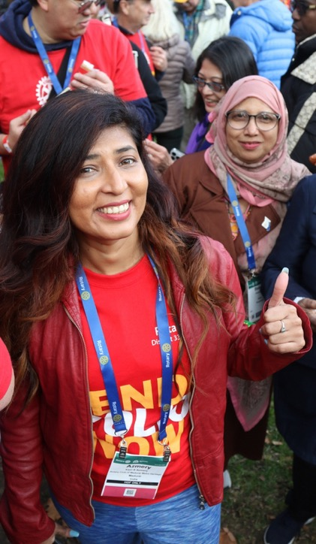
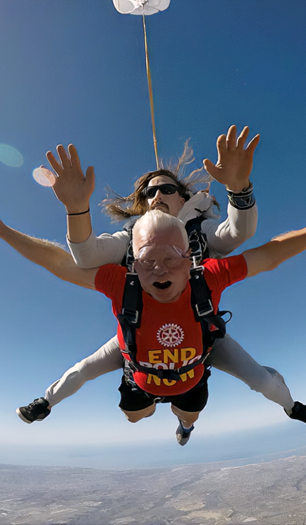
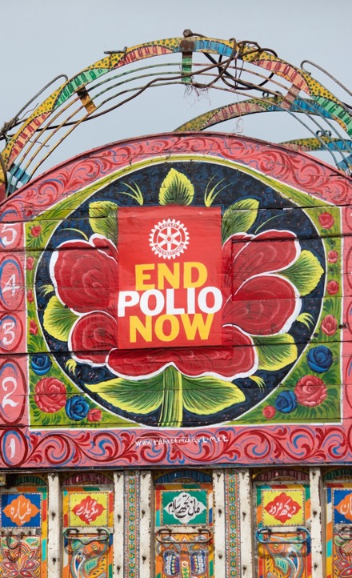
ROTARY’S ROLE: RAISING AWARENESS
Notes:
From events in your community to gatherings at iconic locations, all members can help increase the visibility of our polio eradication efforts. Seize every opportunity to raise awareness of the historic opportunity to End Polio Now!

Slide 20
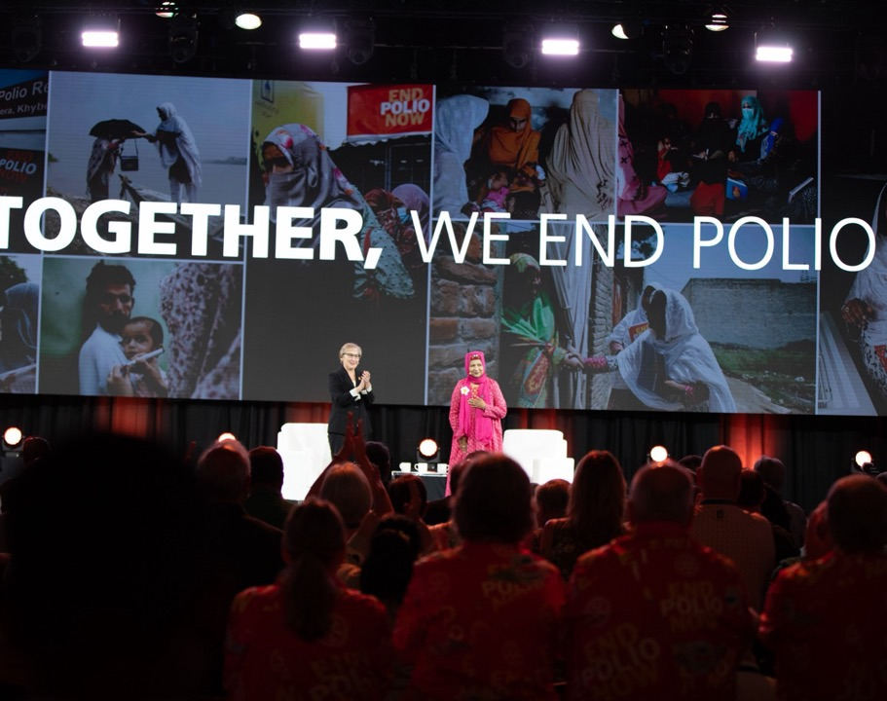
ROTARY’s ROLE: RAISING AWARENESS
Notes:
Rotary leaders and members at events such as the International Assembly and Convention also help raise awareness of our effort to eradicate polio.

Slide 21
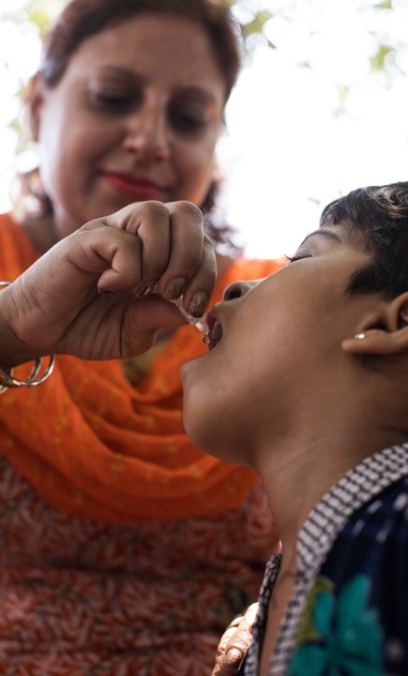
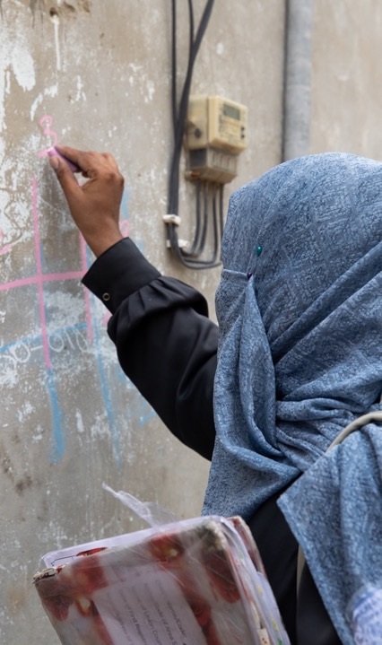
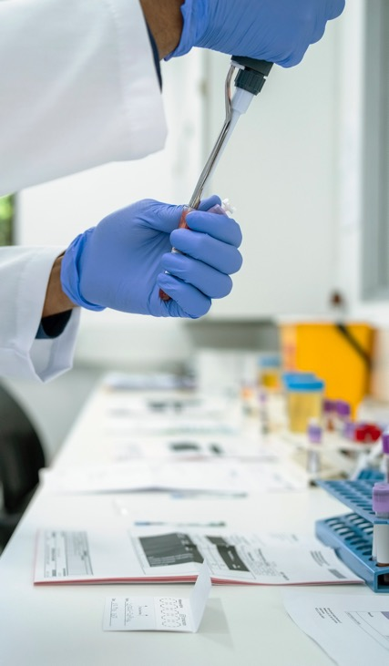
Currently, there are no Rotary surveillance images available with rights to use. Replaced with stock photo.
WHAT WE
will do
IMMUNIZE HUNDREDS OF MILLIONS OF CHILDREN EACH YEAR
DEPLOY HUNDREDS
OF THOUSANDS
OF WORKERS
INTENSIFY SURVEILLANCE ACTIVITIES
Notes:
How do we achieve a polio-free world? We work together and maintain our commitment.
Achieving this goal requires us to reach up to 400 million children per year to sustain high levels of immunity.
Hundreds of thousands of frontline workers are needed to go door to door, house to house, seeking children under age five to vaccinate multiple times per year. Pakistan alone has more than 300,000 frontline workers.
In addition, we need to intensify our disease surveillance activities by searching for the virus in children and the environment. This surveillance helps determine if and where the poliovirus is circulating and is used to determine when it stops circulating.

Slide 22
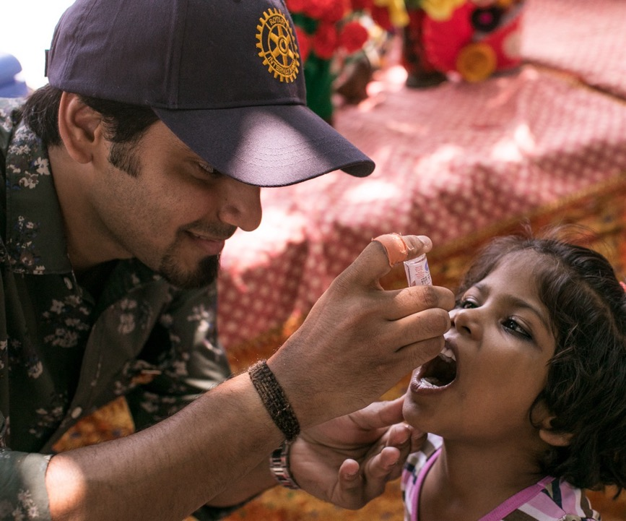
WHAT IS
AT STAKE
POLIO ANYWHERE IS A THREAT TO CHILDREN EVERYWHERE.
If we stop now, 200,000 children will be paralyzed by polio every year within 10 years!
Notes:
If the poliovirus circulates anywhere in the world, it’s a threat to children everywhere. If we stop our eradication efforts now, polio will rebound.
Within 10 years, 200,000 children would be paralyzed by polio every year. We can’t let that happen!

Slide 23


WHAT CAN
you do?
To reach our goal, we need to stay engaged.
This means:
Ensure that we reach our US$50 million fundraising target every year to fully benefit from the Gates Foundation 2-to-1 match
Create or join a PolioPlus Society
Advocate for the polio eradication effort whenever you can and emphasize why it matters so much
Use World Polio Day and World Immunization Week to highlight Rotary’s role in the progress toward eradication
Notes:
We’ve accomplished so much in our efforts to eradicate polio — but we can’t stop now.
I hope everyone here today will consider making a contribution to PolioPlus so that we reach our US$50 million goal and fully leverage the match in order to reach even more children with the vaccine.
Get engaged and encourage other members to do so by creating or joining a PolioPlus Society.
Help sustain the commitment of leaders at every level by communicating the benefits of immunization against polio and other diseases and advocating for continued financial support.
And use events like World Polio Day and World Immunization Week to highlight Rotary’s role in the eradication effort and the opportunity to eradicate a human disease for only the second time in history.

Slide 24
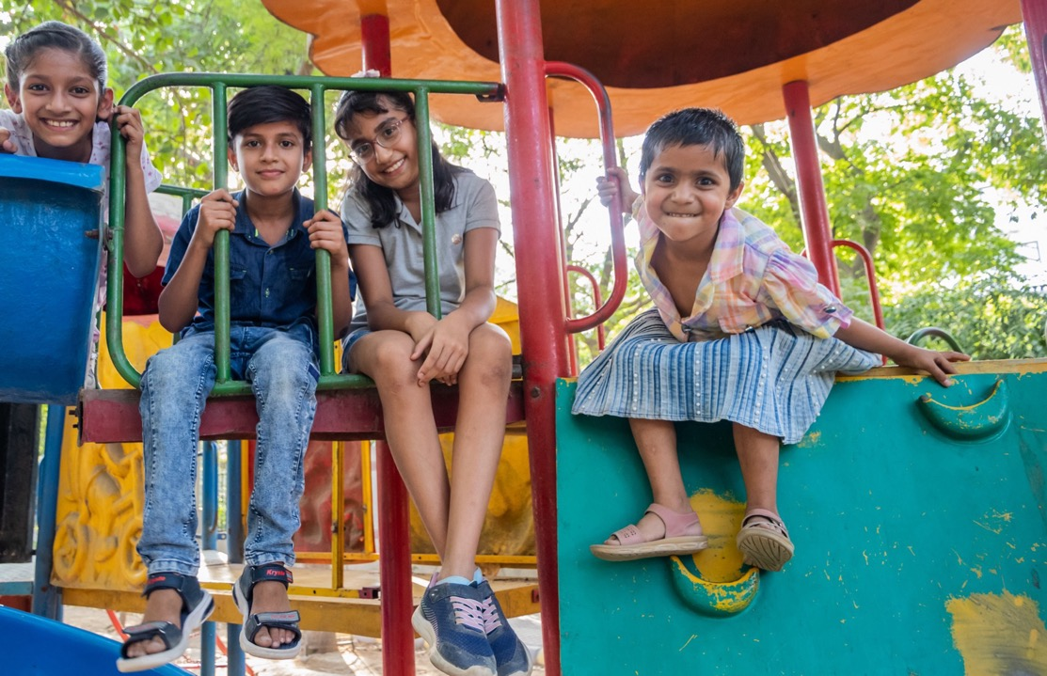
TOGETHER, WE
END POLIO
Notes:
We all have a role in the effort to achieve a polio-free world.
Help ensure that polio doesn’t paralyze any child again by supporting our eradication efforts.
Together, we end polio!
Thank you.

