Slide 1
How to Appoint a RYLA Club Liaison in DACdb

Slide 2
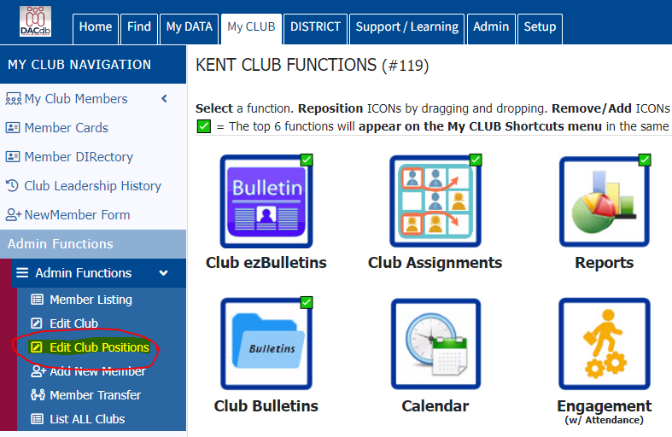
In the left-hand navigation, select the “Admin Functions” dropdown and click on “Edit Club Positions.”

Slide 3
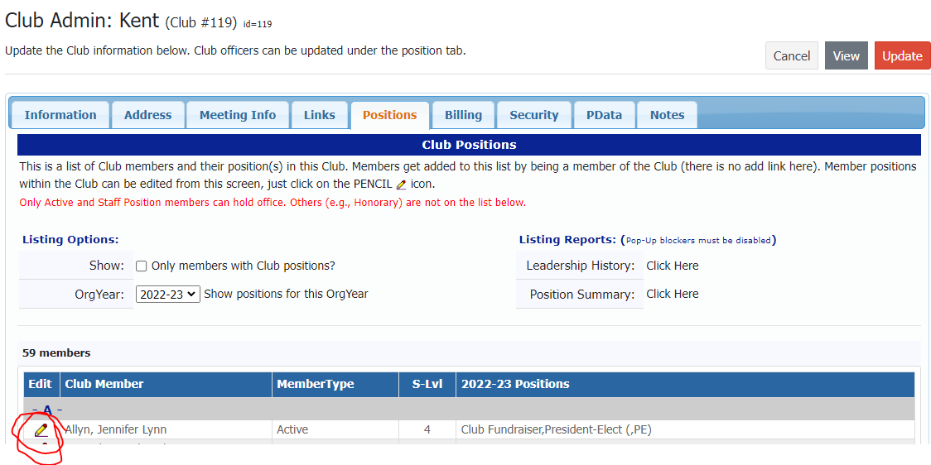
Find the Club Member who will serve as RYLA Club Liaison and click the “Edit” icon (pencil) at the left.

Slide 4
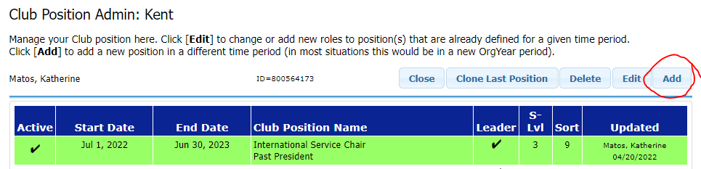
To add a new position for, click the “Add” button in the top right.

Slide 5
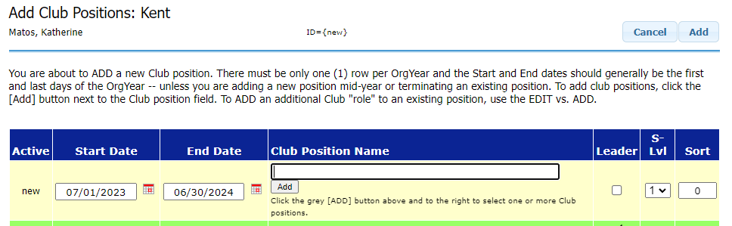
There are two ways to add a new position. First, make sure the “Start Date” and “End Date” match the period of appointment for the position (07/01/YEAR – 06/30/YEAR).
Appointment won’t work if a partial year is entered.

Slide 6
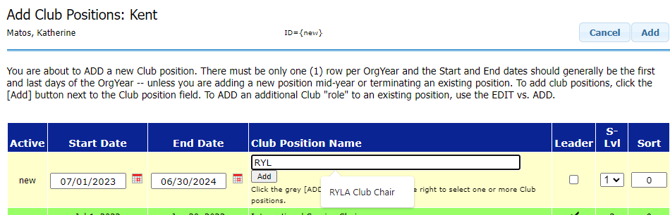
Next, type “RYL” in the open field and click on the pop-up with the RYLA position to select.

Slide 7
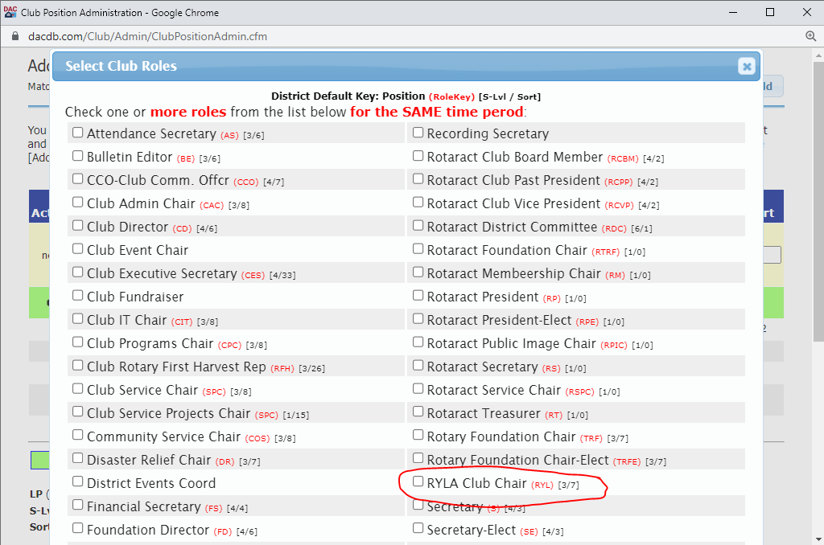
Alternatively, click the “Add” button below the field and select “RYLA Club Chair” in the new window.

Slide 8
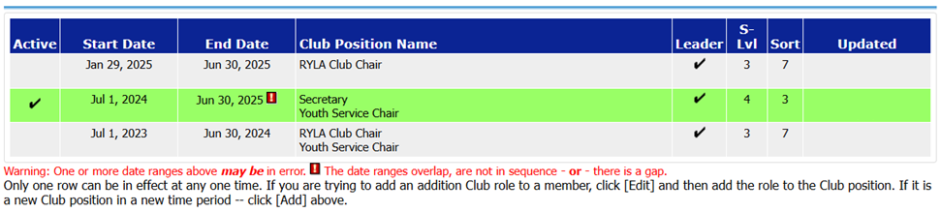
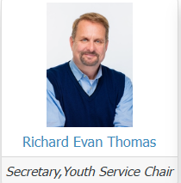
Overlapping Positions
If you receive a warning message about overlapping date ranges, one of the lines won’t register within the DACdb system
Only the green line above is marked active.
Addition of the RYLA Chair is not registered on the Club page.

Slide 9
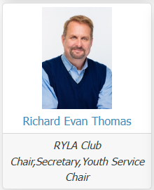
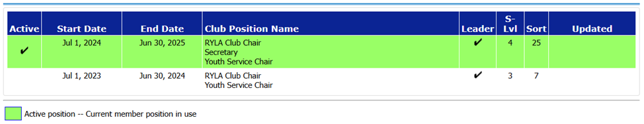
Overlapping Positions
Add all positions to the same line (with one-year period).

