Slide 1
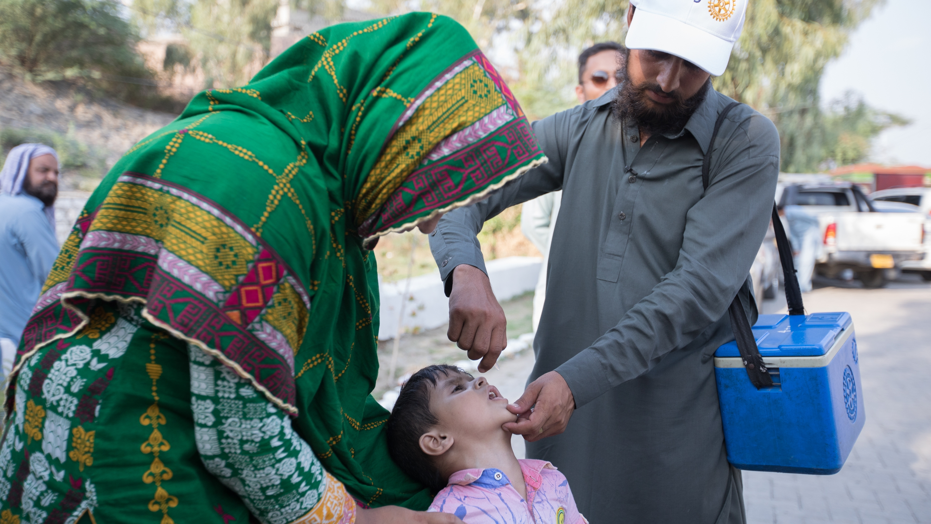

PolioPlus SocietY

Slide 2

Is your district/club looking for an easy way to fundraise for PolioPlus?
Iis
Is Your District/Club looking for an easy way to fundraise for PolioPlus?

Slide 3
Global PolioPlus Societies
Where the PolioPlus Society idea began?
Why a Global initiative
The Initiative – Grassroots is best
District led rather than a trustee-approved program
Rotary Foundation Support
New and updated reports
Power Point Presentation showing Best Practices
Recognition
Sample digital certificates to personalize and print
PolioPlus Society pins available using Rotary licensed vendors
Notes:
I truly appreciate, being able to share what I believe is exciting news about a global strategy to encourage districts to implement a PolioPlus Societies. We know there continues to a critical funding gap and building the PolioPlus Society is one effective strategy that will help us fill that gap as we reach out to our many passionate and dedicated donors.
These are the topics I hope to touch on quickly this afternoon.

Slide 4
Where dID the idea begin?
Perhaps District 5110 in 2012
Established to increase sustainable giving to PolioPlus with a minimum annual gift of $100
The Idea created momentum
Because of our EPNC’s
Notes:
This is a great question and from what I know today is that it began in District 5110 back in 2012. This idea came from the Paul Harris Society initiative, and like most things, it began with one persons dream to encourage donors to make an annual commitment to PolioPlus of $100 or more.
Perhaps District 5110 in 2012
Established to increase sustainable giving to PolioPlus with a minimum annual gift of $100
The Idea created quick momentum
Why? - Because of you – our EPNC’s

Slide 5
Today’s global
PolioPlus Societies initiative
Rotary’s #1 Priority
The PP Society is a proven initiative
Rotary Direct
The PolioPlus Society encourages:
Continued giving at higher levels
Member support around the globe
Rotary on-line giving
Volunteer Networks
Passionate Donors
Allows Districts to thank, steward and cultivate its most generous givers
Notes:
The PolioPlus Society has already proven to be a great strategy to raise funds, it encourages continued member support. and we are seeing higher levels of giving over time. The reports will allow us to thank, steward and cultivate our most generous givers. We are promoting the idea of Rotary direct and on-line giving as well as using the new Raise For Rotary platform.
Perhaps District 5110 in 2012
Established to increase sustainable giving to PolioPlus with a minimum annual gift of $100
The Idea created quick momentum
Why? - Because of you – our EPNC’s

Slide 6
How do we get there?
The Rotary Foundation Support Staff
Communications with staff has begun
Reports:
  Enhanced Contribution Detail Report
  Additional reports may be possible later
Resources:
  A Power Point Presentation on how to begin a PolioPlus Society
  Best Practices
  Digital sample recognition certificates for Individuals and Clubs
Notes:
Would you please identify District Leaders who have access to the CDR?
A: DGs and DRFCs will have access once work is complete (soon). At the Zone level, EPNCs, ARRFCs, RRFCs, EMGAs already have access.
Q: Will there be separate reports for both Clubs and Districts, and will it continue to show all transactions as it does now?
A: A district version is being developed now. It will be available to the roles listed above.
Later, a separate club version could be developed, but this work cannot be done concurrently and may not be realistic due to privacy issues that need to be navigated and resource constraints.
However, Club Presidents, Foundation Chairs, Treasurers and Secretaries can call the Support Center to receive their club’s report as an alternative.
Q: Can the CDR be reformatted for ease in sorting than it does now?
A: Yes, one of the updates being done will create a new tab that only lists the Rotary and Rotaract Clubs with contribution amounts for each fund. Also, downloading most reports into Excel allows users to sort as they see fit rather than adjusting the report itself.
Q: Is the PP Society 100% Certificate created by Rotary or the District?
A: The District
Q: Can you think of other reports that can be created and helpful to the cause?
A: Yes, the PolioPlus District Report after some adjustments are made. Adding current and prior year PolioPlus contribution information will give district and club leaders a lot more flexibility in adjusting approachable PolioPlus giving goals.
This new enhanced version of the Contribution Detail Report (CDR) will allow Districts to properly thank, steward and cultivate those donors – perhaps to the next level.
As a side note: My own District launched a refresh of our PolioPlus Society just last week. We decided to use different levels since our CDR showed a couple donors giving at levels up to and over $1000. As of this morning, we now have 4 donors giving at the Platinum Level of $1000. Are we leaving gifts on the table by not providing an opportunity to give more than $100?
As the end of my presentation today I’ll show you a sample REFRESH Form and another document showing a year long fundraising initiative partially using the Raise 4 Rotary platform. More on that later.
Perhaps District 5110 in 2012
Established to increase sustainable giving to PolioPlus with a minimum annual gift of $100
The Idea created quick momentum
Why? - Because of you – our EPNC’s

Slide 7
How do you get started?
Each District Will Decide to:
Establish
Establish a PolioPlus Society Chair
Include
Include a budget line item for recognition items if used
Use
Use of pins and/or certificates at the individual and/or club level
Include
Include Assistant Governors and Public Image Chairs
Notes:
This initiative will remain a grassroots effort where each District will decide to implement in a manner that suits their District best.
Perhaps District 5110 in 2012
Established to increase sustainable giving to PolioPlus with a minimum annual gift of $100
The Idea created quick momentum
Why? - Because of you – our EPNC’s

Slide 8
PolioPlus Society Membership Form

Slide 9
Tools to help You
Reports:
  Contribution Detail Report
Resources:
  Best Practices
  Digital sample recognition certificates for Individuals and Clubs
Notes:
Perhaps District 5110 in 2012
Established to increase sustainable giving to PolioPlus with a minimum annual gift of $100
The Idea created quick momentum
Why? - Because of you – our EPNC’s

Slide 10
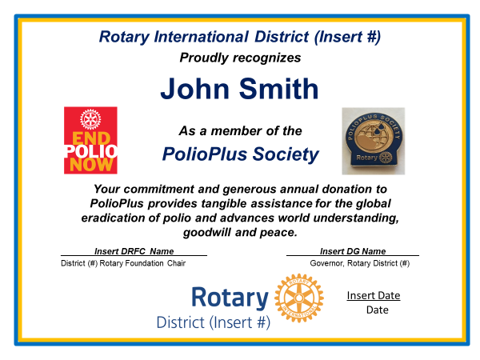

Slide 11
CluB banner for 100% club

Slide 12

Notes:
Follow the PolioPlus Society page on Facebook

Slide 13
Ready to Join?
Notes:
Perhaps District 5110 in 2012
Established to increase sustainable giving to PolioPlus with a minimum annual gift of $100
The Idea created quick momentum
Why? - Because of you – our EPNC’s

